Slide 1
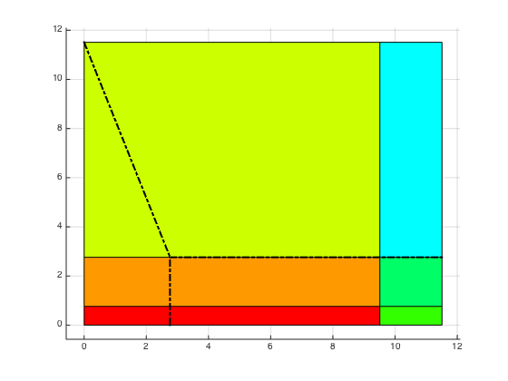
3
6
2
5
1
4

Slide 2
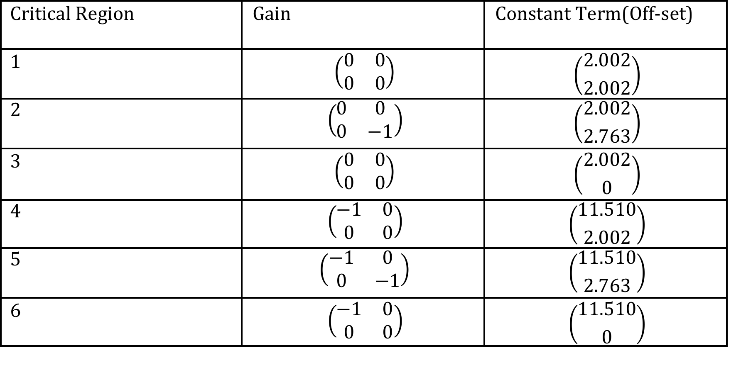

Slide 3
Controller Space

