Slide 1

Easwari Engineering College
SMART URBAN GREEN MANAGEMENT SYSTEM
Cities require digital management of parks, urban forests, green belts, tree inventories, and environmental performance indicators.
Under the Guidance of Presented By
[ Guide Name, Qualification ] Negesh Bala M - 310624148062
[ Guide Designation, Department ]

Slide 2
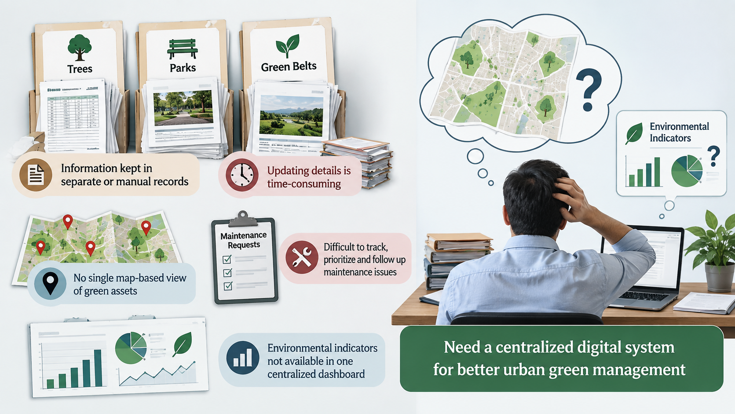
PROBLEM STATEMENT
• Tree, park and green-belt information is often kept in separate or manual records.
• Updating asset details and maintenance history is time-consuming.
• Authorities lack a single map-based view of green assets and their condition.
• Maintenance issues are difficult to track, prioritize and follow up.
• Environmental indicators are not easily available in one centralized dashboard.

Slide 3
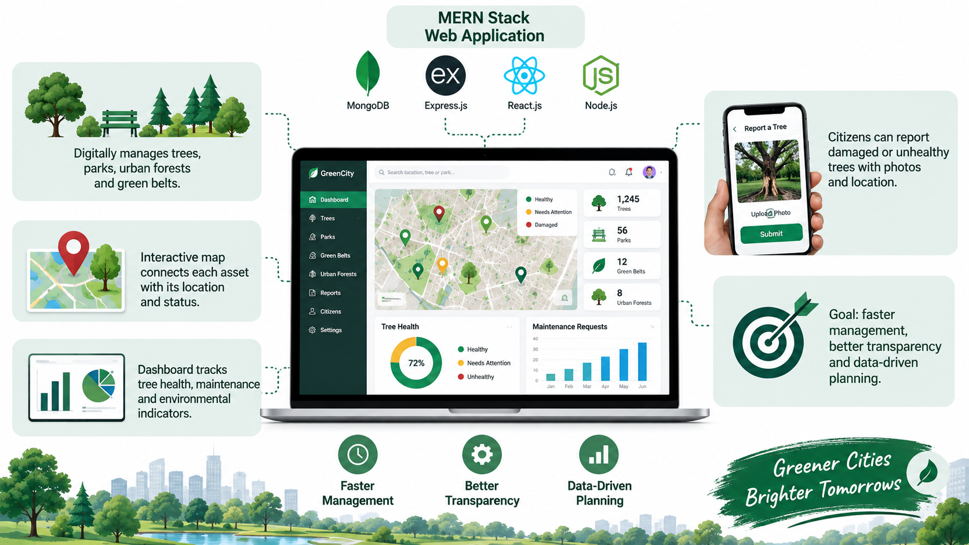
ABSTRACT
• MERN-stack web application for centralized urban green-space management.
• Digitally manages trees, parks, urban forests and green belts.
• Interactive map connects each asset with its location and status.
• Dashboard tracks tree health, maintenance and environmental indicators.
• Citizens can report damaged or unhealthy trees with photos and location.
• Goal: faster management, better transparency and data-driven planning.

Slide 4
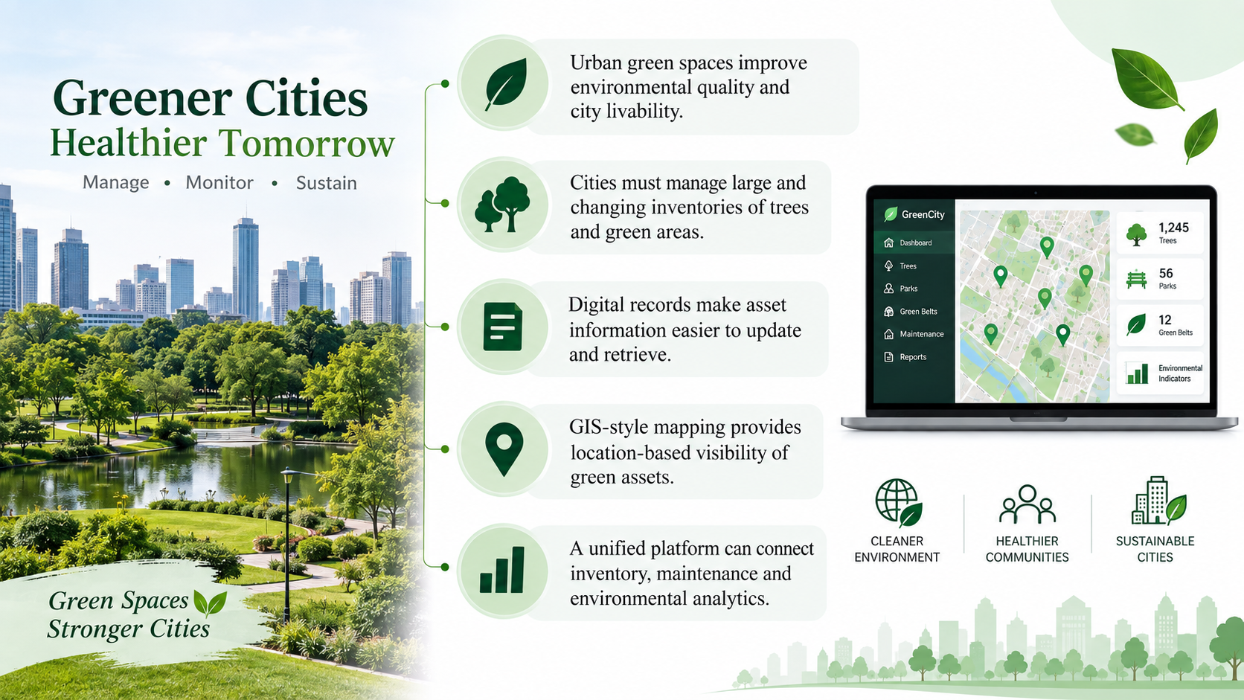
INTRODUCTION
• Urban green spaces improve environmental quality and city livability.
• Cities must manage large and changing inventories of trees and green areas.
• Digital records make asset information easier to update and retrieve.
• GIS-style mapping provides location-based visibility of green assets.
• A unified platform can connect inventory, maintenance and environmental analytics.

Slide 5
EXISTING SYSTEM
• GIS / tree-management platforms support digital mapping and inventories.
• Common features: tree location, inventory records and inspection data.
• Maintenance and operational activities can also be tracked.
LIMITATIONS
• Data can remain fragmented across multiple tools.
• Enterprise GIS solutions may be complex for a focused application.
• Citizen reporting and environmental KPIs may not be unified.

Slide 6
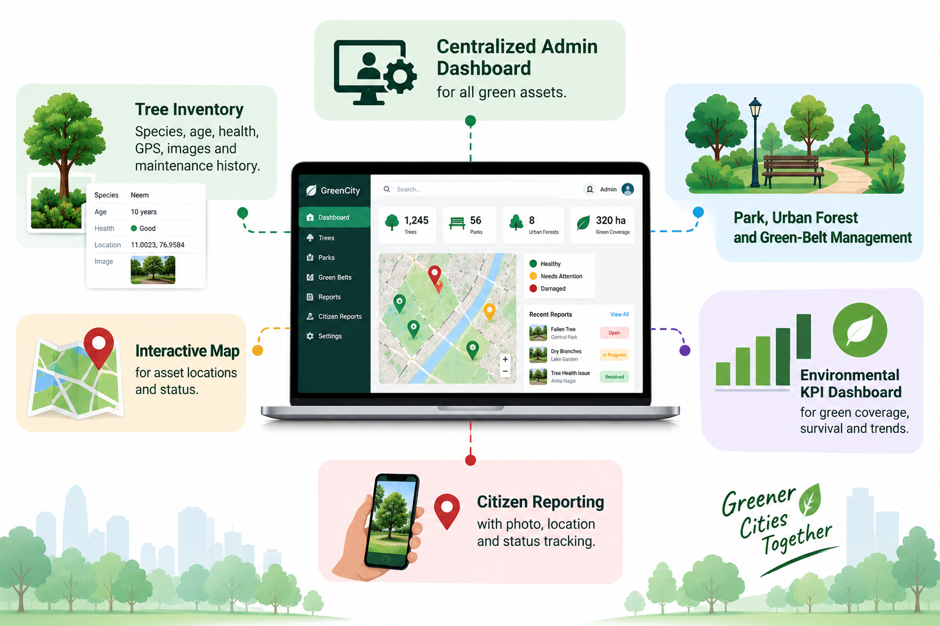
PROPOSED SYSTEM
• Centralized admin dashboard for all green assets.
• Tree inventory: species, age, health, GPS, images and maintenance history.
• Park, urban forest and green-belt management.
• Interactive map for asset locations and status.
• Environmental KPI dashboard for green coverage, survival and trends.
• Citizen reporting with photo, location and status tracking.
MERN: React.js • Node.js • Express.js • MongoDB

Slide 7
OBJECTIVES
• Create a centralized digital inventory of urban green assets.
• Simplify management of trees, parks, forests and green belts.
• Provide location-based visualization through interactive maps.
• Track tree health, inspections and maintenance activities.
• Monitor environmental performance using meaningful KPIs.
• Improve transparency through citizen reporting and status tracking.

Slide 8
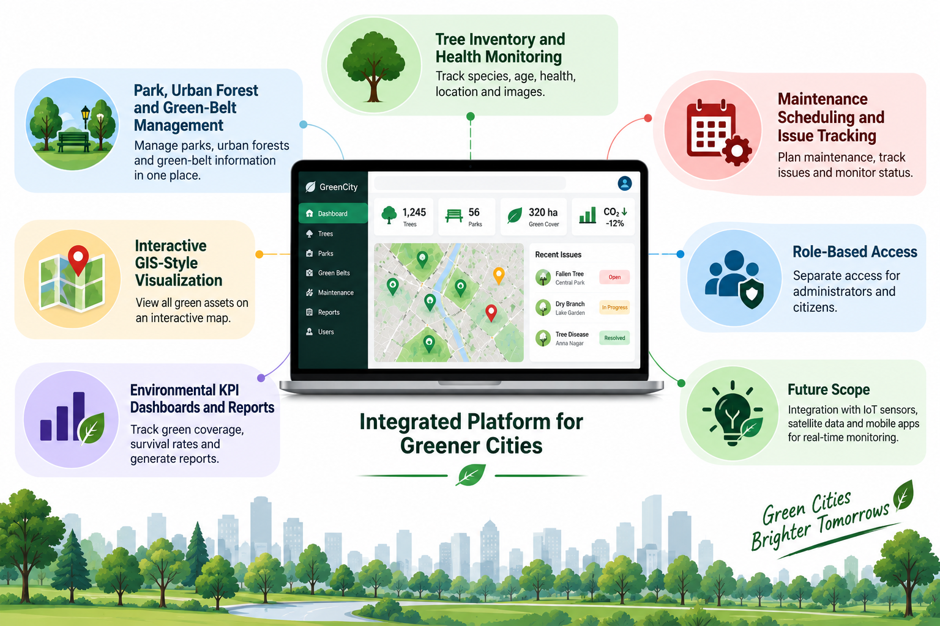
SCOPE
• Tree inventory and health monitoring.
• Park, urban forest and green-belt information management.
• Interactive GIS-style visualization.
• Maintenance scheduling and issue tracking.
• Environmental KPI dashboards and reports.
• Role-based access for administrators and citizens.
• Future scope: IoT sensors, satellite data and mobile apps.

Slide 9
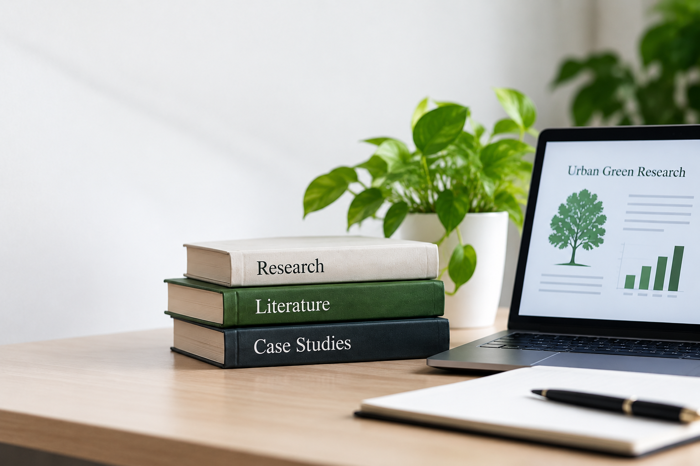
LITERATURE SURVEY
1. A Global Basis of Urban Tree Inventories — Ma, Hauer, Östberg & Koeser (2021)
Insight: standardized digital tree inventories improve urban-tree data management.
2. Urban Tree Monitoring — USDA Forest Service
Insight: systematic inspection and condition monitoring support better maintenance.
3. An Electronic Tree Inventory for Arboriculture Management — Tait et al. (2009)
Insight: electronic records can support organized arboriculture management.
RESEARCH GAP: Combine inventory + mapping + maintenance + KPIs + citizen reporting in one focused MERN platform.

Slide 10
THANK YOU!
SMART URBAN GREEN MANAGEMENT SYSTEM
MERN Stack • Interactive Mapping • Environmental Analytics

