Slide 1

PIZZA SALES ANALYSIS
SQL Data Analytics Project
Prepared by: Anjali Negi

Slide 2

Project Overview
This project analyzes pizza sales data using SQL.
The objective is to understand sales performance, customer ordering patterns, and popular pizza products.
SQL queries are used to retrieve, join, group, filter, and summarize data.
The analysis is divided into Basic, Intermediate, and Advanced business questions.
The final results can support business decisions related to products, pricing, and sales planning.

Slide 3
Tools & Data Analysis Approach
Database: MySQL
Core SQL concepts: SELECT, WHERE, JOIN, GROUP BY, ORDER BY, aggregate functions, and window functions.
Main measures: order count, pizza quantity, revenue, average daily sales, and revenue percentage.
Data is analyzed by pizza type, pizza size, category, date, and hour of the day.
SQL code and query results will be added separately.

Slide 4

Basic Queries

Slide 5

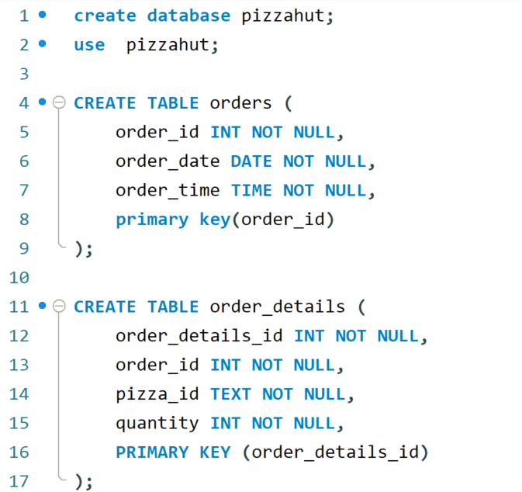
Create Database & Tables

Slide 6
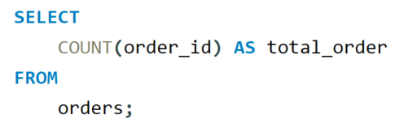

Retrieve the total number of orders placed.

Slide 7
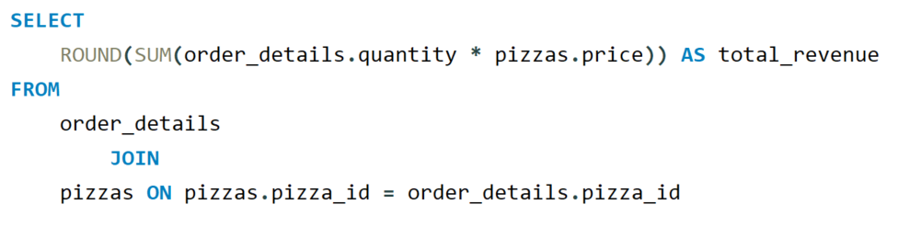
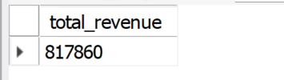
Calculate the total revenue generated from pizza sales.

Slide 8
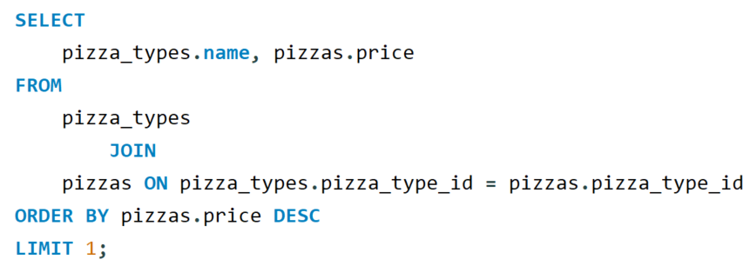

Identify the highest-priced pizza.

Slide 9
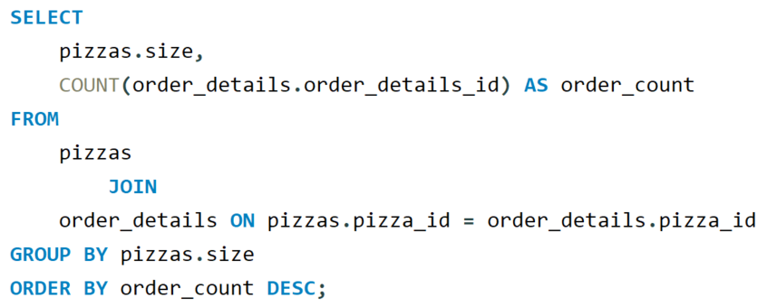
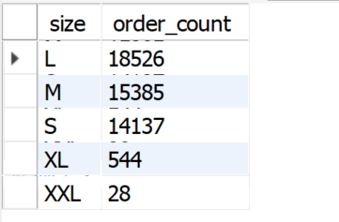
Identify the most common pizza size ordered.

Slide 10
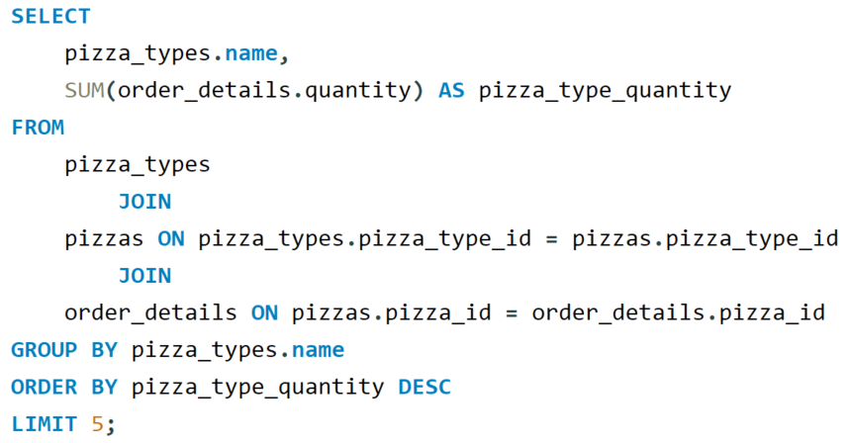
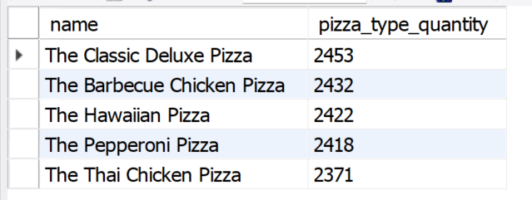
List the top 5 most ordered pizza types along with their quantities.

Slide 11
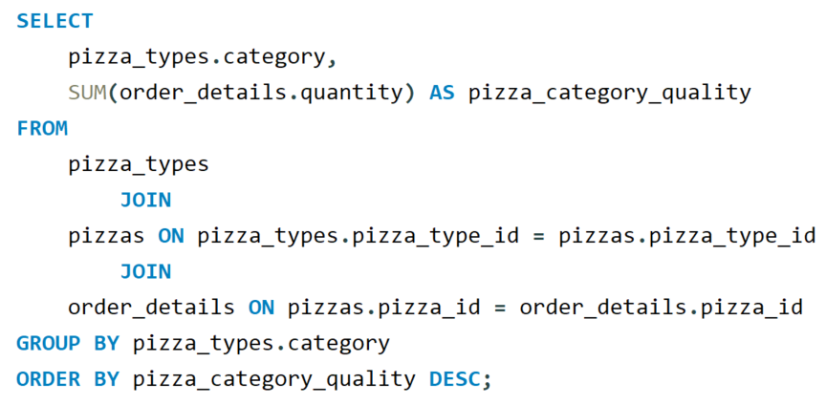
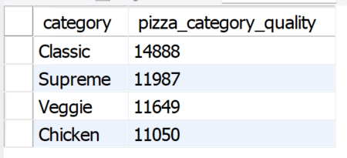
Join the necessary tables to find the total quantity of each pizza category ordered.

Slide 12
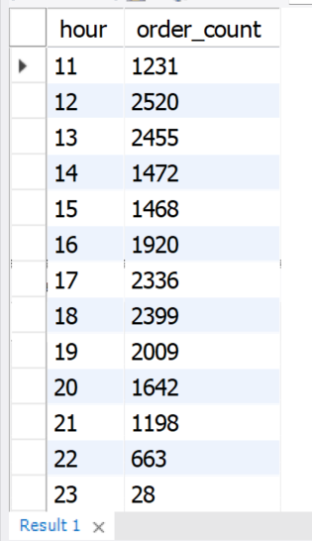
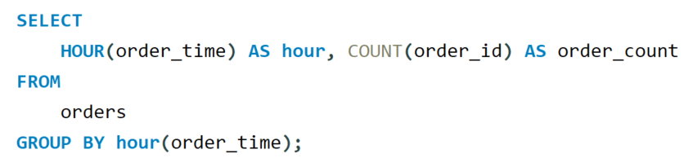
Determine the distribution of orders by hour of the day.

Slide 13
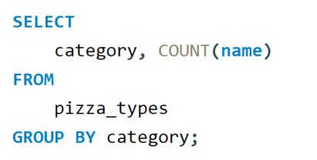
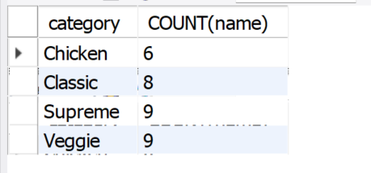
Join relevant tables to find the category-wise distribution of pizzas.

Slide 14
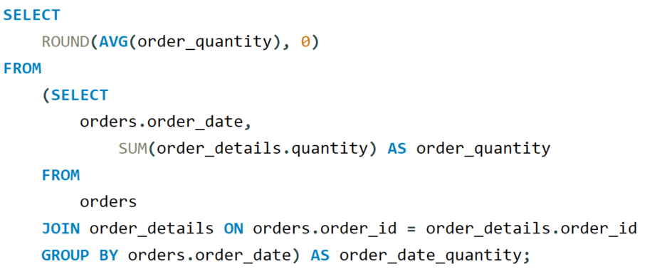

Group the orders by date and calculate the average number of pizzas ordered per day.

Slide 15
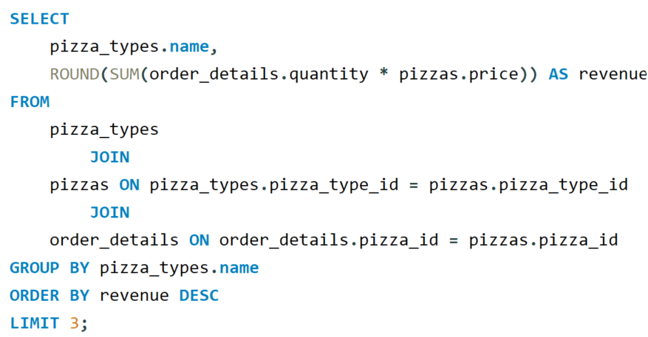
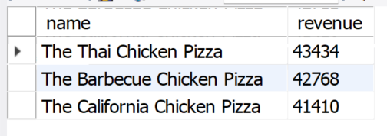
Determine the top 3 most ordered pizza types based on revenue.

Slide 16
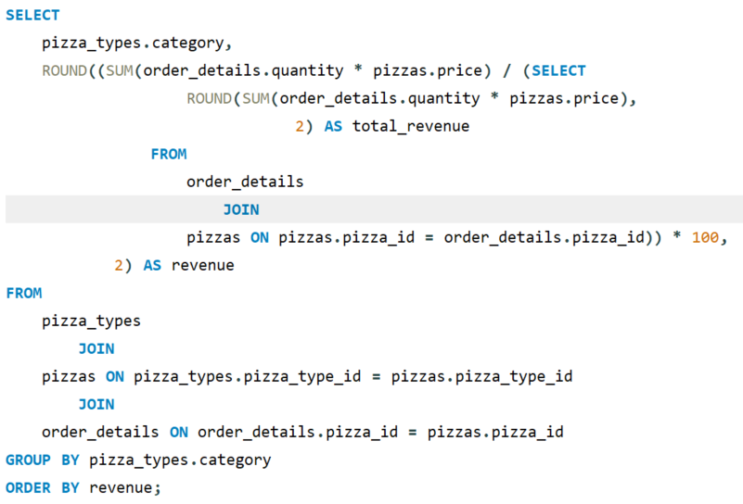
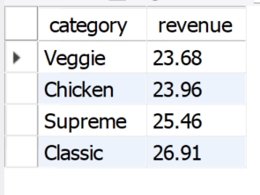
Calculate the percentage contribution of each pizza type to total revenue.

Slide 17
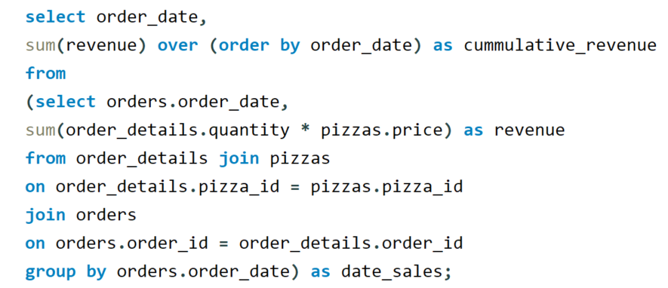
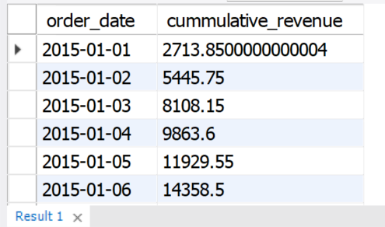
Analyze the cumulative revenue generated over time.

Slide 18
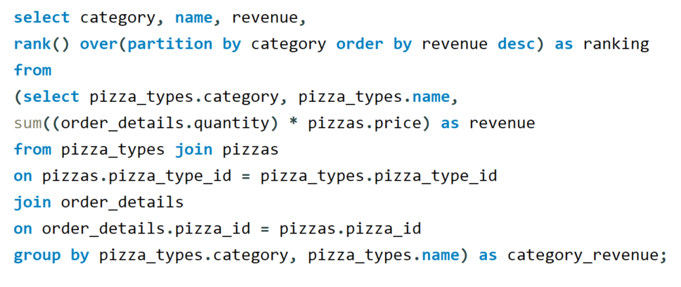
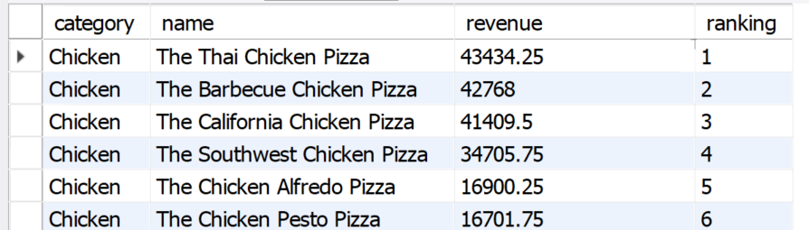
Determine the top 3 most ordered pizza types based on revenue for each pizza category.

Slide 19

Expected Outcomes
Identify the most popular pizza products and sizes.
Understand which categories generate the highest sales.
Analyze peak ordering hours and daily demand.
Measure revenue contribution and cumulative sales growth.
Present data-driven insights using SQL query outputs.

Slide 20
Conclusion
The Pizza Sales Analysis project demonstrates practical SQL and data analytics skills.
It converts raw sales data into meaningful business insights.
The project covers basic aggregation, table joins, time-based analysis, and advanced revenue analysis.
Query code and result screenshots can be added to the following sections of the presentation.

