Slide 1
The Seesaw Project
Modelling and Control of a Cart-on-Seesaw System — Progress Update
054702 — Automation and Control Laboratory
Team:
Negm Karim · Hu Kaipeng · Yan Yawen · Zeep Nathan
Supervisors:
Prof. Ruiz Fredy
Cordoba Andres
Academic Year 2025–2026
Notes:
OWNER: Karim
Open with one-sentence framing: what the setup is, what we set out to do, and where we stand today. Emphasize this is a progress update — honest about what works and what doesn't.

Slide 2
Outline
OWNER: Karim
• Project context and objectives
• Experimental setup: cart + seesaw
• Modelling — from physics to state-space
• Model tuning and experimental validation
• Control strategies under investigation
– Cart position control (PID)
– Body stabilization with LQR
– Pole-placement state feedback
– Trajectory tracking & lift-up
• Status, challenges, and next steps
Seesaw — Automation and Control Laboratory | Politecnico di Milano | 2/21
Notes:
OWNER: Karim
This is the roadmap for the talk. Keep it short (~30s). Point out that most of the time will be on control strategies and results.

Slide 3
Project Motivation and Objectives
OWNER: Karim
• Underactuated mechanical system: cart on a free-rotating seesaw
• Classical benchmark for nonlinear, coupled dynamics
• Goals of the project:
– Build a reliable physical model of the plant
– Validate the model against the real setup
– Design and compare control strategies (PID, LQR, pole placement, …)
– Achieve body stabilization and periodic trajectory tracking
• Deliverable: documented pipeline from modelling → tuning → control → experiment
Seesaw — Automation and Control Laboratory | Politecnico di Milano | 3/21
Notes:
OWNER: Karim
Frame this as: underactuated system is hard, that's the point. We want to show what we've tried — even when it hasn't fully worked — and what we've learned.

Slide 4
Experimental Setup
Cart on a rail mounted on a free-rotating seesaw
OWNER: Nathan / Kaipeng
• Two configurations used:
– Cart only — 1 DoF: cart position x_c
– Cart + seesaw — 2 DoF: (x_c, θ)
• Actuation: DC motor driving cart via pinion/rack
• Sensing: encoders on cart position and seesaw angle
• Datasheet parameters refined experimentally (see tuning section)
• [ ADD: photo of the setup — side view highlighting x_c and θ ]
[ figure placeholder ] Photo of physical setup (to add)
Seesaw — Automation and Control Laboratory | Politecnico di Milano | 4/21
Notes:
OWNER: Nathan or Kaipeng
Add a clean photo of the rig. Point out the two coordinates and the single actuation — this is what makes it underactuated.

Slide 5
Modelling — Cart Dynamics
Single-DoF Euler–Lagrange derivation
OWNER: Nathan / Kaipeng
• Equivalent inertia includes motor + gearbox: M_e = M_c + J_m K_g² / r_mp²
• Motor force: F_c = α·v − B_emf · ẋ_c
• Equation of motion (linear, 2nd-order):
– M_e ẍ_c + (B_eq,c + B_emf) ẋ_c = α · v
• Transfer function: G(s) = α / [M_e s² + B_tot s]
• Integrator + 1st-order pole ⇒ simple structure for PID design
• [ ADD: clean block diagram or free-body sketch ]
Seesaw — Automation and Control Laboratory | Politecnico di Milano | 5/21
Notes:
OWNER: Nathan or Kaipeng — this is the modelling block. Karim is not going to speak on this. Walk through the Lagrangian briefly, show the EoM and TF. Keep equations readable.

Slide 6
Modelling — Cart + Seesaw Dynamics
Coupled nonlinear system via Euler–Lagrange
OWNER: Nathan / Kaipeng
• Lagrangian L = T − V built on generalized coords (x_c, θ)
• Kinetic + potential energy include coupling between cart and seesaw
• Two coupled nonlinear equations:
– translational dynamics of the cart
– rotational dynamics of the seesaw
• Nonlinearities: sin(θ), cos(θ), centripetal ẋ_c θ̇, Coriolis-like terms
• Linearization around θ ≈ 0 used for control design
Seesaw — Automation and Control Laboratory | Politecnico di Milano | 6/21
Notes:
OWNER: Nathan or Kaipeng
Emphasize: (1) the coupling terms, (2) why we linearize around horizontal equilibrium, (3) the limits of that linearization.

Slide 7
State-Space Representation
OWNER: Nathan / Kaipeng
• State vector: x = [x_c, θ, ẋ_c, θ̇]ᵀ
• Input: u = v (motor voltage)
• Linearized system: ẋ = A x + B u, y = C x
• A, B obtained from the linearization of the coupled EoM
• Checks performed:
– controllability of (A, B)
– observability of (A, C)
– open-loop pole locations → instability of horizontal equilibrium
• This SS model is the foundation for LQR and pole-placement design
Seesaw — Automation and Control Laboratory | Politecnico di Milano | 7/21
Notes:
OWNER: Nathan or Kaipeng
State the state vector clearly. Say whether (A,B) is controllable and where the open-loop poles sit. This motivates the need for active stabilization.

Slide 8
Model Tuning — Approach
Fitting the model to the real plant
OWNER: Karim
• Datasheet values assumed correct for most parameters
• Focused tuning on three uncertain quantities:
– viscous damping coefficient B_eq,c
– planetary gearbox efficiency η_g
– motor efficiency η_m
• Excitation: sinusoidal voltage inputs at multiple frequencies
• Objective: match both frequency response (Bode) and time response
• Iterative fit on experimental data
Seesaw — Automation and Control Laboratory | Politecnico di Milano | 8/21
Notes:
OWNER: Karim
Explain WHY these three parameters — they dominate the low-frequency gain and damping, and they are the ones with the largest uncertainty from datasheets. Brief mention of the cost function used.

Slide 9
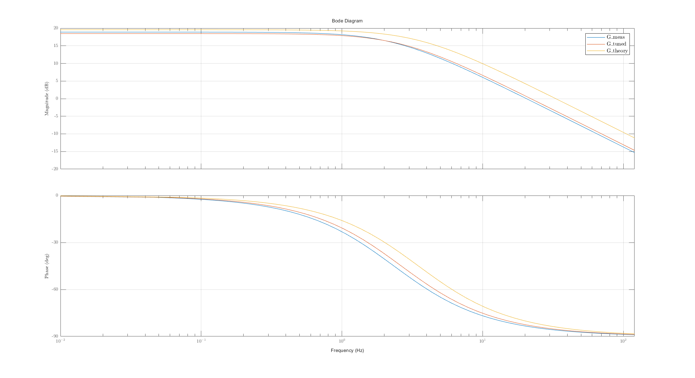
Model Validation — Frequency Domain
Measured vs. theoretical vs. tuned model
OWNER: Karim
• Frequency sweep of the cart sub-system
• Theoretical curve: datasheet parameters only
• Tuned curve: after fitting B_eq,c, η_g, η_m
• Tuned model matches the measured Bode plot within a few dB across the band of interest
• Residual mismatch at high frequency → unmodelled dynamics (friction, motor electrical)
Bode: measured vs. theoretical vs. tuned
Seesaw — Automation and Control Laboratory | Politecnico di Milano | 9/21
Notes:
OWNER: Karim
Walk through the Bode plot: point to where theory and measurement disagree, and how the tuned model closes most of that gap. Be honest about what's still off.

Slide 10
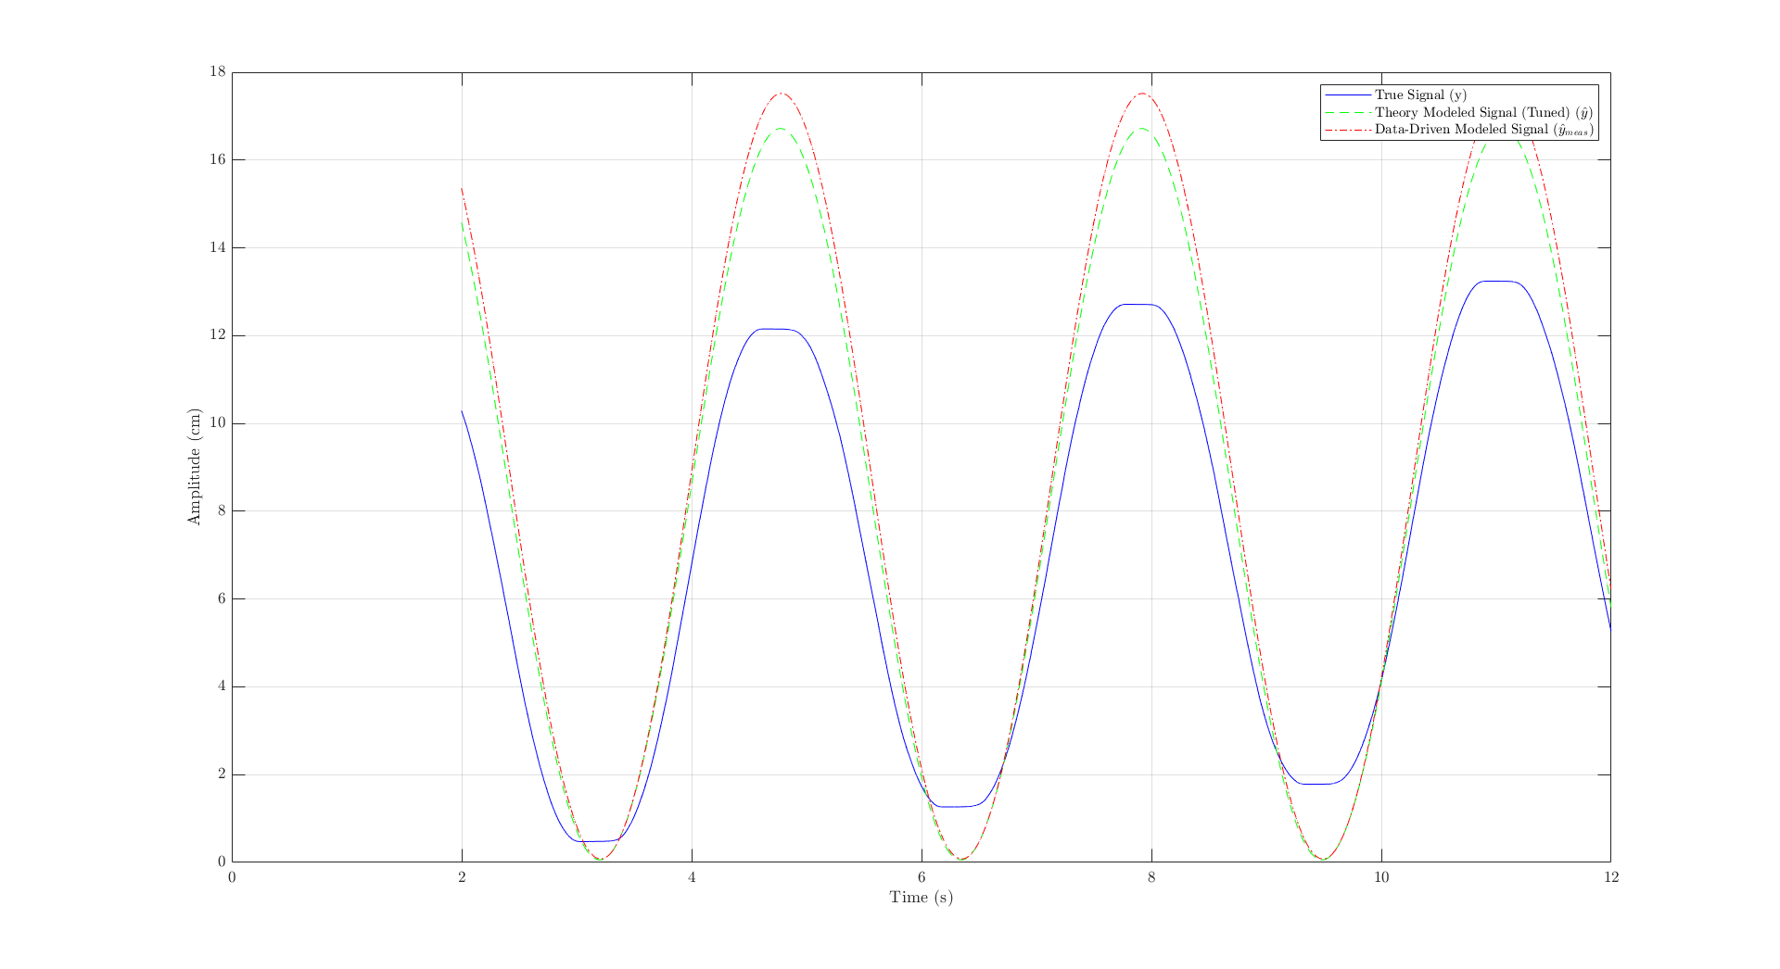
Model Validation — Time Domain (2 Hz)
OWNER: Karim
• Low-frequency excitation: 2 Hz sinusoidal input
• Regime dominated by the integrator + damping → test of the tuned gain
• Tuned model tracks amplitude and phase of the measurement
• Small steady-state offset attributed to stiction / Coulomb friction
Time response — 2 Hz excitation
Seesaw — Automation and Control Laboratory | Politecnico di Milano | 10/21
Notes:
OWNER: Karim
At 2 Hz we test the low-frequency behaviour. Highlight phase agreement and any amplitude bias.

Slide 11
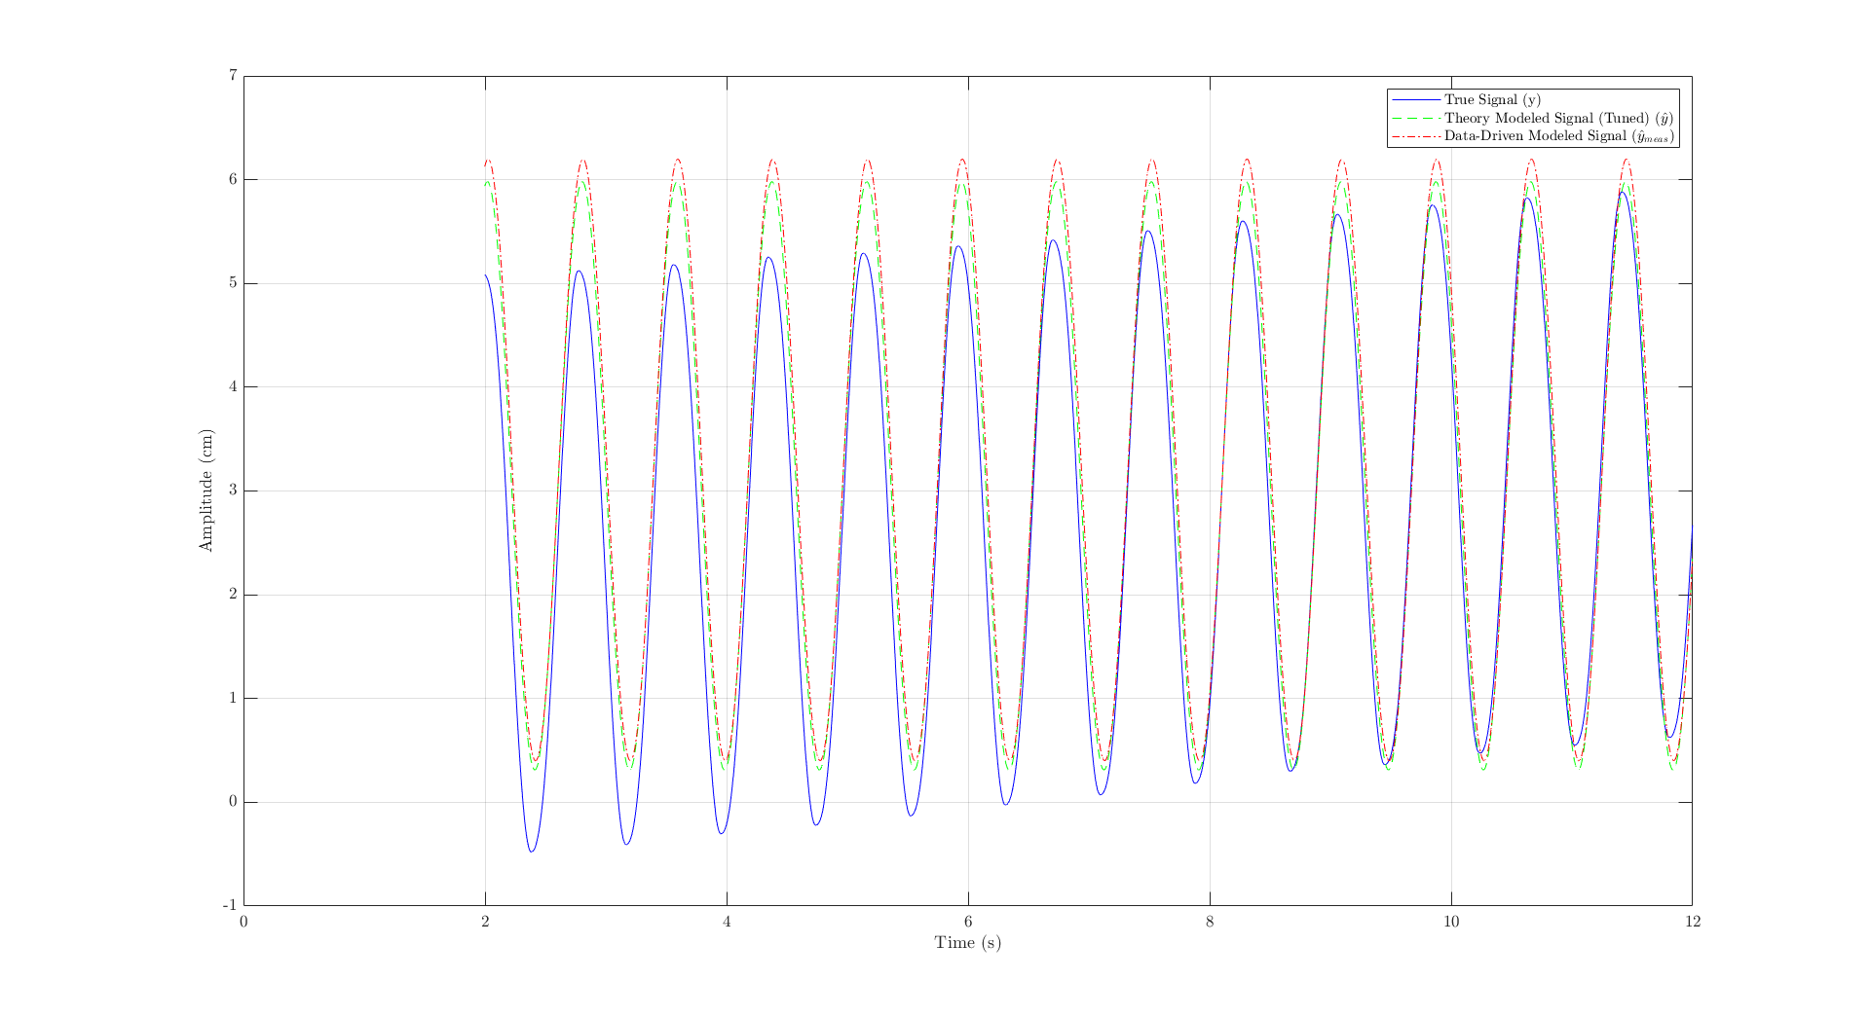
Model Validation — Time Domain (8 Hz)
OWNER: Karim
• Higher-frequency excitation: 8 Hz sinusoidal input
• Regime dominated by inertia and electrical dynamics
• Tuned model still captures envelope; small phase lag appears
• Consistent with the residual high-frequency gap seen in the Bode plot
• Conclusion: tuned model is accurate enough for control design
Time response — 8 Hz excitation
Seesaw — Automation and Control Laboratory | Politecnico di Milano | 11/21
Notes:
OWNER: Karim
At 8 Hz the model starts to show its limits. Use this as the segue: 'the model is good enough to design linear controllers — now let's see how those controllers do.'

Slide 12
Experience 1 — Cart Position Control (PID)
OWNER: Team (lead: TBD)
• Objective: regulate cart position x_c with the seesaw locked
• Design approach: loop-shaping on the tuned model
• Specifications (to confirm): bandwidth, overshoot, steady-state error
• [ ADD: controller parameters (K_p, K_i, K_d) ]
• [ ADD: step response — simulation vs. experiment ]
• [ ADD: disturbance rejection test ]
Seesaw — Automation and Control Laboratory | Politecnico di Milano | 12/21
Notes:
OWNER: Whoever ran the PID experiments. Keep this short — one plot of the closed-loop step response is enough. This is the warm-up exercise, not the main result.

Slide 13
Experience 2 — Body Stabilization (Horizontal)
Why state feedback is needed
OWNER: Kaipeng / Yawen
• Goal: keep seesaw angle θ ≈ 0 while the cart rests on top
• Open-loop horizontal equilibrium is unstable
• Single-output PID on θ is not enough: the cart position drifts
• Need multi-variable control: state feedback on (x_c, θ, ẋ_c, θ̇)
• Two design routes explored: LQR and pole placement
Seesaw — Automation and Control Laboratory | Politecnico di Milano | 13/21
Notes:
OWNER: Kaipeng and Yawen. This is the setup slide before your LQR content.

Slide 14
LQR — Design and Tuning
OWNER: Kaipeng / Yawen
• Minimize quadratic cost J = ∫ (xᵀQx + uᵀRu) dt
• Weighting matrices:
– Q — penalizes state deviations (x_c, θ, ẋ_c, θ̇)
– R — penalizes control effort (motor voltage)
• Tuning procedure we followed:
– [ ADD: initial Q, R values and rationale ]
– [ ADD: iterations / Bryson's rule / manual adjustments ]
• Solve continuous-time ARE → feedback gain K
• [ ADD: final K matrix ]
Seesaw — Automation and Control Laboratory | Politecnico di Milano | 14/21
Notes:
OWNER: Kaipeng and Yawen.
Walk through how you picked Q and R — this is exactly the part the reviewers want to see. If you used Bryson's rule to get started, say so. Show the final K matrix.

Slide 15
LQR — Results
OWNER: Kaipeng / Yawen
• [ ADD: closed-loop pole locations with K ]
• [ ADD: simulation — response to initial θ perturbation ]
• [ ADD: experiment — real-plant response ]
• [ ADD: comparison sim vs. experiment ]
• Discussion:
– what works well
– failure modes observed (saturation, noise, coupling)
Seesaw — Automation and Control Laboratory | Politecnico di Milano | 15/21
Notes:
OWNER: Kaipeng and Yawen. Drop your plots here — one per sub-bullet is fine. Be explicit about any failure modes; they're informative.

Slide 16
Pole-Placement State Feedback
OWNER: Kaipeng / Yawen
• Alternative route: directly prescribe closed-loop pole locations
• Desired poles chosen for target settling time / damping
• Ackermann / place() on (A, B)
• [ ADD: target vs. achieved pole locations ]
• [ ADD: simulation + experimental response ]
• Trade-off vs. LQR: transparent spec, but less systematic on effort
Seesaw — Automation and Control Laboratory | Politecnico di Milano | 16/21
Notes:
OWNER: Kaipeng and Yawen. Short — just contrast with LQR. One comparison plot is enough.

Slide 17
Other Control Strategies Explored
OWNER: Team
• [ ADD: cascade / inner-outer loop attempt ]
• [ ADD: observer-based feedback (Luenberger / Kalman) — status ]
• [ ADD: integral action augmentation for steady-state accuracy ]
• [ ADD: anti-windup, saturation handling ]
• For each strategy note: motivation → implementation status → what we learned
Seesaw — Automation and Control Laboratory | Politecnico di Milano | 17/21
Notes:
OWNER: Whichever team members explored alternative strategies. The point of this slide is to show breadth of effort — even partial / failed attempts belong here.

Slide 18
Experience 3 — Trajectory Tracking & Lift-up
OWNER: Team
• Periodic reference for the seesaw body: sinusoidal θ_ref(t)
• Lift-up task: drive seesaw from rest toward the horizontal equilibrium
• Requires reference tracking + disturbance rejection
• Status:
– [ ADD: current progress ]
– [ ADD: open issues ]
Seesaw — Automation and Control Laboratory | Politecnico di Milano | 18/21
Notes:
OWNER: Whoever is leading Experience 3. If nothing is running yet, say so — and describe the planned approach.

Slide 19
Challenges and Lessons Learned
OWNER: Team
• Modelling:
– Friction is the dominant unmodelled effect at low speeds
– Parameter uncertainty addressed via targeted tuning
• Control:
– [ ADD: actuator saturation at large θ ]
– [ ADD: sensor noise amplified by derivative terms ]
– [ ADD: coupling sensitivity — small Q changes move θ/x_c trade-off ]
• Workflow: systematic pipeline model → simulate → deploy → compare
Seesaw — Automation and Control Laboratory | Politecnico di Milano | 19/21
Notes:
OWNER: Whole team — each person owns one bullet. This is the slide that proves we thought about this seriously.

Slide 20
Status and Next Steps
OWNER: Karim
• Done:
– [ ADD: model derived, tuned and validated
– [ ADD: PID cart control working
– [ ADD: LQR designed and tested in simulation / on rig
• In progress:
– [ ADD: pole placement comparison
– [ ADD: Experience 3 tracking
• Planned:
– [ ADD: observer-based / integral-augmented control
– [ ADD: robustness analysis ]
Seesaw — Automation and Control Laboratory | Politecnico di Milano | 20/21
Notes:
OWNER: Karim.
Close by being explicit: here is what's done, here is what's in flight, here is what we plan to do next. Reviewers value honesty about status.

Slide 21
Thank you — Questions?
The Seesaw Team — Politecnico di Milano — 054702 Automation and Control Laboratory
OWNER: Team
• Team: Negm Karim · Hu Kaipeng · Yan Yawen · Zeep Nathan
• Supervisors: Prof. Ruiz Fredy, Cordoba Andres
•
• Back-up slides follow (extra plots, derivations, parameter tables).
Seesaw — Automation and Control Laboratory | Politecnico di Milano | 21/21
Notes:
OWNER: Team — whoever is presenting should take the first question and route it.
Prepare: (1) a full parameter table, (2) full state-space matrices, (3) any plots cut from the main deck.

