Slide 1

FINAL PRESENTATION
SPARK PROJECT
NEHA ADARSH
NUID: 001566172
DATE: JUNE 27TH, 2022
SUPERVISED BY :
VENKATA DUVVURI, ADJUNCT PROFESSOR
NORTHEASTERN UNIVERSITY

Slide 2

ABOUT PYSPARK
Apache Spark is an open source, distributed computing platform and collection of tools for real-time, massive data processing, and PySpark is its Python API
It functions essentially as a computational engine that handles big data sets by processing them concurrently and in batches. PySpark was created to facilitate the integration of Python and Spark, which is written in Scala.

Slide 3
Big Data in Real Life
Big data is currently being used in different competitive industries, including online stock market trading. Over ninety percent of businesses currently believe that using analytics strategies will help them gain a competitive edge.
Organizations rely on data and analytics to gain important insights and make well-informed business decisions.
Significant data volumes are developed daily since you can engage in online trading through your phone on different trading platforms. Changes in machine learning, artificial intelligence, and analytics have helped reform how the financial industry can incorporate big data into the stock market.
It has helped online traders make better investment decisions while ensuring the returns are consistent in the process.

Slide 4
PROJECT INTRODUCTION
In this Project, I have worked on a Walmart Stock Prices dataset from Kaggle.com. Originally the data is from yahoo.com.
The dataset consists of 7 columns with 2571 observations
Each variable is described below:
- Date: Date of the trading day
- Close: Price of the stock at the end of the trading day
- Volume: Total number of stocks sold on a given trading day
- Open: Price of the stock at the beginning of the trading day
- High: Highest stock price during the trading day
- Low: Highest stock price during the trading day
- Adj Close: Adjusted close is the closing price after adjustments for all applicable splits and dividend distributions.
The reason for choosing this dataset is to better understand the stock market as most of the people invest in stock market in today’s world. Also, this help allocate society's scarce savings to the most promising new investment projects and help discipline managers to make the best use of the productive capacity already under their control
I have reflected the concepts of PySpark using Jupyter Notebook (Python)

Slide 5
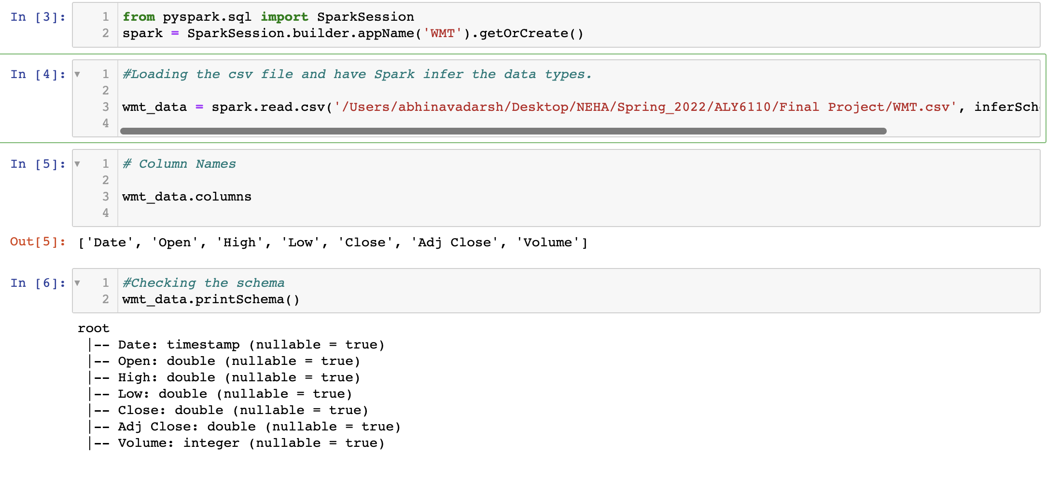
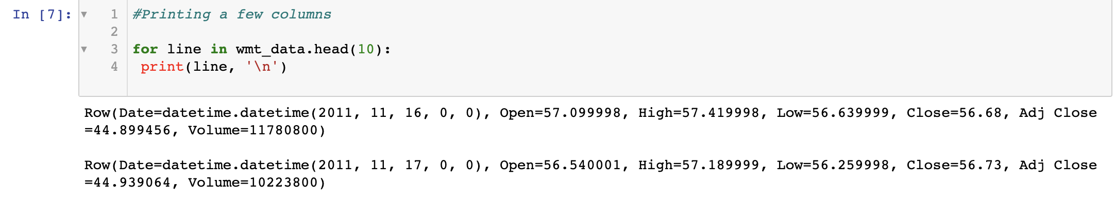
ENVIORNMENT SETTING
First, started a simple Spark session and imported the csv file
By using .columns, checked the columns of the dataset, there are total 7 columns
By using printSchema() function, printed the schema of the data
By applying the for loop and using head() function, printed first 10 records from the dataset

Slide 6
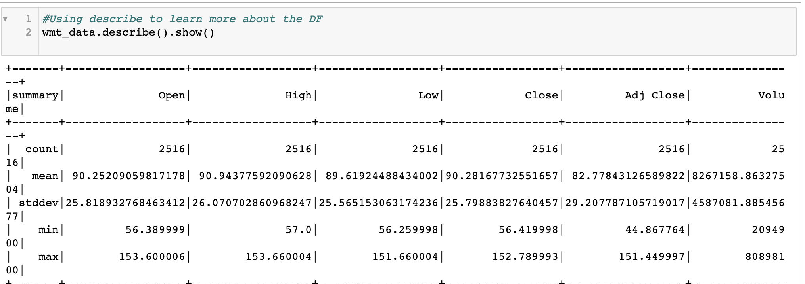
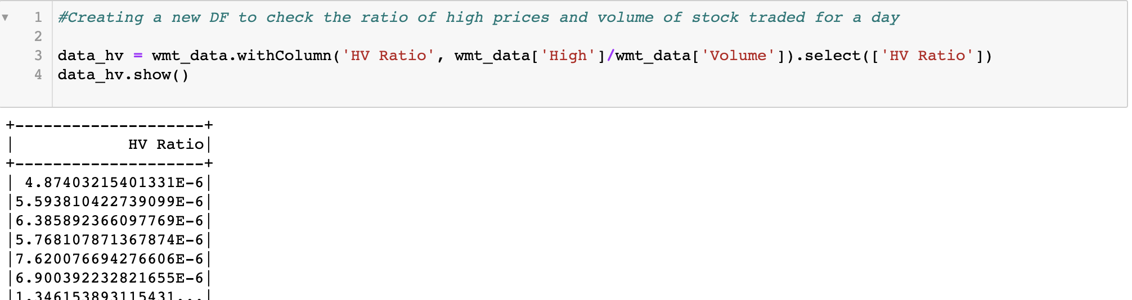
Walmart Stock Prices Analysis
Used describe() function to know check the descriptive statistics of the Data Frame such as Count, mean, median and range of the variables
Create a new dataframe with a column named HV Ratio which is displaying the ratio of the High Price versus volume of stock traded for a day

Slide 7
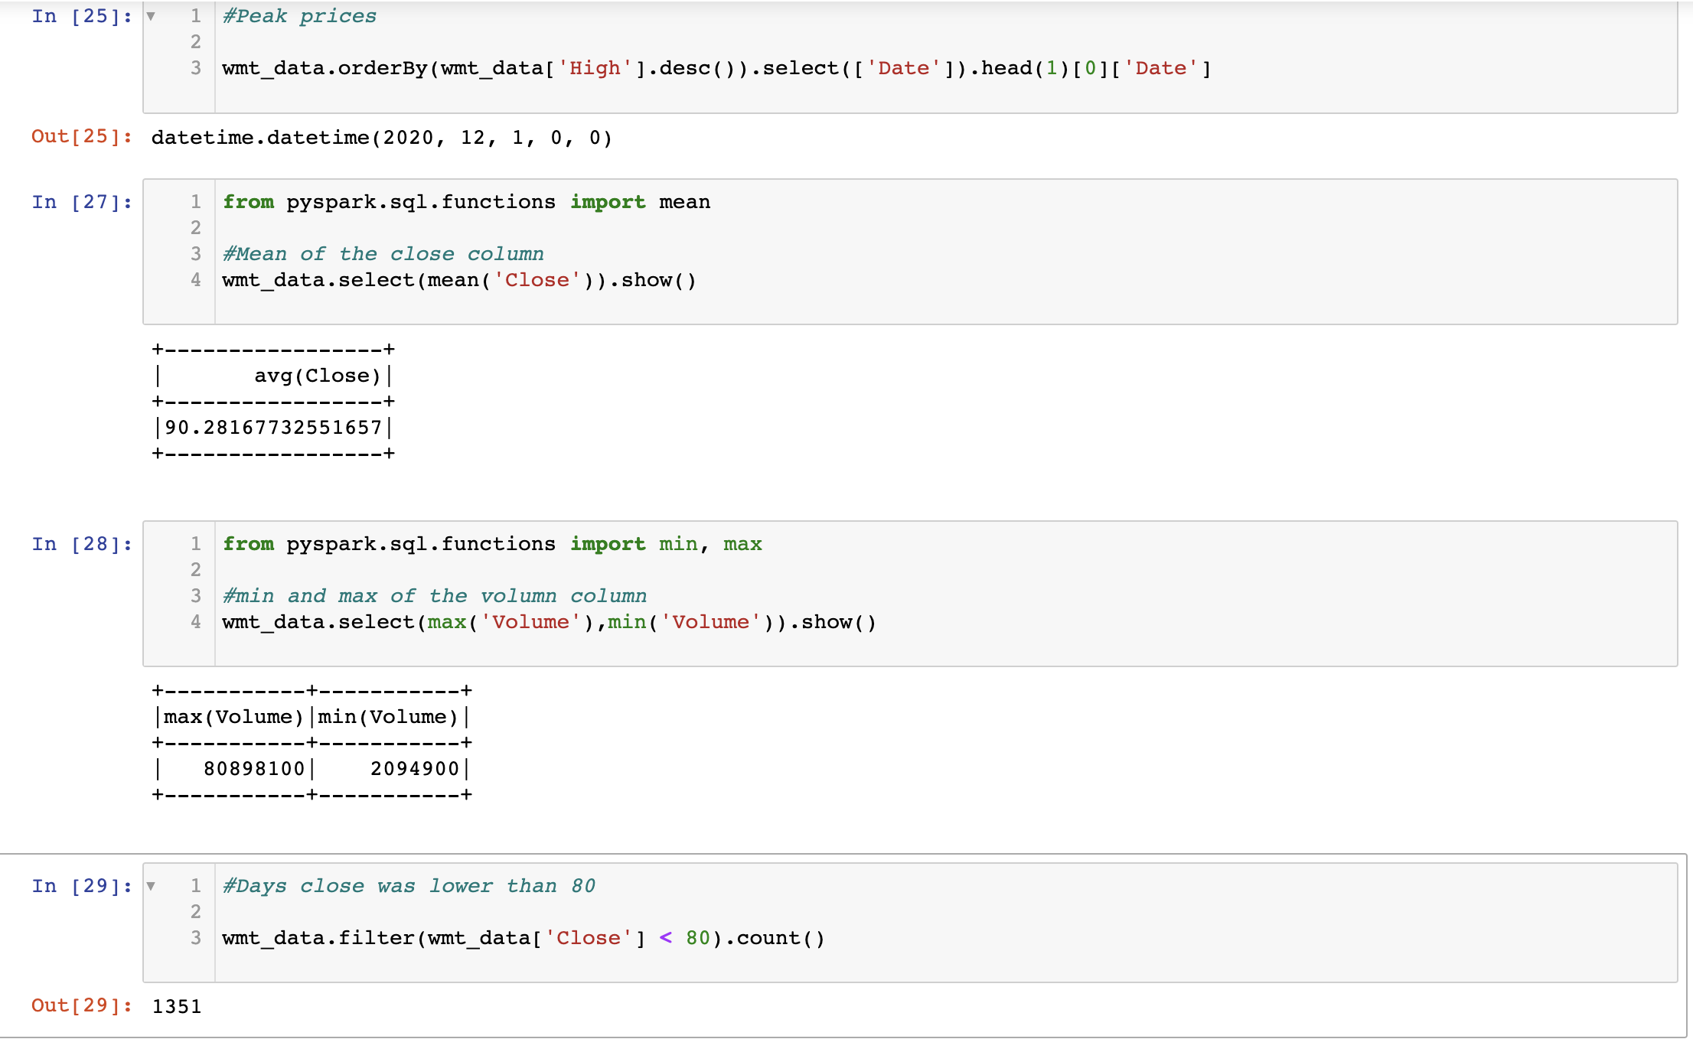
Walmart Stock Prices Analysis
2020.12.01 this date had the peak high prices of the stocks
Close column mean is 90.281
Volumn column’s range (min & max) is from 2094900 ~ 80898100
There were 1315 days when Close (price of the stock at the end of the trading day) was less than 80 dollars

Slide 8
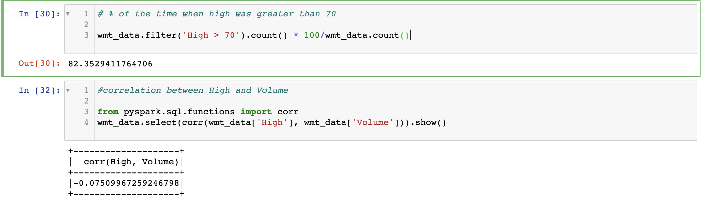
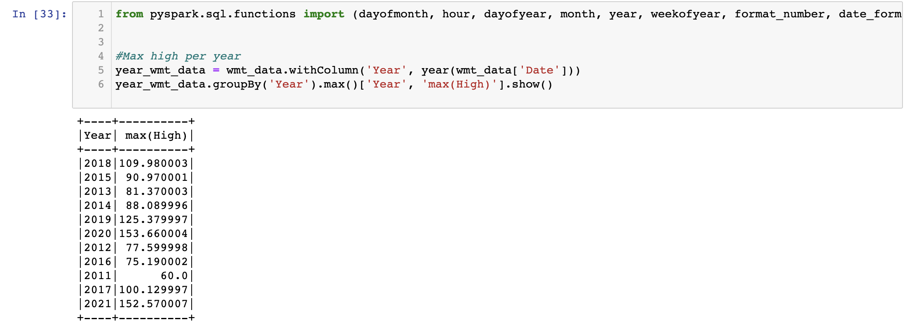
Walmart Stock Prices Analysis
82% of the time, the stock prices were greater than 70
There is a negative correlation between High and Volume which is an indication that both variables move in the opposite direction
The last code snippets displays the highest prices of stocks in each year

Slide 9
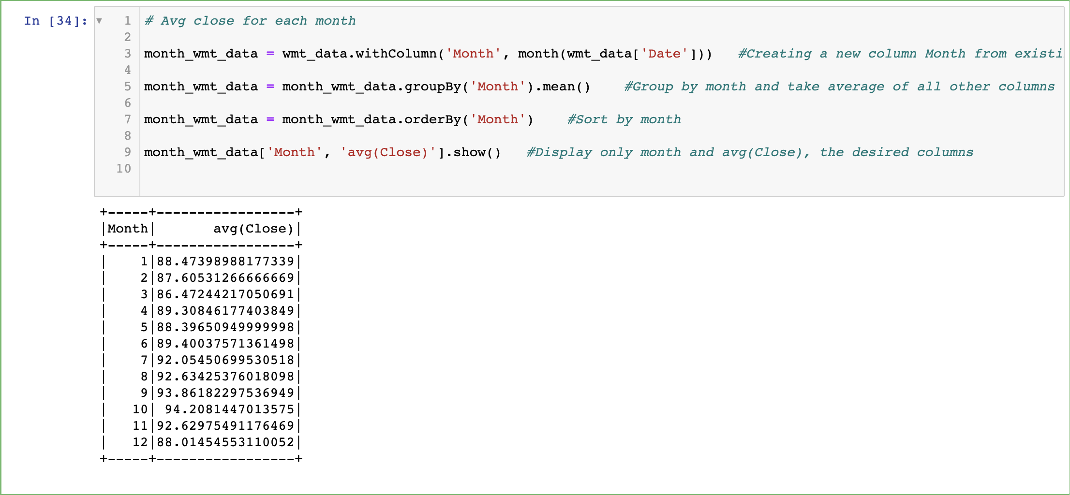
Walmart Stock Prices Analysis
The results displaying the average close (Price of the stock at the end of the trading day ) for each month of all the years combined. In other words, across all the years, the value for the average Close price for each month

Slide 10
REFERENCES
Investopedia, By STEVEN NICKOLAS, May 31, 2021, Reviewed by JULIUS MANSA, Fact checked by KATRINA MUNICHIELLO, https://www.investopedia.com/ask/answers/032515/what-does-it-mean-if-correlation-coefficient-positive-negative-or-zero.asp
Kaggle.com, Dataset, https://www.kaggle.com/code/devmahmoud/walmart-stocks-analysis-using-pyspark/data
https://gktcs.com/media/Reference2/Surendra%20Panpaliya/Python_Pyspark_Datametica/Spark_Walmart_Data_Analysis_Project.pdf
PySpark, https://www.dominodatalab.com/data-science-dictionary/pyspark#:~:text=PySpark%20is%20the%20Python%20API,more%20scalable%20analyses%20and%20pipelines.
Bigdata, 03 December 2020, How Does Big Data Affect the Stock Market, https://bigdataanalyticsnews.com/big-data-affect-stock-market/

Slide 11




THANK YOU

