Slide 1

A PROJECT TITLE ON
Accident Hotspot
Detection
Using DBSCAN-Based Anomaly Detection
project report submitted in partial fulfilment of the requirements for the Course
MACHINE LEARNING • BACHELOR OF TECHNOLOGY • A.Y. 2026-27
Presented by
Bathula Neha 2520090013
Veeramallu Rohita Sai Lakshmi 2520090235
Koumudi 2520090161
Under the esteemed guidance of Haritha, Assistant Professor, Dept. of CS&IT
DEPARTMENT OF CS & IT | KL UNIVERSITY

Slide 2
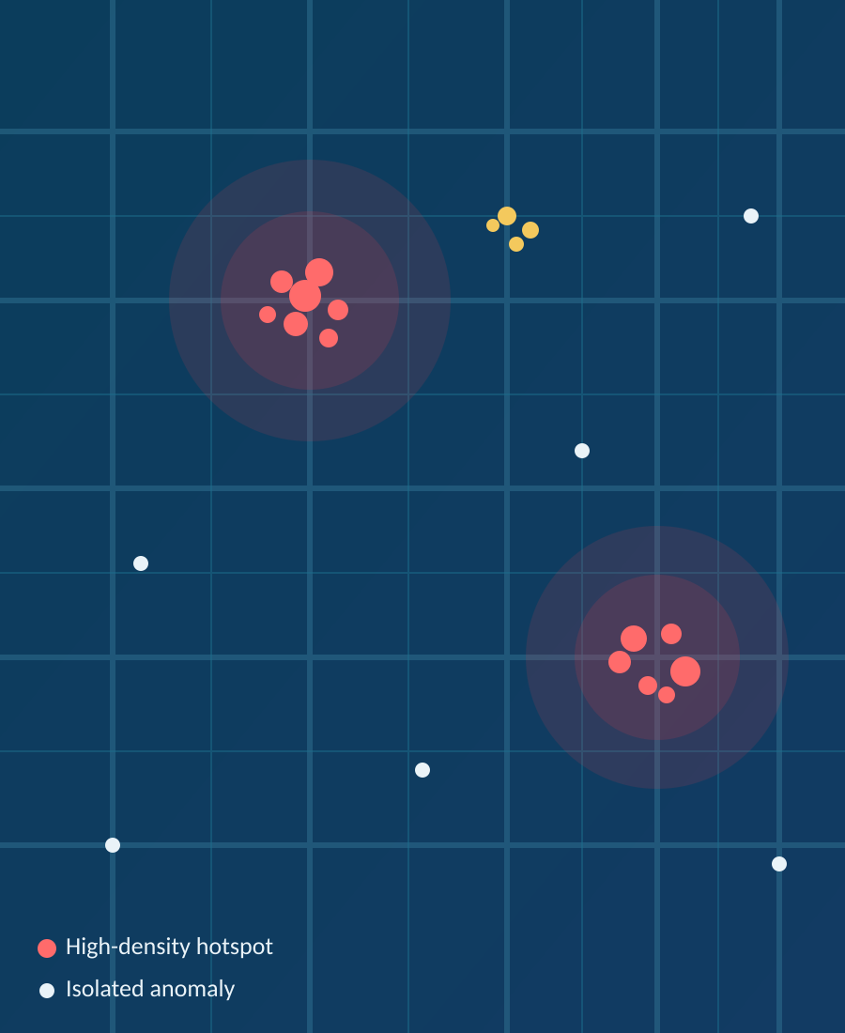
01 • PROJECT OVERVIEW
Abstract
Road accidents frequently recur at specific locations due to poor road conditions, congestion, sharp turns, inadequate lighting, or traffic-rule violations — but manually spotting these hotspots is slow and error-prone.
DBSCAN in one picture
This project builds a Machine Learning-based Accident Hotspot Detection System using DBSCAN, an unsupervised algorithm that groups accident-prone locations while flagging isolated incidents as anomalies.
DBSCAN doesn't need the number of clusters specified in advance, handles irregularly shaped clusters, and copes well with noisy geospatial data — well suited to real-world accident records.
Data is drawn from public sources (US Accidents, UK Road Safety, or Indian Road Accident datasets), with features like location, time, road type, speed limit, weather, and severity.
The workflow covers data collection, preprocessing, EDA, feature selection, and DBSCAN clustering — validated using Silhouette Score, Davies-Bouldin Index, and expert review.
Locations are classified as high, medium, low-risk, or isolated anomalies and visualized on interactive maps (Folium, Plotly) for traffic and safety planning.
Accident Hotspot Detection Using DBSCAN-Based Anomaly Detection
2

Slide 3

02 • BACKGROUND & PROBLEM
Introduction
Why this matters
Our Approach
Road traffic accidents remain a major public safety challenge, often clustering around specific locations.
Causes include poor road design, heavy congestion, sharp turns, inadequate lighting, and frequent traffic-rule violations.
Traditional approaches rely on manual analysis of accident reports — slow, inconsistent, and difficult to scale.
Growing availability of geo-tagged accident records from open datasets enables automated, ML-based pattern detection.
Apply DBSCAN, a density-based clustering algorithm suited to spatial data
Group accident locations into meaningful hotspot clusters
Identify isolated incidents as anomalies, not forced clusters
No need to predefine the number of hotspots in advance
Accident Hotspot Detection Using DBSCAN-Based Anomaly Detection
3

Slide 4
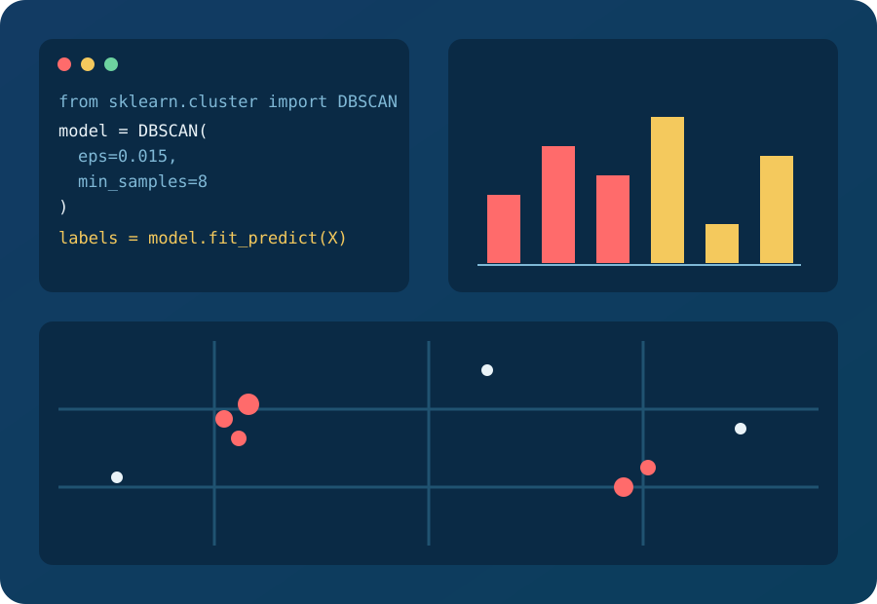




03 • TOOLS & ENVIRONMENT
Software Requirements
Programming Language
Python 3.x
Libraries
Pandas, NumPy, Scikit-learn (DBSCAN), Matplotlib, Seaborn, Folium, Plotly
Development Environment
Jupyter Notebook / Google Colab / Visual Studio Code
Operating System
Windows / Linux / macOS
Accident Hotspot Detection Using DBSCAN-Based Anomaly Detection
4

