Slide 1


A PROJECT TITLE ON
Accident Hotspot Detection
Using DBSCAN-Based Anomaly Detection
Project report submitted in partial fulfilment of the requirements for the course MACHINE LEARNING • BACHELOR OF TECHNOLOGY • A.Y. 2026-27
PRESENTED BY
UNDER THE GUIDANCE OF
Bathula Neha 2520090013
Veeramallu Rohita Sai Lakshmi 2520090235
Koumudi 2520090161
Haritha
Assistant Professor
Department of CSIT
DEPARTMENT OF CSIT | KL UNIVERSITY (DEEMED TO BE UNIVERSITY)
Notes:
Introduce the project title, team members, guide and department. Mention this is for the Machine Learning course, A.Y. 2026-27.

Slide 2





Abstract
01 • PROJECT OVERVIEW
The problem
Accidents recur at specific locations, but spotting these hotspots by hand is slow and error-prone.
DBSCAN in one picture
The method
DBSCAN, an unsupervised algorithm, groups accident-prone locations and flags isolated incidents as anomalies.
The data
Public sources (US Accidents, UK Road Safety, Indian Road Accident); this work uses the Indian dataset, 2022–2025.
The workflow
Collection, preprocessing, EDA, feature selection and DBSCAN, validated by Silhouette, Davies–Bouldin and expert review.
The output
Locations labelled high, medium, low risk or anomaly, shown on interactive maps for safety planning.
Hotspot cluster
Isolated anomaly
Notes:
Summarise the abstract: the problem, why DBSCAN, the dataset, the workflow and the outputs.

Slide 3




Introduction
02 • BACKGROUND
Background
Domain overview
Why it is needed
Road traffic accidents remain a major public-safety challenge and often cluster at specific locations — poor road design, congestion, sharp turns, weak lighting and rule violations.
Geospatial machine learning: geo-tagged accident records from government portals and open datasets let unsupervised algorithms find spatial patterns automatically.
Manual analysis of accident reports is slow, inconsistent and hard to scale across regions. Authorities need an automated, repeatable way to find hotspots.
Goal: a hotspot map that helps traffic authorities, urban planners and emergency services prioritise interventions and allocate resources effectively.
Notes:
Explain the background of road accidents, the ML domain (geospatial clustering) and why an automated method is needed.

Slide 4

Problem Statement
03 • PROBLEM
Limitations & challenges
THE PROBLEM
Accidents repeatedly strike the same places — yet finding those places by hand is slow, inconsistent and hard to scale.
Manual review of accident reports is slow and prone to oversight
No consistent definition of a hotspot between analysts
Does not scale to multi-year, multi-city geo-tagged records
Isolated incidents get mixed up with true recurring hotspots
Who is affected
Recurring locations need targeted fixes — but first they must be found.
Road users
Traffic authorities
Urban planners
Emergency services
Insurers
Notes:
State the existing problem, its limitations and the groups affected.

Slide 5



Motivation
04 • WHY THIS PROJECT
Why we selected it
Accident hotspots are a concrete, high-impact problem where unsupervised ML adds value without labelled data — and DBSCAN's noise handling suits messy geospatial records.
Real-world need
Every accident means lost lives, injuries and property damage. Authorities need to know where to act first, because repeat locations are where targeted fixes pay off most.
Research & industry motivation
Open geo-tagged datasets (US Accidents, UK Road Safety, Indian Road Accident) and smart-city programmes make data-driven road-safety analysis practical.
Notes:
Why the team chose this topic, the real-world need and the research/industry context.

Slide 6
Objectives
05 • AIMS
Collect and preprocess geo-tagged accident records from a public dataset
1
Explore patterns by city, severity, time, cause and weather (EDA)
2
MAIN OBJECTIVE
Build an ML-based system that automatically detects accident hotspots and isolates anomalous incidents using DBSCAN.
Apply city-wise DBSCAN with tuned eps and min_samples to find hotspots
3
Evaluate clusters with Silhouette, Davies–Bouldin and expert review
4
Classify risk levels and visualise results on an interactive dashboard
5
Notes:
State the main objective, then walk through the five specific objectives.

Slide 7



Existing System
06 • CURRENT PRACTICE
Current approach
Limitations
Analysts manually read accident reports, tally incidents per location and mark high-count spots on static maps.
Slow, labour-intensive and inconsistent between analysts
Does not scale to large multi-year datasets
K-Means needs the number of clusters in advance
Centroid methods assume compact, round clusters
Outliers are forced into clusters instead of flagged
Static outputs — no interactive exploration
Existing technologies
Spreadsheets and statistical summaries
Static GIS or paper maps
Centroid-based clustering such as K-Means
Notes:
Describe how hotspots are found today and why those methods fall short.

Slide 8
Proposed System
07 • OUR SOLUTION
Each limitation of the existing approach is addressed:
ROADLENS
Manual, slow analysis
Automated pipeline over geo-tagged records
An automated pipeline that runs city-wise DBSCAN on geo-tagged accident records and presents hotspots on an interactive dashboard.
Cluster count fixed in advance
DBSCAN finds hotspots without a preset k
Outliers forced into clusters
Isolated incidents flagged as noise (−1)
Round-cluster assumption
Density-based clusters of any shape
DBSCAN
Haversine
Flask
Static reports
Interactive map, charts and CSV export
Notes:
Show how the proposed DBSCAN-based system fixes each limitation of the existing approach.

Slide 9



System Architecture
08 • BLOCK DIAGRAM
INPUT
PROCESSING
ALGORITHM
OUTPUT
CSV accident records (Kaggle)
Latitude, longitude, city
Severity, cause, weather, hour
User parameters: min_samples, eps override
Detect and validate columns
Clean and range-check coordinates
Degrees to radians
Split records by city
City-wise DBSCAN
Haversine distance
City-specific eps (km)
min_samples = 10, label −1 = noise
Hotspot clusters and anomalies
High / Medium / Low risk
Silhouette and Davies–Bouldin
Map, charts, CSV export
Notes:
Walk left to right: input data, processing modules, the DBSCAN model and the outputs.

Slide 10
Methodology
09 • WORKFLOW
1
2
3
4
Data collection
Preprocessing
EDA
Feature selection
Indian Road Accident Dataset (Kaggle, 2022–2025)
Clean coordinates, parse fields, drop invalid rows
City, severity, hour, cause, weather and traffic patterns
Latitude and longitude drive clustering; other fields profile hotspots
5
6
7
8
DBSCAN clustering
Evaluation
Risk labelling
Visualisation
City-wise, Haversine distance, tuned eps, min_samples = 10
Silhouette, Davies–Bouldin, noise share and expert review
High / Medium / Low by cluster size; isolated = anomaly
Interactive map, charts, hotspot table and CSV export
Notes:
Eight-step pipeline from data collection to visualisation.

Slide 11





Technology Stack
10 • TOOLS
Language
Python 3.x
Frameworks
Flask
Scikit-learn
Libraries
Pandas
NumPy
Matplotlib
Seaborn
Folium
Plotly
Front end
HTML / CSS / JS
Chart.js
Leaflet.js
Database
CSV in / CSV out
No database server required
Environment
Jupyter / Colab / VS Code
Windows / Linux / macOS
Standard laptop
Notes:
Python with Pandas, NumPy and Scikit-learn for ML; Flask, Chart.js and Leaflet for the dashboard. No database server is needed.

Slide 12






System Modules
11 • COMPONENTS
User Interface
Flask dashboard: upload, parameters, city filter
Data Collection
Kaggle CSV upload or built-in synthetic demo
Data Preprocessing
Column detection, coordinate cleaning, radians
Core ML Module
City-wise DBSCAN with the Haversine metric
Decision Module
Relative High / Medium / Low risk labels
Visualisation & Reporting
Leaflet map, Chart.js charts, CSV export
Database
CSV files only — no database server
Security & Validation
CSV-only, 25 MB cap, parameter range checks, local processing
Notes:
Eight modules: UI, data collection, preprocessing, ML core, decision, visualisation, storage and security/validation.

Slide 13

Implementation
12 • BUILD
Load CSV
Auto-detect latitude, longitude and city columns
1
scikit-learn • core of the model
coords = np.radians(city_df[['lat', 'lon']])
labels = DBSCAN(
eps=eps_km / 6371.0, # km to radians
min_samples=10,
metric='haversine',
algorithm='ball_tree'
).fit_predict(coords) # -1 = noise
Clean
Numeric coercion, range check, drop missing rows
2
Cluster
Run DBSCAN per city on radian coordinates
3
Summarise
Merge labels, profile clusters, compute metrics
4
Serve
Flask returns JSON for charts, map and table
Silhouette and Davies–Bouldin are computed on km-projected coordinates when at least two clusters exist.
5
Notes:
Show the key DBSCAN call. eps is in kilometres and converted to radians for the Haversine metric.

Slide 14
Dataset
13 • INPUT DATA
SOURCE
PERIOD
CITIES
Kaggle — Indian Road Accident Dataset
2022 – 2025
8 cities, clustered separately
Key attributes (used when present in the CSV)
City-specific eps (km)
Location: latitude, longitude, city, state
Time: date, hour, day of week, festival
Road & weather: road type, weather, visibility, traffic density
Accident: severity, cause, vehicles, casualties
Preprocessing
Coerce lat/lon to numbers • drop missing and out-of-range rows • trim city names • convert degrees to radians
Notes:
Dataset: Indian Road Accident Dataset 2022-2025 from Kaggle. Add the final record count from your CSV here when presenting.

Slide 15
Algorithm: DBSCAN
14 • MODEL
How DBSCAN works
Core: at least min_samples neighbours within ε
Border: within ε of a core point, but not dense itself
Noise: neither — flagged as an isolated anomaly (−1)
ε
Why it was selected
No need to preset the number of clusters
Finds irregular, non-spherical hotspot shapes
Robust to noisy geospatial data; flags outliers
Core
Border
Noise
ε (eps) 0.9 – 2.4 km, per city
min_samples 10
Metric Haversine (great-circle)
Notes:
Explain core, border and noise points, why DBSCAN suits accident data, and the three key parameters.

Slide 16

Results & Evaluation
15 • EVALUATION
Metric | What it tells | How to read it | Final run
Clusters detected | Number of hotspot clusters | Count | add value
Noise points | Isolated records (label −1) | Share of records, % | add value
Silhouette Score | Cohesion vs. separation | Closer to 1 is better | add value
Davies–Bouldin Index | Overlap between clusters | Lower is better | add value
Expert review | Match with known black spots | Qualitative | add value
Why not accuracy, precision, recall or F1?
DBSCAN is unsupervised: accident records carry no ground-truth cluster labels, so supervised scores do not apply.
Cluster quality is judged with internal indices (Silhouette, Davies–Bouldin), noise share, map inspection and expert review.
Results describe historical spatial concentrations — not predictions of future crashes. Risk levels are relative to cluster sizes.
Notes:
Fill the 'Final run' column with the values from your Kaggle run. Explain that supervised metrics are not applicable to unsupervised clustering.

Slide 17
Comparison with Existing Methods
15 • BENCHMARK
Criterion | DBSCAN (proposed) | K-Means | Manual analysis
Number of clusters | Not required | Set in advance | Not applicable
Cluster shape | Arbitrary shapes | Roughly round only | Subjective
Isolated incidents | Flagged as noise | Forced into a cluster | Judgement call
Scalability | High, automated | High, automated | Low, labour-intensive
Consistency | Repeatable | Repeatable, init-sensitive | Varies by analyst
Hotspot meaning | Dense areas on a map | Centroid-based regions | Count-based ranking
Qualitative comparison based on the properties of each approach.
Notes:
Qualitative comparison of DBSCAN vs K-Means vs manual analysis. Add measured numbers if you ran a K-Means baseline.

Slide 18
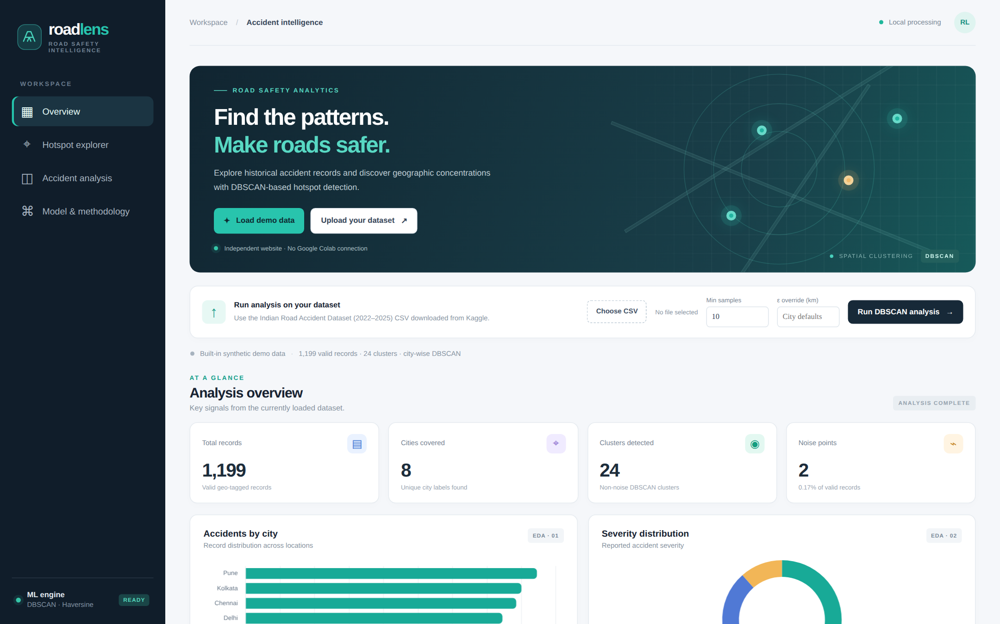
Demo: Home & Input Screens
16 • SCREENSHOTS
Home page
Hero, navigation and a built-in demo dataset
1
Input screen
Upload CSV, set min_samples and optional eps
2
Processing
‘Run DBSCAN analysis’ clusters each city
3
Output screen
Metrics, charts, map and hotspot table
4
Synthetic demo data — illustration only
Notes:
Screenshots of the RoadLens Flask website running on the built-in synthetic demo data.

Slide 19
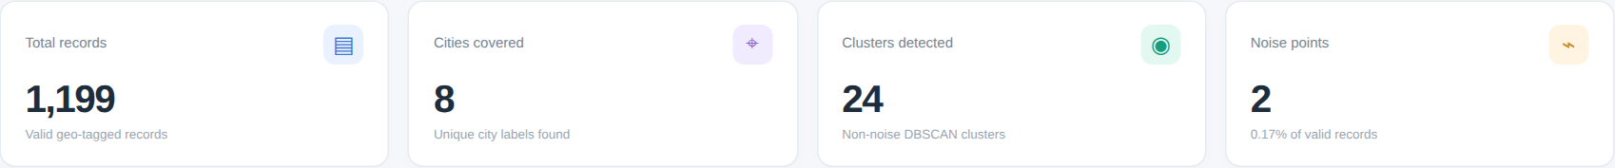

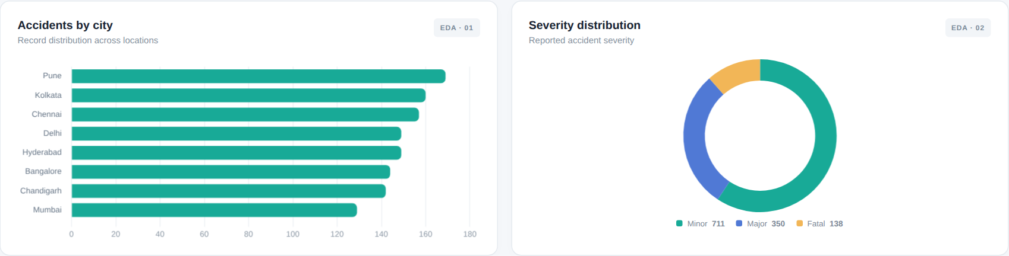
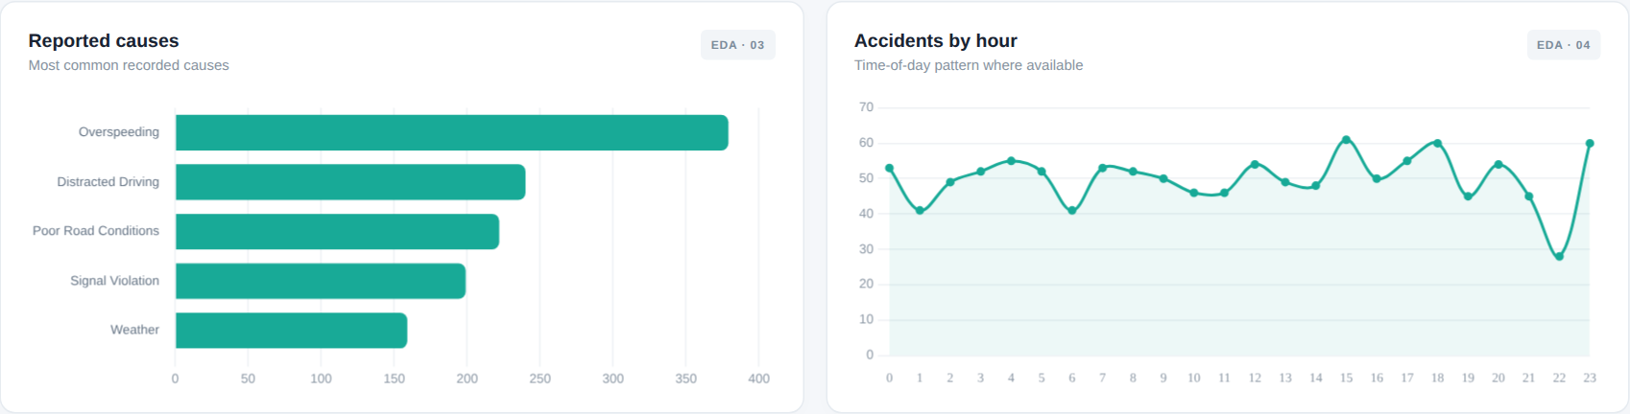

Demo: Analysis Dashboard
16 • SCREENSHOTS
Overview metrics
Records, cities, clusters and noise at a glance
EDA charts
City, severity, cause, hour, density and weather
Live recompute
Change parameters and re-run the analysis
Synthetic demo data — illustration only
Notes:
EDA charts produced by the dashboard: accidents by city, severity, causes and hour, traffic density and weather.

Slide 20
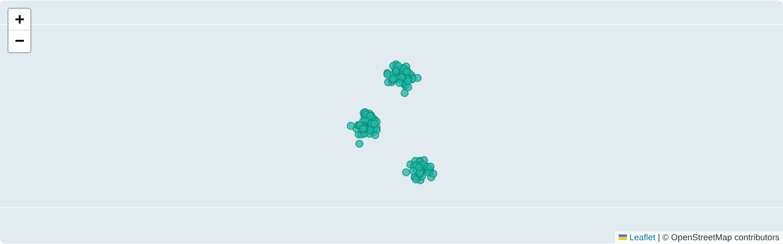

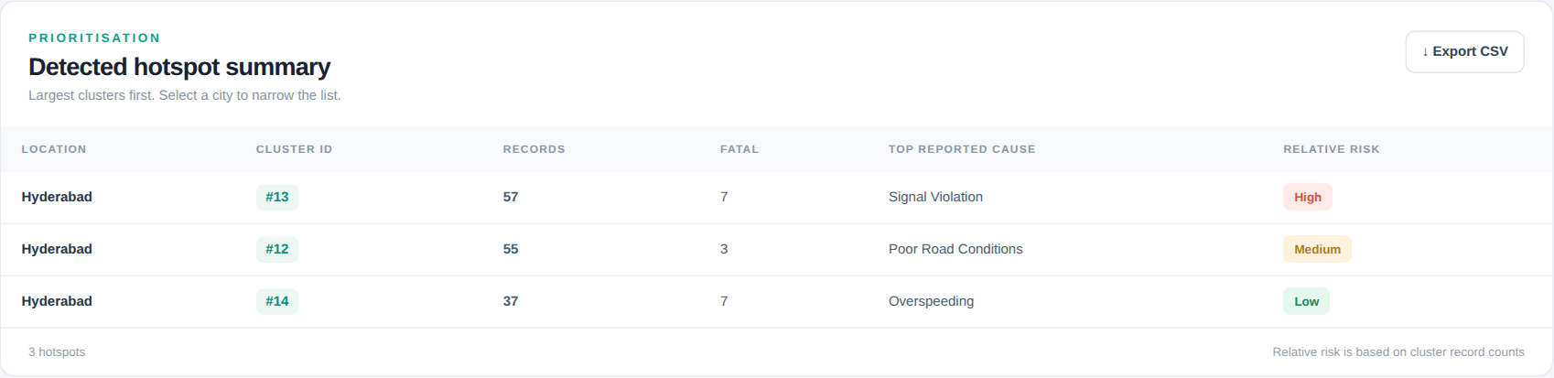

Demo: Hotspot Map & Summary
16 • SCREENSHOTS
Hotspot explorer
Clusters vs noise points, filter by city
Hotspot summary
Cluster id, records, fatal, top cause, relative risk
Export
Download detected hotspots as CSV
Synthetic demo data — illustration only
Notes:
Map and table for Hyderabad in the demo data. Relative risk is based on cluster record counts (33rd and 66th percentiles).

Slide 21





Advantages
17 • BENEFITS
No preset cluster count
Any hotspot shape
Anomaly-aware
DBSCAN discovers the number of hotspots from the data itself.
Follows roads and corridors instead of forcing round clusters.
Isolated incidents are flagged as noise, not forced into hotspots.
Automated and scalable
Actionable outputs
Open and low cost
Replaces slow manual review; city-wise runs handle large data.
Risk levels, maps and a CSV make prioritisation simple.
Free Python tools; runs on a standard laptop.
Notes:
Benefits and improvements over the existing manual and centroid-based approaches.

Slide 22





Applications
18 • USE CASES
Smart-city traffic management
Prioritise junctions and corridors
Road-safety analysis
Find recurring accident locations
TARGET USERS
Traffic authorities and road agencies
Urban and transport planners
Emergency services
Insurance companies
Researchers and students
Accident-prevention planning
Target engineering and enforcement
Emergency-response optimisation
Position resources near hotspots
Insurance risk assessment
Inform location-based risk models
Notes:
Real-world applications and target users from the abstract.

Slide 23
Limitations
19 • CONSTRAINTS
Current limitations
Dataset & technical constraints
Shows historical concentrations, not predictions of future crashes
Risk levels are relative to cluster sizes — not calibrated probabilities
Results are sensitive to the eps and min_samples choices
No live data: hotspots update only when a new CSV is run
Depends on reporting coverage and quality of geo-tags
Records without valid latitude/longitude are dropped
Silhouette / DBI need 2+ clusters and ≤ 5,000 clustered points
Map view capped at 12,000 points; map tiles need internet
Notes:
Be upfront: DBSCAN finds historical concentrations; results depend on data quality and parameter choice.

Slide 24




Future Scope
20 • ROADMAP
1
2
3
4
5
Real-time reporting
Dynamic hotspots
Web & mobile app
Deep learning
Safer routing
Ingest accident reports as they happen.
Combine live GPS, weather and traffic data.
Cloud-hosted app for authorities and citizens.
Predict accident severity for each hotspot.
Recommend alternative routes that avoid hotspots.
Notes:
Possible improvements: real-time reporting, dynamic hotspots, web/mobile deployment, deep-learning severity prediction and safer-route recommendation.

Slide 25


Conclusion
21 • SUMMARY
What was achieved
Key outcome
Overall contribution
An end-to-end pipeline — cleaning, EDA, city-wise DBSCAN and evaluation — with an interactive RoadLens dashboard.
Recurring accident hotspots and isolated anomalies are separated automatically, without presetting the number of clusters.
A reusable, low-cost and explainable approach that helps authorities prioritise road-safety interventions.
Find the patterns. Make roads safer.
Notes:
Close by summarising what was built, the key outcome and the contribution.

Slide 26
Thank You
REFERENCES
Ester, Kriegel, Sander, Xu (1996). A density-based algorithm for discovering clusters in large spatial databases with noise. KDD-96.
Pedregosa et al. (2011). Scikit-learn: Machine Learning in Python. JMLR 12.
Indian Road Accident Dataset 2022–2025, Kaggle (sehaj1104).
Questions & Discussion
Bathula Neha • 2520090013
Veeramallu Rohita Sai Lakshmi • 2520090235
Koumudi • 2520090161
Guide: Haritha, Assistant Professor, Dept. of CSIT
DEPARTMENT OF CSIT | KL UNIVERSITY
Notes:
Invite questions.

