Slide 1
Terps & Burps
Group: 0501-09
Vrinda Bhatu, Atharva Patil, Rakshit Sinha, Neha Ambekar

Slide 2
Background
This platform is built for students of UMD who are looking for recommendations for restaurants nearby.
Each user is identified by a unique UserId.
The types of users are Restaurants and Reviewers.
Each Reviewer can submit two types of reviews for a business: Review and Suggestions.
The data has been scraped from yelp.com.

Slide 3
Introduction
Mission Statement
To create a platform in which users can search for information regarding restaurants as
well as for reviews or suggestions for any restaurants which have been posted by other
users who have been to these restaurants. Users can also check the credibility of
other users based on the rating their reviews have received.
Mission Objectives
User can get all information regarding a restaurant in a single report.
User can then look for reviews for a particular restaurant.
User can also look for suggestions for a particular restaurant.
User can check the credibility of the reviewers by looking at the rating received by the reviewer.

Slide 4
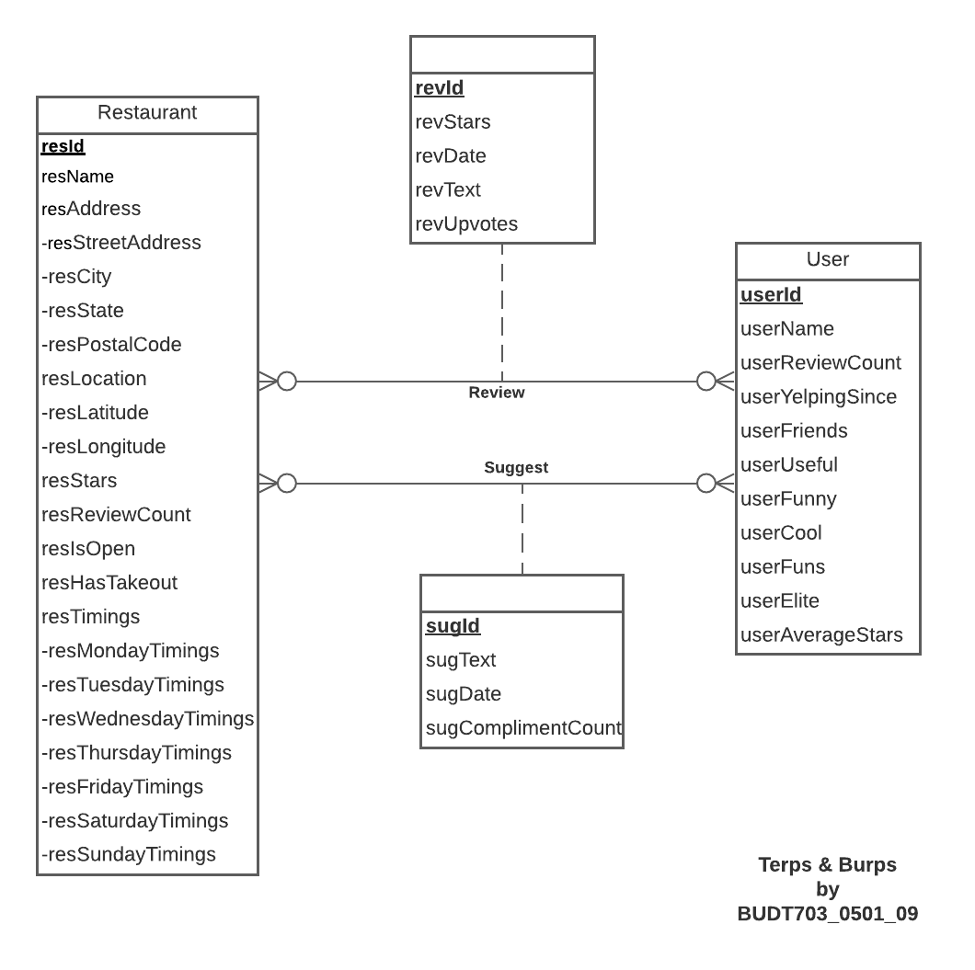
Conceptual Database Design: ER DIAGRAM

Slide 5
Logical Database Design:
Relational Schema
Restaurant (resId, resName, resStreetAddress, resCity, resState, resPostalCode, resLatitude, resLongitude, resStars, resReviewCount, resIsOpen, resHasTakeout, resMondayTimings, resTuesdayTimings, resWednesdayTimings, resThursdayTimings, resFridayTimings, resSaturdayTimings, resSundayTimings)
User (userId, userName, userReviewCount, userYelpingSince, userFriends, userUseful, userFunny, userCool, userFuns, userElite, userAverageStars)
Review (revId, revStars, revDate, revText, revUpvotes, userId, resId)
Suggest (sugId, sugText, sugDate, sugComplimentCount, userId, resId)

Slide 6
Physical Database Design
-- Creating table for Review
CREATE TABLE [TerpsandBurps.Review] (
revId VARCHAR(23) NOT NULL,
userId VARCHAR(23) NOT NULL,
resId VARCHAR(50) NOT NULL,
revStars DECIMAL(3),
revDate DATE,
revText VARCHAR(5000),
revUpvotes INT,
CONSTRAINT pk_Review_revId PRIMARY KEY (revId),
CONSTRAINT fk_Review_userId FOREIGN KEY (userId)
REFERENCES [TerpsandBurps.User] (userId)
ON DELETE CASCADE ON UPDATE CASCADE,
CONSTRAINT fk_Review_resId FOREIGN KEY (resId)
REFERENCES [TerpsandBurps.Restaurant] (resId)
ON DELETE CASCADE ON UPDATE CASCADE);

Slide 7
Use Cases and Application
Use Case 1) View for getting all information regarding a restaurant in a single report.
CREATE VIEW [Restaurant_Report] AS
SELECT [resName] AS 'Restaurant Name', CONCAT([resStreetAddress],', ',[resCity],',
', [resState],', ',[resPostalCode]) AS 'Restaurant Address',
[resStars] AS 'Restaurant Rating', [resReviewCount] AS 'Number of reviews
received', CASE WHEN ( [resHasTakeout] =1 ) THEN 'YES' ELSE 'NO' END
AS 'Offers Takeout', CONCAT('MONDAY: ',[resMondayTimings],'TUESDAY: ',
[resTuesdayTimings],'WEDNESDAY: ',[resWednesdayTimings],'THURSDAY: ',
[resThursdayTimings],
'FRIDAY: ',[resFridayTimings], 'SATURDAY: ', [resSaturdayTimings], 'SUNDAY: ',
[resSundayTimings]) AS 'Restaurant Timings'
FROM [BUDT703_Project_0501_09].[dbo].[TerpsandBurps.Restaurant] res;

Slide 8
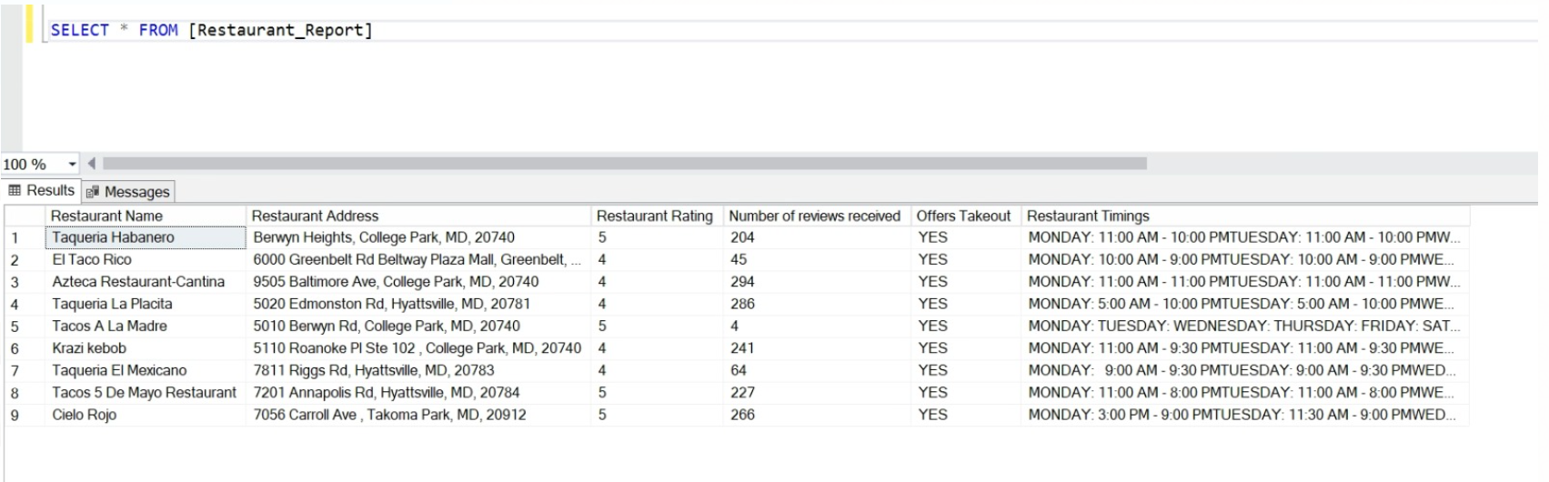
Application
Use Case 1) View for getting all information regarding a restaurant in a single report.

Slide 9
Application
Use Case 2) View for the user to check the credibility of the reviewer by checking the rating of the reviewer.
CREATE VIEW [User_Credibility_Report] AS
SELECT u.[userName] AS 'Name of the Reviewer', u.[userReviewCount] AS 'Number of
reviews submitted by Reviewer', u.[userYelpingSince] AS 'When the Reviewer joined
Terps & Burps',
u.[userFriends] AS 'Number of friends', u.[userUseful] AS 'Count of users that
found the review useful', u.[userAverageStars] AS 'The average rating of all
ratings provided by Reviewer',
CASE WHEN ((u.[userElite] = 1 ) and (u.[userFriends] >100) and (u.
[userReviewCount] > 50) and (u.[userUseful] > 500)) THEN 'Highly Credible' ELSE
'Moderately Credible' END AS 'Reviewer Credibility'
FROM [BUDT703_Project_0501_09].[dbo].[TerpsandBurps.User] u ;

Slide 10
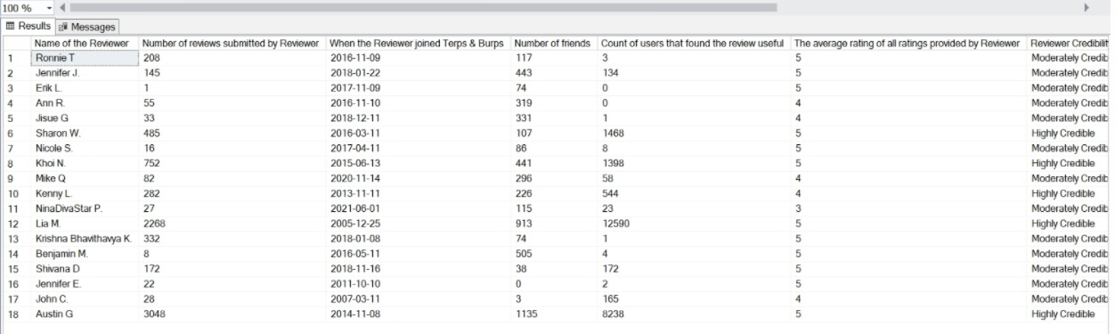
Application
Business question 4) View for the user to check the credibility of the reviewer by checking the rating of the reviewer.

Slide 11
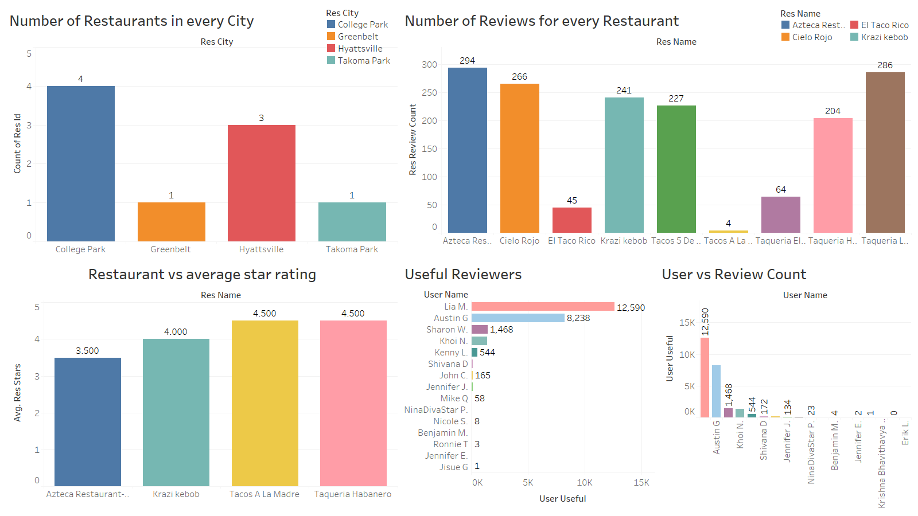
Tableau Dashboard for Data Visualization

Slide 12
Thank You

