Slide 1
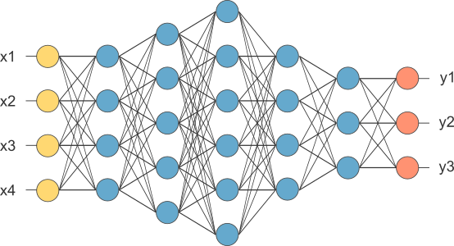
RNN
This is our fully connected network. If x_{1 .}... x_{n}, n is very large and growing,
this network would become too large. We now will input one x_{i} at a time,
and re-use the same edge weights.

Slide 2
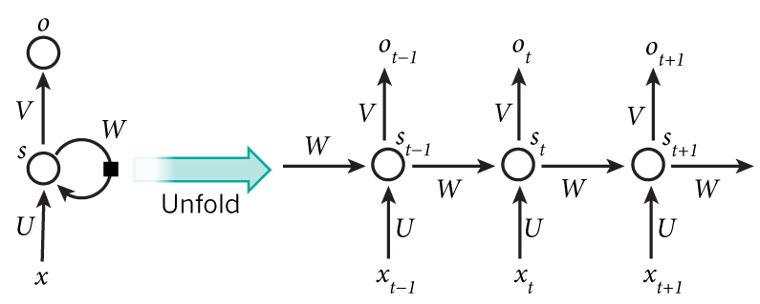
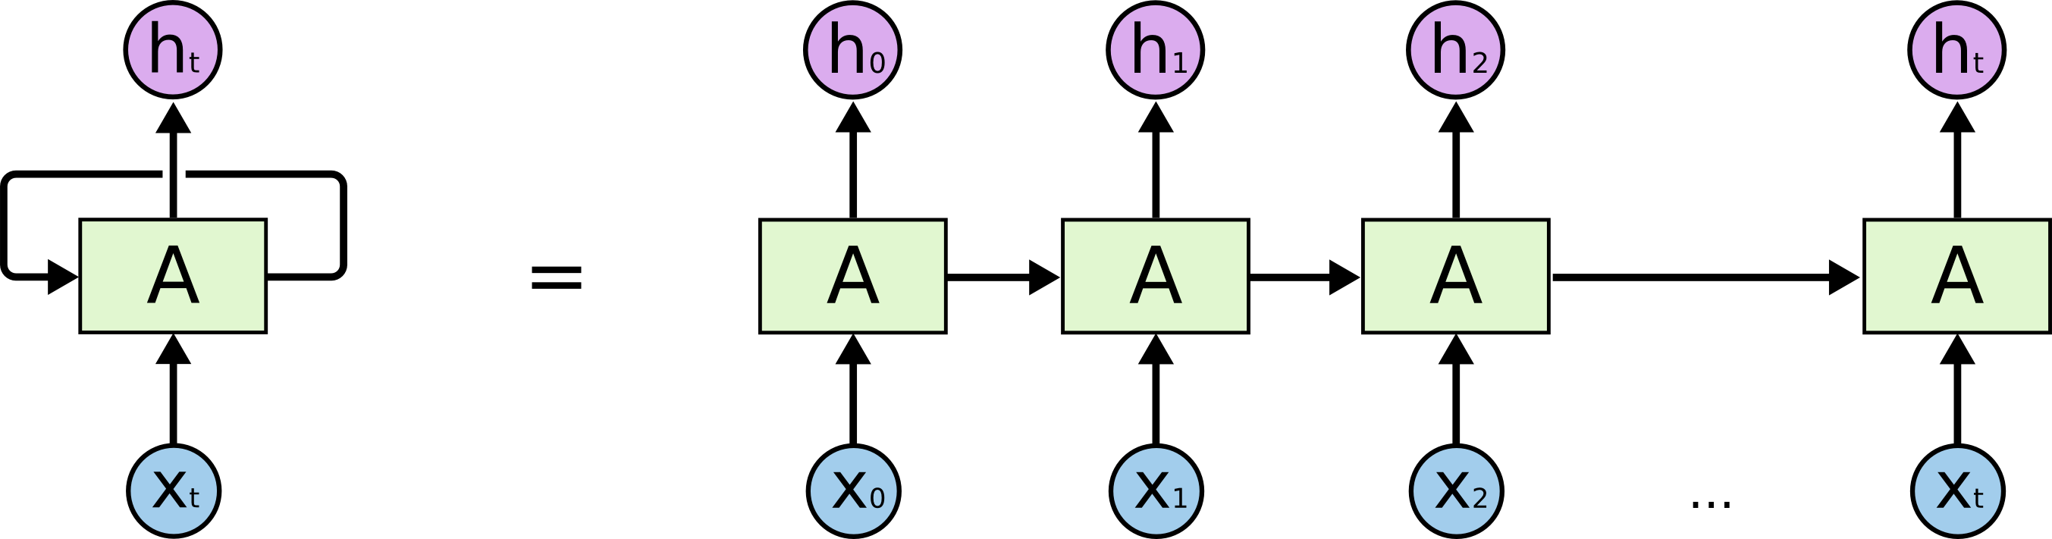
Recurrent Neural Network

Slide 3
How does RNN reduce complexity?
Given function f: h’,y=f(h,x)
h and h’ are vectors with the same dimension
y¹
y²
y³
h⁰
f
h¹
f
h²
f
h³
……
x¹
x²
x³
No matter how long the input/output sequence is, we only need one function f. If f’s are different, then it becomes a feedforward NN. This may be treated as another compression from fully connected network.

Slide 4

Deep RNN
h’,y = f₁(h,x), g’,z = f₂(g,y)
…
…
…
z¹
z²
z³
g⁰
f₂
g¹
f₂
g²
f₂
g³
……
y¹
y²
y³
h⁰
f₁
h¹
f₁
h²
f₁
h³
……
x¹
x²
x³

Slide 5
Bidirectional RNN
y,h=f₁(x,h)
z,g = f₂(g,x)
x¹
x²
x³
g⁰
f₂
g¹
f₂
g²
f₂
g³
z¹
z²
z³
p¹
p²
p³
p=f₃(y,z)
f₃
f₃
f₃
y¹
y²
y³
h⁰
f₁
h¹
f₁
h²
f₁
h³
x¹
x²
x³

Slide 6
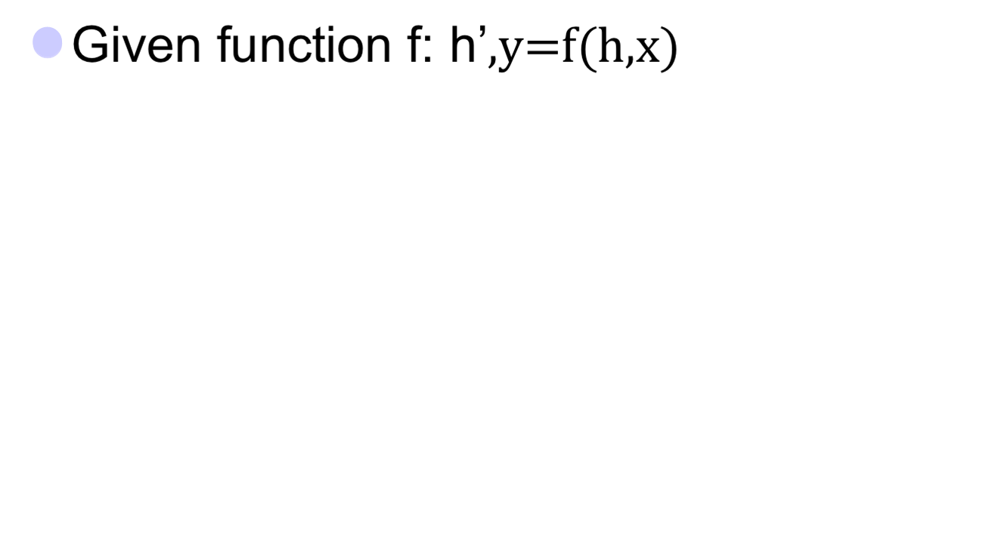


Naïve RNN
y
h'
W^{h}
^{h}
W^{i}
x
h
f
h'
y
Wº
^{h’}
Note, y is computed
from h’
x
softmax
We have ignored the bias

Slide 7
Problems with naive RNN
When dealing with a time series, it tends to forget old information. When there is a distant relationship of unknown length, we wish to have a “memory” to it.
Vanishing gradient problem.

Slide 8
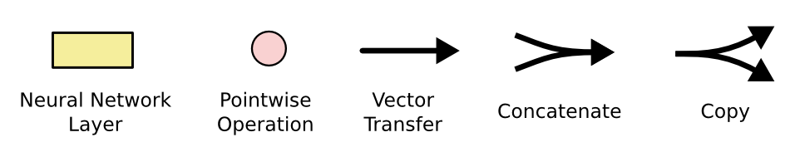
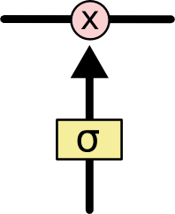
The sigmoid layer outputs numbers between 0-1 determine how much
each component should be let through. Pink X gate is point-wise multiplication.

Slide 9
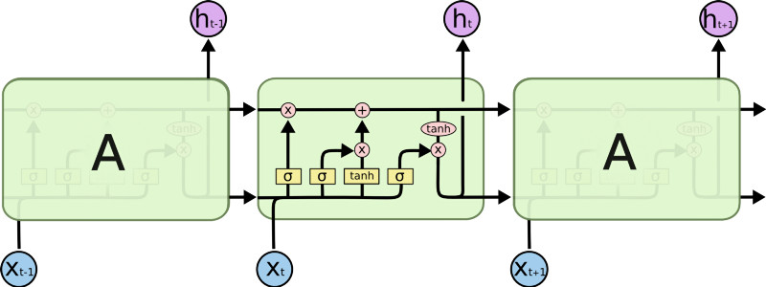
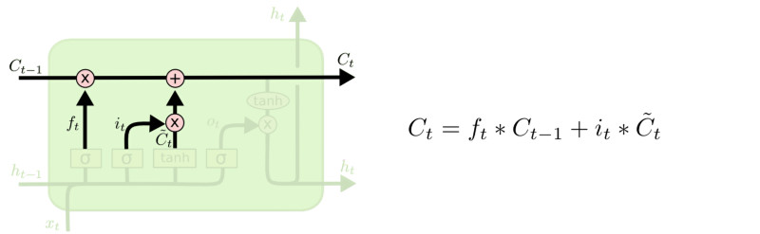
LSTM
Output gate
Controls what
goes into output
This decides what info
Is to add to the cell state
This sigmoid gate
determines how much
information goes thru
C_{t-1}
h_{t-1}
Why sigmoid or tanh:
Sigmoid: 0,1 gating as switch.
Vanishing gradient problem in
LSTM is handled already.
ReLU replaces tanh ok?
Forget input
gate gate
The core idea is this cell state C_{t}, it is changed slowly, with only minor linear interactions. It is very easy for information to flow along it unchanged.

Slide 10
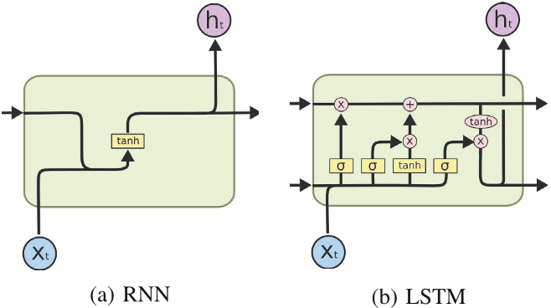
RNN vs LSTM

Slide 11
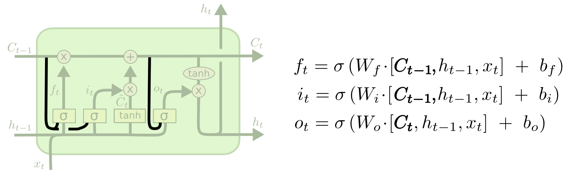
Peephole LSTM
Allows “peeping into the memory”

Slide 12
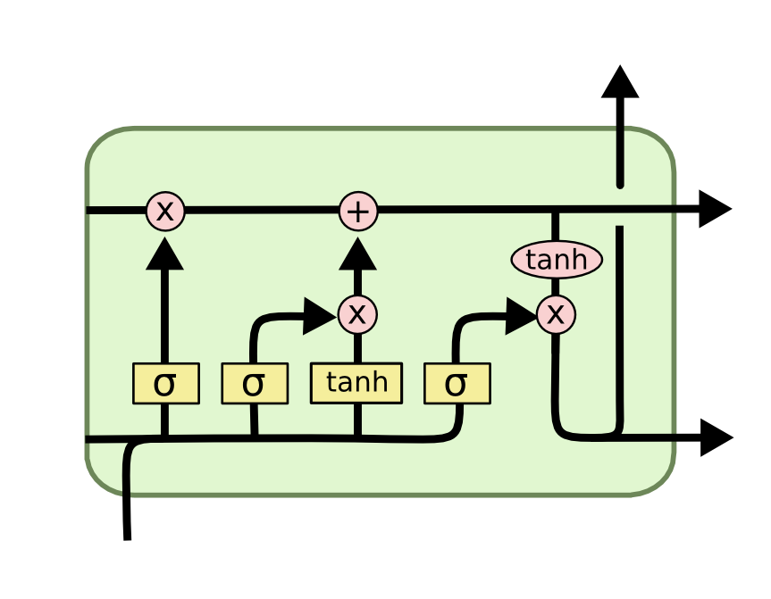
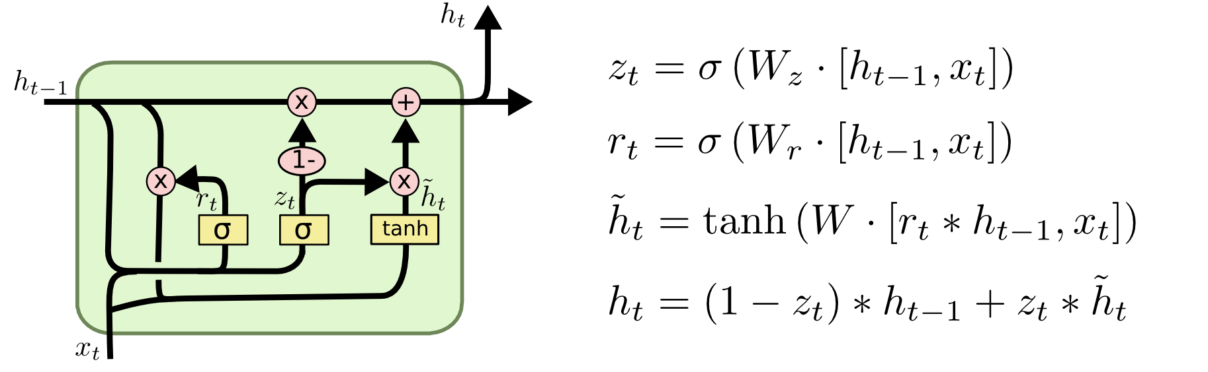
GRU – gated recurrent unit
(more compression)
LSTM
reset gate
Update gate
It combines the forget and input into a single update gate.
It also merges the cell state and hidden state. This is simpler
than LSTM. There are many other variants too.
X,*: element-wise multiply

Slide 13
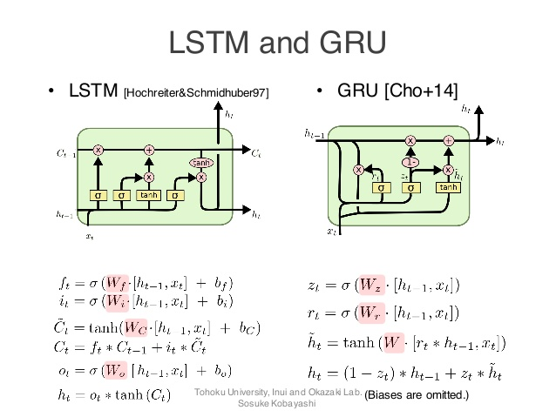
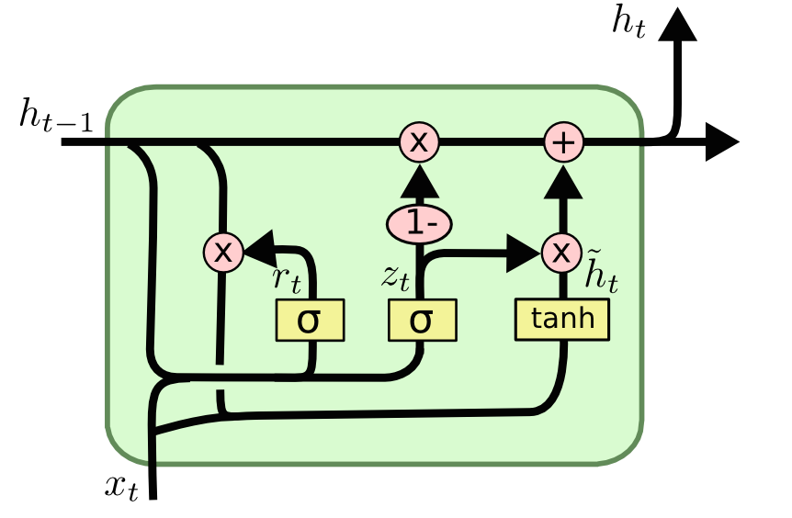
GRUs also takes x_{t} and h_{t-1} as inputs. They perform some calculations and then pass along h_{t}. What makes them different from LSTMs is that GRUs don't need the cell layer to pass values along. The calculations within each iteration insure that the h_{t} values being passed along either retain a high amount of old information or are jump-started with a high amount of new information.

Slide 14
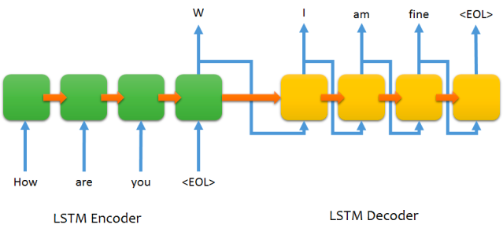
Sequence to sequence chat model

Slide 15

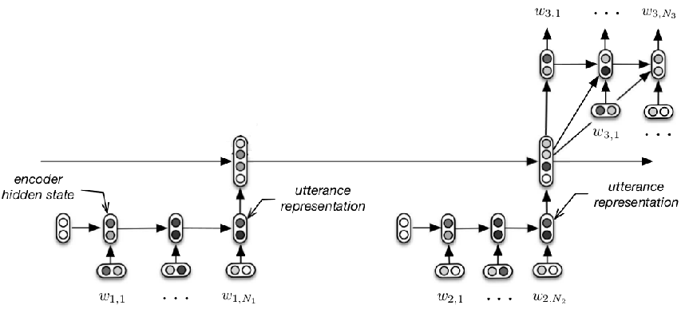
Chat with context
M: Hi
M: Hello
U: Hi
M: Hi
M: Hello
U: Hi
Serban, Iulian V., Alessandro Sordoni, Yoshua Bengio, Aaron Courville, and Joelle Pineau, 2015 "Building End-To-End Dialogue Systems Using Generative Hierarchical Neural Network Models.

Slide 16
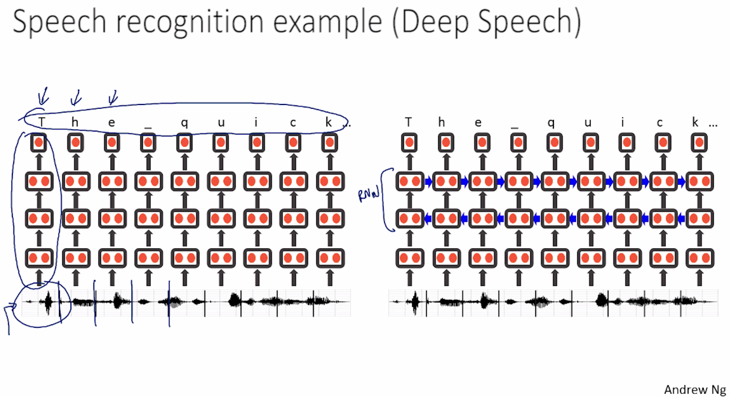
Baidu’s speech recognition using RNN

Slide 17
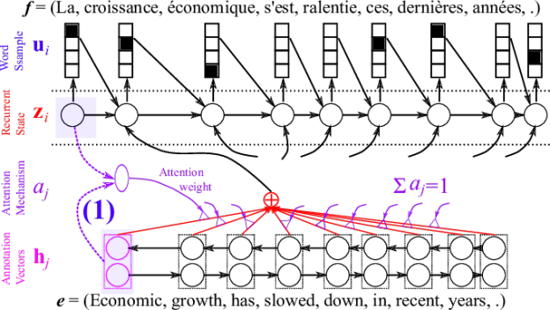
Attention

