Slide 1
Unsupervised Learning
Clustering and Autoencoders

Slide 2
Supervised learning vs. unsupervised learning
Supervised learning: discover patterns in the data that relate data attributes with a target (class) attribute.
  These patterns are then utilized to predict the values of the target attribute in future data instances
Unsupervised learning: The data have no target attribute.
  We want to explore the data to find some intrinsic structures in them.

Slide 3
What is Cluster Analysis?
Finding groups of objects in data such that the objects in a group will be similar (or related) to one another and different from (or unrelated to) the objects in other groups
Inter-cluster distances are maximized
Intra-cluster distances are minimized

Slide 4
What is clustering for?
Let us see some real-life examples
Example 1: groups people of similar sizes together to make “small”, “medium” and “large” T-Shirts.
  Tailor-made for each person: too expensive
  One-size-fits-all: does not fit all.
Example 2: In marketing, segment customers according to their similarities
  To do targeted marketing.

Slide 5
What is clustering for? (cont…)
Example 3: Given a collection of text documents, we want to organize them according to their content similarities,
  To produce a topic hierarchy
In fact, clustering is one of the most utilized data mining techniques.
  It has a long history, and used in almost every field, e.g., medicine, psychology, botany, sociology, biology, archeology, marketing, insurance, libraries, etc.
  In recent years, due to the rapid increase of online documents, text clustering becomes important.

Slide 6
Types of Clusterings
A clustering is a set of clusters
Important distinction between hierarchical and partitional sets of clusters
Partitional Clustering
  A division data objects into non-overlapping subsets (clusters) such that each data object is in exactly one subset
Hierarchical clustering
  A set of nested clusters organized as a hierarchical tree

Slide 7

Partitional Clustering
(Bölümsel Kümeleme)
Original Points
A Partitional Clustering

Slide 8
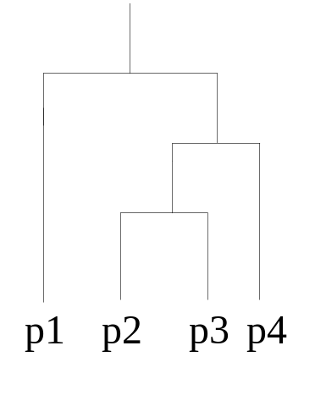
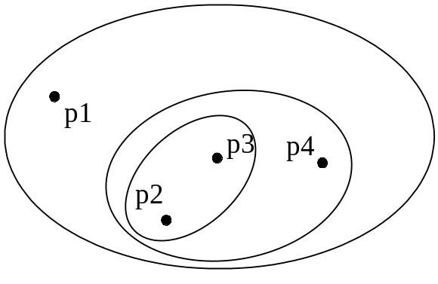
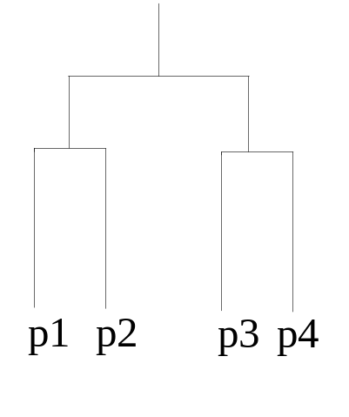
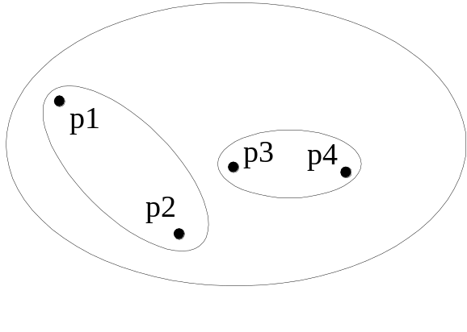
Hierarchical Clustering
(Hiyerarşik Kümeleme)
Traditional Hierarchical Clustering
Traditional Dendrogram
Non-traditional Hierarchical Clustering
Non-traditional Dendrogram

Slide 9
Clustering Algorithms
K-means
Hierarchical clustering
Density-based clustering

Slide 10
K-means clustering
K-means is a partitional clustering algorithm
Let the set of data points (or instances) D be
{x₁, x₂, …, x_{n}},
  where x_{i} = (x_{i1}, x_{i2}, …, x_{ir}) is a vector in a real-valued space X ⊆ R^{r}, and r is the number of attributes (dimensions) in the data.
The k-means algorithm partitions the given data into k clusters.
  Each cluster has a cluster center, called centroid.
  k is specified by the user

Slide 11
K-means Clustering – Details
Initial centroids are often chosen randomly.
  Clusters produced vary from one run to another.
The centroid is (typically) the mean of the points in the cluster.
‘Closeness’ is measured by Euclidean distance, cosine similarity, correlation, etc.
K-means will converge for common similarity measures mentioned above.
Most of the convergence happens in the first few iterations.
  Often the stopping condition is changed to ‘Until relatively few points change clusters’
Complexity is O( n * K * I * d )
  n = number of points, K = number of clusters,
  I = number of iterations, d = number of attributes

Slide 12



Two different K-means Clusterings
Original Points
Optimal Clustering
Sub-optimal Clustering

Slide 13
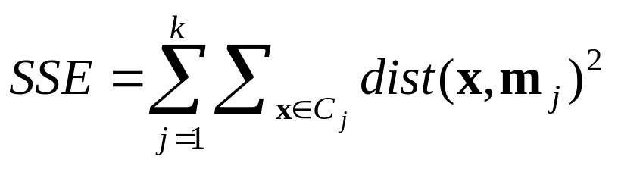
Evaluating K-means Clusters
Most common measure is Sum of Squared Error (SSE)
  For each point, the error is the distance to the nearest cluster
  Given two clusters, we can choose the one with the smallest error
  One easy way to reduce SSE is to increase K, the number of clusters
    A good clustering with smaller K can have a lower SSE than a poor clustering with higher K

Slide 14
Limitations of K-means
K-means has problems when clusters are of differing
  Sizes
  Densities
  Non-globular shapes
K-means has problems when the data contains outliers.

Slide 15


Hierarchical Clustering
Produces a set of nested clusters organized as a hierarchical tree
Can be visualized as a dendrogram
  A tree like diagram that records the sequences of merges or splits

Slide 16
Strengths of Hierarchical Clustering
Do not have to assume any particular number of clusters
  Any desired number of clusters can be obtained by ‘cutting’ the dendogram at the proper level
They may correspond to meaningful taxonomies
  Example in biological sciences (e.g., animal kingdom, phylogeny reconstruction, …)

Slide 17
Hierarchical Clustering
Two main types of hierarchical clustering
  Agglomerative:
    Start with the points as individual clusters
    At each step, merge the closest pair of clusters until only one cluster (or k clusters) left
  Divisive:
    Start with one, all-inclusive cluster
    At each step, split a cluster until each cluster contains a point (or there are k clusters)
Traditional hierarchical algorithms use a similarity or distance matrix
  Merge or split one cluster at a time

Slide 18
Agglomerative Clustering Algorithm
More popular hierarchical clustering technique
Basic algorithm is straightforward
  Compute the proximity matrix
  Let each data point be a cluster
  Repeat
  Merge the two closest clusters
  Update the proximity matrix
  Until only a single cluster remains
Key operation is the computation of the proximity of two clusters
  Different approaches to defining the distance between clusters distinguish the different algorithms

Slide 19
computation of the proximity of two clusters
Similarity?
MIN
MAX
Group Average
Distance Between Centroids
Other methods driven by an objective function
  Ward’s Method uses squared error

Slide 20
Hierarchical clustering
Pros
Dendogramsare great for visualization
Provides hierarchical relations between clusters
Shown to be able to capture concentric clusters
Cons
Not easy to define levels for clusters
Experiments showed that other clustering techniques outperform hierarchical clustering

Slide 21
DBSCAN: Density-Based Clustering
DBSCAN is a Density-Based Clustering algorithm
Reminder: In density based clustering we partition points into dense regions separated by not-so-dense regions.
Important Questions:
  How do we measure density?
  What is a dense region?
DBSCAN:
  Density at point p: number of points within a circle of radius Eps
  Dense Region: A circle of radius Eps that contains at least MinPts points

Slide 22
DBSCAN
Characterization of points
  A point is a core point if it has more than a specified number of points (MinPts) within Eps
    These points belong in a dense region and are at the interior of a cluster
  A border point has fewer than MinPts within Eps, but is in the neighborhood of a core point.
  A noise point is any point that is not a core point or a border point.

Slide 23
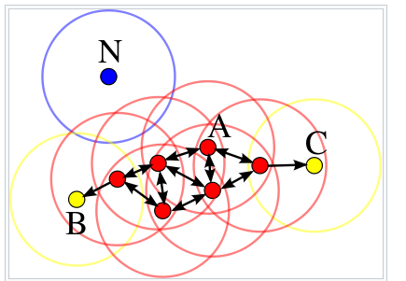
DBSCAN

Slide 24
AutoEncoder

Slide 25
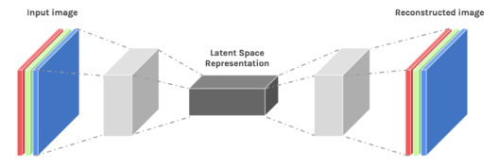
Autoencoders
Autoencoders are designed to reproduce their input, especially for images.
  Key point is to reproduce the input from a learned encoding.

Slide 26
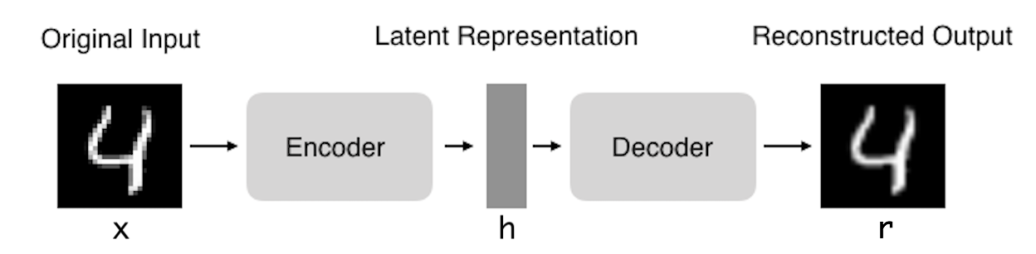
Autoencoders: structure
Encoder: compress input into a latent-space of usually smaller dimension. h = f(x)
Decoder: reconstruct input from the latent space. r = g(f(x)) with r as close to x as possible

Slide 27
Types Of AutoEncoders
Vanilla Autoencoder
Denoising Autoencoder
Sparse Autoencoder
Contractive Autoencoder
Stacked Autoencoder
Variational Autoencoder (VAE)

Slide 28
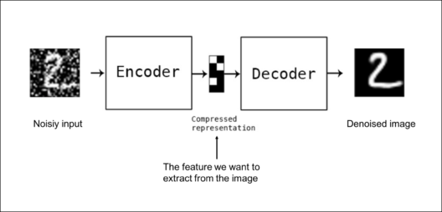
Autoencoders: applications
Denoising: input clean image + noise and train to reproduce the clean image.

Slide 29
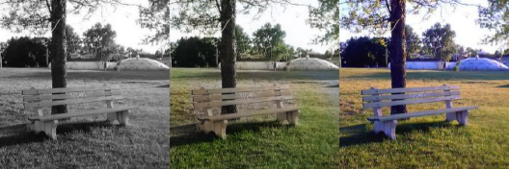
Autoencoders: Applications
Image colorization: input black and white and train to produce color images

Slide 30
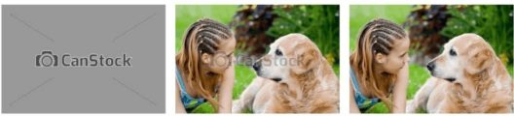
Autoencoders: Applications
Watermark removal

Slide 31
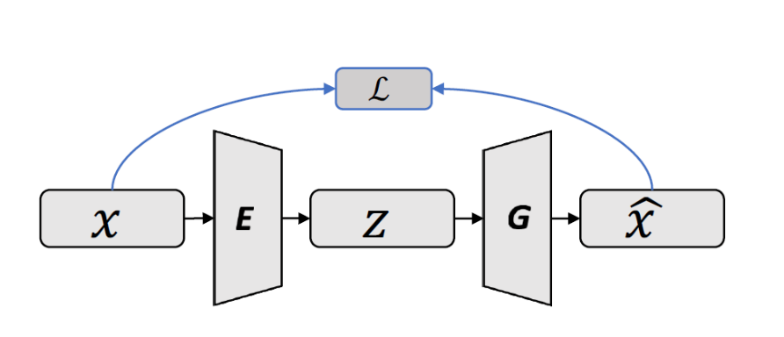
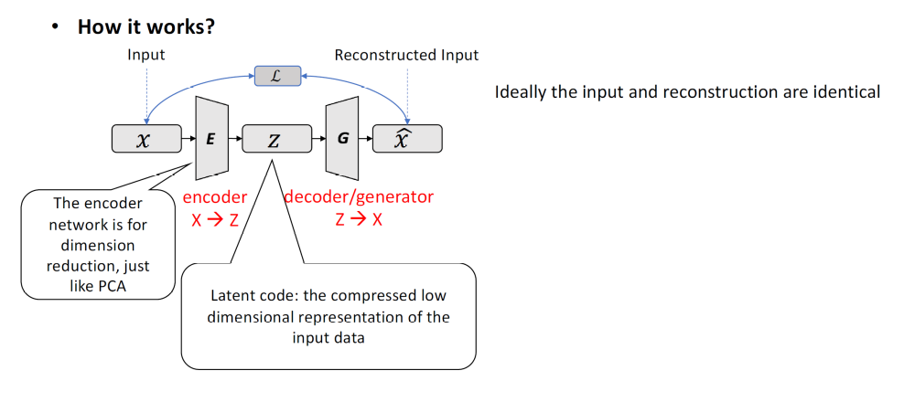
Auto-encoder
Reconstruct high-dimensional data using a neural network model with a narrow
bottleneck layer.
The bottleneck layer captures the compressed latent coding, so the nice by-product
is dimension reduction.
The low-dimensional representation can be used as the representation of the data
in various applications, e.g., image retrieval, data compression …

Slide 32

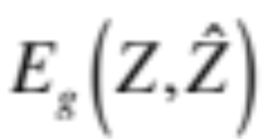
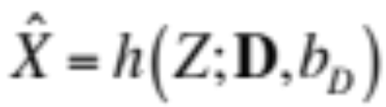
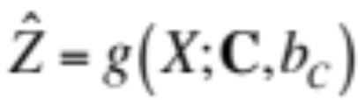
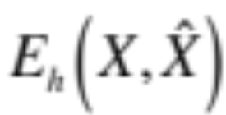

Auto-encoder
Code
Encoding
“energy”
Input
decoding
Code
prediction
Decoding
“energy”
Input

Slide 33
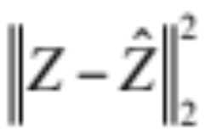
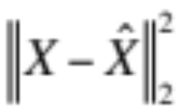
Auto-encoder
Code
Encoding
energy
Input
decoding
Code
prediction
Decoding
energy
Input

Slide 34
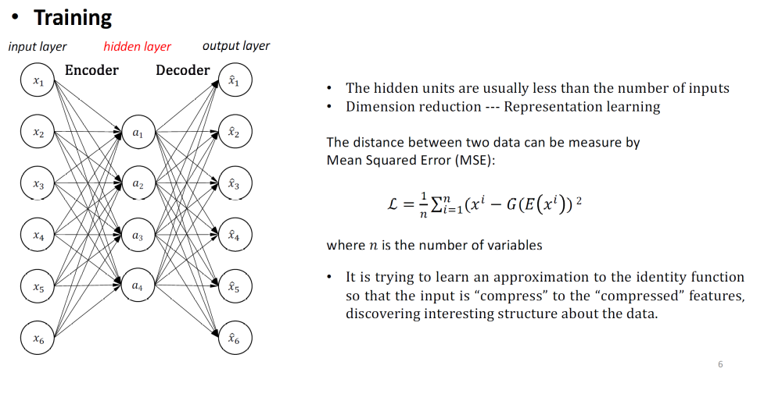
Auto-encoder

Slide 35
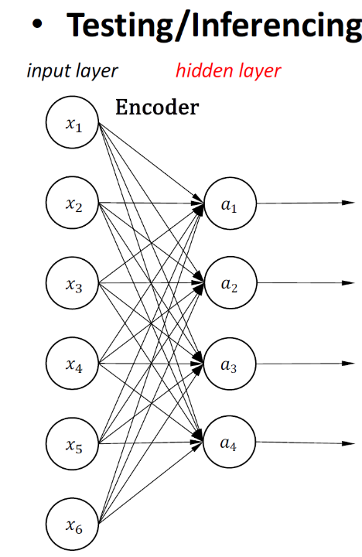
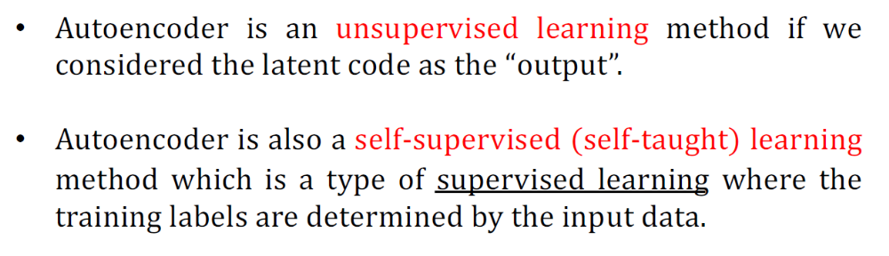
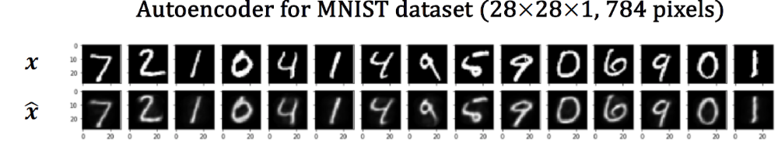
Auto-encoder
Extracted Features

Slide 36
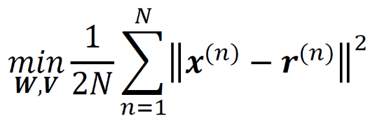
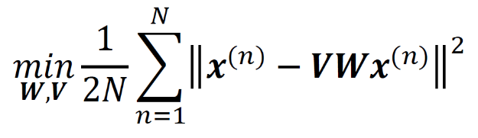
Undercomplete Autoencoders
If the code dimension is larger than the input dimension, an autoencoder tends to learn 𝑔∘𝑓as a identity function.
An autoencoder whose code dimension is smaller than the input dimension is called undercomplete.
When the encoder and decoder are linear and L is the mean squared error, an undercomplete autoencoder learns to span the same subspace as PCA.
Define 𝒉=𝑓(𝑾𝒙); 𝒓=𝑔(𝑽𝒉)
Goal
If f and g are linear
In other words, the optimal solution is PCA

Slide 37
Undercomplete Autoencoders
Problem:
Undercomplete autoencoders can also fail to learn anything useful if the encoder and decoder are given too much capacity e.g. nonlinearity.
Solution:
Add a loss function that encourages the model to have other properties besides the ability to copy its input to its output:
Sparsity of the representation
Robustness to noise or to missing inputs
Smallness of the derivative of the representation

Slide 38
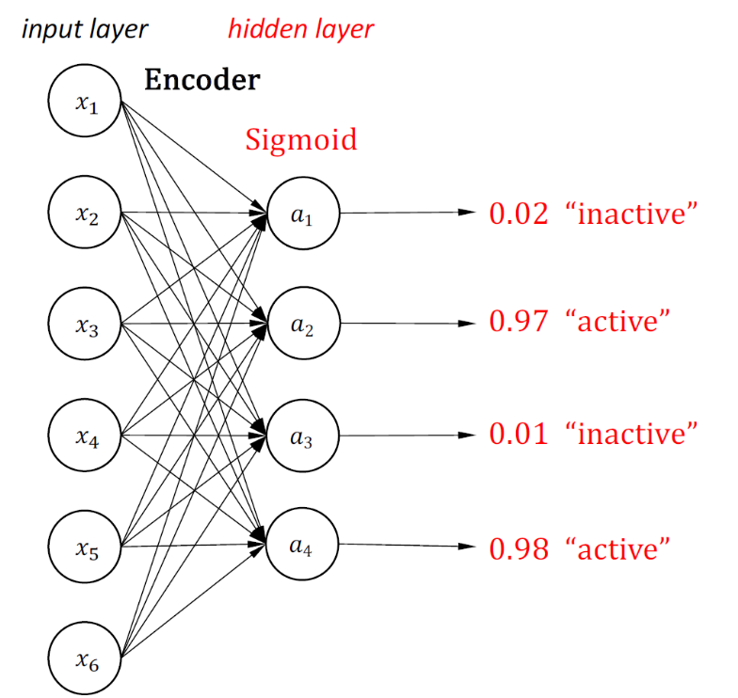
Sparse Autoencoders
Why?
Even when the number of hidden units is large (perhaps even greater than the number of input pixels), we can still discover interesting structure, by imposing other constraints on the network.
In particular, if we impose a ”‘sparsity”’ constraint on the hidden units, then the autoencoder will still discover interesting structure in the data, even if the number of hidden units is large.

Slide 39
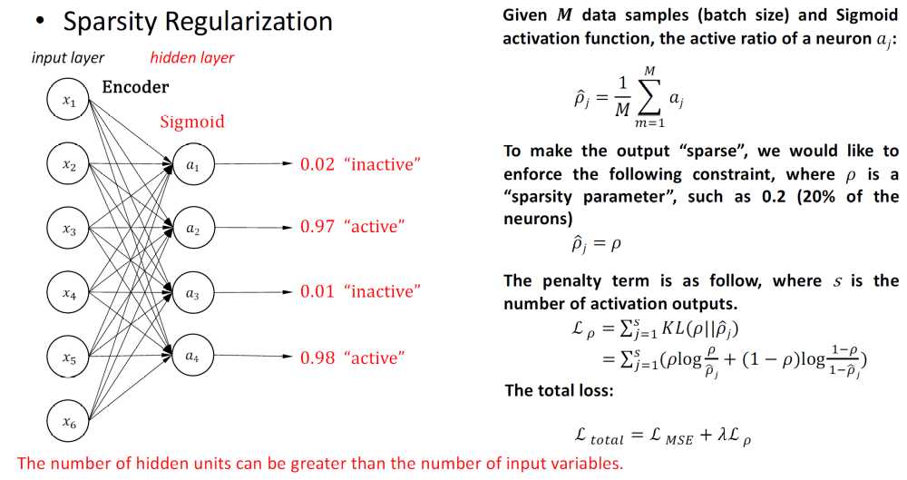
Sparse Autoencoders

Slide 40
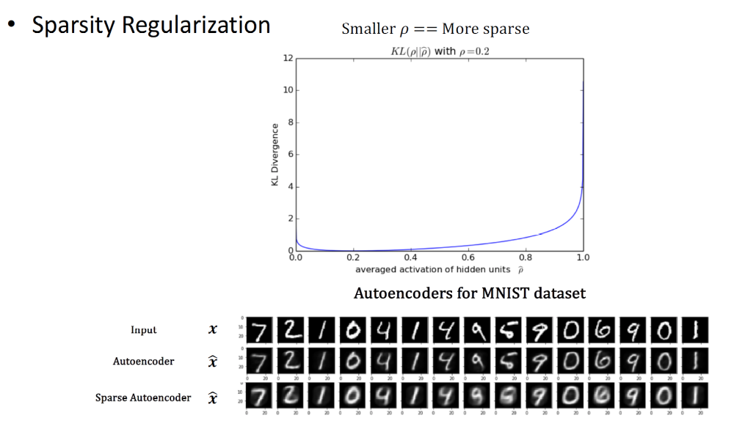
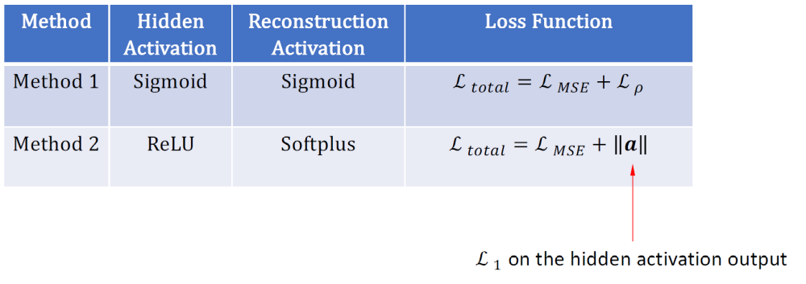
Sparse Autoencoders

Slide 41
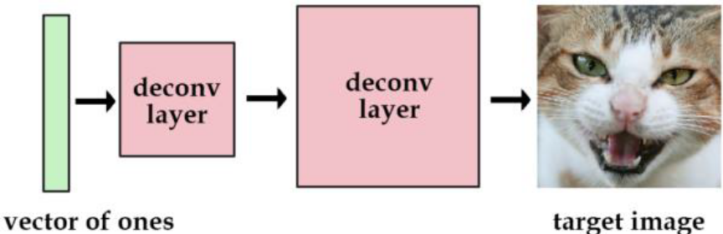
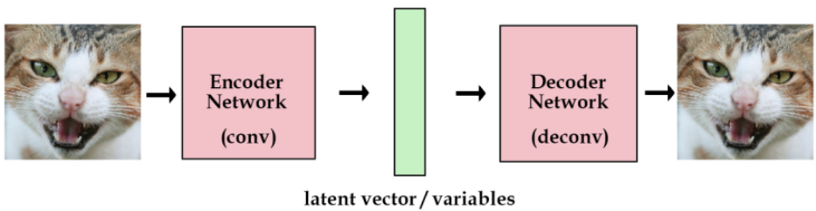
Variational Autoencoders
Train the network to reduce the mean squared error between the deconvoluted image and the target image.
The "data" for that image is now contained within the network's parameters.
Use real vector (latent variable) to remember more images
Choosing the latent variables randomly is a bad idea.
In an autoencoder, we add in another component that takes in the original images and encodes them into vectors for us.

Slide 42
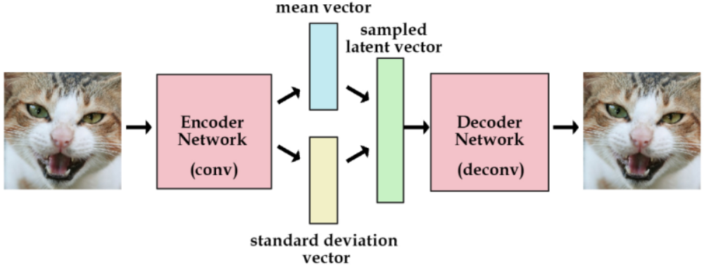
Variational Autoencoders
Loss Function
MSE regularization
In order to optimize the KL divergence, we need to apply a simple reparameterization trick:
Instead of the encoder generating a vector of real values
It will generate a vector of means and a vector of standard deviations.
1. Encode the input
2. Predict means
3. Predict standard derivations
4. Use the predicted means and standard
derivations to sample new latent
variables individually
5. Reconstruct the input

Slide 43

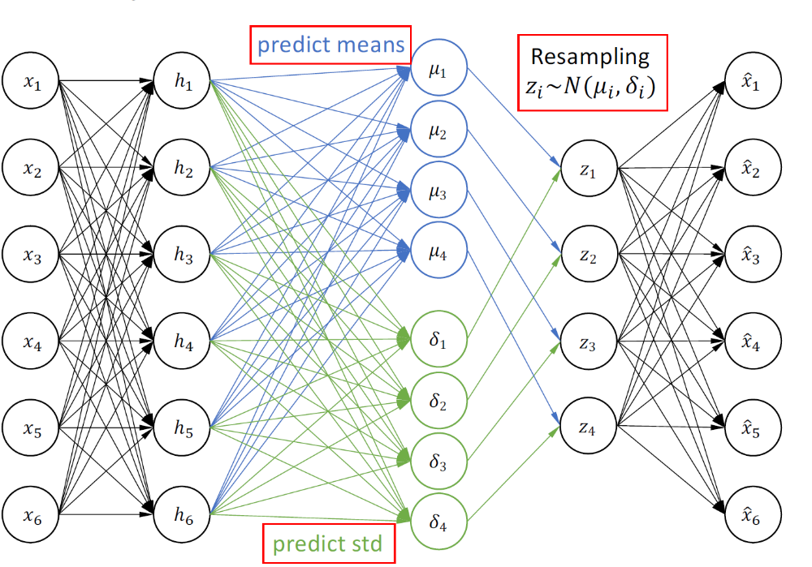
Variational Autoencoders
1. Encode the input
2. Predict means
3. Predict standard derivations
4. Use the predicted means and standard
derivations to sample new latent
variables individually
5. Reconstruct the input

