Slide 1


Department of CSE (AI & AIML)
Excel Automation With Python
Guide:
Prof. Bhagyashri Wankar
Group no:
CB-07
Name of Project Members:
B 03 Laxmi Aher
B 13 Neha Makru

Slide 2
Contents
Introduction
Justifications for Selecting the Title
Problem Statement
Study of Existing System
Proposed System
Work flow
Result
Conclusion
References

Slide 3
Introduction
Our Project, ‘Excel Automation With Python’ is about utilizing Python programming language to make excel operations automated. This is specially catering to the audiences who are not technically sound when it comes to using both Excel or using Python functionalities.
The format that we have used to create the end user project is Streamlit, the reason behind choosing this format is because it is easy to customize and also has a friendly interface, that would pose to be appealing and easy to navigate for end users.
The project aims to help individuals automate manual tasks like filtering the data within the dataset, creating interactive visualizations, computing the hypothesis test scores, implementing time series analysis and data aggregation, with just a few clicks, after uploading their respective excel or csv files into the model.

Slide 4
Justification For Selecting The Title
The title, "Excel Automation with Python," accurately reflects the project's purpose. It highlights the core idea of automating Excel-related tasks through Python, making processes like data analysis, visualization, and testing faster and simpler. The project is built to assist users in handling Excel operations with minimal manual effort, staying true to the title's promise. Further, this project can be used to perform data analysis, visualizations, hypothesis and statistical testing, and Time series analysis wherever possible, for both Excel as well as csv files.

Slide 5
Problem Statement
Problem Statement: Working with large datasets in Excel can be time-consuming, especially for non-technical users. Manually filtering data, performing complex analyses, and visualizing trends requires both advanced Excel skills and significant effort.
Our Solution: We developed an automated Python-based solution using Streamlit, where users can upload their Excel or CSV files and perform tasks like data filtering, visualizations, hypothesis testing, and time series analysis with just a few clicks.
Justification: Our solution simplifies these complex tasks for users with limited technical skills. By automating key processes, it saves time, reduces the risk of errors, and makes data analysis accessible to a wider audience without needing deep Excel or Python knowledge.

Slide 6
Study of Existing System
Table No. 1 Study of Existing System
Sr. No. | Existing System | Working | Findings
1 | Automation Add ins | Automation add-ins integrate external functionalities directly into Excel, enhancing built-in capabilities. | It streamlines repetitive tasks, but often require technical expertise for setup.
2 | VBA | VBA allows users to write scripts that automate Excel tasks using a programming interface. | Powerful for customization, but has a steeper learning curve and potential security risks.
3 | Macros | Macros record user actions in Excel, allowing automation of repetitive tasks with ease. | Easy to implement, but limited flexibility compared to VBA and lacks advanced functionality.

Slide 7
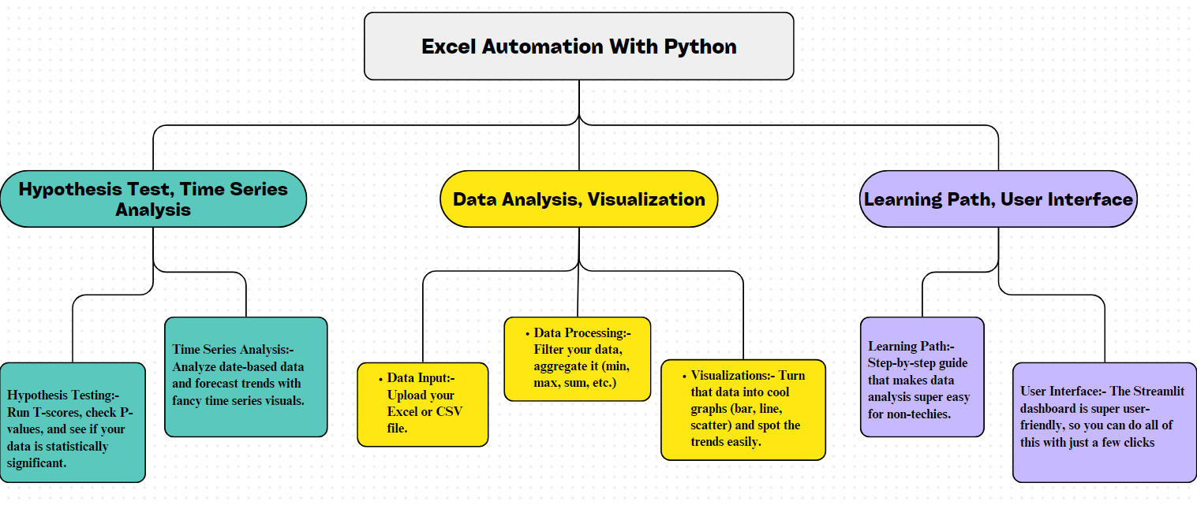
Proposed System
Fig.1 : Block diagram of Proposed System

Slide 8
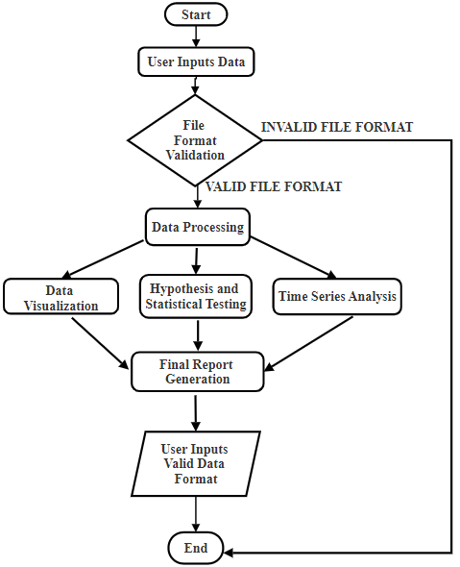
Work Flow
Fig. 2: Workflow of the system

Slide 9
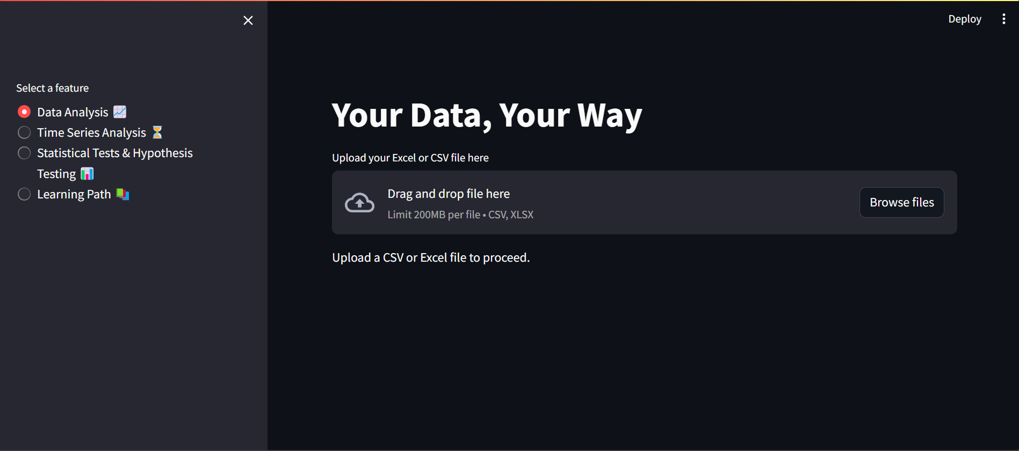
Result
Automated Data Analysis: Efficient and accurate analysis of uploaded datasets without manual intervention.
Interactive Visualizations: Dynamic charts (bar, line, scatter plots) that visualize data trends and relationships effectively.
Statistical Insights: Clear and concise outputs of hypothesis testing, including T-scores and P-values, to determine data significance.
Time series forecasting: Predictive models that analyze time-based data, generating insightful forecasts and trends.
User-friendly interface: A straightforward, customizable Streamlit interface that simplifies data upload and analysis for non-technical users.
Comprehensive Learning Path: Step by step guidance for users, enabling them to perform data analysis and understand the steps that are followed in this process.
Fig. 3: Interface sample

Slide 10
Conclusion
The Excel Automation with Python project significantly enhances data analysis and management for non-technical users. By providing a user-friendly interface built on Streamlit, the application allows users to easily upload datasets and perform essential operations like filtering, aggregation, and visualization. The integration of hypothesis testing and time series analysis enables users to derive meaningful insights from their data, fostering informed decision-making. Feedback from users indicates that the application's intuitive design simplifies complex tasks, making data analysis accessible and engaging. This project exemplifies how combining Excel with Python can create efficient, automated solutions, empowering users to navigate their data confidently and effectively.

Slide 11
References
[1] Ali, O. M., Breik, M., Aly, T., Raslan, A. T. N. E. D., & Gheith, M. (2024). Enhancing Data Analysis and Automation: Integrating Python with Microsoft Excel for Non-Programmers. Journal of Software Engineering and Applications, 17(6), 530-540.
[2] Zumstein, F. (2021). Python for Excel. " O'Reilly Media, Inc.".
[3] Martínez González, L. F. (2016). Automated Data Acquisition using Microsoft Excel. Computer Science;
[4] Soliev, B. N., Odilov, A., & Sh, A. (2023). Leveraging Python for Enhanced Excel Functionality: A Practical Exploration. Al-Farg’oniy avlodlari, 1(4), 267-271.
[5] Richards, T. (2021). Getting Started with Streamlit for Data Science: Create and deploy Streamlit web applications from scratch in Python. Packt Publishing Ltd.
[6] Ari, N., & Ustazhanov, M. (2014, September). Matplotlib in python. In 2014 11th International Conference on Electronics, Computer and Computation (ICECCO) (pp. 1-6). IEEE.
[7] Nelli, F. (2015). Python data analytics: Data analysis and science using PANDAs, Matplotlib and the Python Programming Language. Apress.
[8] McKinney, W., Perktold, J., & Seabold, S. (2011, July). Time Series Analysis in Python with statsmodels. In SciPy (pp. 107-113).

Slide 12
Thank you !

