Slide 1
PERISHABLE FOOD MONITORING THROUGHOUT THE SUPPLY CHAIN
TEAM MEMBERS :
Mirza Akber Namazi
Neha Dinesh Prabhu
Ambica Tandle

Slide 2
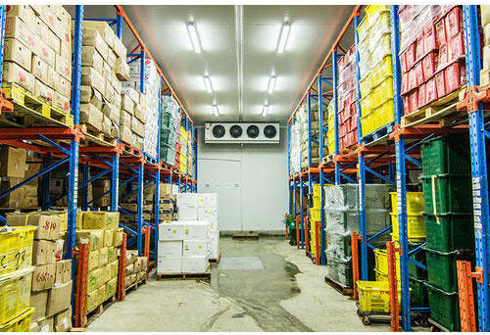
introduction
Everyday several thousand food stuff are stored in warehouse and are transported using cold storage truck.
Storing them in cold chain is essential to keep them fresh for the market and for selling them to potential customer .

Slide 3
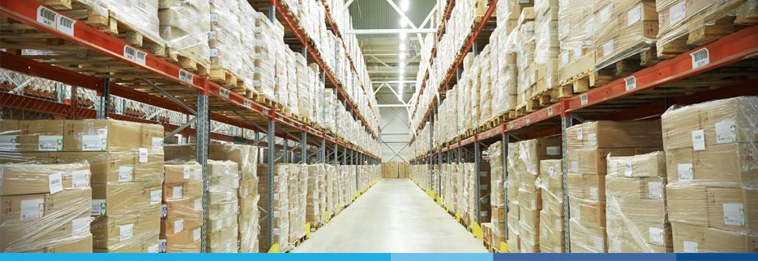
Food like raw meat and fish are particularly very sensitive food may that require more care. Air quality is also responsible for storage of food, if air is humid that leads to drying of food and too humid environment may cause bacterial growth warm weather may further accelerate the process. The goods need to be further be cleaned regularly to remove any underlying bacteria or mould present in the refrigerator.

Slide 4
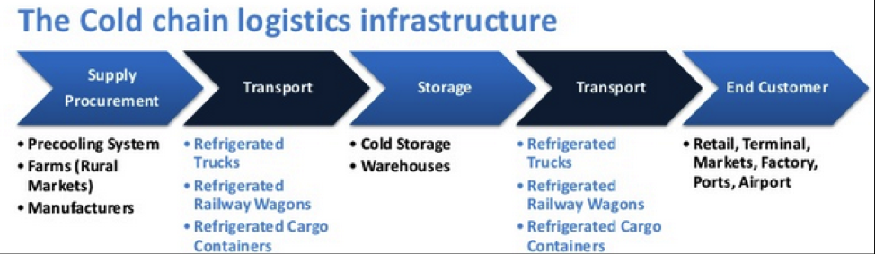
EXISTING SYSTEM:
Common tools in the cold chain range from refrigerated trucks to smart tracking solutions.
There are trucks, warehouses, and ships all designed to keep goods at the correct temperature. On top of this, properly insulated packaging keeps smaller units well controlled. These might include thermal blankets, vacuum insulated panels, vacuum flasks, or other insulators.

Slide 5
OBJECTIVE
We need to upgrade the existing technology in the cold chain system to :
Reduce food wastage.
Increase shelf life of food.
Save energy wastage.

Slide 6
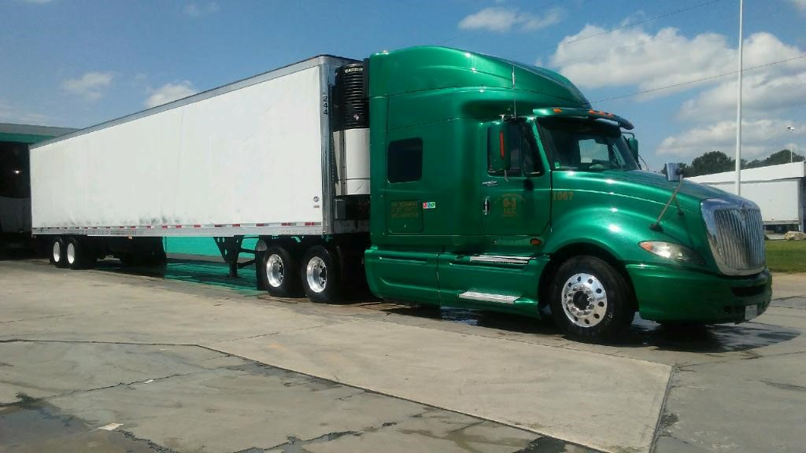
PROPOSED SYSTEM
To Monitor the temperature and various factors which effect the food decay process throught out the supply food chain using sensors.

Slide 7
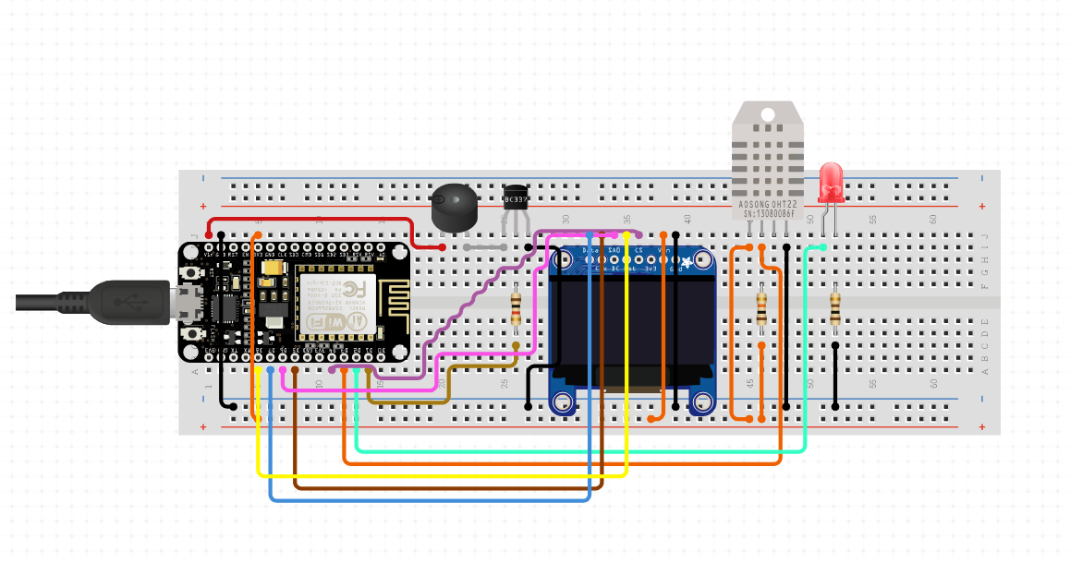
Components and Technology used
NodeMCU
Oled screen
Bread board
DHT11 sensor
Connecting wires
IBM Cloud
Arduino
Schematic diagram

Slide 8
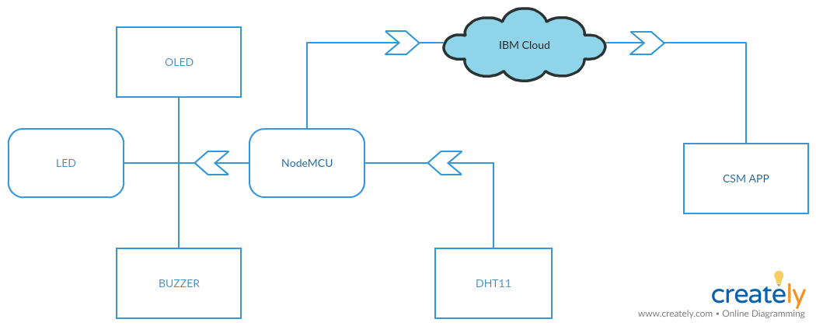
Use case diagram

Slide 9
Working
We monitor food in the cold storage truck through the an app, the app tracks the live temperature of the storage truck during the transportation .
An authorised personnel sets the temperature limits for the items in the storage so they may remain fresh.
After setting limits the both the admin and the truck driver both can monitor temperature of the storage.
Once the acceptable temperature level has been breached, these systems can trigger an immediate alert by setting off buzzer. Or, with planning, operators can set alerts to occur before goods approach maximum temperature, enabling changes to be promptly made and goods to be saved.

Slide 10
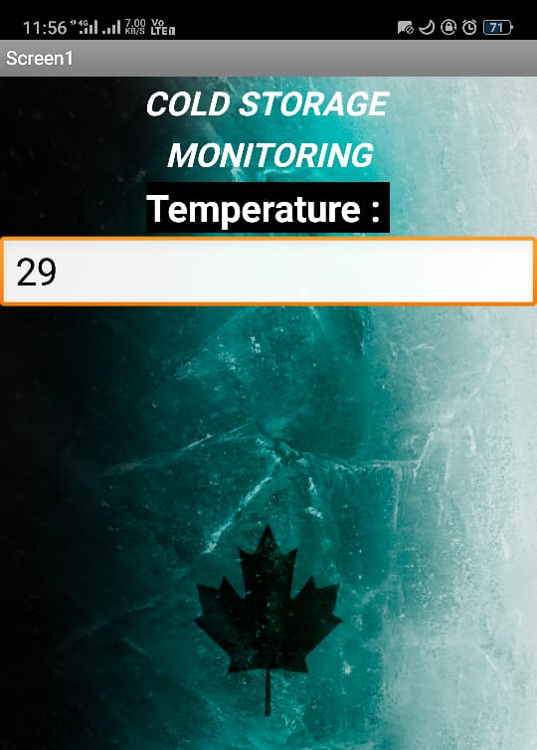
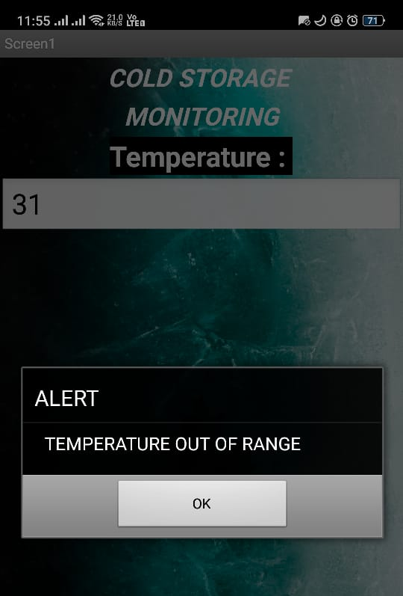
Mit app

Slide 11
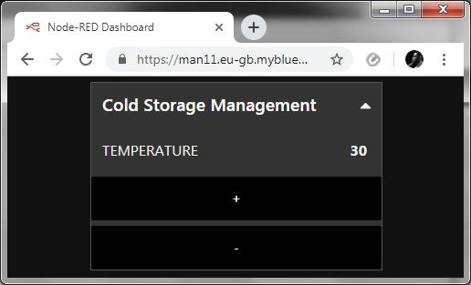
Web app

Slide 12
Future scope
We can include BLE ( Bluetooth Low Energy) Beacon, in the this system so that we can track the location of the food so that we can specifically cool that area only than wasting energy in remaining compartments.
We can replace Oled screen with TFT LCD display.TFT screens with pre installed temperature monitoring app, can be placed beside driver seat so that he can live track the cold chain.
Driver can select temperature of all sets of items present individually.
By adding this we can further manage the food economically.

Slide 13
conclusion
Continuous monitoring of temperature & humidity inside the truck containers through out the supply chain and manage the temperature.

