Slide 1
Smart Connected Sign Boards For Improved Road Safety
By
Mirza Akber Namazi
Neha Dinesh Prabhu
Ambica Tandle

Slide 2
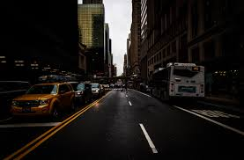
Introduction
Our Project is about digitizing the road signs and change the content dynamically using various Technology.

Slide 3
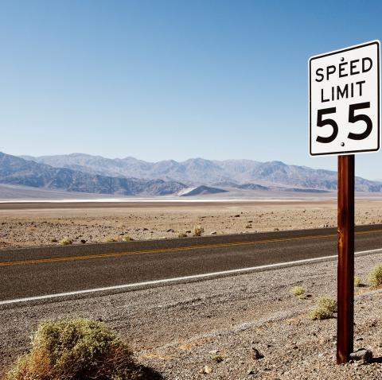
Existing System:
In present Systems the road signs and the speed limits are Static. But the road signs can be changed in some cases. We can consider some cases when there are some road diversions due to heavy traffic or due to accidents then we can change the road signs accordingly if they are digitalized.
Also the speed Limit can be changed based on weather which is not constant over an area.

Slide 4
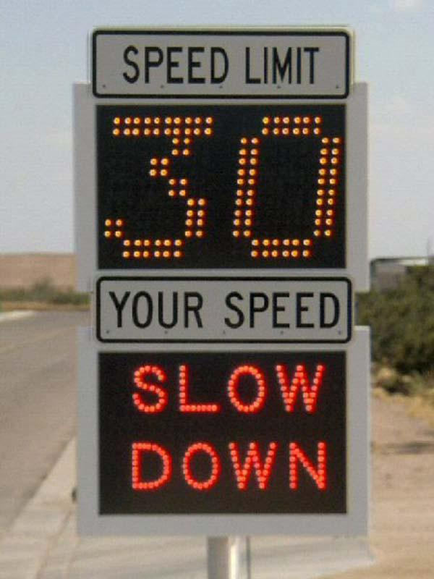
Proposed System:
This project proposes a system which has digital sign boards on which the signs can be changed dynamically. By using the Weather API ,we can get the weather reports based on which we can set the speed limit to particular area.
There is a web app through which you can enter the data of the road diversions, accident prone areas etc. This data is retrieved and displayed on the sign boards accordingly.

Slide 5
Technology used:
Nodemcu
Oled screen
Ultra sonic sensor
Connecting wires
Bread board
IBM Cloud
Weather API
Arduino IDE
IBM Watson IOT platform

Slide 6
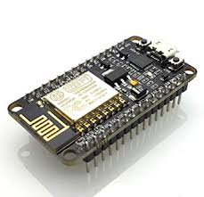
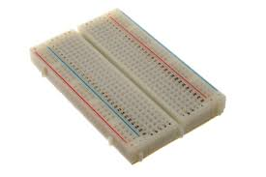
NodeMCU Bread board

Slide 7
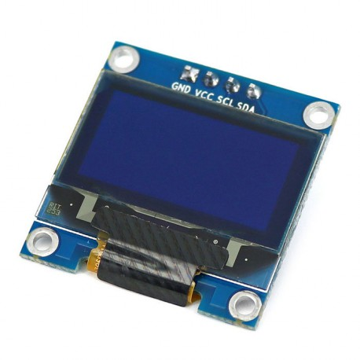
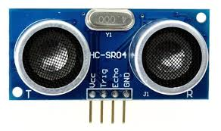
Oled screen
Ultra sonic sensor

Slide 8
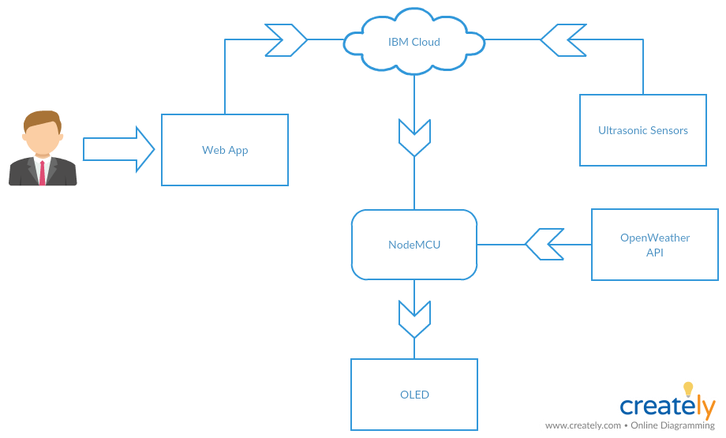
Use Case Diagram:

Slide 9
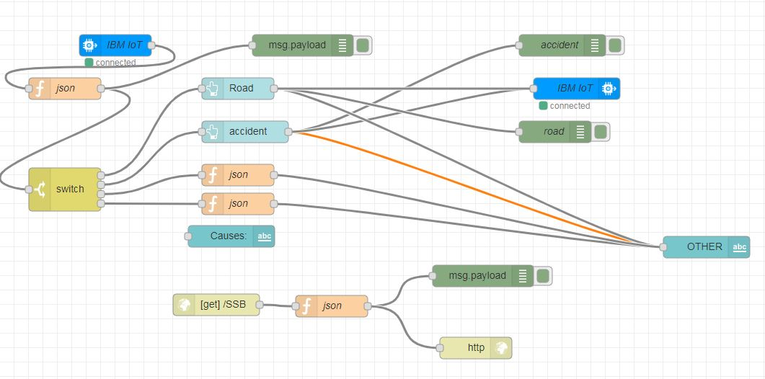
NodeRED Flow:

Slide 10
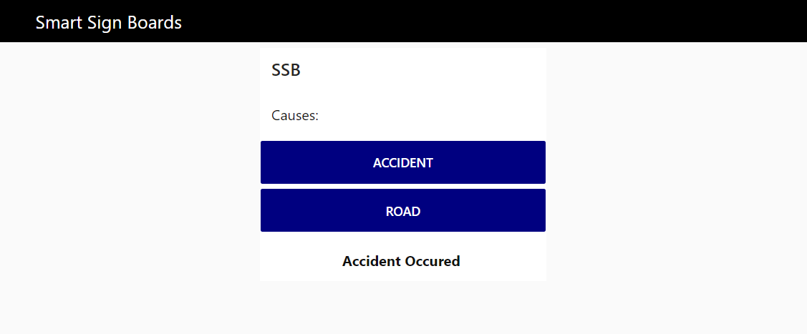
Web App:

Slide 11
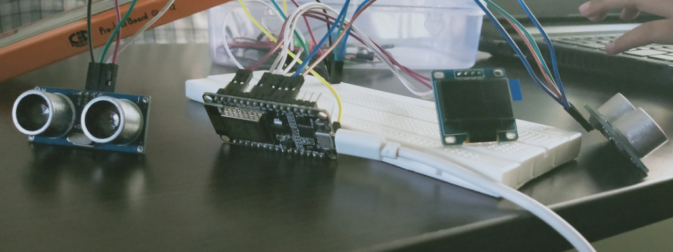

Slide 12
Conclusion:
Time can be saved.
Unnecessary traffic can be avoided
Through speed limits, various lives can be saved.

Slide 13


