Slide 1
PROPOSAL DEFENSE “Text-to-image Generation”
Neha Shrestha (24287 / 7th Semester / 2076)
Norden Ghising Tamang (24290 / 7th Semester / 2076)

Slide 2
1. INTRODUCTION

Slide 3
2. PROBLEM DEFINITION
The problem of data scarcity in data augmentation can be solved through generative AI where huge amounts of training data can be built. Noise injection technique can be used in audio data augmentation improving the model performance. Moreover, visual cues are the base for effective communication along with textual information. The text-to-image model helps to enhance communication and increase learning and understanding skills. Additionally, the developers and graphic professionals need to make a quick visual ideation of the concepts for clarity and conciseness. The model provides a fast and intuitive way to transform textual ideas into visual prototypes.

Slide 4
3. OBJECTIVE
Transform textual descriptions into visually appealing images.
Ensure the generated images are coherent and contextually accurate.
Provide a user-friendly interface for users to input text and retrieve generated images.

Slide 5
4. RESEARCH METHODOLOGY
4.1. Literature Review
4.2. The Framework Of The Model
4.3. Algorithms / Methods / Theory

Slide 6
4.1. Literature Review

Slide 7
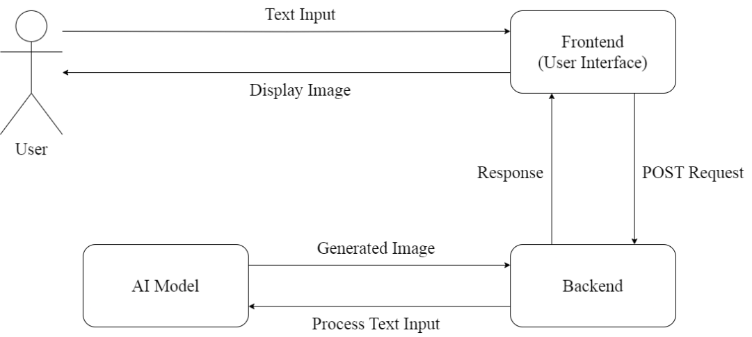
4.2. The Framework Of The Model
Frontend
Backend
AI Model

Slide 8
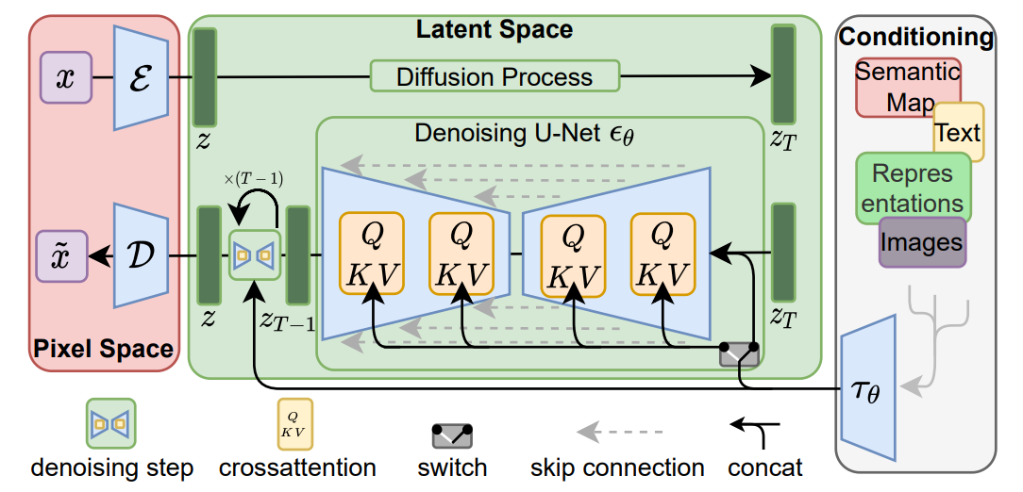
4.3. Algorithms / Methods / Theory

Slide 9
4.3. Algorithms / Methods / Theory

Slide 10
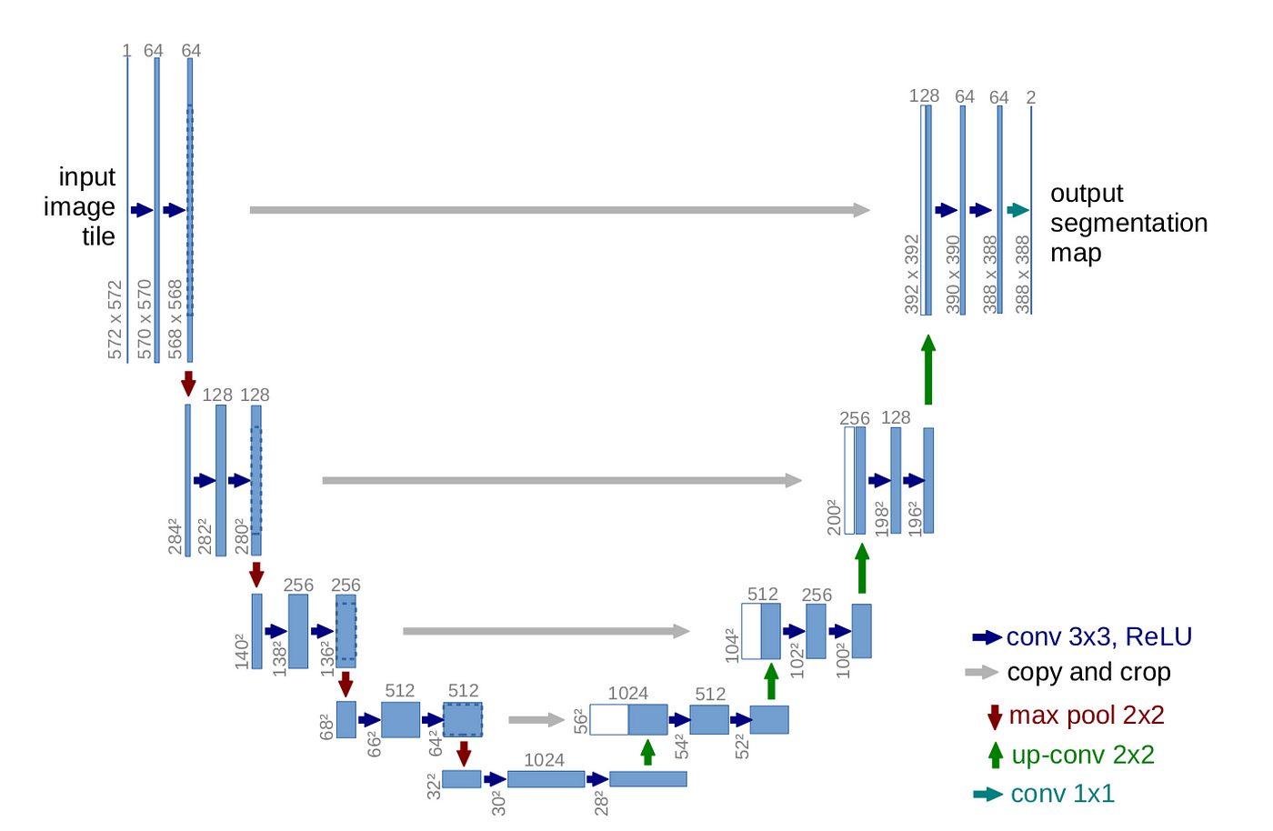
4.3. Algorithms / Methods / Theory
U-Net Architecture:
CONV
RELU
MAX POOL
UP CONV
DOWN CONV

Slide 11
4.3. Algorithms / Methods / Theory
Loss Function:
Mean Squared Error Loss given below:

Slide 12
5. DATA COLLECTION
Online Dataset: Free to use non-commercial datasets such as LAION, ImageNet image-text pairs datasets and other resources will be used.
Web Scraping: Python web scraping scripts will crawl the web and look for image-text pairs. We will be careful not to use copyrighted images.

Slide 13
6. TESTING AND VERIFICATION
Testing involves assessing whether the Text-to-Image generation app performs its intended functions correctly. This can be divided into several components:
Input Validation: Verify that the app correctly processes user input, handles potential errors in the textual descriptions.
Image Generation: Confirm that the generated images align with the input text and are contextually relevant. Ensure that the generated images maintain consistency and coherence with the descriptions.
User Interface (UI) Testing: Evaluate the user interface for usability, responsiveness, and intuitive design. Check for any bugs or glitches in the application's graphical user interface.
For Verification, we verify using following measures:
Perceptual Metrics: Frechet Inception Distance (FID) can quantitatively evaluate the visual quality of the generated images.
User Evaluation: Conduct user evaluations where experts or users rate the generated images for aspects such as realism, relevance to the input text and overall quality. Collect qualitative feedback.

Slide 14
7. EXPECTED OUTPUT
The outcome of this project is to accept user-provided text input, create images based on the input and show the user the generated images.

Slide 15
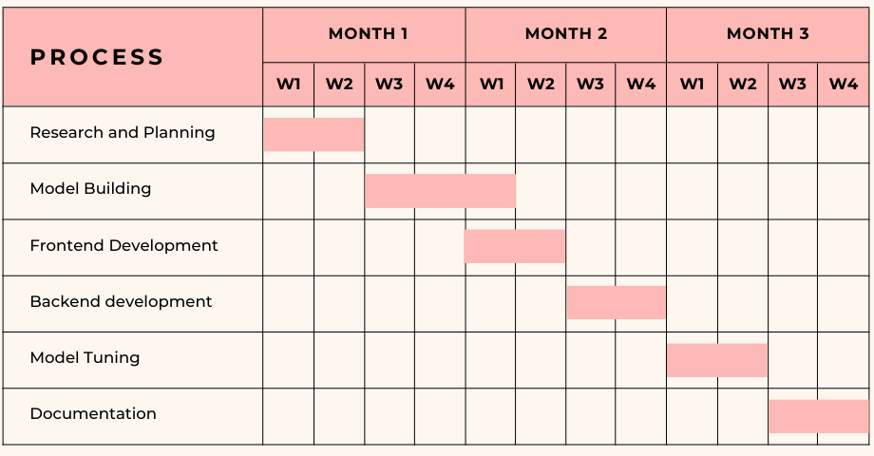
8. GANTT CHART

Slide 16
9. CONCLUSION
This project aims to create a model that generates a response image to the user text input.
This model is based on the stable diffusion model which uses latent space that is more suitable for likelihood-based generative models.
This latent representation model allows us to reach a balance between complexity reduction and detail preservation, greatly boosting visual fidelity.

Slide 17
10. REFERENCES
[1] Robin Rombach, Andreas Blattmann, Dominik Lorenz, Patrick Esser, Bjorn Ommer, “High-Resolution Image Synthesis with Latent Diffusion Models”, Arxiv, Apr. 13, 2022. [Online]. Available: https://arxiv.org/pdf/2112.10752.pdf
[2] M. N. S. Larcher, “Paper Explained — High-Resolution Image Synthesis with Latent Diffusion Models,” Medium, Apr. 04, 2023. [Online]. Available: https://towardsdatascience.com/paper-explained-high-resolution-image-synthesis-with-latent-diffusion-models-f372f7636d42
[3] “Generative AI – What is it and How Does it Work? | NVIDIA,” NVIDIA. https://www.nvidia.com/en-us/glossary/data-science/generative-ai/
[4] “High-Resolution Image Synthesis with Latent Diffusion Models - Computer Vision & Learning Group,” Computer Vision & Learning Group, Jul. 12, 2023. https://ommer-lab.com/research/latent-diffusion-models/
[5] A. Awan, “A complete guide to data augmentation,” Nov. 2022, [Online]. Available: https://www.datacamp.com/tutorial/complete-guide-data-augmentation

