Slide 1
EFFICIENT DATA PREPARATIONAND PROCESSING TECHNIQUES
Made by - Neha Thakare

Slide 2
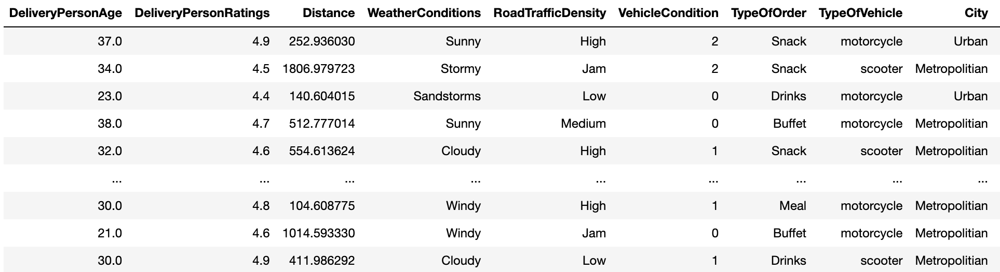
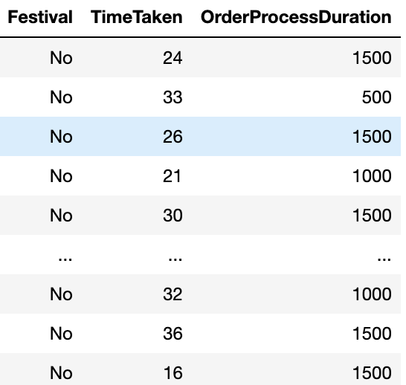
ATTRIBUTES IN OUR DATASET

Slide 3
CONTINUOUS DATA | CATEGORICAL DATA
DeliveryPersonAge | WeatherConditions
DeliveryPersonRatings | RoadTrafficDensity
Distance | TypeofOrder
VehicleCondition | TypeOfVehicle
TimeTaken | City
OrderProcessDuration | Festival

Slide 4
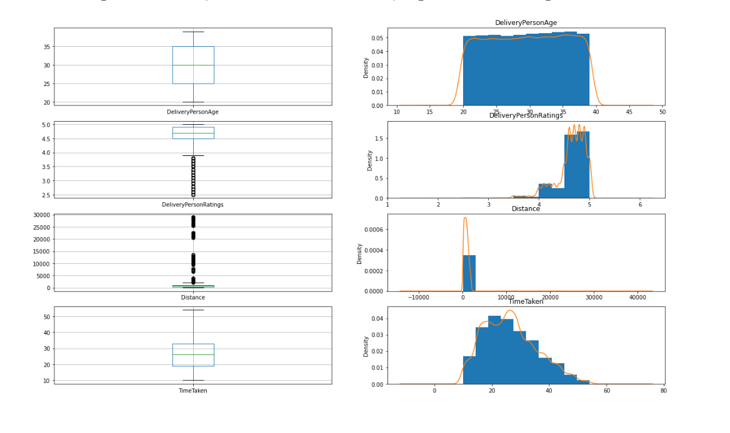
VARIABLE DISTRIBUTION AND DISCUSSION (CONTINUOUS DATA)

Slide 5
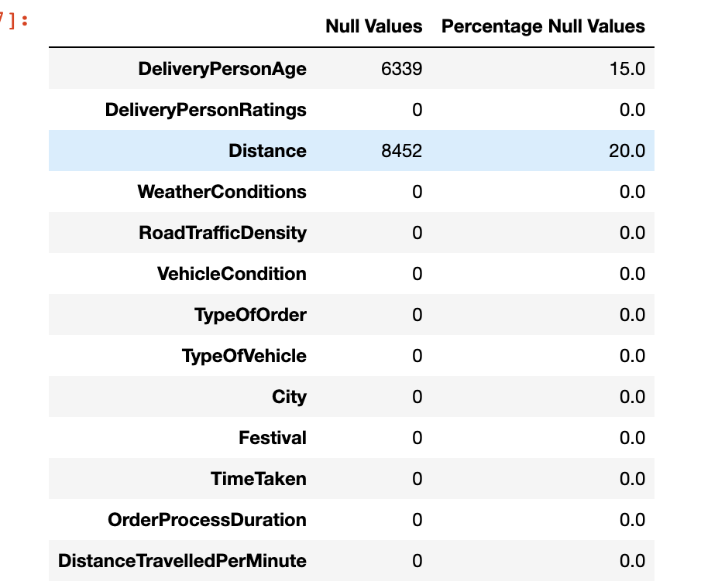
NULL VALUES

Slide 6
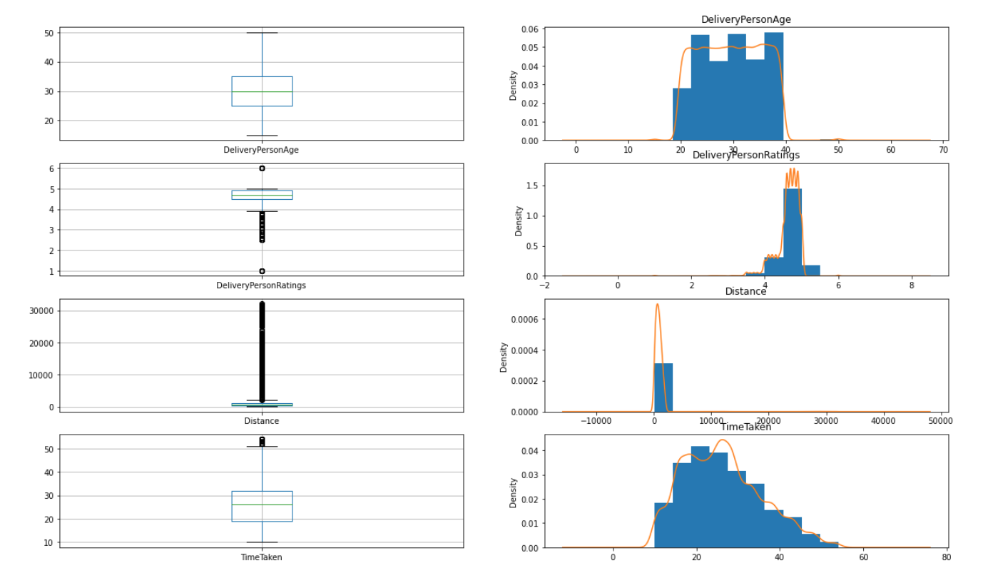
OUTLIER IDENTIFICATION AND CLEANING

Slide 7
OUTLIER IDENTIFICATION AND CLEANING
ATTRIBUTE | METHOD | REASON
DeliveryPersonRatings | Capping values above 5 and removing them | Bad performance of the delivery person can reduce their ratings upto 0 - as extreme scenarios and not cleaning them.
Distance | IQR | - Heavily skewed, not possible to remove with the 'Standard Deviation' method. - Not using flooring/capping - lack of domain knowledge. - Due to the presence of extreme outliers and heavy skew, IQR is the best method to remove outliers in this attribute.
TimeTaken | Quantile based capping | Since the outliers are present in the upper end, quantile based capping could be used to get rid of them.

Slide 8
FEATURE ENCODING
ATTRIBUTE | METHOD | REASON
RoadTrafficDensity | Ordinal Encoding | Since the attribute has an order associated with that (High, Low, Medium and Jam).
TypeOfVehicle | Label encoder | - The frequency for few of the values in these attributes clashes, hence we cannot use 'frequency encoder' - Using 'one-hot encoding' increases the dataset as the sample space is more.

Slide 9
FEATURE ENCODING
TypeOfOrder | Label encoder | - The frequency for few of the values in these attributes clashes, hence we cannot use 'frequency encoder’ - Using 'one-hot encoding' increases the dataset as the sample space is more
City | Label encoder | - The frequency for few of the values in these attributes clashes, hence we cannot use 'frequency encoder’ - Using 'one-hot encoding' increases the dataset as the sample space is more
WeatherConditions | one-hot encoding | - Sample space of this attribute is less - There is overlap of frequency which rules out the possibility to use 'frequency encoding'.

Slide 10
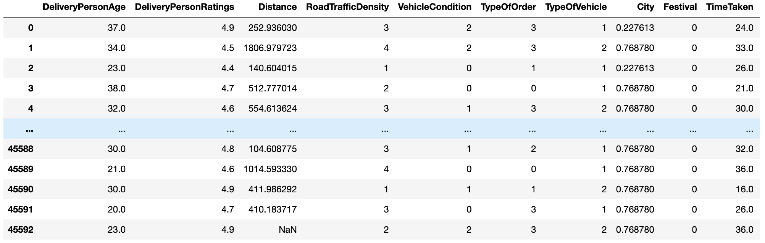
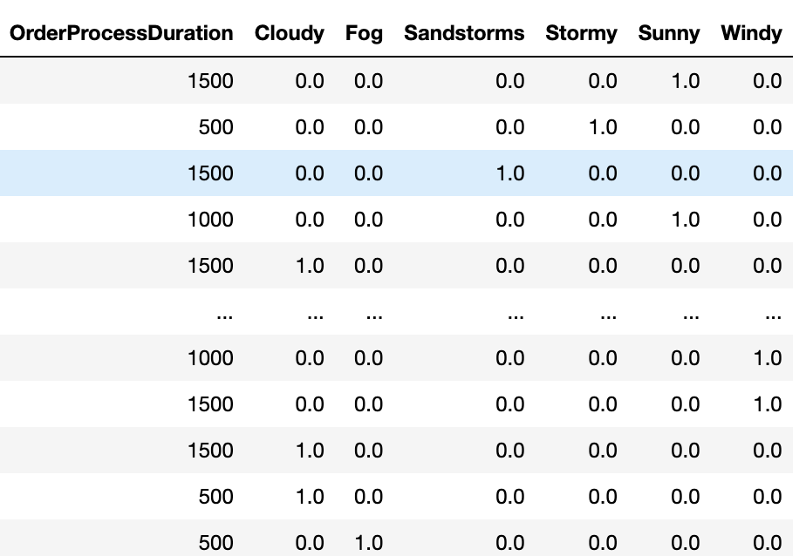
DATASET AFTER ENCODING

Slide 11
SCALING
'DeliveryPersonRatings' - outliers (which could be valid ones), a scaling that is robust to outliers.
Most of the attributes are skewed
Expect for the attribute 'DeliveryPersonAge' none of them is close to Gaussian distribution.
Our data has uniform modal and close to bimodal in the attribute 'TimeTaken' and 'OrderProcessDuration'.
We need our distribution close to normal/Gaussian for the use in our algorithm.

Slide 12
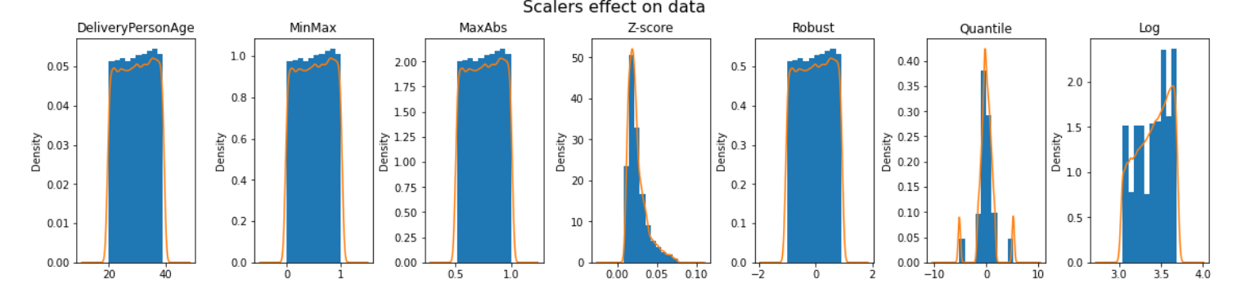
AFTER SCALING ‘DeliveryPersonAge’
With MinMax , MaxAbs and robust the distribution (shape) remains the same while the data is scaled.
With Z-Score, the raw data which in itself was close to normal distribution, has been left skewed.
With Qunatile, it is close to Gaussian with a peak.
With Log, the values looks more spread.

Slide 13
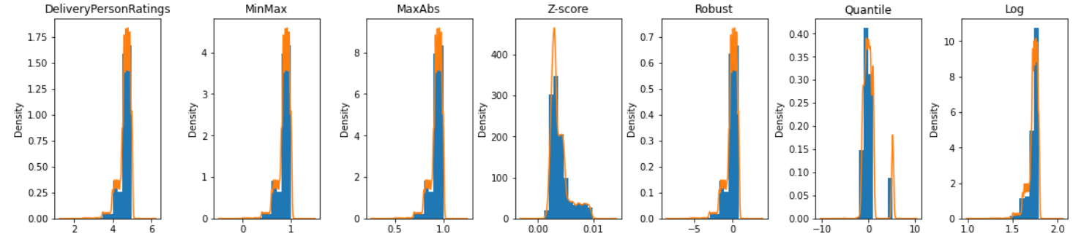
AFTER SCALING ‘DeliveryPersonRatings’
With MinMax , MaxAbs, log and robust the distribution (shape) remains the same while the data is scaled.
Extreme values present – still MinMax , MaxAbs performs.
With Z-Score, the raw data which was right skewed distribution, has been left skewed.
With Qunatile, it is close to Gaussian with a peak.
With Log, the values looks more spread.

Slide 14
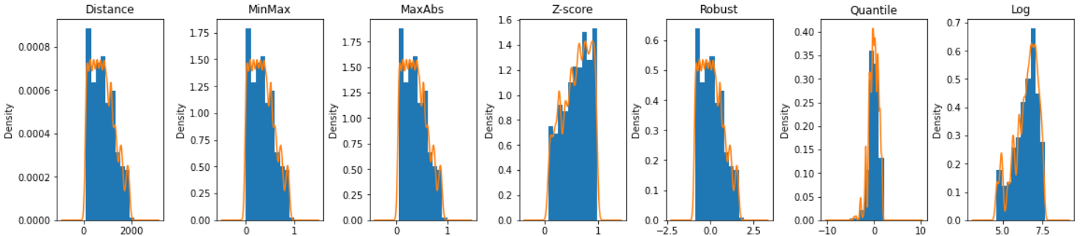
AFTER SCALING ‘Distance’
With MinMax , MaxAbs and robust the distribution (shape) remains the same while the data is scaled.
With Z-Score, Close to unimodel, the frequent values has been spread out, thus increasing the variance, moving the distribution close to normal.
With Qunatile, it is close to Gaussian with a peak.
The value has been spread out and looks skewed.

Slide 15
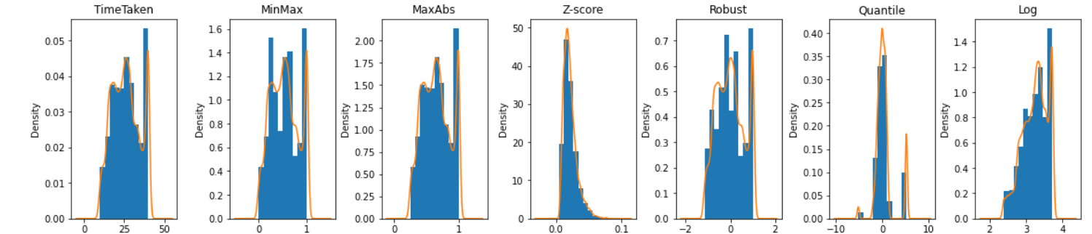
AFTER SCALING ‘TimeTaken’
With MinMax , MaxAbs and robust the distribution (shape) remains same while the data is scaled.
With Z-Score, it was close to normal distribution, but after scaling moved to left skewed.
With Qunatile, it is close to Gaussian with a peak.
With log has close to normal distribution once scaled.

Slide 16
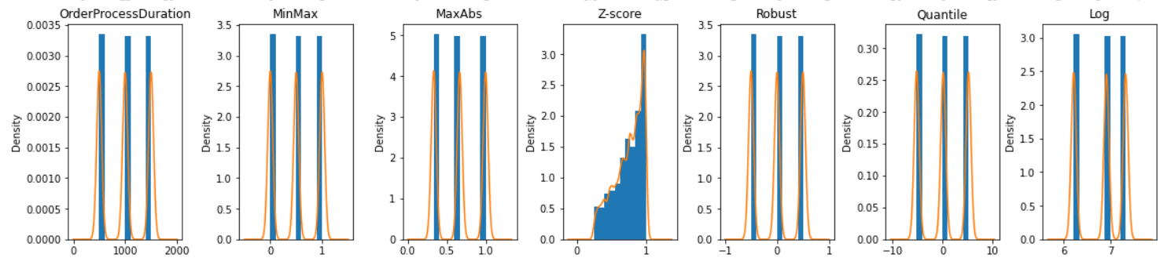
AFTER SCALING ‘OrderProcessDuration’
With MinMax , MaxAbs, Robust, Quantile and log the distribution (shape) remains same while the data is scaled.
With Z-Score, it was which has multimode model, the data has also been heavily skewed.

Slide 17
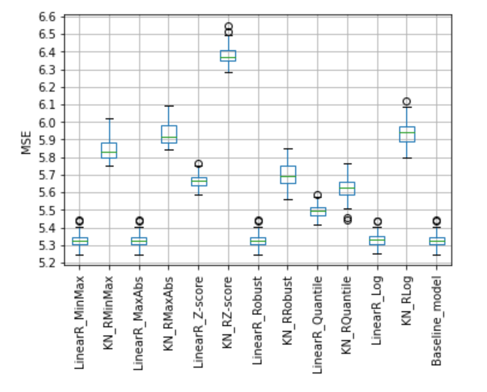
PERFORMANCE OF ALGORITHMS

Slide 18
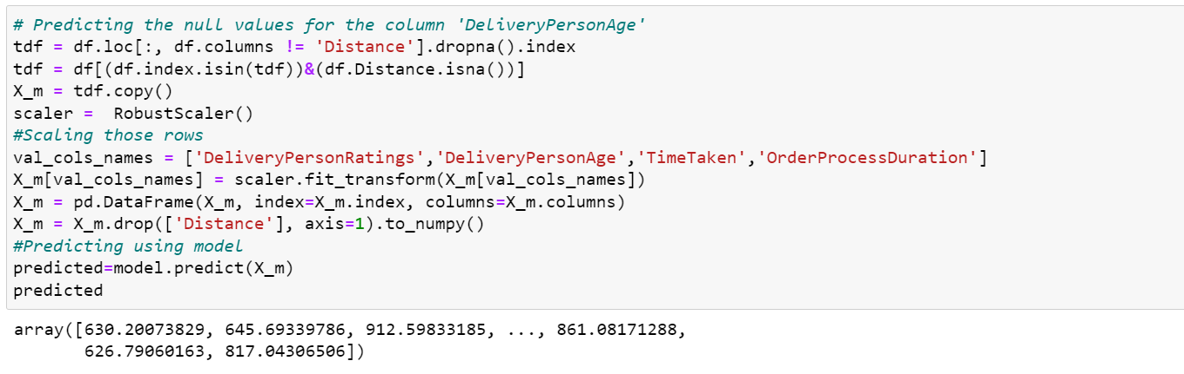
USING ALGORITHM TO REPLACE MISSING VALUES AND OUTLIERS

Slide 19
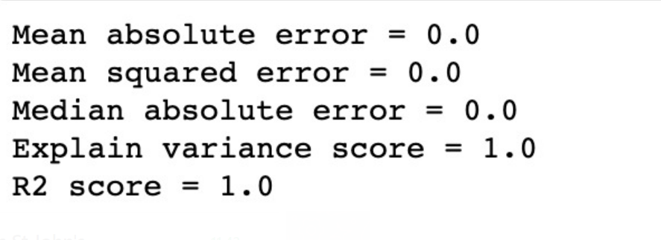
Final Improved Performance

Slide 20
THANK YOU !

