Slide 1
Image Embedding and Classification using Pre-Trained Deep Learning Architectures
Paper ID: 1570853697
Authored by:
Dr. Raj Gaurang Tiwari, Alok Misra, Neha Ujjwal
INTERNATIONAL CONFERENCE ON SIGNAL PROCESSING AND COMMUNICATION
(ICSC 2022)

Slide 2
Contents
Introduction
Literature Review
Proposed Work
Results and Analysis
Conclusion
References

Slide 3
Abstract
The use of deep learning in image analysis has been a game-changer. Common methods have relied on problem-specific algorithms to characterize pictures using properties like cell shape, count, intensity, and texture that were painstakingly constructed by human experts. With deep convolutional neural networks, feature learning occurs implicitly, and training the network often zeroes down on specific tasks. To get a vector representation of a picture by embedding, the image is fed into a preexisting deep neural network. An image embedding is a representation of the picture in fewer dimensions. It is a dense vector representation of the picture that may be used for things like categorization and plenty of other things. In this research, we profile pictures by using vectors of features and pre-trained deep learning architectures (Inception V3, VGG16, VGG19, Painter, SqueezeNet, and DeepLoc). The process of picture categorization makes use of these vectors. For experimentation purposes, we used the dataset containing images of yoga positions and classified them using Multilayer Perceptron (MLP) Classifier.

Slide 4
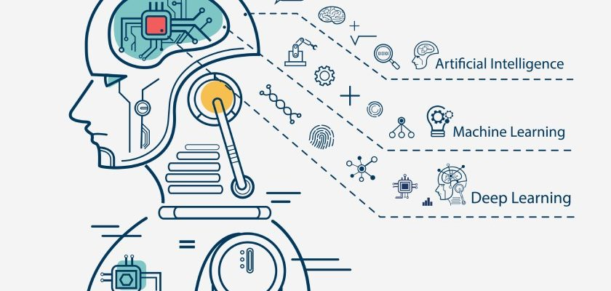
Introduction
As one of computer science's most rapidly expanding fields, machine learning has a wide range of potential applications, making it an excellent starting place for this study.
Artificial intelligence (AI) is the branch of computer science that focuses on teaching computers to learn on their own. Computer programs that can access data and learn from patterns in training samples without explicit instructions and then utilize inference to produce meaningful predictions are the primary goal of machine learning.
It enables computers to think and learn on their own via machine learning (ML).

Slide 5

Introduction
Machine Learning
The field of artificial intelligence, known as machine learning enables machines to learn from their own data and make predictions about future output with little to no human input.
.
Machine learning is a method to put human intelligence into the computer system.
Machine learning is training the computer system to predict results. Prediction becomes more accurate as the machine gains more information with experience.

Slide 6
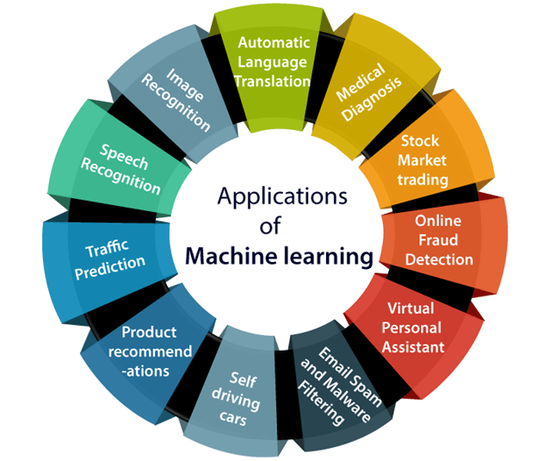
Applications of Machine Learning

Slide 7
Image Embedding
When it comes to picture recognition, machine learning does not necessarily need training on a group of photos that are very similar to one another. A deep network pre-trained on a big enough sample of varied pictures may be able to infer relevant characteristics from a wide variety of fresh image sets, just as how the human visual brain can adapt to the study of numerous scenarios and images.
Image processing systems operate with rich, high-dimensional datasets that contain raw pixel intensities. Raw images may not be suitable for various needs. Find comparable publications or photos based on a cover picture. Comparing the input picture's raw pixels (2,048 2,048) to another is inefficient and ineffective. However, extracting lower-dimensional feature vectors (embeddings) may help compare images.
The concept is to use a big picture dataset (like ImageNet) to train a model for categorizing images. Some examples of such models are Inception, Deep Residual Learning (ResNet), and Network Architecture Search (NASNet)

Slide 8

Objective of Research
To get a vector representation of a picture by embedding, the image is fed into a preexisting deep neural network. An image embedding is a representation of the picture in fewer dimensions. It is a dense vector representation of the picture that may be used for things like categorization and plenty of other things. In this research, we profile pictures by using vectors of features and pre-trained deep learning architectures (Inception V3, VGG16, VGG19, Painter, SqueezeNet, and DeepLoc). The process of picture categorization makes use of these vectors.

Slide 9

Literature Review
Using image feature vector clustering and a deep learning model, Jiyeon Kim et al. suggested an approach for automatically categorizing tourist images by tourist attractions. To achieve this goal, we first collected images that were included with reviews left by non-native speakers on TripAdvisor.
For fast and accurate picture retrieval and classification, Dongmei Mo et al. presented a concentrated hashing approach using neighborhood embedding (CHNE). CHNE can do this by combining the Cauchy cross-entropy with pair-wise weighted similarity loss. This results in pairs of data that are similar having a lower Hamming distance and pairs of data that are different having a greater Hamming distance.
According to the suggested architecture by Shubham Garg et al., the pictures are first skeletonized. The MediaPipe library is used to identify keyframes in the body during the skeletonization process. The authors also examined the difference in efficiency between skeletonized and non-skeletonized deep learning models.
Gandhi Pavitra et al developed, tested, and evaluated an automated yoga asana identification and correction system that shows promise in the absence of a human teacher by using human action recognition methods for yoga posture estimate.

Slide 10
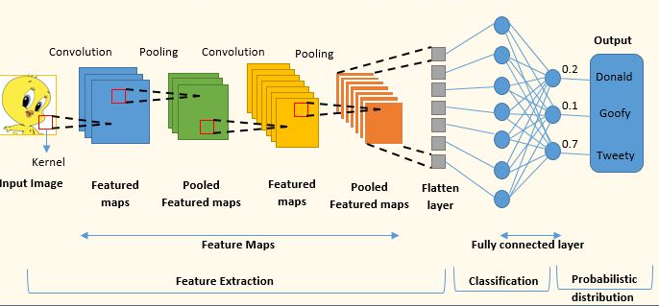
Methodology
Image embeddings are generated using a pre-trained model up until the second-to-last (or "penultimate") layer before classification (Fig.). To decide which class has the greatest probability score, a CNN (Convolutional Neural Network) uses a loss function such as softmax after the first few layers have extracted features from the input picture and the fully-connected layers have handled classification and returned class probabilities.

Slide 11
Methodology
Data Acquisition
Image Embedding
SqueezeNet:
Small and fast model for image recognition trained on ImageNet
Inception v3:
Google’s Inception v3 model trained on ImageNet.
VGG-16/19:
16/19-layer image recognition model
trained on ImageNet.
Painters:
A model trained to predict painters from artwork images
DeepLoc: A model trained to analyze
yeast cell images
Classification
Model Evaluation

Slide 12

Materials and Methods
Dataset
Yoga is widely recognized as an effective method for reducing stress, calming the mind, and improving health. Downward dog, goddess, tree, plank, and warrior are just a few of the most well-known yoga positions. Dataset used in this research has five subfolders, one for each of the five categories of yoga postures. Bing's API is used to get the photos, which are then processed by hand to remove duplicates, improve quality, and reduce file size.
Reference
“Yoga Pose Classification | Kaggle.” https://www.kaggle.com/datasets/ujjwalchowdhury/yoga-pose-classification (accessed Aug. 23, 2022).

Slide 13
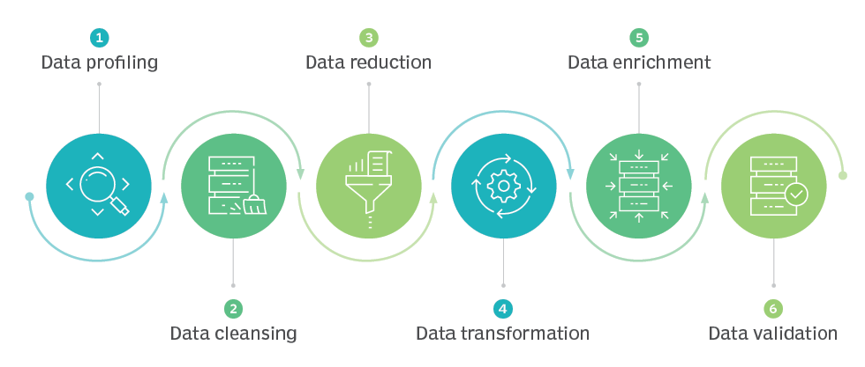
Preprocessing
Significant steps applied in data preprocessing are identifying and handling the missing values, data integration, data cleaning, data transformation.

Slide 14
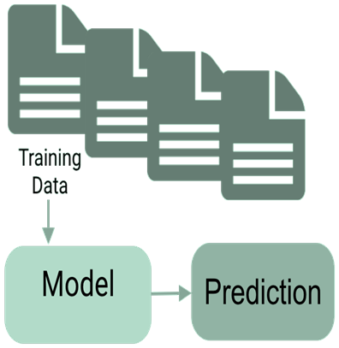
Model Training
The Multilayer Perceptron classifier is used to categorize images based on their embeddings, which were generated using a variety of deep architectures. Classification metrics including accuracy, precision, recall, F1 score, and area under the curve are compared across several image embeddings to determine which one produces the best results for the MLP classifier.

Slide 15
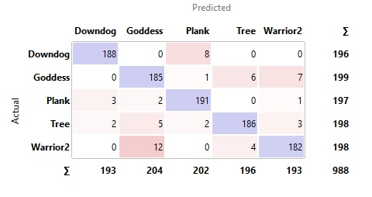
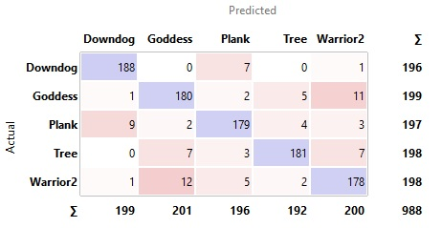
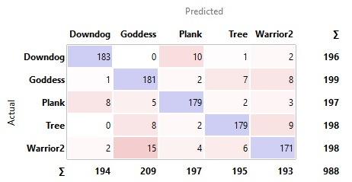
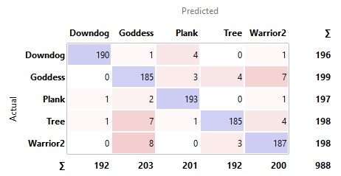
Results
Confusion matrices derived from all of the models that were used in this study are as:
Confusion Metrix of Inception V3
Confusion Metrix of VGG16
Confusion Metrix of VGG19
Confusion Metrix of Squeezenet

Slide 16
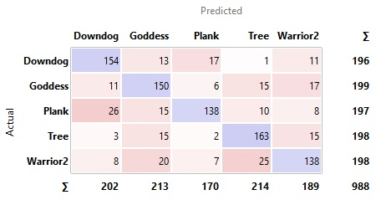
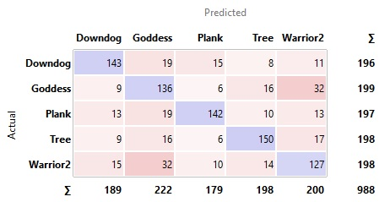
Confusion Metrix of Painters
Confusion Metrix of Deeplock

Slide 17
Performance Comparison
Embedding Method for Classification | AUC | CA | F1 | Precision | Recall
Inception V3 | 0.9961 | 0.9433 | 0.9434 | 0.9436 | 0.9433
SqueezeNet | 0.9938 | 0.9514 | 0.9515 | 0.9518 | 0.9514
VGG16 | 0.9875 | 0.9170 | 0.9170 | 0.9172 | 0.9170
VGG19 | 0.9841 | 0.9038 | 0.9039 | 0.9043 | 0.9038
Painters | 0.9488 | 0.7520 | 0.7516 | 0.7539 | 0.7520
DeepLoc | 0.8849 | 0.7065 | 0.7078 | 0.7107 | 0.7065

Slide 18
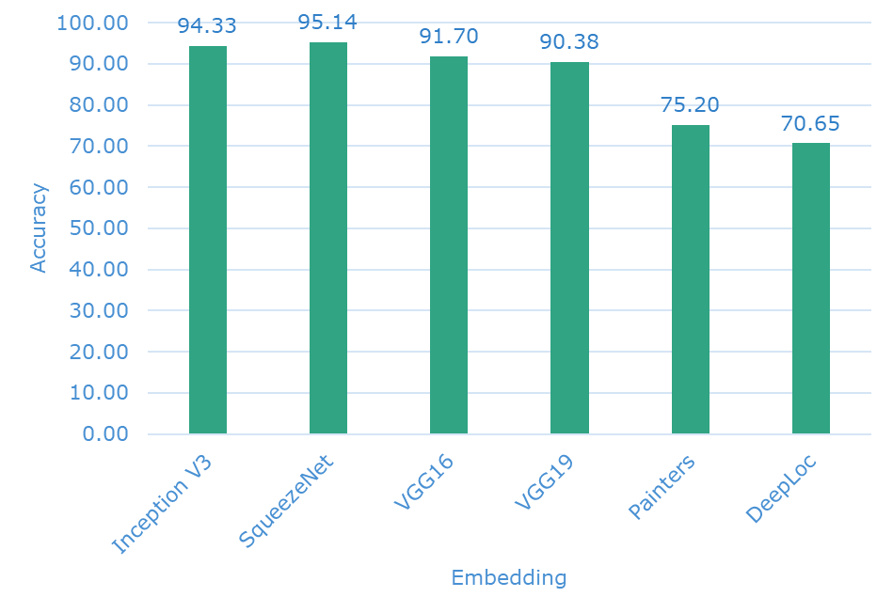
Analysis
A comparison of the classification accuracy MLP after diverse image embedding is shown in following figure:
Fig clearly shows that the SqueeseNet embedding method gives the best accuracy of 95.14%. This fact is also supported by Precision, Recall, and F1 score.
This fact is also supported by Precision, Recall and F1 score.

Slide 19

Conclusion
Yoga has been practiced for hundreds of years and is now often used as a form of exercise and rehabilitation by athletes, patients, and physiotherapists. Obtaining the utmost benefits from yoga requires proper posture and technique. As a result, there is a new field of study devoted to the creation of a model to properly categorize yoga poses. In this study, we explored image embedding, a technique that converts an image into a vector of characteristics for further processing. Methods like grouping, similarity search, and classification might fall under this category. Inception V3, VGG16, VGG19, Painters, SqueezeNet, and DeepLoc embedders have been used to profile images of the YogaPoses dataset with vectors of features. For evaluation of embedders Multi-Layer Perceptron classifier is used. Results show that the SqueeseNet embedding method gives the best accuracy 95.14%.

Slide 20
References
S. Savaş, “Detecting the Stages of Alzheimer’s Disease with Pre-trained Deep Learning Architectures,” Arabian Journal for Science and Engineering 2021 47:2, vol. 47, no. 2, pp. 2201–2218, Sep. 2021, doi: 10.1007/S13369-021-06131-3.
J. V. Shanmugam, B. Duraisamy, B. C. Simon, and P. Bhaskaran, “Alzheimer’s disease classification using pre-trained deep networks,” Biomed Signal Process Control, vol. 71, p. 103217, Jan. 2022, doi: 10.1016/J.BSPC.2021.103217.
F. Zhuang et al., “A Comprehensive Survey on Transfer Learning,” Proceedings of the IEEE, vol. 109, no. 1, pp. 43–76, Jan. 2021, doi: 10.1109/JPROC.2020.3004555.
G. Pinto, Z. Wang, A. Roy, T. Hong, and A. Capozzoli, “Transfer learning for smart buildings: A critical review of algorithms, applications, and future perspectives,” Advances in Applied Energy, vol. 5, p. 100084, Feb. 2022, doi: 10.1016/J.ADAPEN.2022.100084.
S. Garg, A. Saxena, and R. Gupta, “Yoga pose classification: a CNN and MediaPipe inspired deep learning approach for real-world application,” Journal of Ambient Intelligence and Humanized Computing 2022, pp. 1–12, Jun. 2022, doi: 10.1007/S12652-022-03910-0.
M. Chasmai, N. Das, A. Bhardwaj, and R. Garg, “A View Independent Classification Framework for Yoga Postures,” Jun. 2022, doi: 10.48550/arxiv.2206.13577.
G. Pavitra and C. Anamika, “Deep Learning-Based Yoga Learning Application,” pp. 365–380, 2022, doi: 10.1007/978-981-16-8225-4_29.
S. Mishra, B. Joshi, R. Paudyal, D. Chaulagain, and S. Shakya, “Deep Residual Learning for Facial Emotion Recognition,” Lecture Notes on Data Engineering and Communications Technologies, vol. 68, pp. 301–313, 2022, doi: 10.1007/978-981-16-1866-6_22/COVER.
M. K. Dahouda and I. Joe, “Neural Architecture Search Net-Based Feature Extraction With Modular Neural Network for Image Classification of Copper/ Cobalt Raw Minerals,” IEEE Access, vol. 10, pp. 72253–72262, 2022, doi: 10.1109/ACCESS.2022.3187420.
C. Fugazza, W. Kainz, J. Kim, and Y. Kang, “Automatic Classification of Photos by Tourist Attractions Using Deep Learning Model and Image Feature Vector Clustering,” ISPRS International Journal of Geo-Information 2022, Vol. 11, Page 245, vol. 11, no. 4, p. 245, Apr. 2022, doi: 10.3390/IJGI11040245.

Slide 21
Thank You !

