Slide 1



Water Quality Prediction
Presented by: Neha Chawda Student ID:STU67ea9719a05bf1743427353

Slide 2

Learning Objectives
Understand and handle water quality datasets with missing values.
Apply feature engineering techniques for date and categorical data.
Implement MultiOutput Regression using Random Forest.
Evaluate model performance using MSE and R² metrics.
Predict future pollutant levels using trained models
To build a machine learning model that predicts key water pollutants
(O₂, NO₃, NO₂, SO₄, PO₄, CL) at different monitoring stations
for a given year.
GOAL
Source :
www.freepik.com/

Slide 3
Tools and Technology used
Language: Python
Libraries: Pandas, NumPy, Scikit-learn, Joblib
Deployment & UI: Streamlit (for web-based user interface)
Model: Random Forest Regressor with MultiOutput Wrapper
IDE: Jupyter Notebook and VS Code
File Format: CSV

Slide 4
Methodology
Load and explore the dataset.
Convert date fields and engineer features (year, month).
Drop rows with missing target values.
One-hot encode station ID.
Train a MultiOutput Random Forest model.
Predict pollutants and evaluate performance using MSE & R².
Save the trained model and structure for future use.

Slide 5
Problem Statement:
Real-World Challenge in Water Quality Monitoring:
Access to clean and safe water is essential for public health, agriculture, and industry. However, many regions
face growing challenges in managing water resources due to increasing pollution from agricultural runoff, industrial
discharge, sewage, and climate change.
Traditional water testing methods are manual, time-consuming, and reactive in nature. They often fail to provide
timely insights into the water quality of rivers, lakes, and groundwater. This delay hinders environmental agencies,
local governments, and communities from making proactive decisions about pollution control and resource planning.
In the absence of a predictive system, authorities struggle to forecast pollutant trends and prevent harmful exposure.
There is an urgent need for a data-driven solution that can analyze historical water quality data and accurately
predict future levels of critical pollutants. Such a system would support real-time awareness, early warning,
and smarter water management.

Slide 6
Solution:
To address the problem of delayed and manual water quality analysis, we developed a machine learning-based
predictive model that forecasts the concentration of key water pollutants such as O₂, NO₃, NO₂, SO₄, PO₄, and CL.
Using historical water quality data collected from multiple monitoring stations, we trained a
MultiOutput Random Forest Regressor, capable of predicting all six pollutant levels simultaneously based on inputs
like Station ID and Year.
The solution includes:
Data preprocessing: Handling missing values, converting date formats, and encoding categorical station IDs.
Model training: Using scikit-learn’s Random Forest for accurate multi-target regression.
Web deployment: A Streamlit-based user interface allows users to input station ID and year, and receive predicted
pollutant levels instantly.
Exported model: Saved with joblib, enabling reuse without retraining.

Slide 7
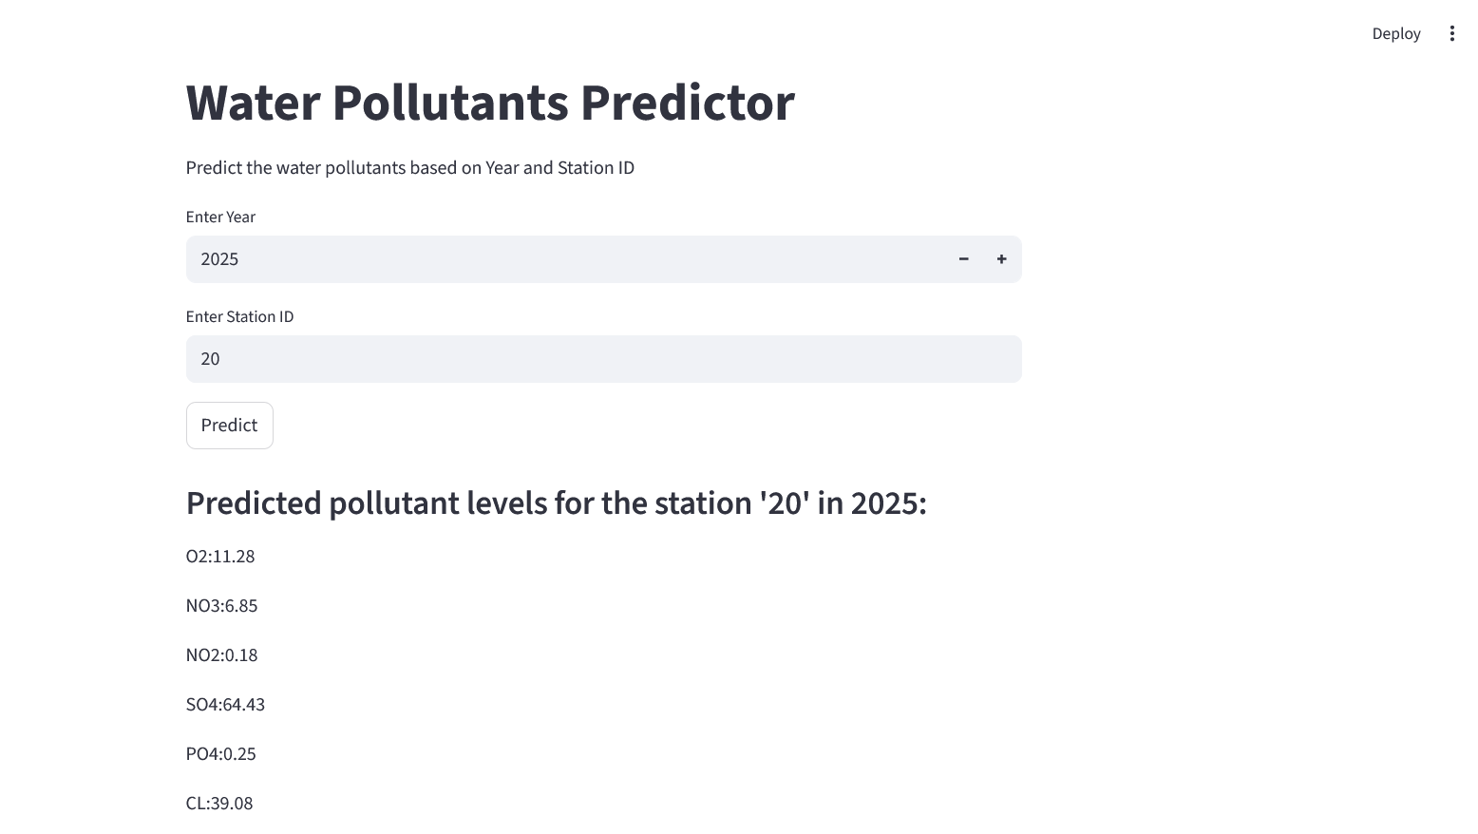
Screenshot of Output:

Slide 8
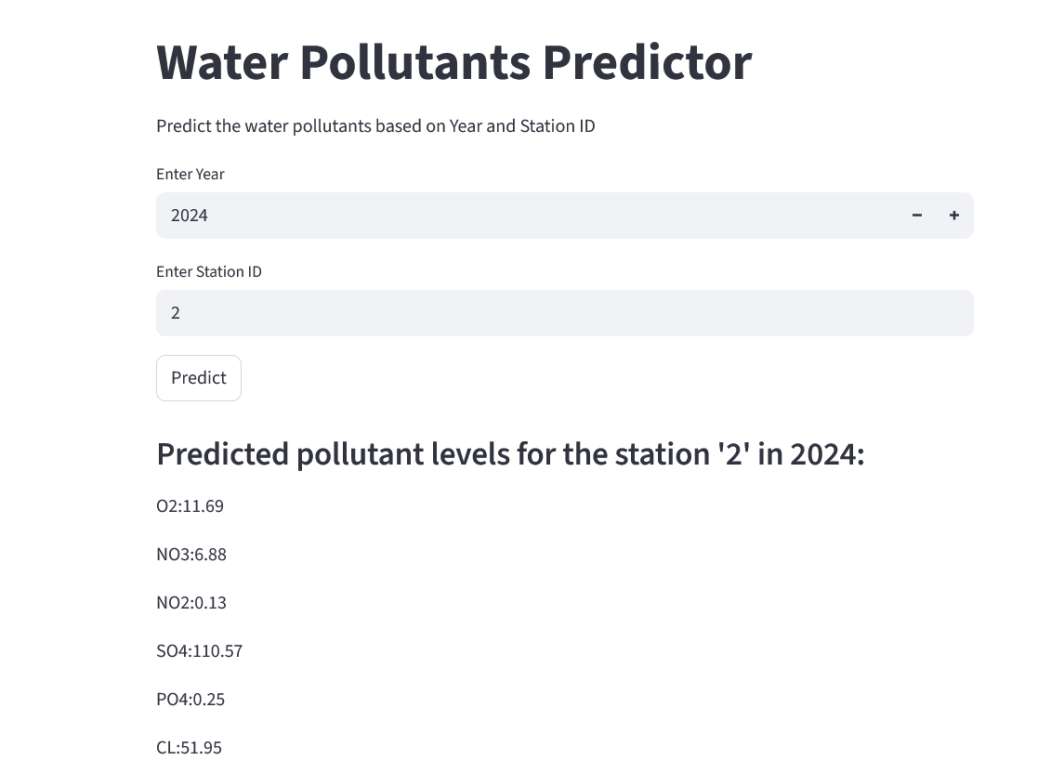
Screenshot of Output:

Slide 9
Conclusion:
The project successfully demonstrates the use of machine learning to predict key water pollutant levels using
historical data. A MultiOutput Random Forest Regressor model was implemented to estimate
six pollutants — O₂, NO₃, NO₂, SO₄, PO₄, and CL — based on the selected year and station ID.
A Streamlit web interface enables users to interact with the model in real time, making it accessible and deployable
in real-world applications.
Key Outcomes:
Successfully predicted water pollutant levels using a robust ML pipeline.
Model performance is strong across pollutants (high R² values).
Scalable solution: new stations or years can be easily added.
Helps in proactive water quality management and policy planning.
Promotes data-driven environmental monitoring and early warning systems
Git Link - https://github.com/Neha-chawda/AICTE_WaterQualityPrediction_Project.git

