Slide 1

LEAD SCORING
CAPSTONE PROJECT
Group 8:
Neha Jindal
Aviraj Roy
Lovely Kumari
Mohan C R
Nikhil Niket
Mentor:
Anjana Agrawal

Slide 2
PROBLEM STATEMENT
X Education sells online courses to industry professionals. Although X Education gets a lot of leads, its lead conversion rate is very poor. For example, If they acquire 100 leads in a day, only about 30 of them are converted.
To make this process more efficient, the company wishes to identify the most potential leads, also known as ‘Hot Leads’. If they successfully identify this set of leads, the lead conversion rate should go up as the sales team will now be focusing more on communicating with the potential leads rather than making calls to everyone.
Business Objective:
X education wants to know most promising leads.
For that they want to build a Model which identifies the hot leads and predict whether they’ll get converted to customer or not.
Deployment of the model for the future use.
Notes:
MOHAN

Slide 3
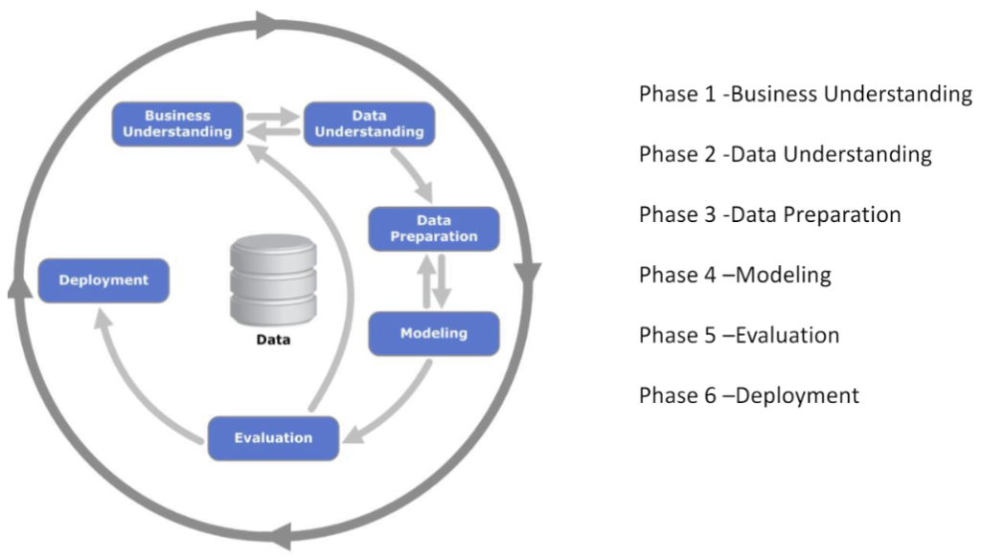
SOLUTION METHODOLOGY
Notes:
LOVELY

Slide 4
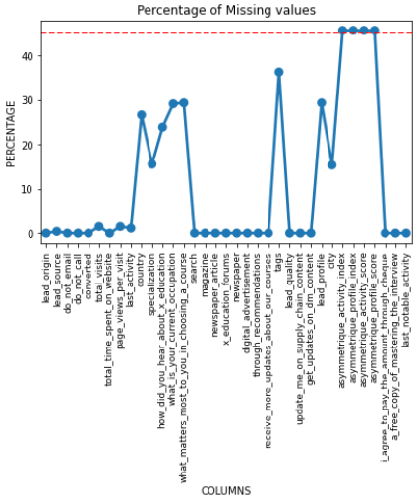
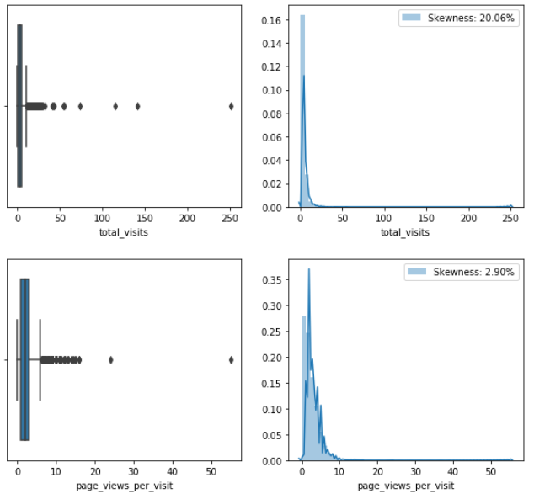
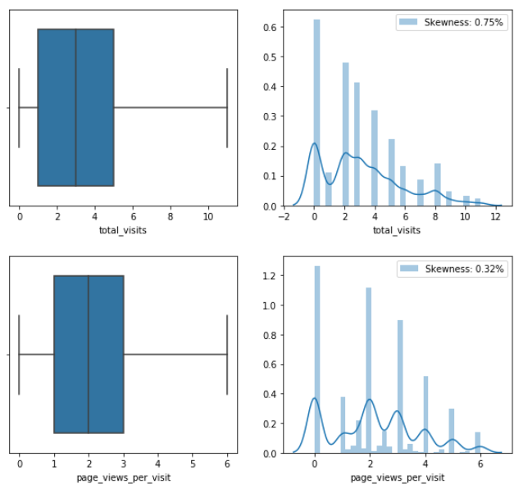
DATA MANIPULATION
IQR Treatment
Notes:
LOVELY

Slide 5
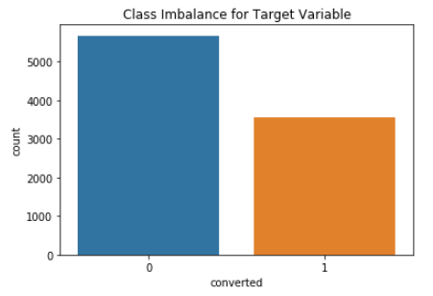
EXPLORATORY DATA ANALYSIS
The target variable has no class imbalance
Notes:
LOVELY

Slide 6
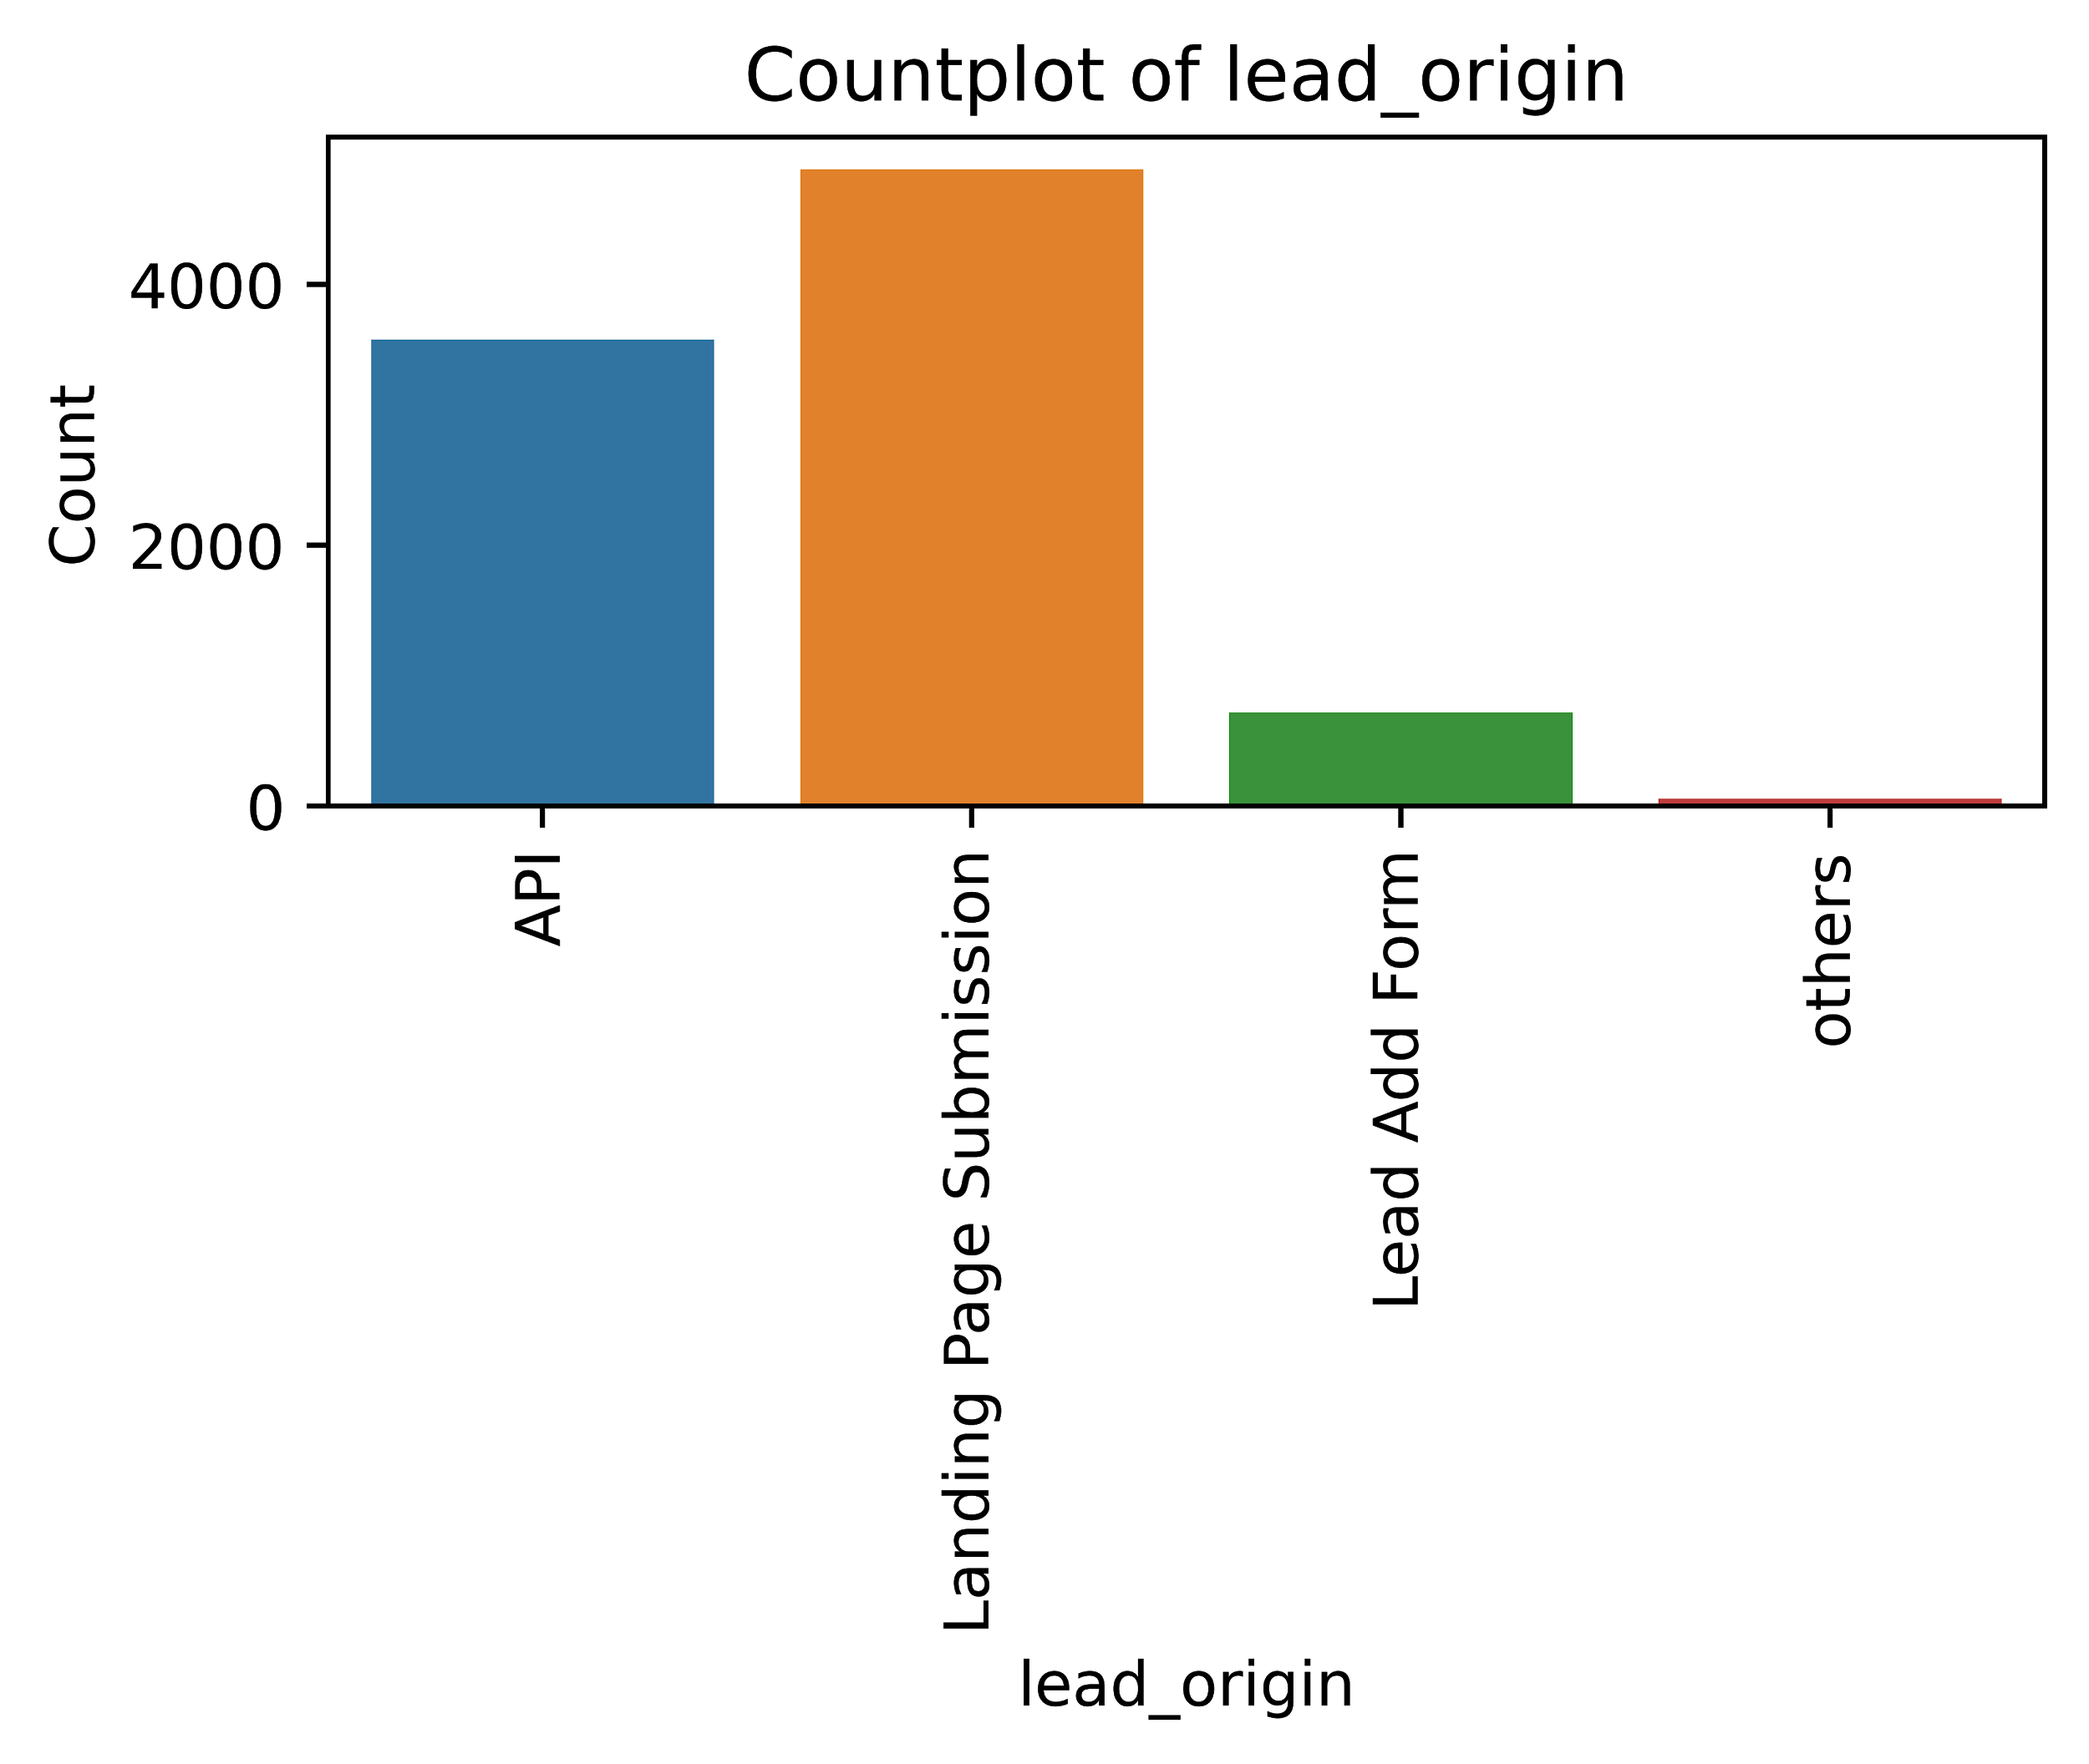
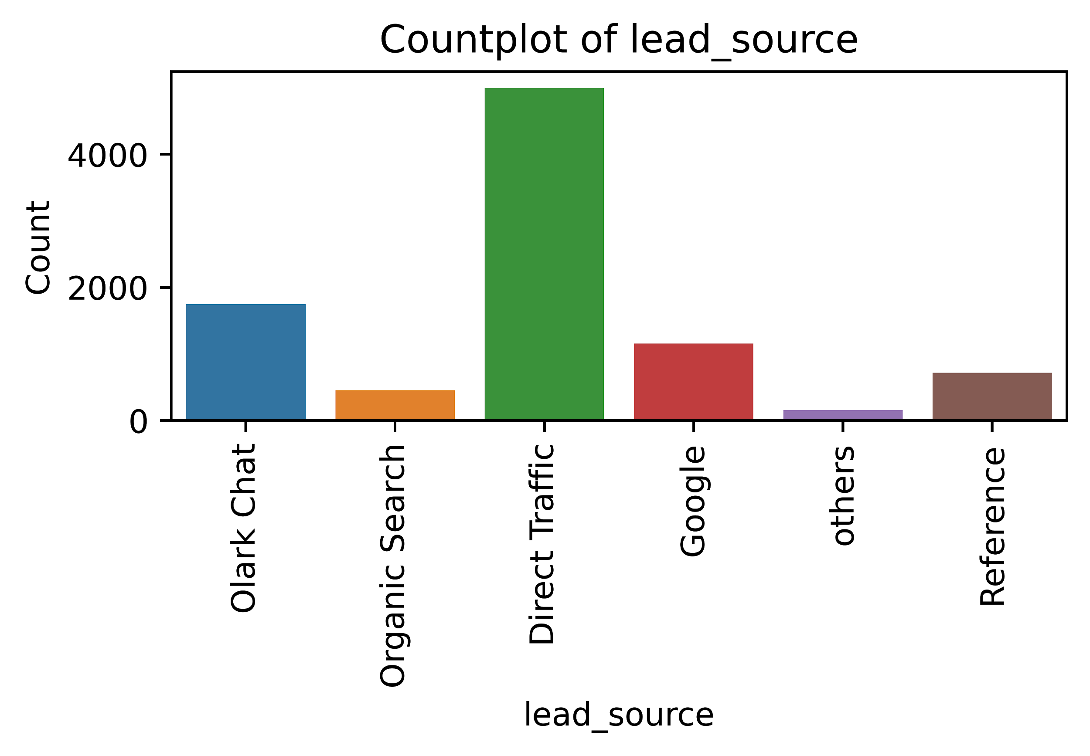
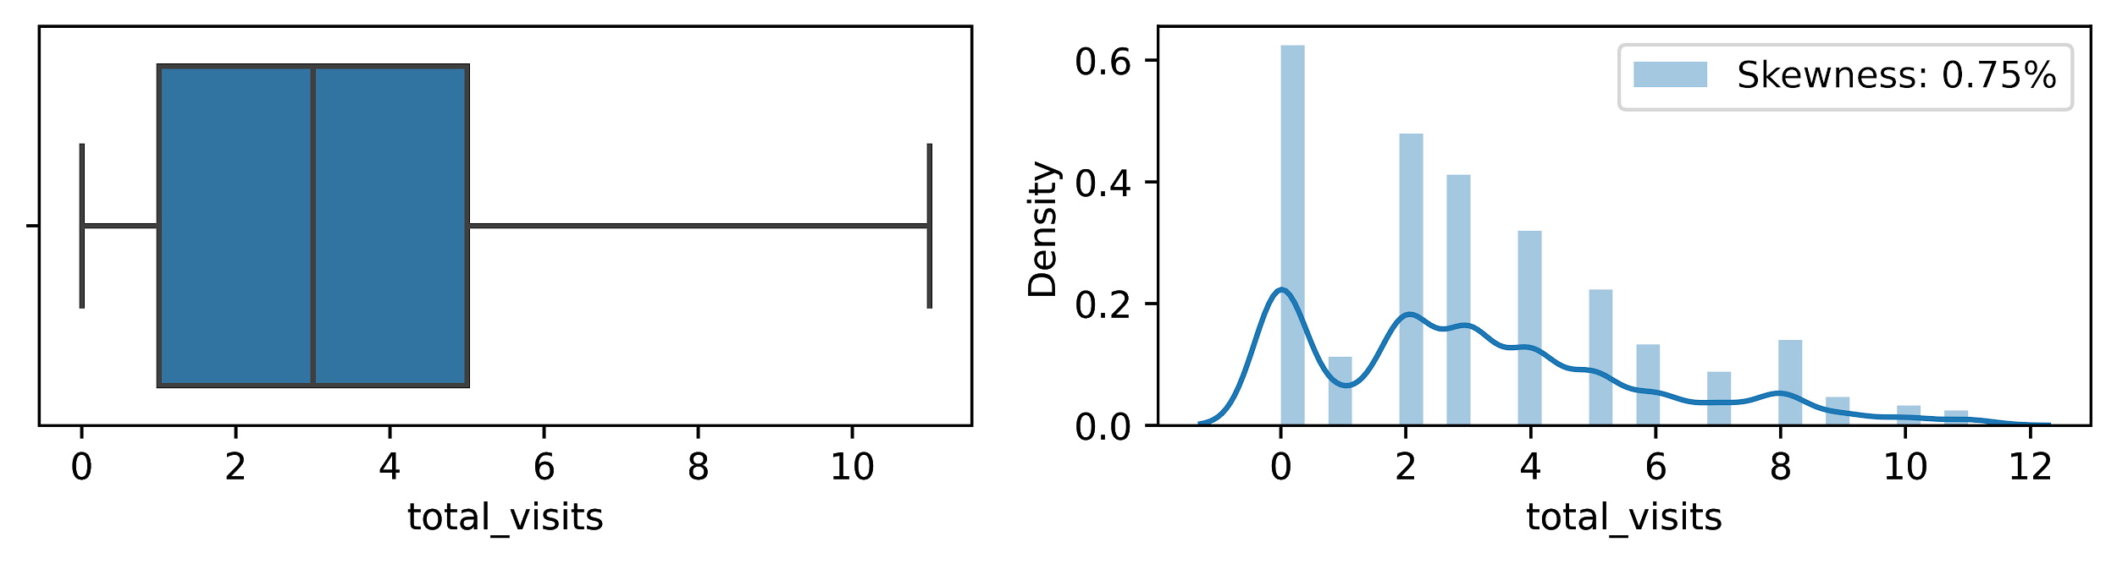
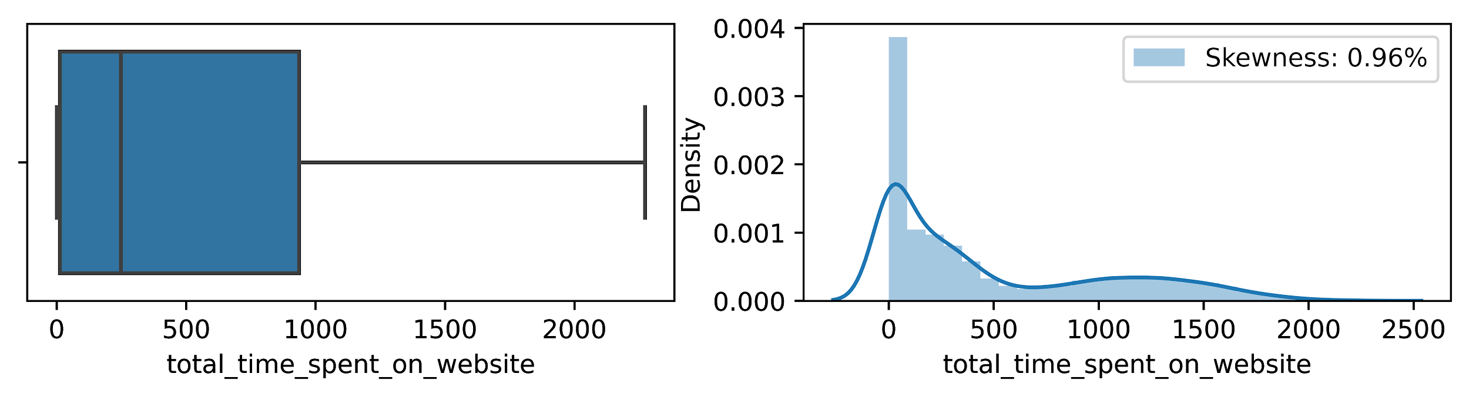
Univariate Analysis
The maximum number of leads are generated through Landing Page Submission
The leads are generated from 6 different sources, highest of which are generated through Direct Traffic
The customers who want to gain an idea about X education visit 1-5 times.
The least engagement of the website is from leads who tend to spend less time on the website
Notes:
LOVELY

Slide 7
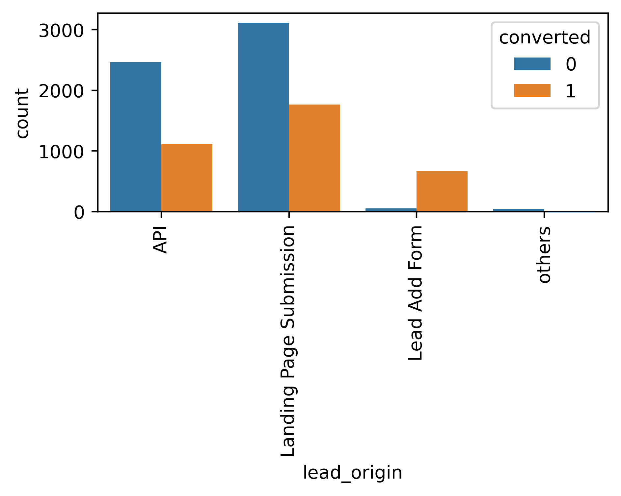
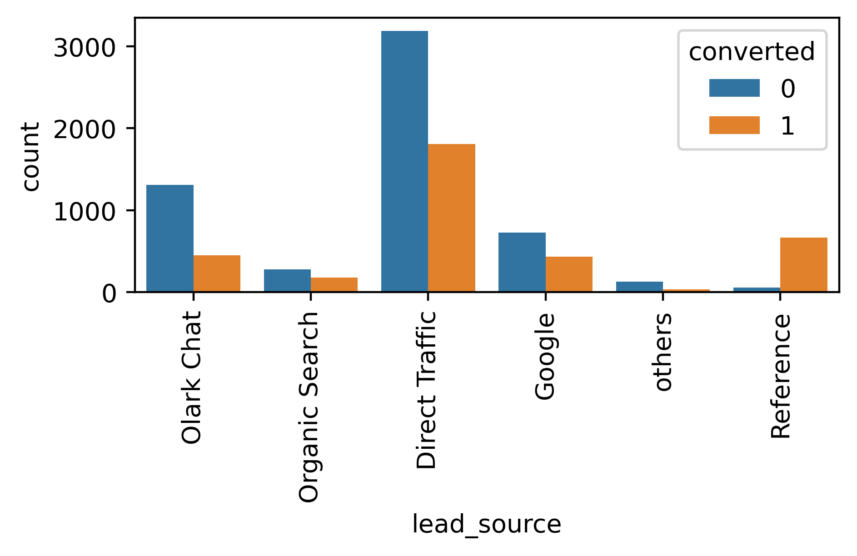
Bivariate Analysis & Key Insights
Categorical Vs Target Column
Lead Add Form has more than 90% conversion rate but count of lead are not extremely high
Olark Chat and Direct traffic generates maximum number of leads. Conversion Rate of Reference leads is high
Notes:
NIK

Slide 8
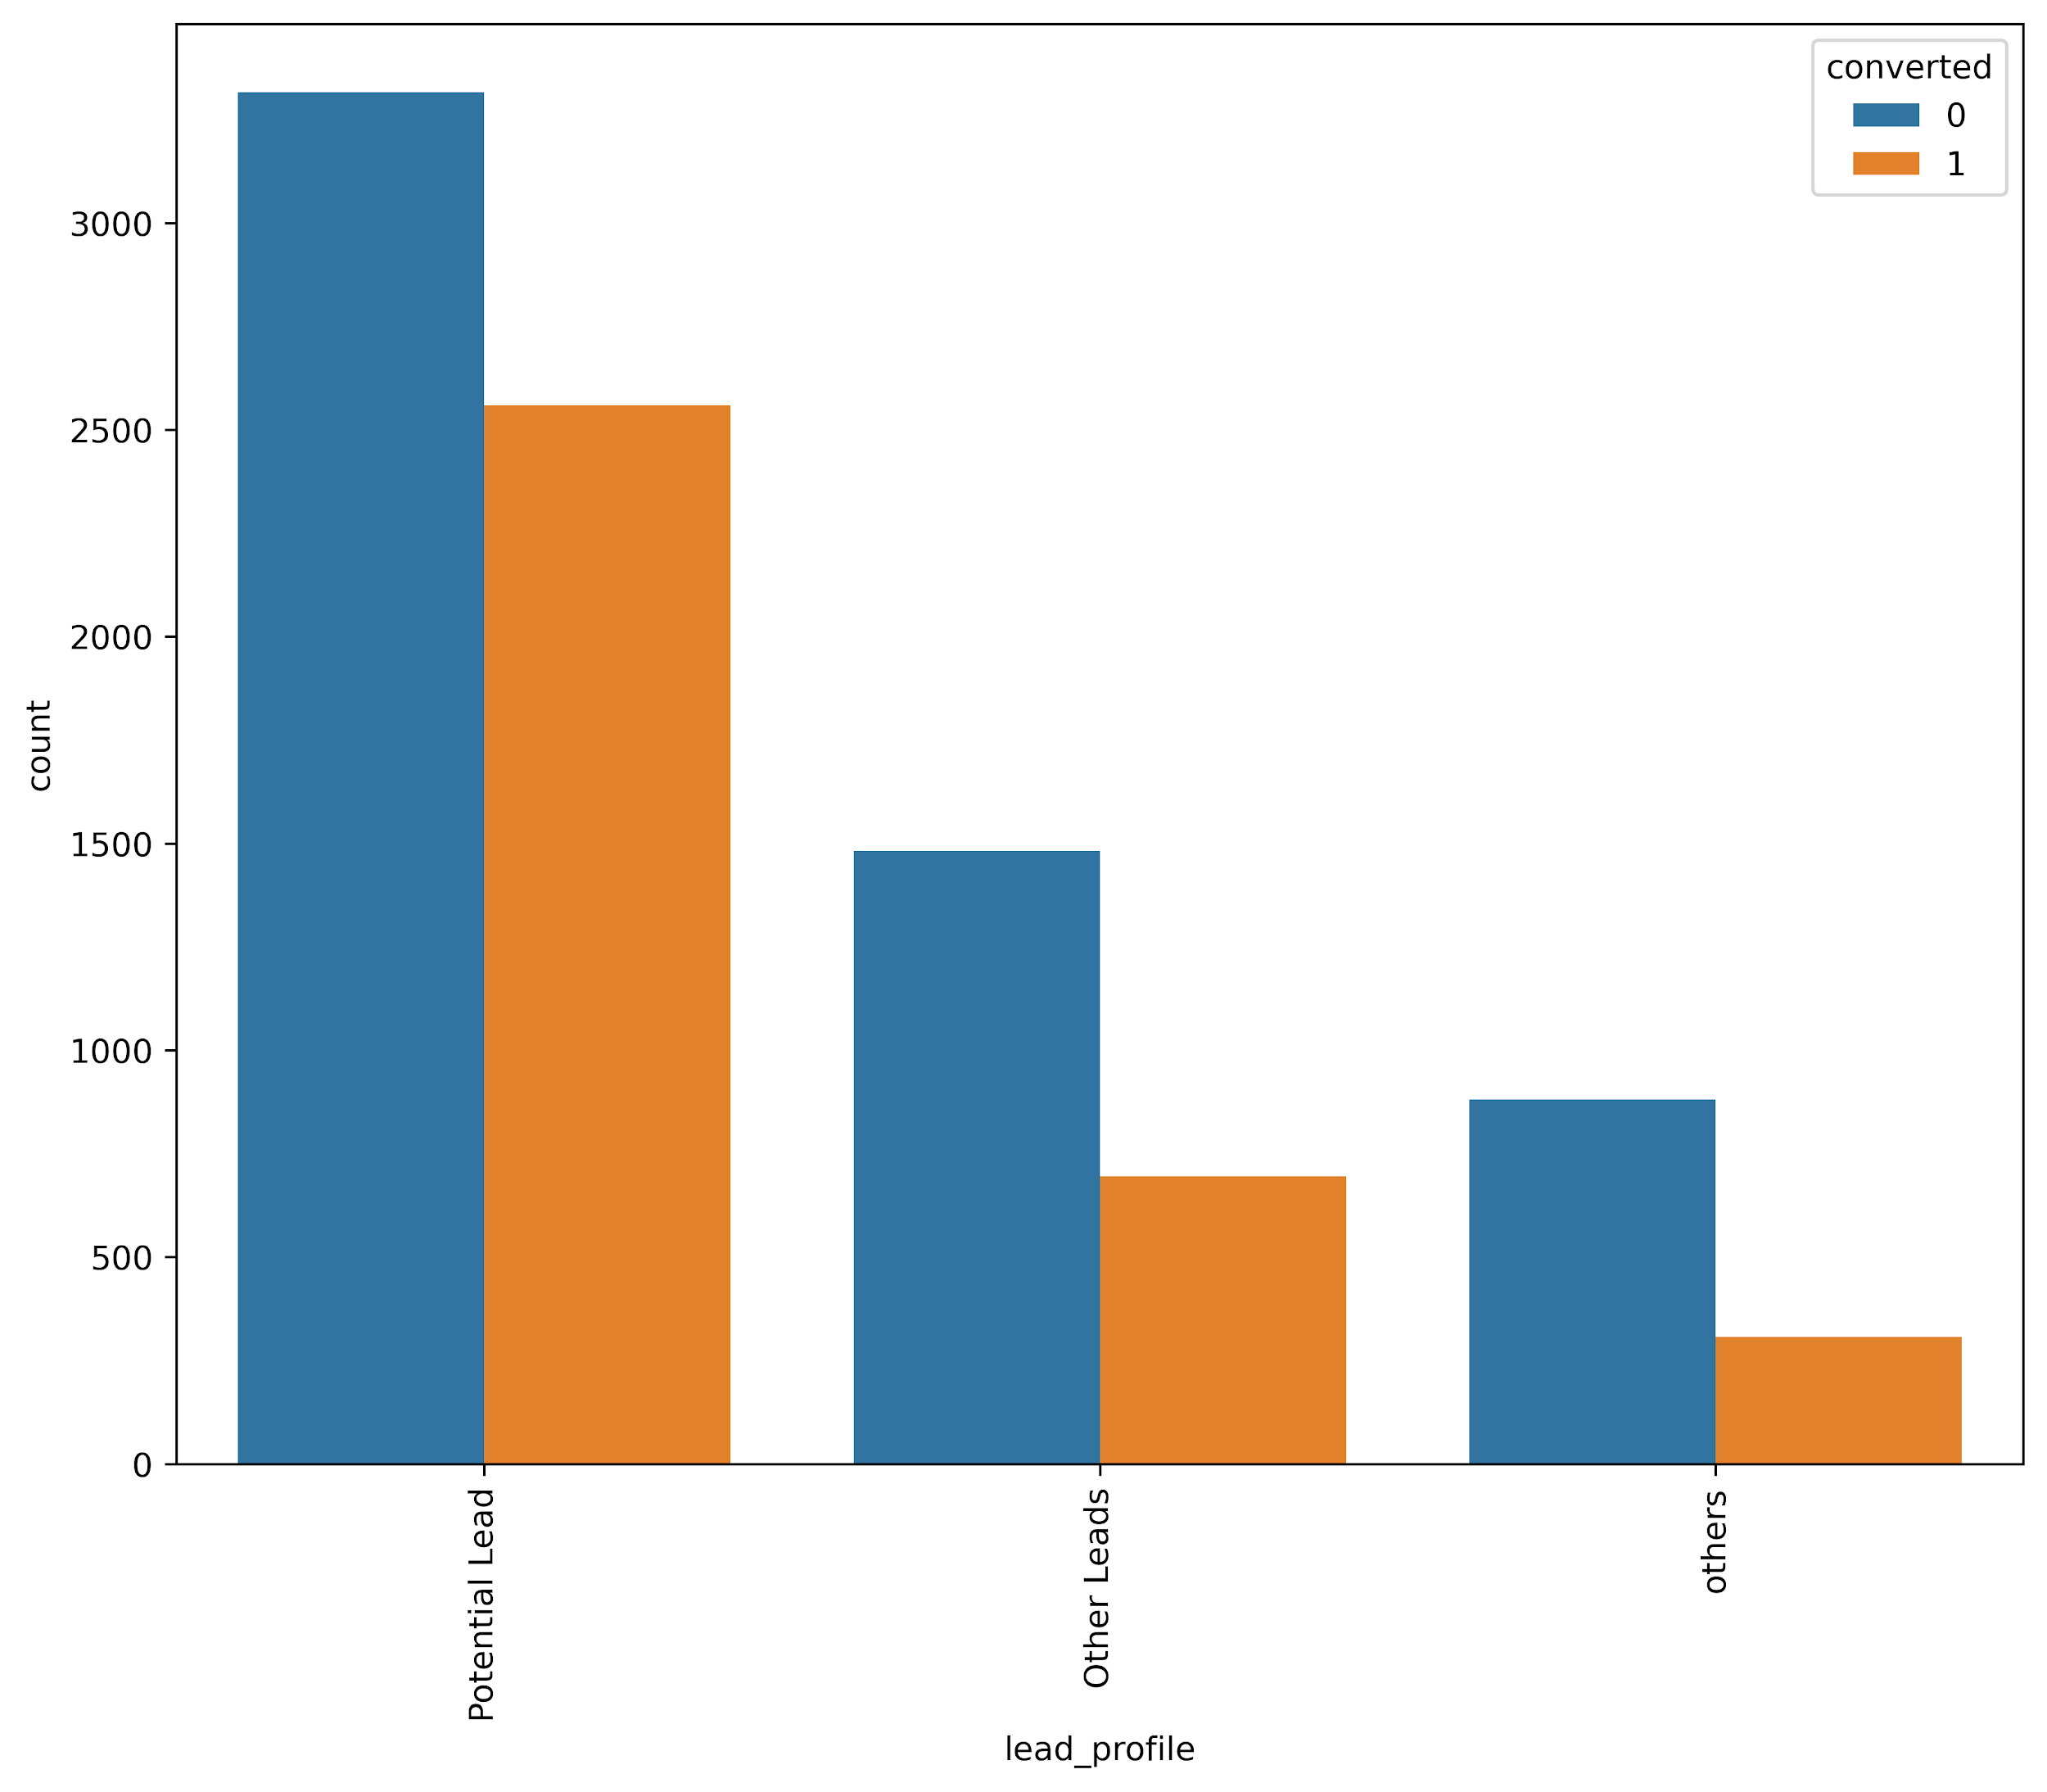
“Potential Leads” have highest conversion of 50%.
“Other Leads” and “Others” have ~40% conversion rate.

Slide 9
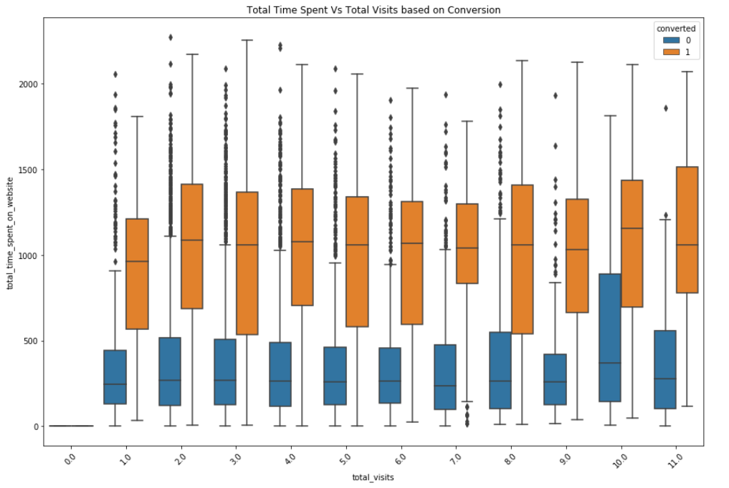
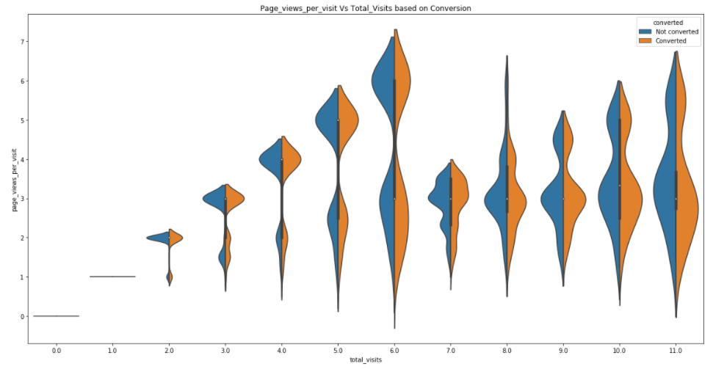
Multivariate Analysis
Numerical Vs Target Column
The highest number of conversions happen when people are spending around 18 hours or above on the website.
Most total visits on the website is 6. Until total visits is 6, the conversion rate is higher than when page views per visit is high. When total visits cross 6, the conversion rate drops as total pageviews decrease

Slide 10
STATISTICAL TESTS
Features | P-Value | Significance
Lead_Origin | 3.29e-212 | Yes
Lead_Source | 6.43e-223 | Yes
Do_Not_Email | 1.33e-38 | Yes
Last_Activity | 0 | Yes
Country | 0.011 | Yes
Specialization | 0.003 | Yes
How_did_you_hear_about_X_Education | 0.004 | Yes
What_is_your_current_occupation | 4.25e-114 | Yes
What_matters_most_to_you_in_choosing_a_course | 0.87 | No
Tags | 0 | Yes
Lead_Quality | 0 | Yes
Lead_Profile | 1.39e-40 | Yes
City | 0.18 | No
A_free_copy_of_Mastering_The_Interview | 0.00014 | Yes
Last_Notable_Activity | 5.55 e-279 | Yes
Total_visits | 9.06e-6 | Yes
total_time_spent_on_website | 6.06e-285 | Yes
Page_views_per_visit | 0.59 | No

Slide 11
FEATURE ENGINEERING
Numerical Variables are Normalized
Dummy Variables are created for object type variables
Total Rows for Analysis: 9240
Total Columns for Analysis: 18+1(Target)
VIF is used to reduce multi collinearity and dimensionality of the data.
SFS is used in selecting best features.
We have generated a new feature ‘time_spent_per_visit’ to reduce the number of features.
This new feature is significant towards target variable as per the T-Test conducted where p-value of the feature is less than 0.05.
Notes:
NEHA

Slide 12
MODEL BUILDING
TRANSFORMATION:
Scaling and transformation was done using Power Transformer
TRAIN TEST SPLIT:
Performing a train-test split, we have chosen 70:30 ratio
BASE MODEL:
We have built our base model with all features including the insignificant ones
FEATURE SELECTION:
We have selected best features using Sequential Feature Selection and Recursive Feature Elimination
FINAL MODEL:
Our final model is achieved by reducing dimensionality by using the VIF method for removing multicollinear features.

Slide 13
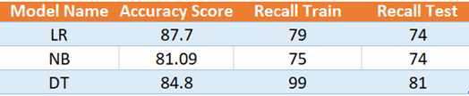
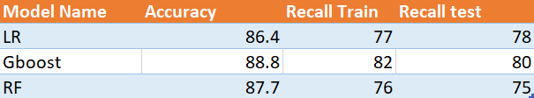
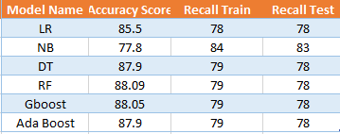
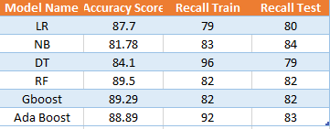
MODEL EVALUATION
We have given more importance to Recall score as the significance of False Negative is high i.e., we don’t want to miss any lead who is a potential buyer, but our model has classified as negative
Overall accuracy 87% for Logistic Regression used in Base Model
We derived a new feature and tested models on it with below accuracy
After Feature Selection using SFS, below results were achieved
After Feature Selection using RFE, below results were achieved
Notes:
AVIRAJ

Slide 14
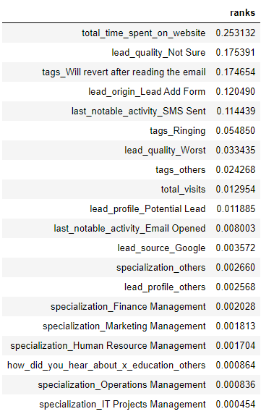
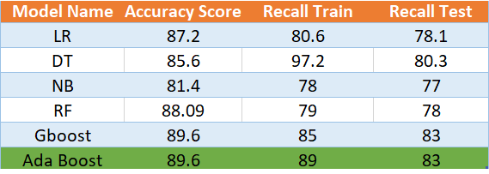


After extracting features by reducing dimensionality by VIF method, we achieved the best results

Slide 15
Key Observations: 1.Overall it is safe to say that the more time the user spends on the website, the better their chances of becoming a student. 2.We have observed the probability of a lead being converted into a customer increases with a small decrease of page_views_per_visit from its mean value the pivot point is when the total number of visits on the website is 6 When total visits cross 6, the conversion rate drops as total pageviews decrease. 3. Olark Chat and Direct traffic generate the maximum number of leads. The conversion Rate of Reference leads is high. 4.There exists an 80% conversion rate of working professionals who have previously worked/working in Finance Management, Human Resource Management, and Marketing Management. Unemployed people have been contacted in the highest number, the conversion rate is low ~40%. 5.The last notable activity being SMS Sent has the highest conversion rate of ~70%. Email opened has a good conversion rate of ~40%.
BUSINESS INSIGHTS
Notes:
AVIRAJ

Slide 16
Recommendation: 1.Approach the leads who spent more time and were not converted and collect the feedback so as to improve the user experience. 2.For the profiles having current_occupation as “Unemployed” the company can look for relevant skills in the lead profile and approach the lead by coming up with offering scholarships and loans. 3.Integration of course recommender into chat bots so as to suggest to the user the course which interests them the most rather than going through the entire course catalog and offering some free content in that particular course. 4.Since the ‘Email opened’ last notable activity has a good conversion rate of 40%. The company can go about increasing this interaction rate by reducing the output email for a particular user rather they can go about mentioning free course contents that the user might be interested in.

Slide 17
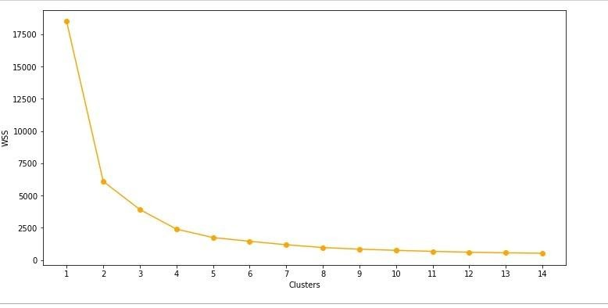
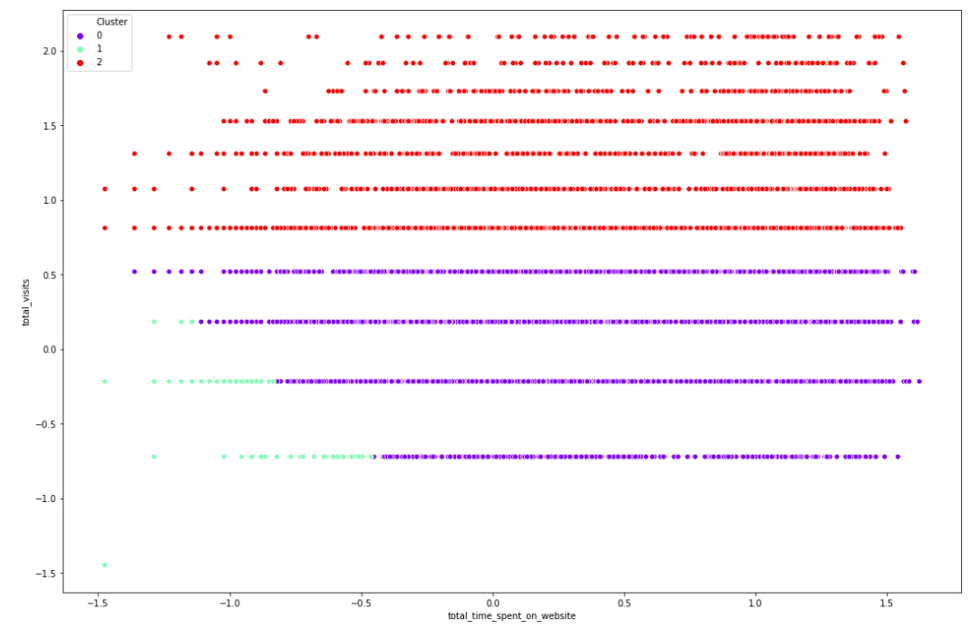

FUTURE SCOPE
Treating this dataset as unsupervised and forming clusters led us to interpret that this is a multiclass dataset and not binary.
Here we see that we get good precision and recall scores for both Logistic & Random Forest Models. We shall go ahead with the LR model for multiclass target labels. Here Class 2- Converted, Class 1- Not Converted and Class 0- Could be Converted. Hence, correctly predicting Class 0 customers is helpful for X Education’s increase of Conversion rate as they should be focused more on these leads.
The LR model gives no error in Class 1 and Class 2 and it gives lesser error than Random Forest Model for Class-0 as it is the most important class to focus on to increase sales
Notes:
AVIRAJ

Slide 18
Thank You!
Proprietary content. ©MilleNNiALs💯. All Rights Reserved. Unauthorized use or distribution prohibited.

