Slide 1

APEX INSTITUTE OF TECHNOLOGY
DEPARTMENT OF COMPUTER SCIENCE & ENGINEERING
Artificial Intelligence (20CSD-385)
Faculty: Ankur Sharma(E13693)
Lecture – 1.2.5
Searching Techniques
DISCOVER . LEARN . EMPOWER

Slide 2
Artificial Intelligence : Course Objectives
COURSE OBJECTIVES
(AI) is a research field that studies how to realize the intelligent human behaviors on a computer. The ultimate goal of AI is to make a computer that can learn, plan, and solve problems autonomously. Although AI has been studied for more than half a century, we still cannot make a computer that is as intelligent as a human in all aspects, The main research topics in AI include: problem solving, reasoning, planning, natural language understanding, computer vision, automatic programming, machine learning, and so on. Of course, these topics are closely related with each other. In this course, we will study the most fundamental knowledge for understanding AI. We will introduce some basic search algorithms for problem solving; knowledge representation and reasoning; pattern recognition; fuzzy logic; and neural networks

Slide 3
COURSE OUTCOMES
On completion of this course, the students shall be able to:-
CO1 | Understand the basics of the theory and practice of Artificial Intelligence as a discipline and about intelligent agents capable of problem formulation
CO2 | Apply different uninformed search algorithms on well formulate problems along with stating valid conclusions that the evaluation supports.

Slide 4
Unit-1 Syllabus
Unit-1
Ch1.Introduction to AI | Introduction Artificial Intelligence and its applications, Artificial Intelligence Techniques, Intelligent Agents, Nature of Agents, Learning Agents., advantages, and limitations of AI, Application of AI.
Ch2.Searching techniques | Problem solving techniques State space search, control strategies, Blind search
Ch3.Informed search | Heuristic search, problem characteristics, production system characteristics., Generate and test, Hill climbing, best first search, A* search, Constraint satisfaction problem.

Slide 5
SUGGESTIVE READINGS
TEXT BOOKS
T1. Artificial Intelligence: A Modern Approach by Stuart Russell and Peter Norvig. Prentice-Hall, 2003 (2ndEdition). T2. Elaine Riche, Kevin Knight and Shivashankar B. Nair, “Artificial Intelligence”, Third Edition, TMH Educations Pvt. Ltd., 2008
REFERENCE BOOKS
R1 Nils J. Nilsson, “The Quest for Artificial Intelligence”, Second Edition, Cambridge University Press, 2009
R2 Artificial Intelligence and Expert Systems – Dan W. Patterson, Prentice Hall of India

Slide 6
Depth Limited Search(DLS):
DLS is an uninformed search algorithm. This is similar to DFS but differs only in a few ways. The sad failure of DFS is alleviated by supplying a depth-first search with a predetermined depth limit. That is, nodes at depth are treated as if they have no successors. This approach is called a depth-limited search.

Slide 7
Depth Limited Search(DLS):
The depth limit solves the infinite-path problem. Depth-limited search can be halted in two cases:
— Standard Failure Value(SFV): The SFV tells that there is no solution to the problem.
— Cutoff Failure Value(CFV): The Cutoff Failure Value tells that there is no solution within the given depth-limit.

Slide 8
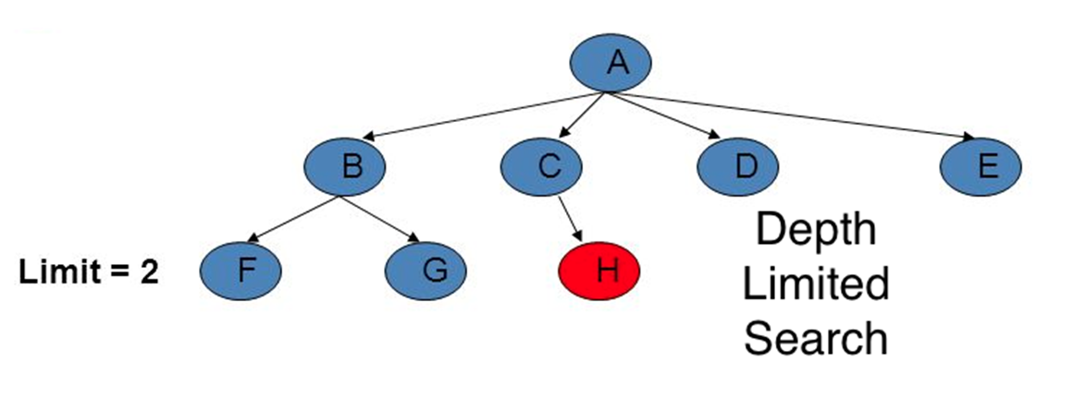
Depth Limited Search(DLS):
Node A is at Limit = 0, followed by nodes B, C, D, and E at Limit = 1 and nodes F, G, and H at Limit = 2. Our start state is considered to be node A and our goal state is node H. To reach node H we apply DLS.

Slide 9
Depth Limited Search(DLS):
Advantages:
Depth-limited search is Memory efficient.
Disadvantages:
The DLS has disadvantages of completeness and is not optimal if it has more than one goal state.
Conclusions:
Complete: Complete (if solution > depth-limit)
Time Complexity: O(bl) where, l -> depth-limit
Space complexity: O(bl)

Slide 10
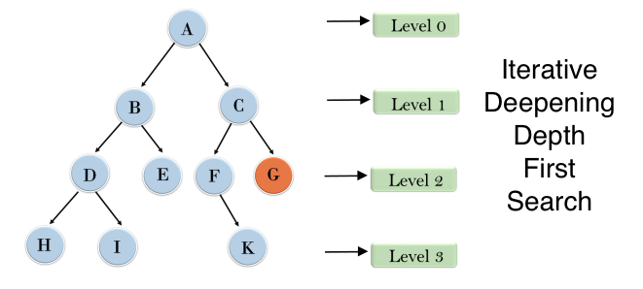
Iterative Deepening Depth First Search(IDDFS):
It is a search algorithm that uses the combined power of the BFS and DFS Algorithm. It is iterative in nature. It searches for the best depth in each iteration. It performs the Algorithm until it reaches the goal node. The algorithm is set to search until a certain depth and the depth keeps increasing at every iteration until it reaches the goal state.

Slide 11
Iterative Deepening Depth First Search(IDDFS):
IDDFS from node A. In the first iteration, it traverses only node A at level 0. Since the goal is not reached we expand our nodes, go to the next level i.e. 1 and move to the next iteration. Then in the next iteration, we traverse the node A, B, and C
next iteration, we traverse the node A, B, and C. Even in this iteration our goal state is not reached so we expand the node to the next level i.e. 2, and the nodes are traversed from the start node or the previous iteration and expand the nodes A, B, C, D, E, F, G. Even though the goal node is traversed we go through for the next iteration and the remaining nodes A, B, D, H, I, E, C, F, K, G(BFS & DFS) too are explored and we find the goal state in this iteration.

Slide 12
Iterative Deepening Depth First Search(IDDFS):
Advantages:
It combines the benefits of BFS and DFS search algorithms in terms of fast search and memory efficiency.
Disadvantages:
The main drawback of IDDFS is that it repeats all the work from the previous phase.
Conclusions:
Complete: Yes (by limiting the depth)
Time Complexity: O(bd)
Space complexity: O(bd)

Slide 13
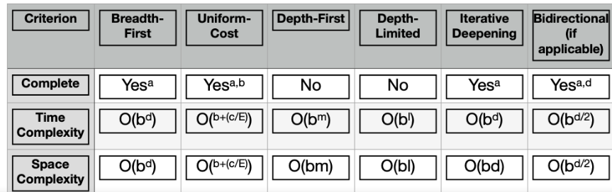
FINAL
The Uninformed Search strategies for searching is a multipurpose strategy that combines the power of unguided search and works in a brute force way

Slide 14
REFERENCES
Artificial Intelligence: A Modern Approach by Stuart Russell and Peter Norvig. Prentice-Hall, 2003 (2nd Edition).

Slide 15
THANK YOU
For queries
Email: Ankur.e13693@cumail.in

