Slide 1

APEX INSTITUTE OF TECHNOLOGY
DEPARTMENT OF COMPUTER SCIENCE & ENGINEERING
Artificial Intelligence (20CSD-385)
Faculty: Ankur Sharma(E13693)
Lecture – 2.1
FOPL
DISCOVER . LEARN . EMPOWER

Slide 2
Artificial Intelligence : Course Objectives
COURSE OBJECTIVES
(AI) is a research field that studies how to realize the intelligent human behaviors on a computer. The ultimate goal of AI is to make a computer that can learn, plan, and solve problems autonomously. Although AI has been studied for more than half a century, we still cannot make a computer that is as intelligent as a human in all aspects, The main research topics in AI include: problem solving, reasoning, planning, natural language understanding, computer vision, automatic programming, machine learning, and so on. Of course, these topics are closely related with each other. In this course, we will study the most fundamental knowledge for understanding AI. We will introduce some basic search algorithms for problem solving; knowledge representation and reasoning; pattern recognition; fuzzy logic; and neural networks

Slide 3
COURSE OUTCOMES
On completion of this course, the students shall be able to:-
CO3 | Design and Analyse search algorithms on well formulated problems.
CO4 | Evaluate the problem using Propositional and First order logic.

Slide 4
Unit-2 Syllabus
Unit-2 |  | Contact Hours:15 hours
Ch1. FOPL & Knowledge representation | First order logic. Inference in first order logic, propositional vs. first order inference, unification & lifts forward chaining, Backward chaining, Resolution,
Ch2. REASONING Programming: | Reasoning under uncertainty, review of probability, Bayes’ Logic probabilistic interferences and dempster Shafer theory.
Ch 3. Knowledge representation | Knowledge representation issues, predicate logic- logic programming, semantic nets- frames and inheritance, constraint propagation, representing knowledge using rules, rules-based deduction systems.

Slide 5
SUGGESTIVE READINGS
TEXT BOOKS
T1. Artificial Intelligence: A Modern Approach by Stuart Russell and Peter Norvig. Prentice-Hall, 2003 (2ndEdition). T2. Elaine Riche, Kevin Knight and Shivashankar B. Nair, “Artificial Intelligence”, Third Edition, TMH Educations Pvt. Ltd., 2008
REFERENCE BOOKS
R1 Nils J. Nilsson, “The Quest for Artificial Intelligence”, Second Edition, Cambridge University Press, 2009
R2 Artificial Intelligence and Expert Systems – Dan W. Patterson, Prentice Hall of India

Slide 6
FOPL & Knowledge representation
First order logic, Inference in first order logic, propositional vs. first order inference, unification & lifts forward chaining, Backward chaining, Resolution,

Slide 7

Inference Procedures
There exist complete and sound proof procedures for propositional and FOL.
– Propositional logic
• Use the definition of entailment directly. Proof procedure is exponential in n, the number of symbols.
• In practice, can be much faster…
• Polynomial-time inference procedure exists when KB is expressed as Horn clauses:
where the Pi and Q are non-negated atoms.
– First-Order logic
• Godel’s completeness theorem showed that a proof procedure exists…
• But none was demonstrated until Robinson’s 1965 resolution algorithm.
• Entailment in first-order logic is semi decidable.

Slide 8
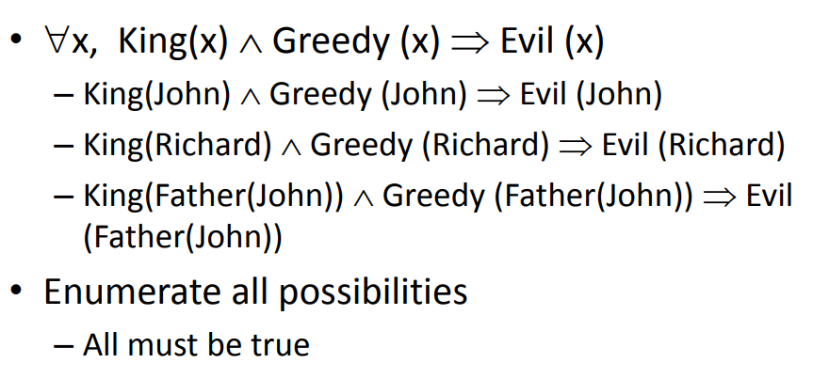
Types of inference
Universal Instantiation
• Reduction to propositional logic
– Then use propositional logic inference, e.g. enumeration, chaining
• Manipulate rules directly

Slide 9
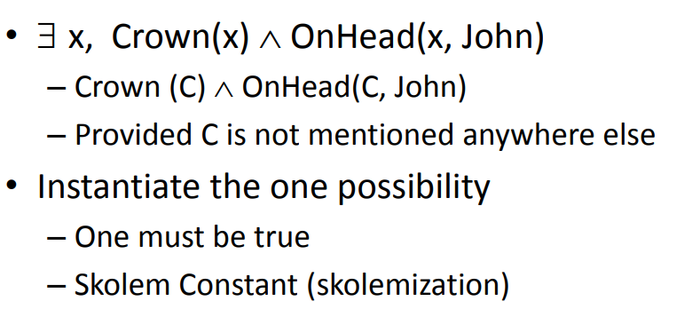
Existential Instantiation

Slide 10
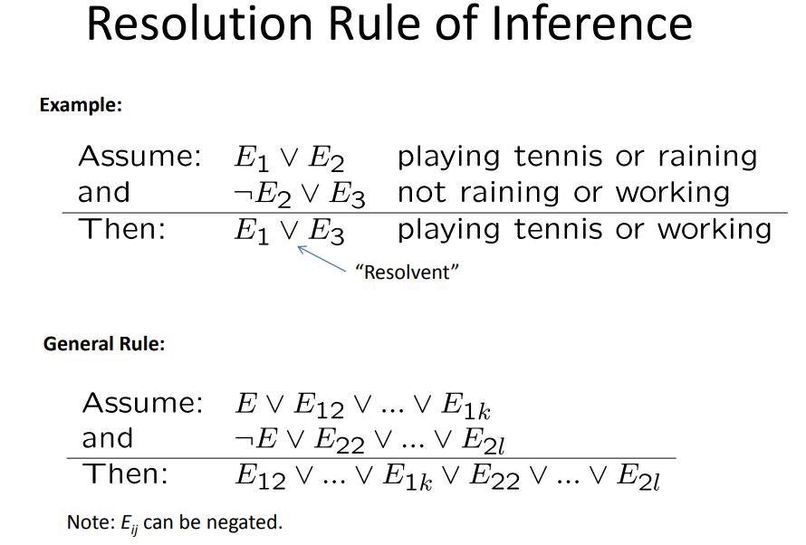
Algorithm: Resolution Proof
• Negate the original theorem to be proved, and add the
result to the knowledge base.
• Bring knowledge base into conjunctive normal form
(CNF)
– CNF: conjunctions of disjunctions
– Each disjunction is called a clause.
• Repeat until there is no resolvable pair of clauses:
– Find resolvable clauses and resolve them.
– Add the results of resolution to the knowledge base.
– If NIL (empty clause) is produced, stop and report that the
(original) theorem is true.
• Report that the (original) theorem is false.

Slide 11
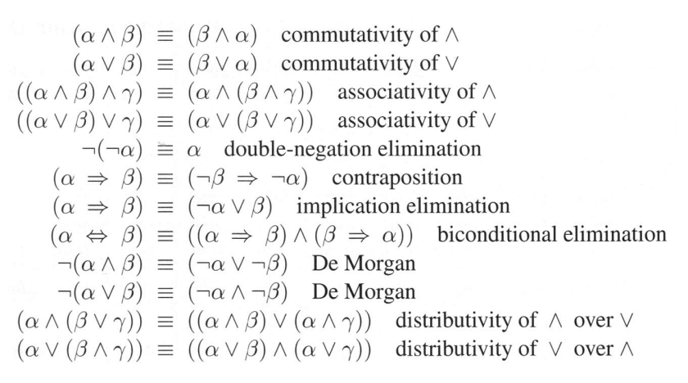

Slide 12
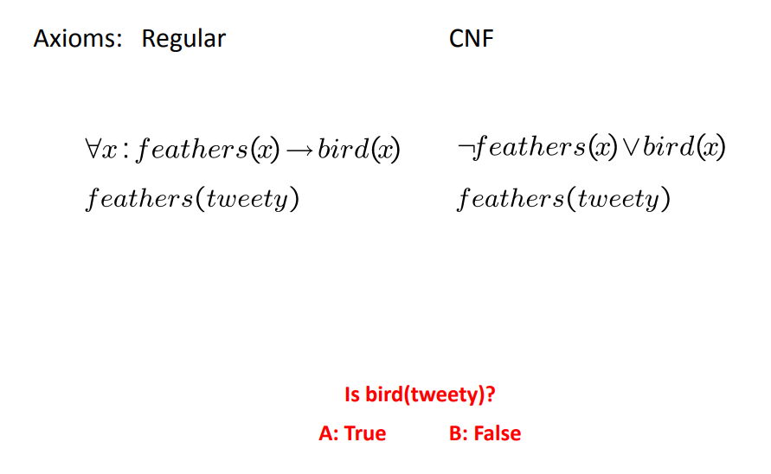
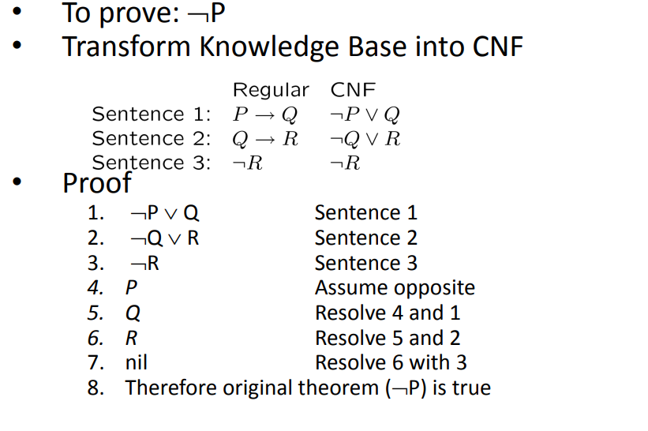
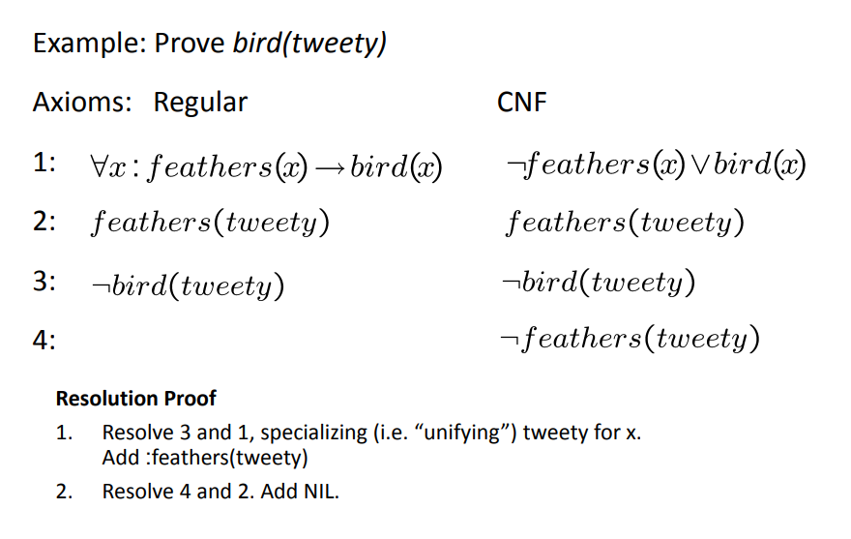
Resolution Example: Propositional Logic

Slide 13
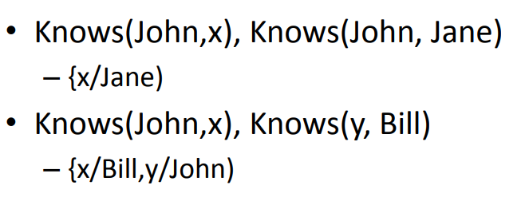
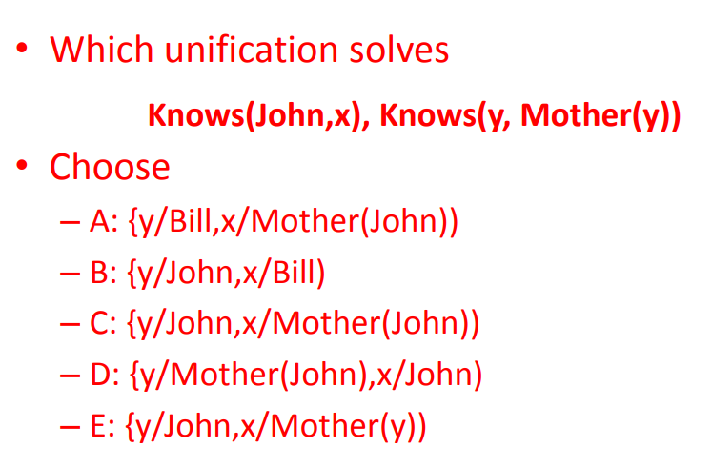
Unification
Unify procedure: Unify(P,Q) takes two atomic (i.e. single predicates) sentences P and Q and returns a substitution that makes P and Q identical.
Unifier: a substitution that makes two clauses resolvable.

Slide 14
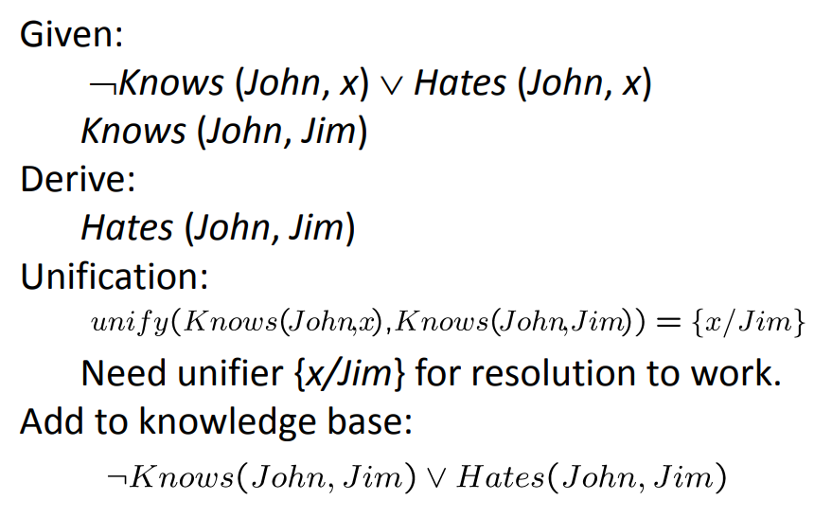
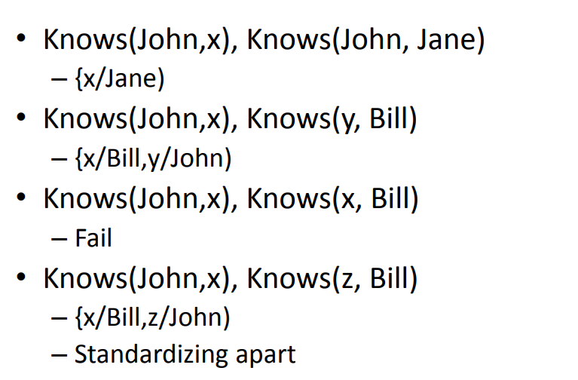

Slide 15
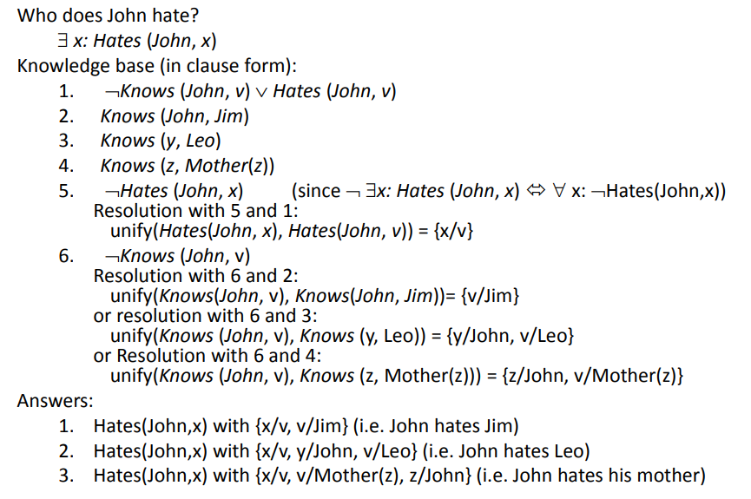
Unification (example)

Slide 16
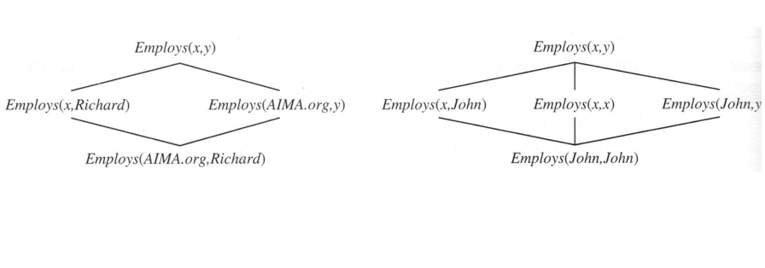
Subsumption Lattice

Slide 17
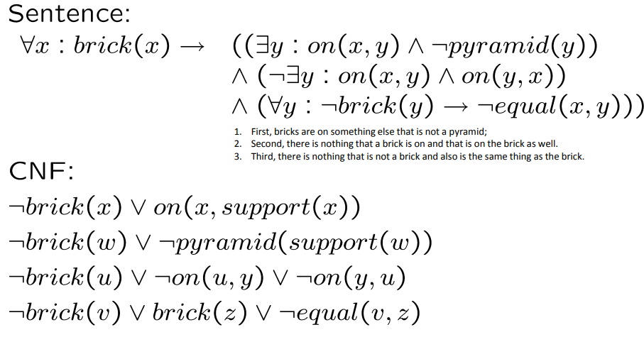
Converting More Complicated Sentences to CNF

Slide 18
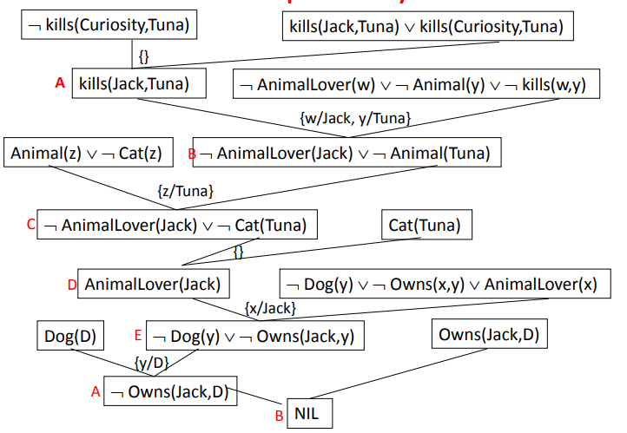
Find Mistake in proof by Resolution

Slide 19
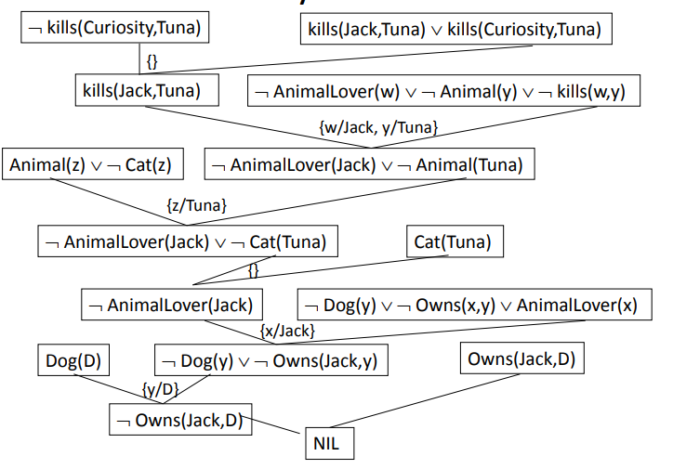
Proof by Resolution

Slide 20
REFERENCES
Artificial Intelligence: A Modern Approach by Stuart Russell and Peter Norvig. Prentice-Hall, 2003 (2nd Edition).

Slide 21
THANK YOU
For queries
Email: Ankur.e13693@cumail.in

