Slide 1


DESCRIPTIVE DATA ANALYSIS OF CREDIT CARD TRANSACTIONS
Presented By,
Neha Gamanagatti (1MV19IS039)
Vaishnavi R (1MV19IS062)
8th semester
Information Science and Engineering
Sir MVIT, Bengaluru
Guided by,
Mr. Manohar R
Asst. Prof. Dept. Of ISE,
Sir MVIT, Bengaluru

Slide 2

Introduction
In this presentation, we will explore the art of data analysis, which is the process of examining and interpreting data to extract meaningful insights. We'll cover the different types of data, techniques and tools used in data analysis, and the beneﬁts of effective data analysis.

Slide 3
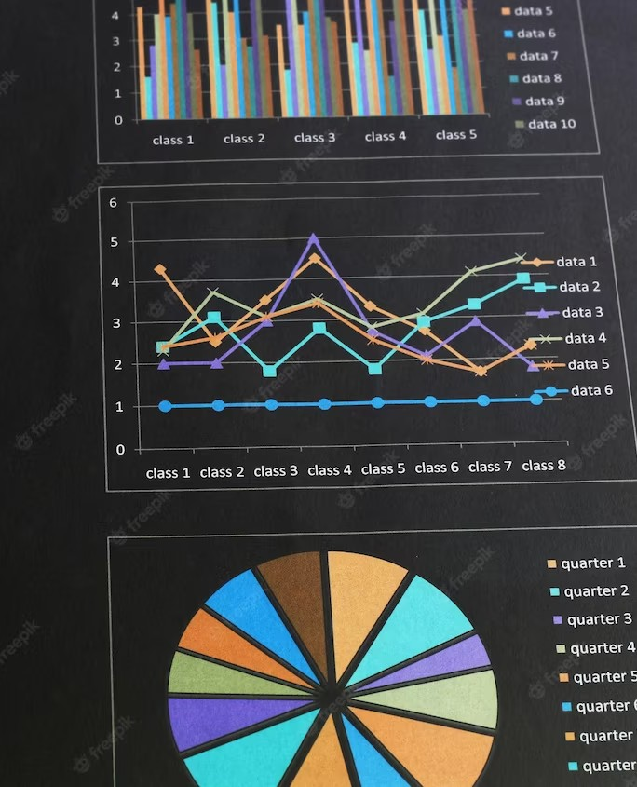
Types of Data
Data can be classiﬁed into two types:
qualitative and quantitative. Qualitative data is descriptive and non-numeric, while quantitative data is numeric and measurable.
Understanding the type of data you're working with is critical to selecting the appropriate analysis techniques.

Slide 4

Data Analysis Techniques
There are several data analysis techniques, including descriptive, inferential, and predictive analysis. Descriptive analysis involves summarizing and visualizing data, inferential analysis involves drawing conclusions from a sample to a larger population, and predictive analysis involves forecasting future events based on historical data.

Slide 5

Data Analysis Tools
There are numerous data analysis tools available, ranging from spreadsheets to specialized software. Some popular tools include Microsoft Excel, R, and Python. These tools provide powerful capabilities for data manipulation, visualization and modeling.

Slide 6




SOFTWARE USED

Slide 7

Beneﬁts of Data Analysis
Effective data analysis provides numerous beneﬁts, including identifying trends and patterns, improving decision-making, and increasing operational efﬁciency. By unlocking insights hidden in data, businesses can gain a competitive edge and achieve strategic goals.

Slide 8

Unveiling Insights: A Comprehensive Guide to Descriptive Data Analysis

Slide 9

Introduction
Descriptive data analysis is an essential tool for making sense of large datasets. In this presentation, we will cover the basic concepts of descriptive data analysis and its importance in decision making.

Slide 10

Data Visualization
Visualizing data is key to understanding it. Charts, graphs, and tables can be used to identify trends and patterns in the data. We will explore the different types of visualizations and how to choose the right one for your data.

Slide 11

Credit Cards
Credit card transactions have become an integral part of our daily lives. This presentation aims to provide a comprehensive study on the analysis of credit card transactions. The objective is to understand the patterns of credit card usage and the signiﬁcance of these patterns.

Slide 12

Credit Card Usage
The frequency and amount of transactions made using credit cards are important factors that need to be analyzed. This slide will provide an insight into the trends and patterns of credit card usage. The data will be presented using graphs and charts.

Slide 13
OBJECTIVES
Analyses consumer trends and interests by looking at
the type of purchases people make based on their gender and city.
To help in product marketing analysis.
Allows to identify the top merchants based on
the number of transactions and the value of the transaction.

Slide 14
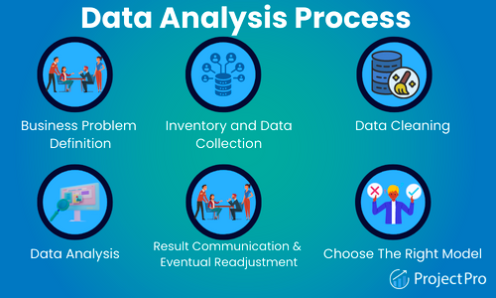

Slide 15
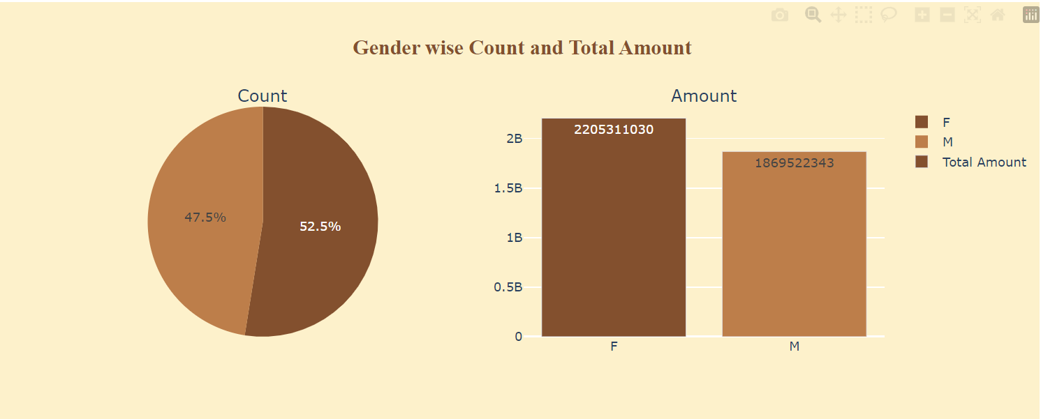
Results

Slide 16
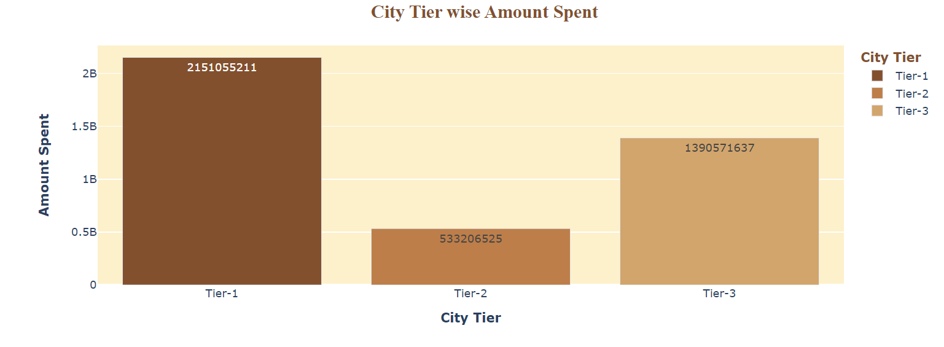

Slide 17
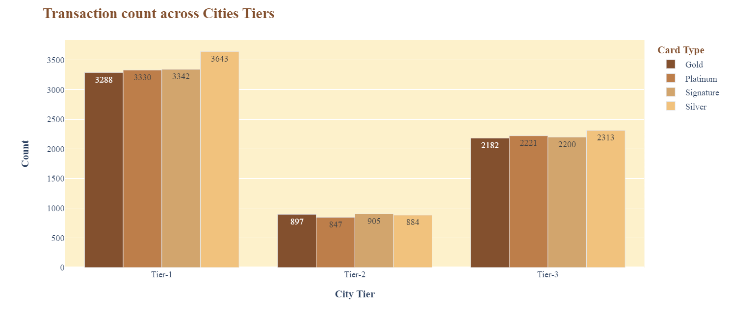

Slide 18
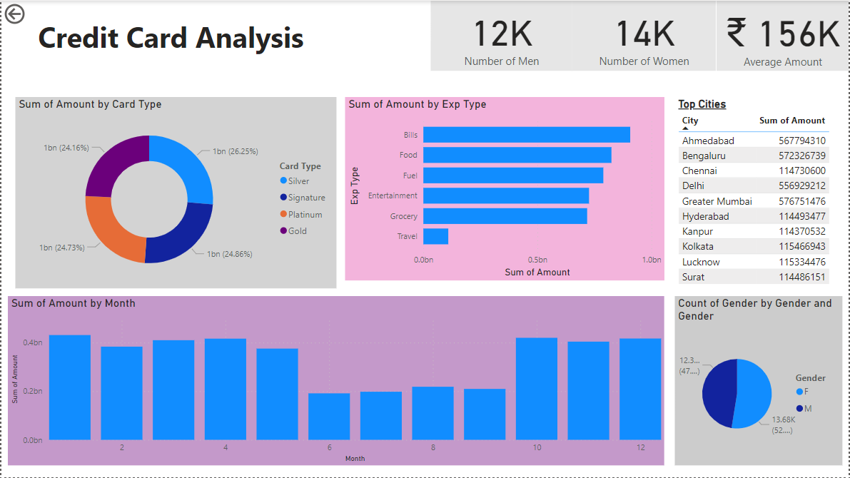

Slide 19
Conclusion
Descriptive data analysis is a powerful tool for making informed decisions based on data with the help of Descriptive Data Analysis we can understand the data set in a better manner which would in turn add value to the business as now we know more about our customers.

Slide 20
Thanks!

