Slide 1

Stayze rent prediction
Swati Patel & Neha Pant

Slide 2
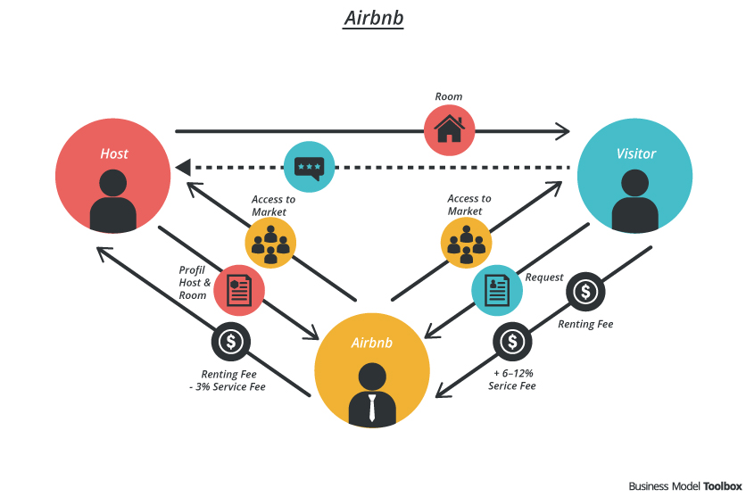
STAYZE
STAYZE BUSINESS MODEL
STAYZE

Slide 3
Problem statement
Stayze is an online market for providing lodging or primary homestays. The company does not own any real estate or properties, it acts as a broker receiving commission from each booking.
Stakeholders want to predict the rent of the properties using available data which can help them decide the next investment or target areas of the potential business.
Understand the behaviour of travellers and hosts for guidance of marketing and other services.

Slide 4
STAKEHOLDERS
STAYZE
Hosts
Employees
Shareholders
Guests
Communities

Slide 5
OBJECTIVE OF ANALYSIS
Estimate listing price based on provided information
Help stakeholders decide next investment options
Derive additional useful and interesting insights
Help customers evaluate offered price
Help hosts determine the number of customers approximately

Slide 6
WORKFLOW
Acquire data
Visualize
Reformat and clean
Model
Hyperparameter tuning
Result
Insights
Explore Data

Slide 7
The dataset
Dataset Information: Data has been provided in 2 files namely train and test. Train has records of 34226 properties having 15 features. 14 predictors and 1 target variable, price. Test has 14 features for 14669 properties.
Column | Data type | Column | Data type
id | int64 | room_type | object
name | object | price | int64
host_id | int64 | minimum_nights | int64
host_name | object | number_of_reviews | int64
neighbourhood_group | object | last_review | object
neighbourhood | object | reviews_per_month | float64
latitude | float64 | calculated_host_listings_count | int64
longitude | float64 | availability_365 | int64

Slide 8
THE Dataset
Host descriptors:
host_id: host ID
host_name: name of the host
calculated_host_listings_count: amount of listing per host
Review descriptors:
number_of_reviews: number of reviews
last_review: latest review
reviews_per_month: number of reviews per month
Listing descriptors:
id: listing ID
name: name of the listing
room_type: listing space type
minimum_nights: amount of nights minimum
availability_365: number of days when listing is available for booking
price: price in dollars
Location descriptors:
neighbourhood_group: location
neighbourhood: area
latitude: latitude coordinates
longitude: longitude coordinate

Slide 9
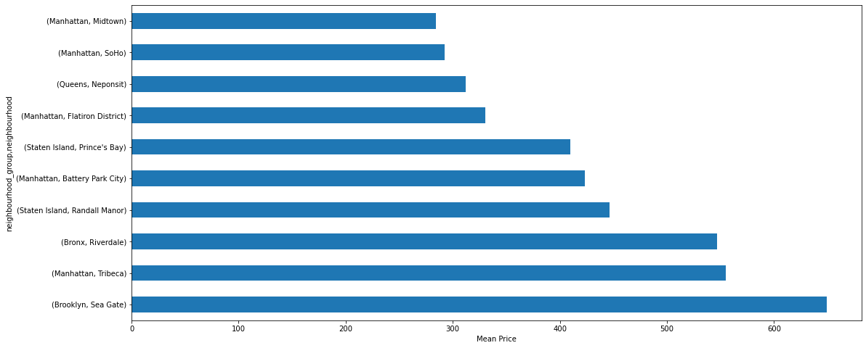
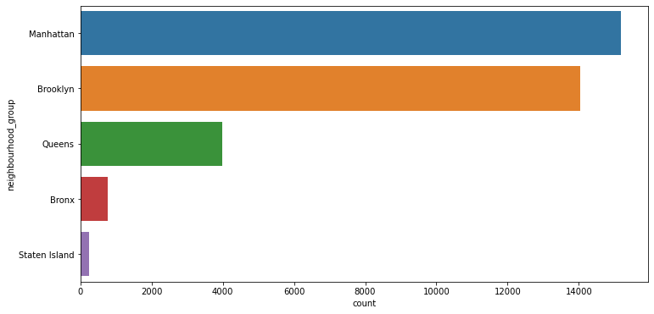
SNEAK PEEK INTO THE DATA
Neighborhood areas vs number of listings
10 Most Popular Neighborhood areas

Slide 10
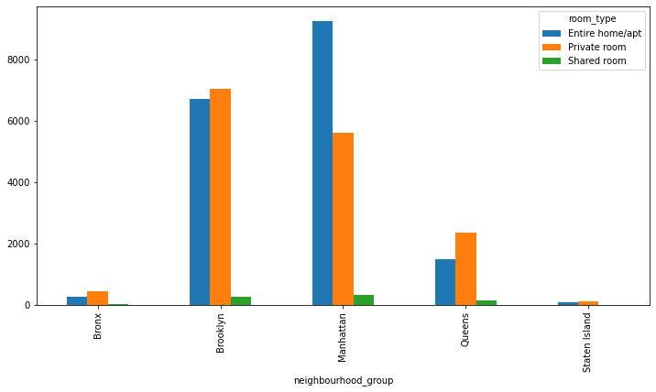
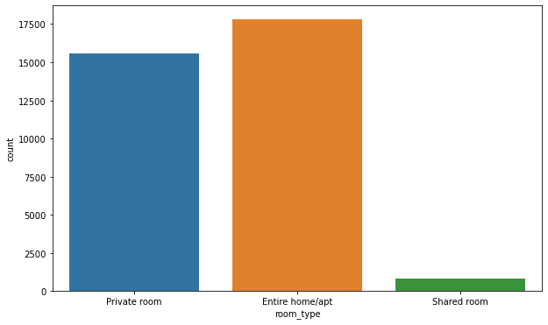
…contd.
Availability by type of rooms available
Neighborhood areas with type of rooms available

Slide 11
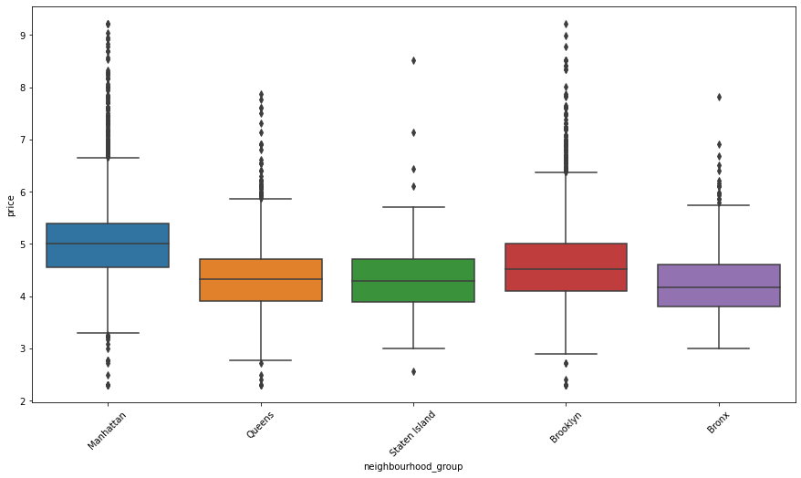
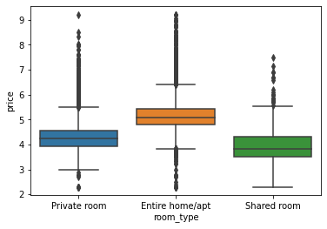
…CONTD.
Room type vs log of price
Neighborhood vs log of price

Slide 12
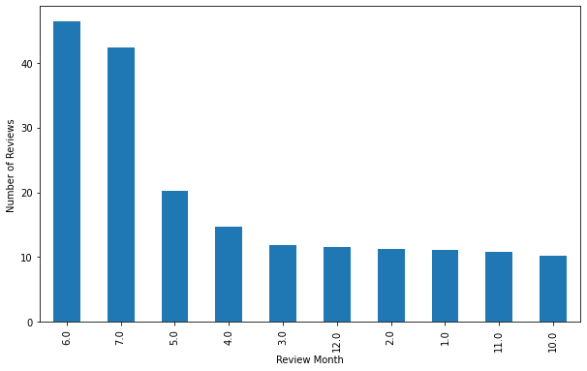
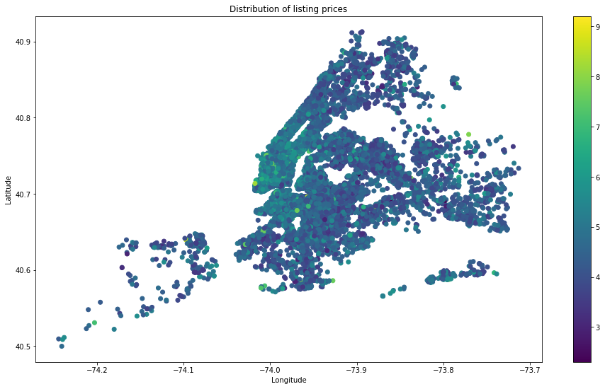
…contd.
Distribution of listing prices
Reviews received by months of the year

Slide 13
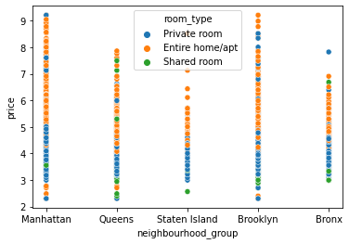
…contd.
Neighborhood areas, price and room type distribution

Slide 14
data Exploration and cleaning
Parsed last review column as date and created three new columns day, month and year of the last review date.
Checked for missing data. Filled reviews_per_month column with 0 as there are no reviews for that property.
Filled date, month and year column with median values and dropped last review column
Checked for correlation between the data features.
Made scatter plots and other graphs for understanding the data better.
Dropped id, host_id and name columns as we think they are not related to target variable.
Checked for outliers and tried removing those but it didn't help much to reduce error.
Checked for skewness of data and tried log and sqrt transformation but no change error.
Encoded all categorical columns.

Slide 15
Evaluation metrics
As this is a Regression predictive modeling problem and we must predict a numeric value of price for the Stayze, we can use any of the following for measuring the accuracy of our predictions:
Mean Squared Error
Root Mean Squared Error
Mean Absolute Err
The criteria set for this hackathon is RMSE so have used this score to validate our model.
We tried MAPE but got huge error values so we decided not to use that.

Slide 16
Models and approaches
We assessed the following models for getting the minimum RMSE value:
Linear Regression
Lasso and Ridge Regression
Decision Tree Regression
Random Forest Regression
Polynomial Model
Voting Regressor
XG Boost Regressor
The RMSE score for all theses models was as below:

Slide 17
Models and approaches
Model | RMSE value
Linear Regression | 213
Random Forest Regressor | 212
Decision Tree Regressor | 214
Polynomial Model | 210
Lasso Regression Model | 211
Ridge Regression Model | 211
Voting Regressor | 207
XG Boost Model | 200

Slide 18
Result
From the above observations it is evident that XGBoost is giving RMSE score of 200. XGBoost is always considered to be a good and give the best results, it is considered a good practice to check all the other models also.
So, we used XGBoost to predict the values of the test data and got a RMSE score equivalent to 213.

Slide 19
Insights and decisions
Manhattan and Brooklyn are most popular and most expensive neighbourhoods. Staten Island has the lease number of properties. Investors should invest in areas around Manhattan and Brooklyn.
People are most interested in entire apartment followed by private rooms and least interested in shared rooms.
Assuming people have written the reviews the same month they hired the place, May, June and July are the busiest months of the year

Slide 20
What we could have done better
We would have worked more on the EDA as the data has a lot of outliers and it is skewed a lot also. However, we could not find much improvement in RMSE by removing outliers or skewness.
We could have used the latitude and longitude data more to link them with the price and find important insights.

Slide 21
What we felt the dataset was missing
It would have been better if we had the date of stay rather than the date of last review
We would have preferred the rating of the review in addition to the date
More data points for a better understanding of the dataset
We would have liked to know the occupancy % in the previous year

Slide 22


