Slide 1
Data Storytelling &
Statistical Validation
ApexPlanet Analytics — Task 4
Business narrative, key sales insights, and hypothesis testing using the provided 1,000-order dataset.

Slide 2
1. Executive business story
The dataset shows a sizeable sales base with Electronics as the largest revenue contributor.
₹13.94 Cr
Total recorded sales
1,000
Orders
5,435
Units sold
₹139.4K
Average order value
Electronics generated ₹5.08 Cr, about 36.4% of total recorded sales.
Laptop was the highest-revenue product at ₹2.54 Cr, followed by Mobile and Book.
Sales peaked in March 2025 at ₹1.31 Cr and were lowest in September at ₹0.92 Cr.
The gender-based average order difference is small relative to the variation in individual order values; the statistical test checks whether it is meaningful.
ApexPlanet Task 4 • Data Storytelling & Statistical Validation | 2

Slide 3
2. Data quality & scope
Validation before storytelling prevents incomplete or inconsistent data from driving the narrative.
1,000
Rows
12
Columns
0
Duplicate rows
₹139.4K
Median order value
Coverage: 01 Jan 2025 to 01 Jan 2026. The five orders on 1 Jan 2026 make that date a partial period, so the monthly trend uses complete 2025 months.
Missing values: Age = 20 rows; City = 13 rows. Sales, order IDs, product, category, quantity and price are complete.
No duplicate rows were found.
Missing Age/City values do not prevent the main revenue analysis. Any age- or city-specific follow-up should explicitly account for missing values.
ApexPlanet Task 4 • Data Storytelling & Statistical Validation | 3

Slide 4
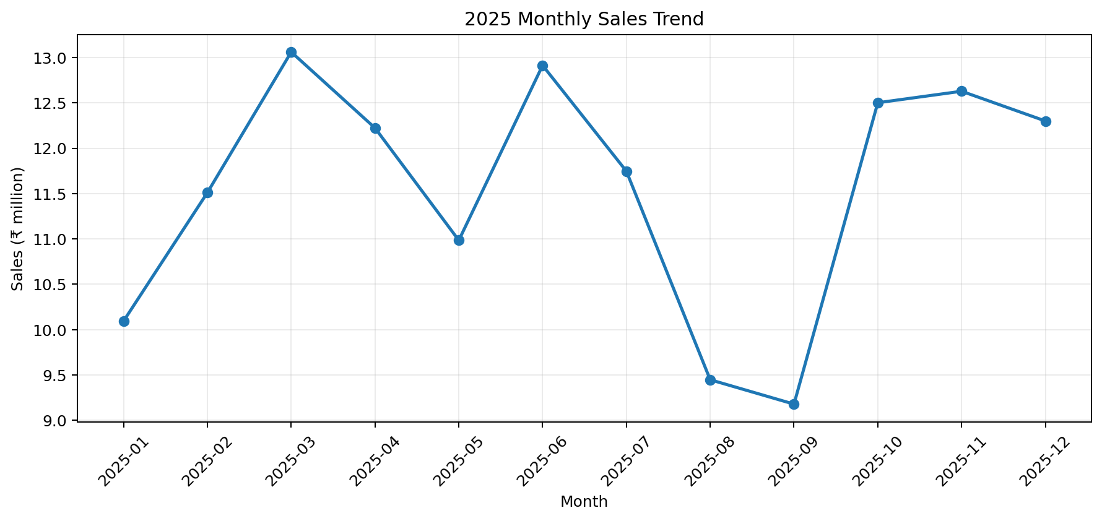
3. Sales trend: performance is uneven across the year
Use the monthly pattern to identify periods that deserve operational investigation.
Peak month: 2025-03 with ₹1.31 Cr.
Lowest full month: 2025-09 with ₹0.92 Cr.
September sales were about 29.7% below the March peak.
October–December recovered from the August–September dip; December also had the highest order count of 2025 (98).
Action: compare promotions, product mix, inventory availability and campaign activity between strong and weak months.
ApexPlanet Task 4 • Data Storytelling & Statistical Validation | 4

Slide 5
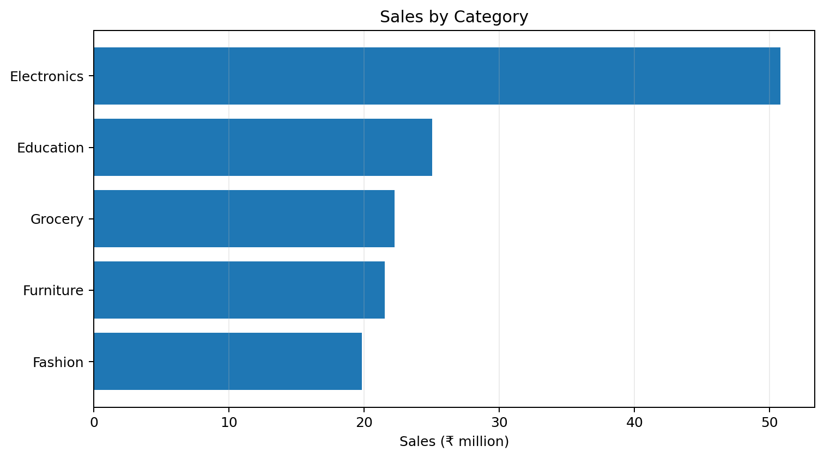
4. Product and category story
Revenue is concentrated in Electronics, while product-level revenue is relatively balanced among the top three.
Electronics leads with ₹5.08 Cr and 354 orders.
Education contributes ₹2.50 Cr; Grocery contributes ₹2.22 Cr.
Top products by revenue: Laptop ₹2.54 Cr; Mobile ₹2.53 Cr; Book ₹2.50 Cr.
Revenue depends on both quantity and unit price, so revenue alone should not be interpreted as product demand.
ApexPlanet Task 4 • Data Storytelling & Statistical Validation | 5

Slide 6
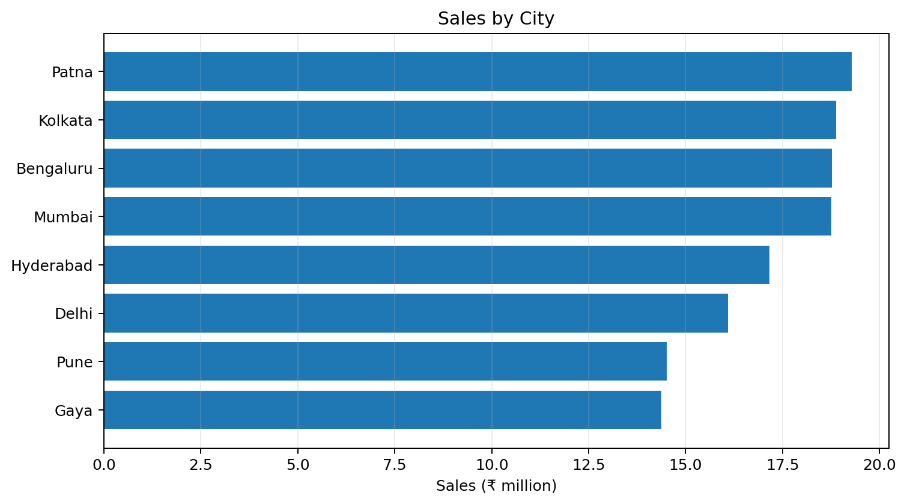
5. Geographic and customer pattern
City totals reflect both order volume and order value; gender split is close to balanced.
Patna has the highest total sales among named cities: ₹1.93 Cr across 135 orders.
Bengaluru has the highest average order value among named cities: ₹153.9K.
Gender order share is Male 51.1% vs Female 48.9%.
Average order value: Male ₹141.8K vs Female ₹136.9K. The statistical test checks whether this observed gap is meaningful.
ApexPlanet Task 4 • Data Storytelling & Statistical Validation | 6

Slide 7
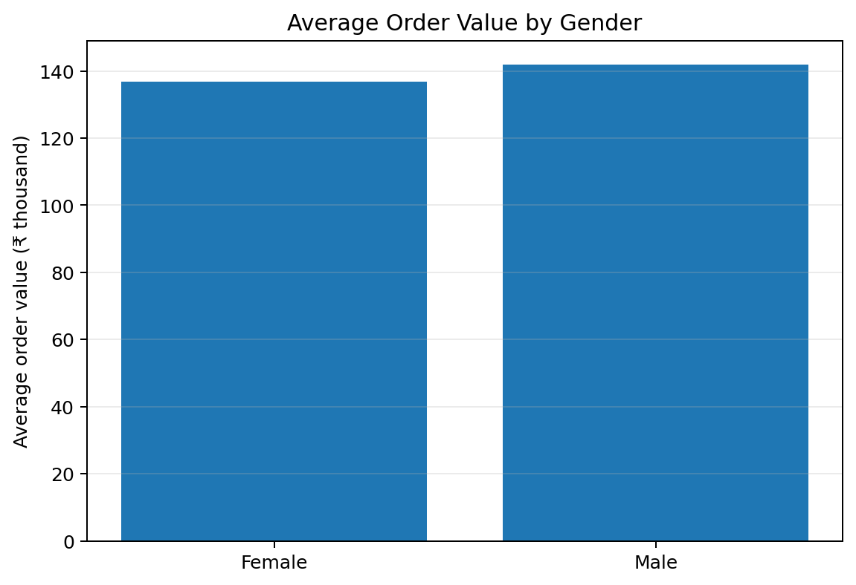
6. Hypothesis test: does average order value differ by gender?
Welch's independent two-sample t-test; α = 0.05.
H₀: μMale = μFemale
H₁: μMale ≠ μFemale
Test: Welch's t-test (two-sided)
Male mean AOV: ₹141,807
Female mean AOV: ₹136,883
Observed difference (Male − Female): ₹4,924
t = 0.683, df ≈ 998.0, p = 0.495
95% CI for difference: ₹-9,232 to ₹19,080
Cohen's d = 0.043
Statistical interpretation: At the 5% significance level, this sample does not provide sufficient evidence of a difference in mean order value between the two gender groups.
ApexPlanet Task 4 • Data Storytelling & Statistical Validation | 7

Slide 8
7. Additional validation: category mix vs gender
Chi-square test of independence; α = 0.05.
χ² = 9.09
Test statistic
p = 0.059
p-value
4
Degrees of freedom
0.05
Significance level
H₀: Gender and product category are independent.
H₁: Gender and product category are associated.
The p-value (0.059) is above 0.05, so this sample does not provide sufficient evidence of an association at the 5% level.
The result is relatively close to the threshold; a larger or more representative dataset could be used for further validation rather than treating observed category differences as confirmed.
ApexPlanet Task 4 • Data Storytelling & Statistical Validation | 8

Slide 9
8. Business implications & call to action
Translate the findings into measurable next steps.
1
Protect the Electronics engine
Track Laptop/Mobile availability, pricing and contribution margin because Electronics is the largest revenue category.
2
Investigate the Aug–Sep dip
Compare campaigns, inventory, pricing and product mix with March and Q4 to identify operational drivers.
3
Use city-level metrics together
Monitor both sales volume and average order value; high revenue can come from more orders or larger orders.
4
Validate before gender-based targeting
The observed AOV gap was not statistically significant at α = 0.05. Validate with more data before making gender-based targeting decisions.
ApexPlanet Task 4 • Data Storytelling & Statistical Validation | 9

Slide 10
Final takeaway
The dataset records ₹13.94 Cr in sales across 1,000 orders.
Electronics is the largest category, while monthly performance shows meaningful variation.
City performance differs in both volume and order value.
The gender AOV test returned p = 0.495; the observed difference is not statistically significant at the 5% level.
Next step: connect these patterns to marketing, pricing, inventory and conversion data for stronger causal analysis.
ApexPlanet — Task 4 | Prepared from the provided sales dataset

