Slide 1
RONAQ Co-Operative Bank
Our Team:
M. Qasim Charolia
Neha Bhutkar
Rachel Mathias
Supervisor :
Mrs. Muskan Gulrajani

Slide 2
Overview
Introduction
Technologies used for project
ER Diagram and workflow
User Interface Specification
Thank You

Slide 3

Introduction
RONAQ Co-Operative bank is a bank owned by its customers. Co-operative banks work on the principle of “No Profit No Loss”.
The main reason why a Co-Operative bank came into existence is it helps to uplift the middle class people and people working in rural areas.
Our project mainly focuses on providing the services which will cater the basic financial needs of the rural areas, like online transactions and loan facility.
A user friendly interface for naïve users.

Slide 4
Technologies used for project
We have implemented this project using Spring MVC framework to achieve simplification and flexibility.
Along with that we have used Hibernate, which is an ORM tool .
We are providing a simple and user friendly User Interface, focusing on our naive clients.
We have used Apache Maven, a powerful project management tool, which supports uniform build.

Slide 5
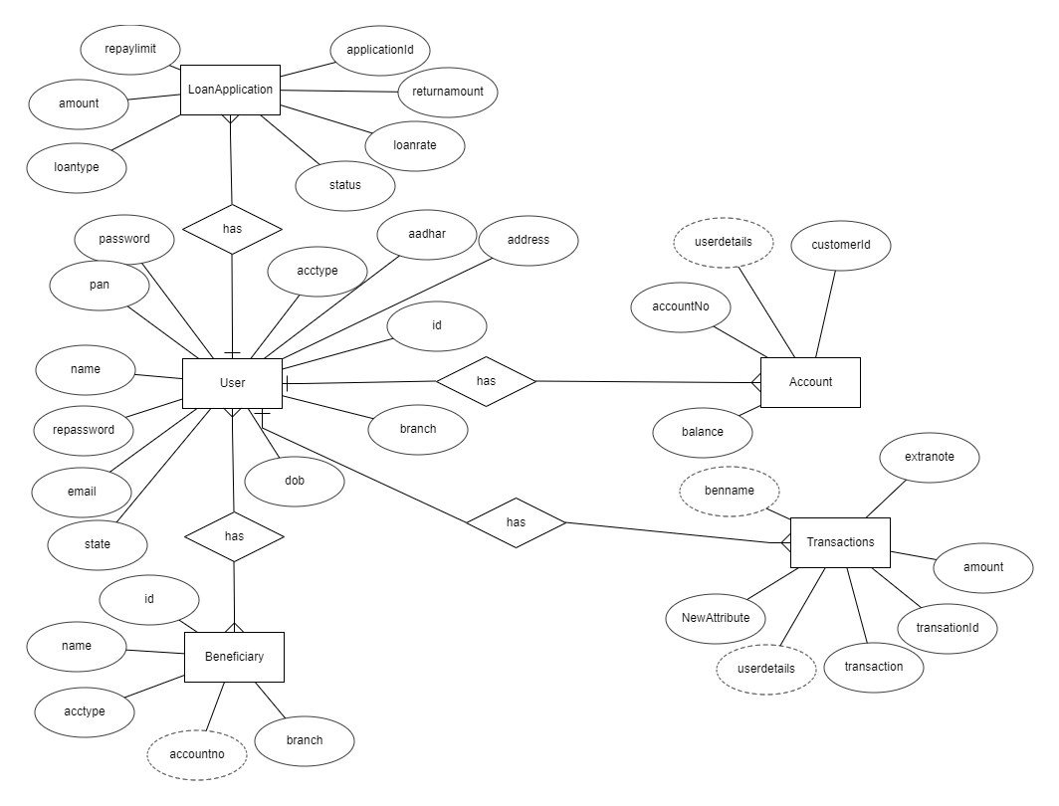
Er-Diagram

Slide 6

User Interface Specification

Slide 7
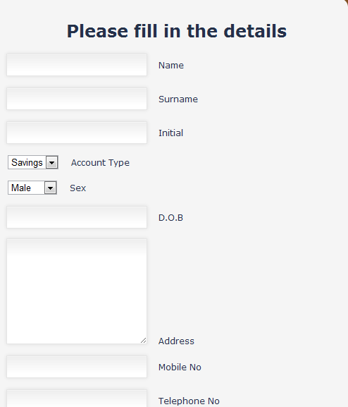
Registration Page as well as opening a new account

Slide 8
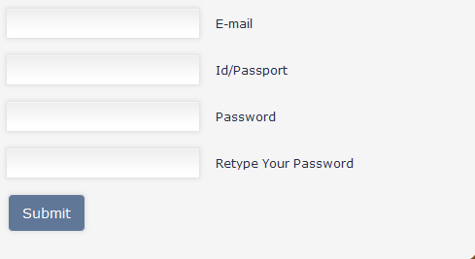
Registration Page as well as opening a new account (Continue..)

Slide 9
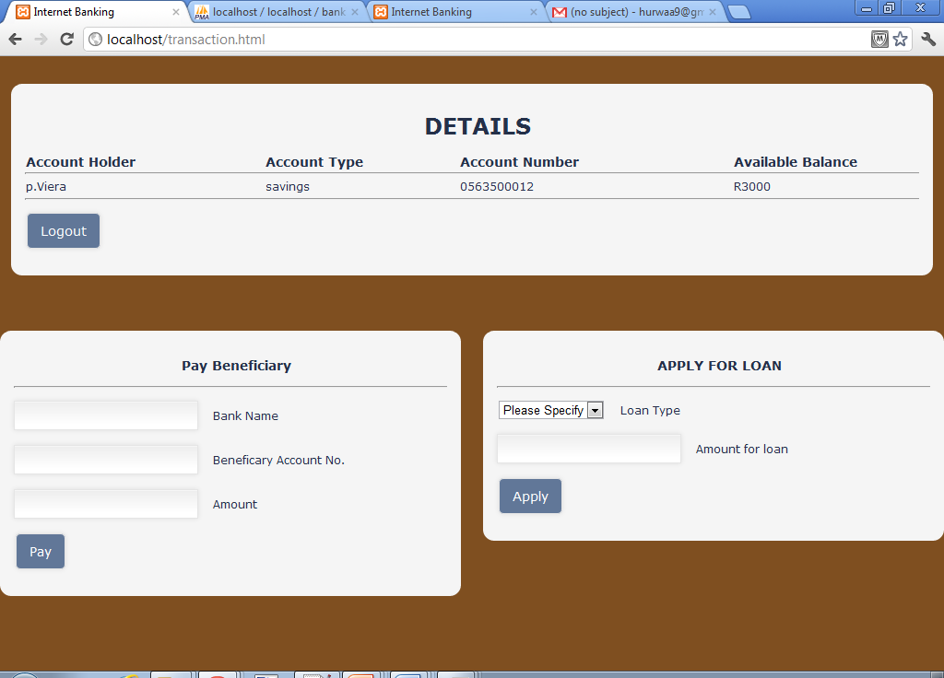
Transactions Page

Slide 10
CUSTOMERS TABLE
Key | Field Name | Data Type | Length | Nullable
 | NAME | VARCHAR | 45 | NO
 | SURNAME | VARCHAR | 45 | NO
 | INITIAL | VARCHAR | 10 | NO
 | ACCOUNTTYPE | VARCHAR | 45 | NO
 | SEX | VARCHAR | 6 | NO
 | D.O.B | DATE |  | NO
 | ADDRESS | VARCHAR | 200 | NO
 | MOBILENO | VARCHAR | 10 | NO
 | TELEPHONENO | VARCHAR | 10 | NO
 | EMAIL | VARCHAR | 45 | NO
PK | ID_PASSPORT | VARCHAR | 45 | YES

Slide 11
ACCOUNTS TABLE
Key | Field Name | Data Type | Length | Nullabe
PK | ACCOUNTNO | VARCHAR | 12 | NO
 | ACCOUNTTYPE | VARCHAR | 45 | NO
 | ACCOUNTHOLDER | VARCHAR | 45 | NO
 | DATEOPENED | DATE |  | NO
 | BRANCHCODE | INT | 5 | NO
 | DATEAPPROVED | DATE |  | NO
 | ACCOUNTBALANCE | DECIMAL |  | NO
 | APPROVED | VARCHAR | 6 | NO
 | DISAPPROVED | VARCHAR | 6 | NO

Slide 12
Process of Beneficiary Payment
Start
Balance
Sufficient?
No
Insufficient
Yes
Make
Payment
Update Beneficiary Account
Update
Balance
Data
Base
Send data
To Transaction
End

Slide 13
Abstract of Project Plan
Project Module | Documentation Submission
Project Analysis | 2012 03 30
Project Design and Development | 2012 06 21
Project Implementation | 2012 08 31
Project Testing, Evaluation and Presentation | 2012 11 02

Slide 14
REFERENCES
http://mym.wikispaces.com/Internet+banking+Conclusion
Barry Williams.(2008).www.databaseanswers.org/data_models/online_banking
/facts.ht
Seminarprojects.com/Thread-insurance-on-internet—9437
http://www.scribd.com/pgailani/d/36880246-Synopsis- Internet-Banking
http://smartbisplan.com/Internet-banking-for-many-benefits/

Slide 15
PROTOTYPE DEMO
Registration/Opening a new Account
Balance Enquiry
Paying a Beneficiary
Security Feature

Slide 16
Thank You!
“Talent wins games, but teamwork and intelligence wins championships”

