Slide 1
RONAQ Co-Operative Bank
GROUP 04
Our Team:
M. Qasim Charolia
Neha Bhutkar
Rachel Mathias
UNDER THE GUIDANCE OF:
Muskaan Gulrajani

Slide 2
Overview
Introduction
Scope
Software tools used
Technologies used for project
ER Diagram and workflow
User Interface Specification
Thank You

Slide 3
INTRODUCTION
RONAQ Co-Operative bank is a bank owned by its customers. Co-operative banks work on the principle of “No Profit No Loss”.
The main reason why a Co-Operative bank came into existence is it helps to uplift the middle class people and people working in rural areas.
Our project mainly focuses on providing the services which will cater the basic financial needs of the rural areas, like online transactions and loan facility.
A user friendly interface for naïve users.

Slide 4
SCOPE
To deliver a fully functional, customer centric, dynamic software p;roduct.
PRESENT SCOPE
We are providing basic financial services provided by any rural co-operative bank like, loan, money transfer etc.
FUTURE SCOPE
We will focus on developing a software that will cover other than basic services in a co-operative bank.

Slide 5
SOFTWARE TOOLS USED
Oracle 10g
Eclipse Java EE for web Developers 2018.
Tomcat server 8.0
JAVA 8
Spring MVC Hibernate
HTML5, CSS3, JAVASCRIPT, BOOTSTRAP, jQuery
GIT
APACHE MAVEN

Slide 6
Technologies Used
RONAQ Co-operative bank is developed using Agile.
We have implemented this project using Spring MVC framework to achieve simplification and flexibility.
Along with that we have used Hibernate, which is an ORM tool .
We have even tried to implement it using Dev-Ops.
We have used Apache Maven, a powerful project management tool, which supports uniform build.

Slide 7
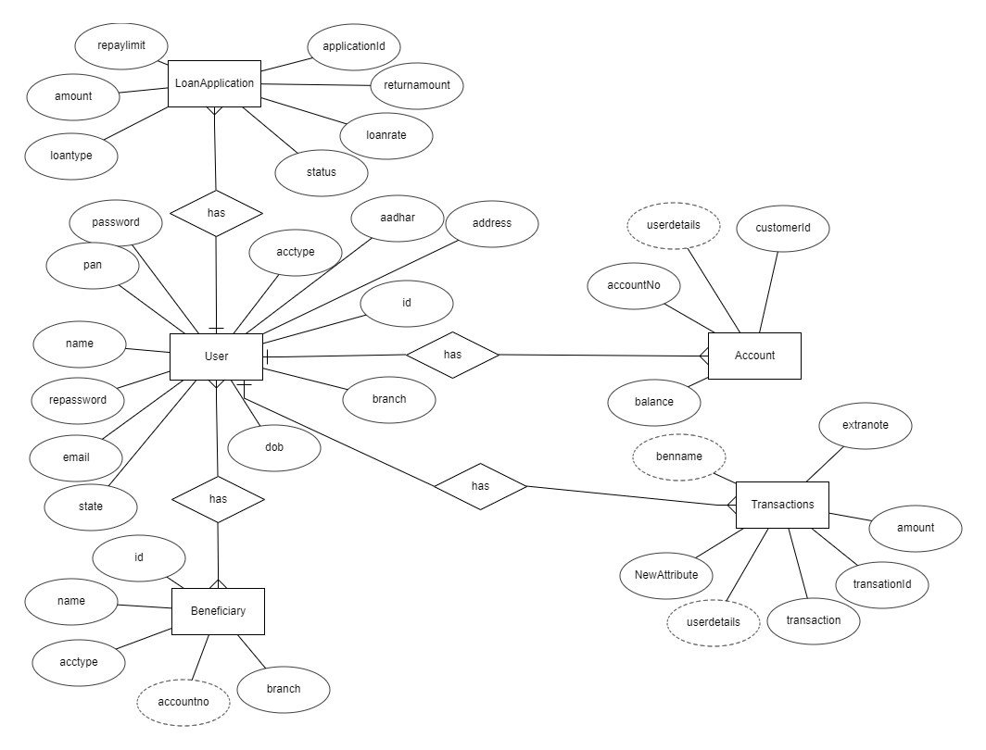
ER-DIAGRAM

Slide 8
USER INTERFACE SPECIFICATION

Slide 11
THANK YOU!!
“Talent wins games, but teamwork and intelligence wins championships”.

