Slide 1

ARKA JAIN UNISERSITY
Medical Insurance Analysis Dashboard
PRESENTED BY- NEHA KUMARI
ENROLLMENT NUMBER-AJU/251238

Slide 2
INDRODUCTION
Medical insurance or Health insurance is a financial tool that provides financial coverage for medical expenses. A health insurance policy is a contract between the insurance company and an individual. The individual pays a premium to the insurer and the insurer offers financial protection against healthcare expenses to the individual in return.

Slide 3
Key Dashboard Components
Average insurance cost
Average BMI
Total children covered
Smoker percentage

Slide 4
Dashboard Visualization
Visual 1: Insurance cost by age
Type : Line chart
Axis: Age
Values: Average Insurance cost
Visual 2: BMI vs Insurance cost
Type : Scatter chart
X -Axis: BMI
Y- Axis: Insurance cost
Legend: Sex
Size: Children
Visual 3: Insurance cost by smoker type
Type : Clustered column chart
Axis: Smoker status
Values: Average Insurance cost
Visual 4: Medical History distribution
Type : Donut chart
Legend: Medical History
Value: Cost of Medical history
Visual 5: Regional cost comparison
Type : Bar graph
Axis: Region
Values: Average Insurance cost
Slicer filters(Right sidebar)
Age
Sex
Smoker status
Region
Medical history

Slide 5
Benefits of a Medical Insurance Dashboard
• Faster decision-making
• Improved customer service
• Better fraud detection
• Accurate forecasting & budgeting
• Real‑time monitoring of performance

Slide 6
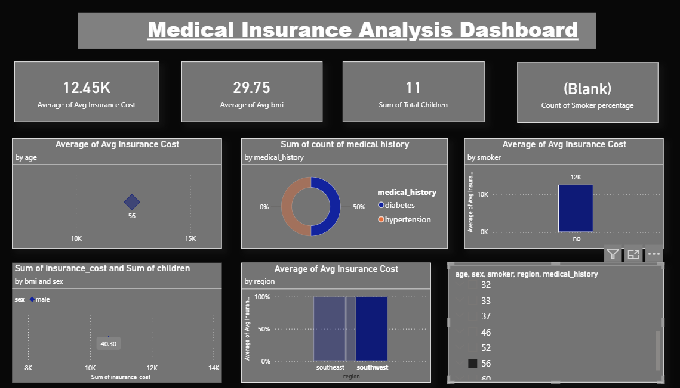
Dashboard

Slide 7
Conclusion
A Medical Insurance Dashboard provides a clear and data‑driven overview of insurance operations, helping organizations improve efficiency, transparency, and customer satisfaction.

