Slide 1

Project: Employee Retention
Team members:
Sandeep
Kiran jhadav
Ashwini p
Neha Singh
Subham Khand
Rahul Yadav
Mentors:
NEHA MAM

Slide 2
Agenda
Average Attrition rate for all Departments
Average Hourly rate of Male Research Scientist
Attrition rate Vs Monthly income stats
Average working years for each Department
Job Role Vs Work life balance
Attrition rate Vs Year since last promotion relation

Slide 3
DATA SETS
ITS WAS THE 2 EXCEL FILES WHICH ONE WAS HR1 AND HR 2 WE MERGE THE DATA BY SAME COLUMN IN BOTH DATA SETS .
THERE IS 5001 ROWS AND 36 COLUMN IN DATA SET
Objective:
• The main purpose here is to determine those aspects of HR management that must be prioritized and improved to allow the HR to perform better.
• HR analytics is concerned with many areas of the organization at large. This could include day-to-day HR operations, procedure efficiencies, or strategic organizational issues in other areas.

Slide 4
Project Details
Domain : HR Analytics
Project Name: Employee Retention
Dataset Name: HR_1 & HR_2
Dataset Type: Excel Data
Dataset Size: 50k records each

Slide 5
Tools used:-
MS Excel
sql
tableau
Power bi

Slide 6
MS Excel:Microsoft Excel enables users to format, organize and calculate data in a spreadsheet. Data analysts and other users can make information easier to view as data is added or changed.
SQL:SQL stands for Structured Query language, SQL is used to communicate with a database. SQL statements are used to perform tasks such as update data on a database, or retrieve data from a database.
Tableau:Tableau helps people and organizations be more data-driven, analytics platform makes it easier for people to explore and manage data & Helps to create reports, dashboards, and stories using different charts and graphs.
Power bi:Power BI can help connect disparate data sets, transform and clean the data into a data model and create charts or graphs to provide visuals of the data.

Slide 7
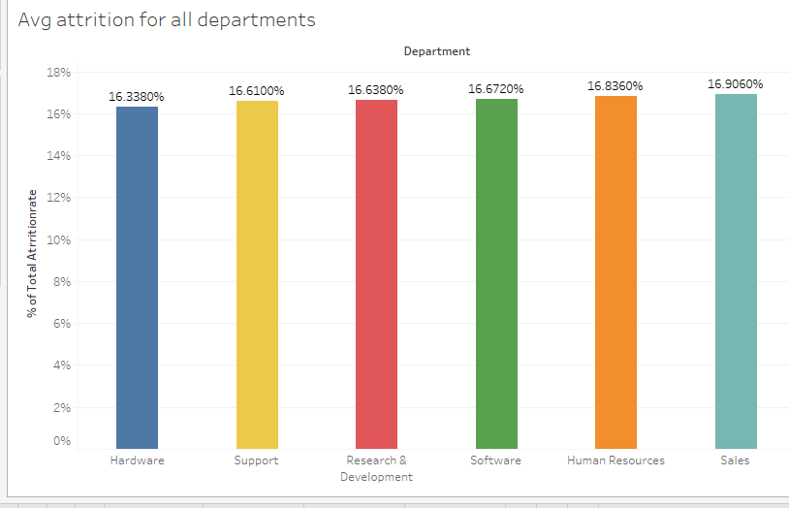
KPI 1
To find out what is the Average Attrition rate for all Departments?.
The average attrition ratio across all five departments falls within the range of 49% to 50%. The Research department exhibits the highest attrition rate, while the Hardware department shows the lowest. This data can provide insights into employee retention and inform future workforce planning strategies.
• Range: 49% to 50%
• Highest: Research Department
• Lowest : Hardware Department

Slide 8
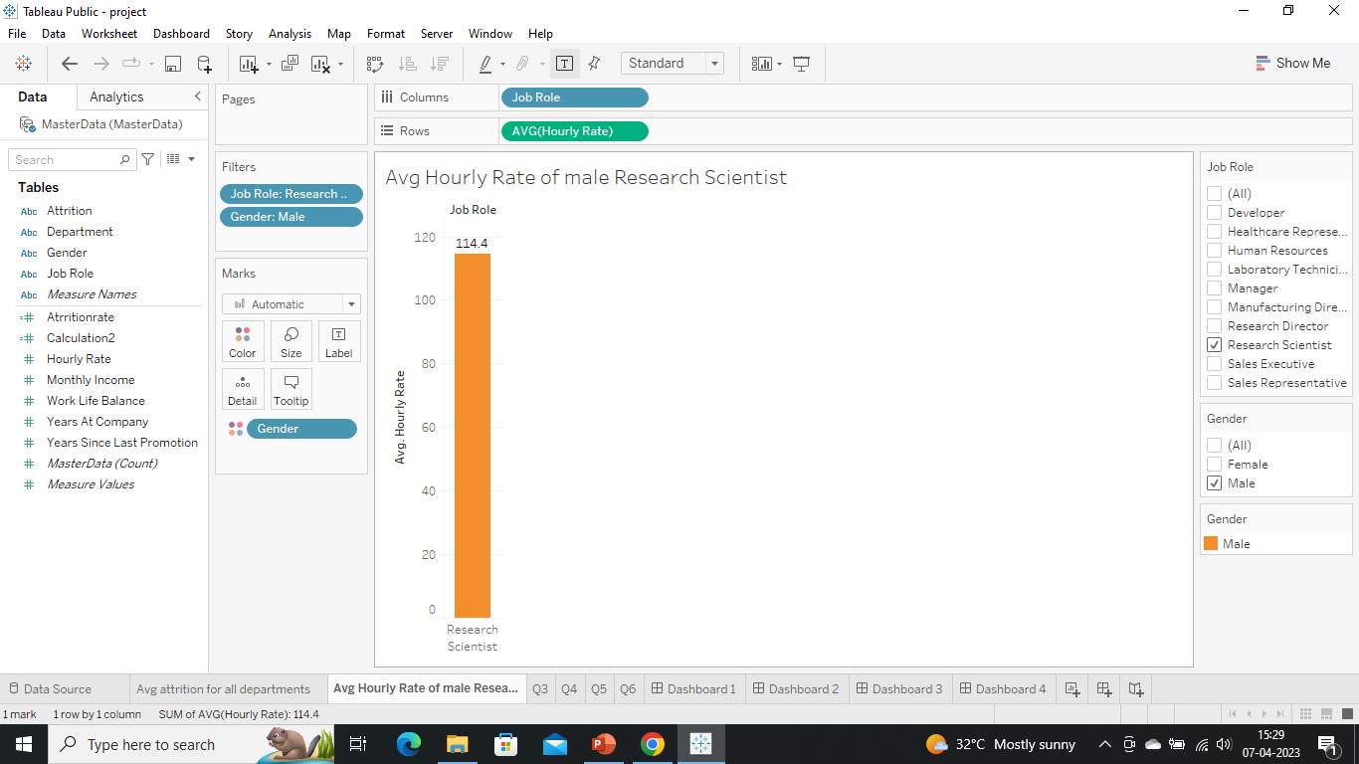
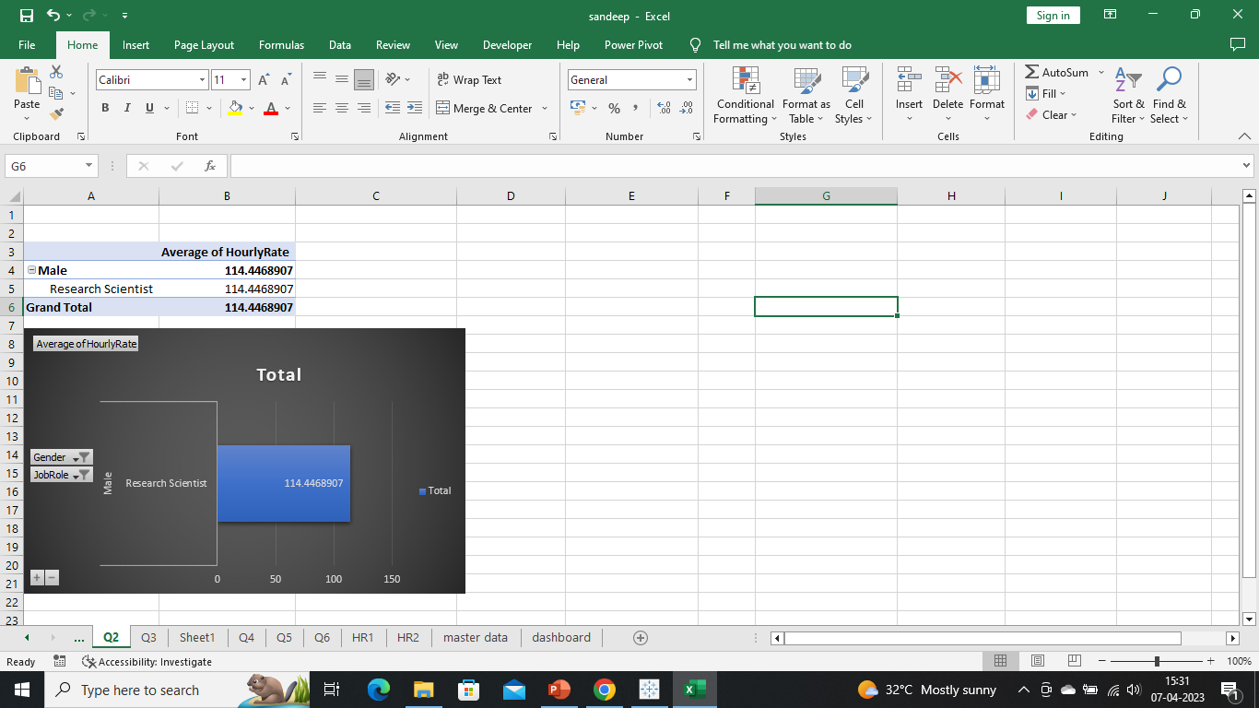
KPI 2
2. Average Hourly rate of Male Research Scientist
The average hourly rate for male employees in the job role of Research Scientist is $115.
This information can be useful for analyzing pay equity and ensuring that male and female employees in similar roles are compensated fairly. It can also inform recruitment efforts and salary negotiations for future employees in this job role.

Slide 9
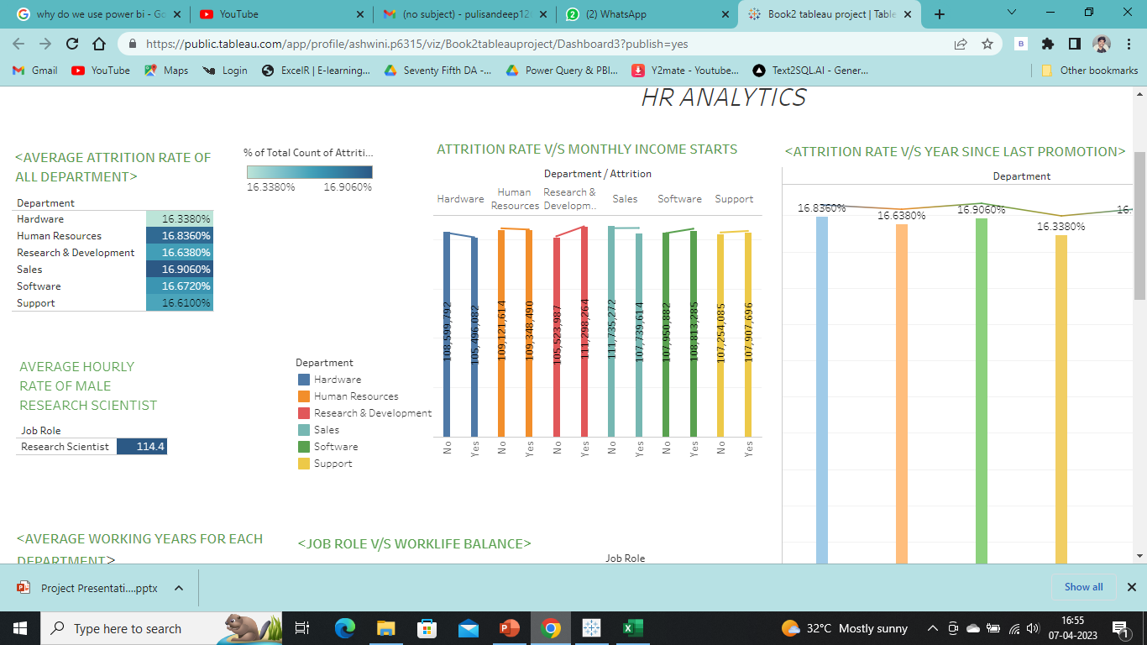
KPI 3. Attrition rate Vs Monthly income stats
The data reveals that the highest attrition rate is observed in the income range of $48,000 to $52,000, while lowest attrition rate is observed in the range of $36,000 to $40,000. These insights can be valuable for understanding the relationship between Income and employee retention, and inform compensation and benefits strategies to improve employee retention in the higher income bracket

Slide 10
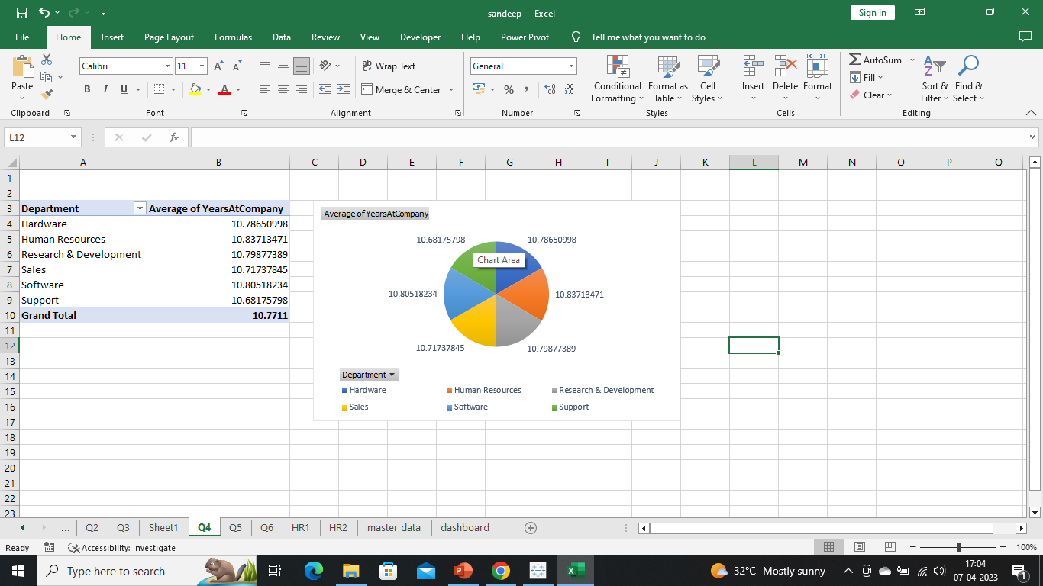
KPI 4
Average working years for each Department
The average working years of employees in each department have been analyzed and visualized using a pie chart. The overall average working years for all departments is 20.50. The Human Resources department has the highest average working years, while the Sales department has the lowest. These findings can provide insights into employee retention and inform strategies to retain employees for longer durations. It can also inform succession planning efforts and guide decision-making regarding promotions and career growth opportunities for employees in different departments.

Slide 11
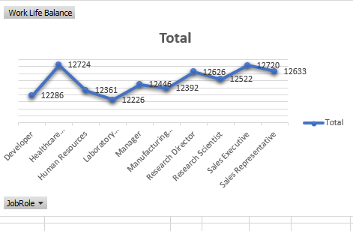
Kpi 5 Job Role Vs Work life balance
Our analysis indicates that the work-life balance varies across different job roles and is assessed across four dimensions. The human resources job role scores a high work-life balance of 25.2%, while the research director job role scores a low work-life balance of 25.6%. These findings can assist organizations and individuals in making informed decisions regarding job roles and work-life balance.

Slide 12
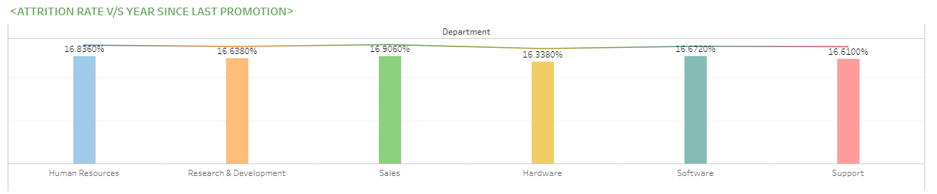
Kpi 6 Attrition rate Vs Year since last promotion relation
The data reveals that the highest Attrition rate of 60% is observed in the 36-40 years since last promotion bin, while the lowest attrition rate of 49.66% is observed in the 11-15 years since last promotion bin. These findings can be valuable for understanding the impact of promotion opportunities on employee retention and inform strategies to retain employees for longer durations. It can also guide decision-making regarding promotion timelines and opportunities for employees in different stages of their careers

Slide 13
Thank you
Questions?

