Slide 1

Power BI Banking Dashboard

Slide 2
ABOUT THE PROJECT
The project is a banking dataset analysis, where we have used a banking dataset. Here in this dashboard we are going to show features like Loan analysis and Deposit Analysis and summary of the overall dataset.

Slide 3
Some important KPI’s
Total Clients
188
Total CC Account
$135
Total Engagement Account
$18.26K

Slide 4
Financial Goals
Total Deposit
$111.49M
Total Loan
$139.9M
Total Fees
$5.17M

Slide 5
Bank Numbers
$55.5M
$60.18M
$83.52M
Bank Loan
Bank Deposit
Business Lending

Slide 6
Checking amount and Saving amount
Saving Account (in Millions)
19.85
Foreign Currency Amount (in millions)
2.71

Slide 7
$ 2.71 M
FOREIGN CURRENCY AMOUNT

Slide 8
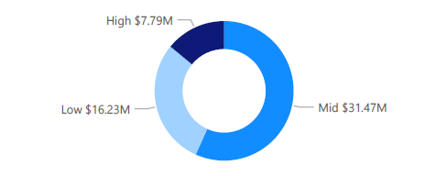
Bank Loan by Income band
What I observed?
Bank loan is highest for Mid Income band and lowest for High Income band.

Slide 9
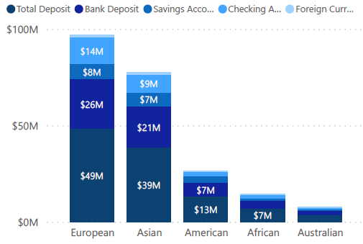
Bank Loan by Income band
What I observed?
Highest features are in the European countries followed by Asian Countries.
Lowest features are in Australian countries followed by African countries.

Slide 10
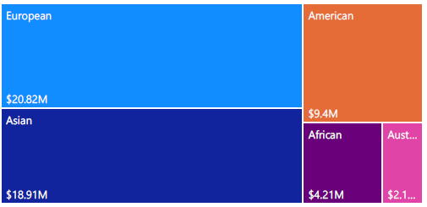
Bank Loan by Nationality
What I observed?
Bank loan is highest for European countries and lowest for Australian countries.

Slide 11
THANK YOU !
ANY QUESTIONS?

