Slide 1


HTML BASICS

Slide 2



What is HTML?
Hyper Text Markup Language
Describes the structure of a Web page
Tells the browser how to display the content

Slide 3
Anatomy of a tag
<p>This is a paragraph tag</p>
Starting tag
Ending tag
Content

Slide 4
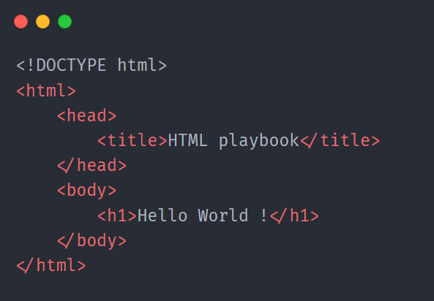
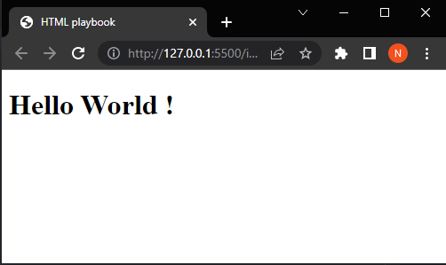
Boilerplate code
HTML5 document
Root of document
Contains meta info
Title of web page
Contains all elements
Heading tag

Slide 5
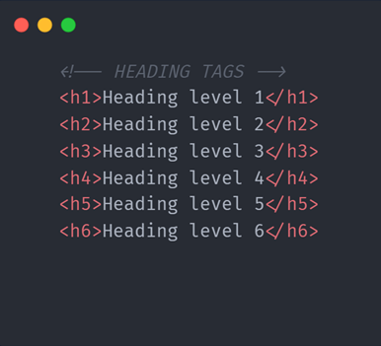
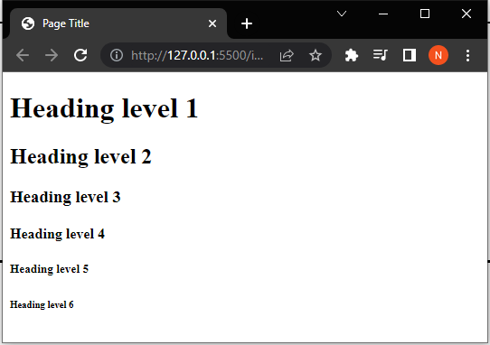
Heading tag <h1> - <h6>

Slide 6
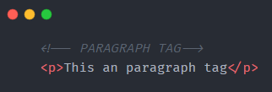
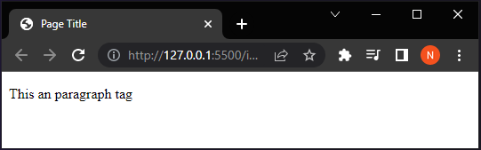
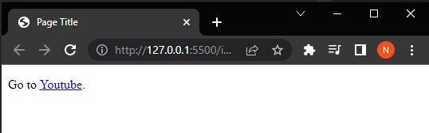
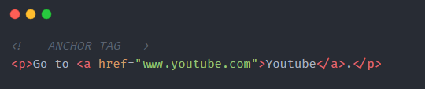
Paragraph tag <p>
Anchor tag <a>

Slide 7
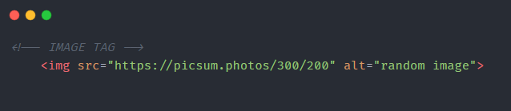
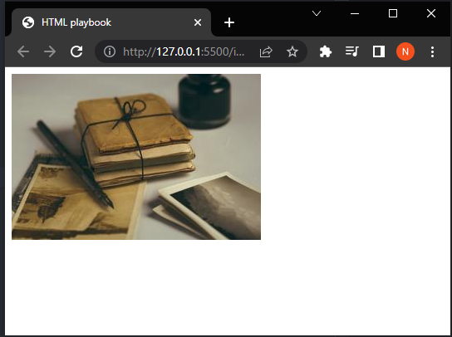
Image tag <img>
<img src="url" alt="alternatetext">
Embed image in a web page
Only attributes , no closing tag

Slide 8
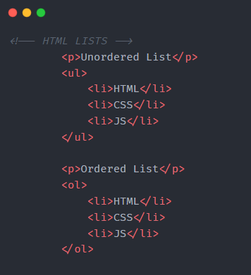
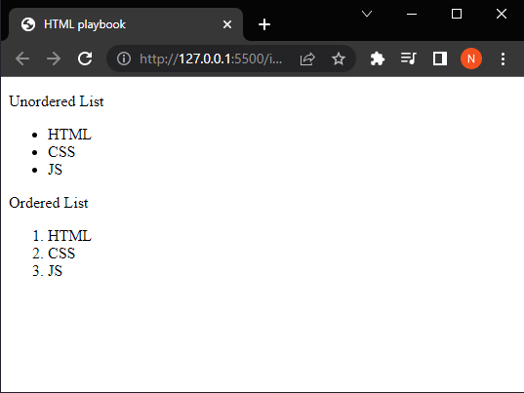
HTML Lists <ul> and <ol>

Slide 9
Semantic Elements
<header>
<header>
<nav>
<nav>
<section>
<section>
<article>
<aside>
<aside>
<footer>
<article>
<footer>

Slide 10
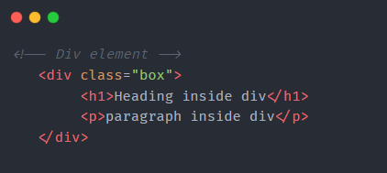
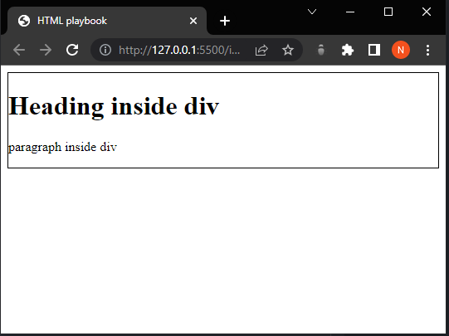
Division tag <div>
Groups content for easy styling
Note:
It should be used when no other
Semantic elements are used.

Slide 11
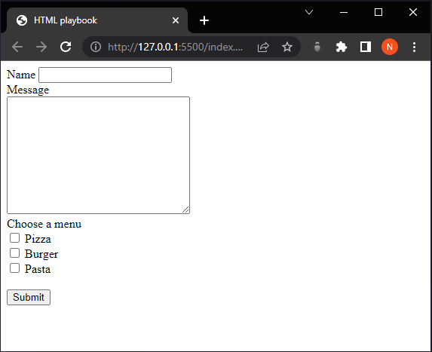
Form Elements
<label>
<input type=“text”>
<textarea>
<input type=“checkbox”>
<button>

Slide 12
Let’s Learn CSS

