Slide 1
BLUESTOCK FINTECH
MUTUAL FUND ANALYTICS DASHBOARD
Capstone Project I | Group: asthananeha2015 / bsoham2704 / Bubai Das
Day 6 — Dashboard Development
Page 1: Industry Overview | Page 2: Fund Performance Page 3: Investor Analytics | Page 4: SIP & Market Trends
Powered by Python | Data: AMFI / MFAPI / NSE / BSE
Bluestock Fintech | July 2026

Slide 2
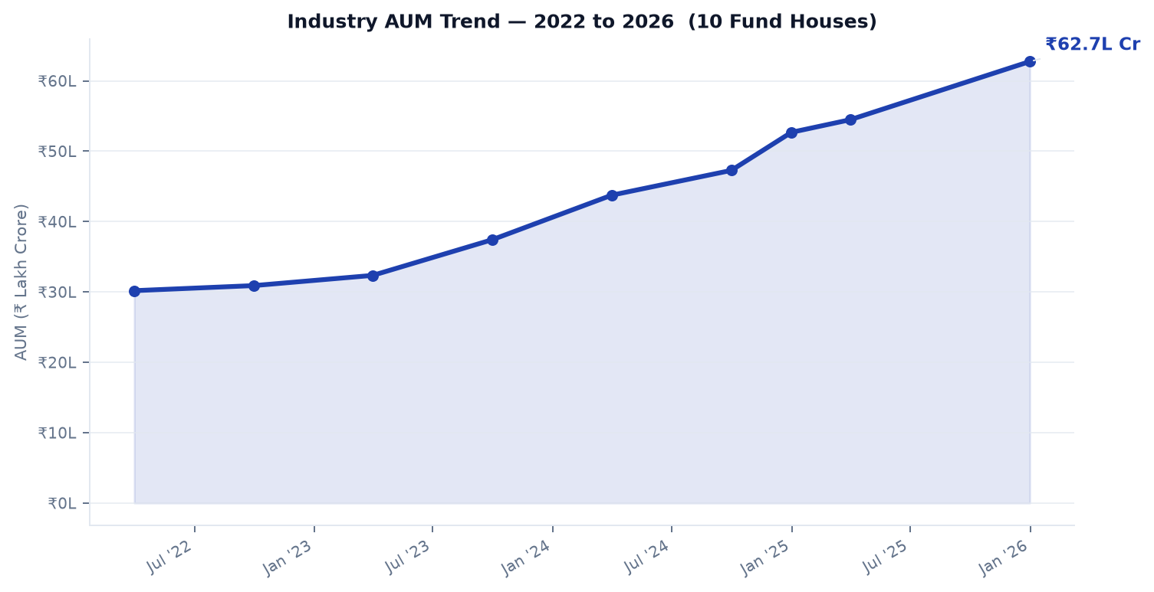
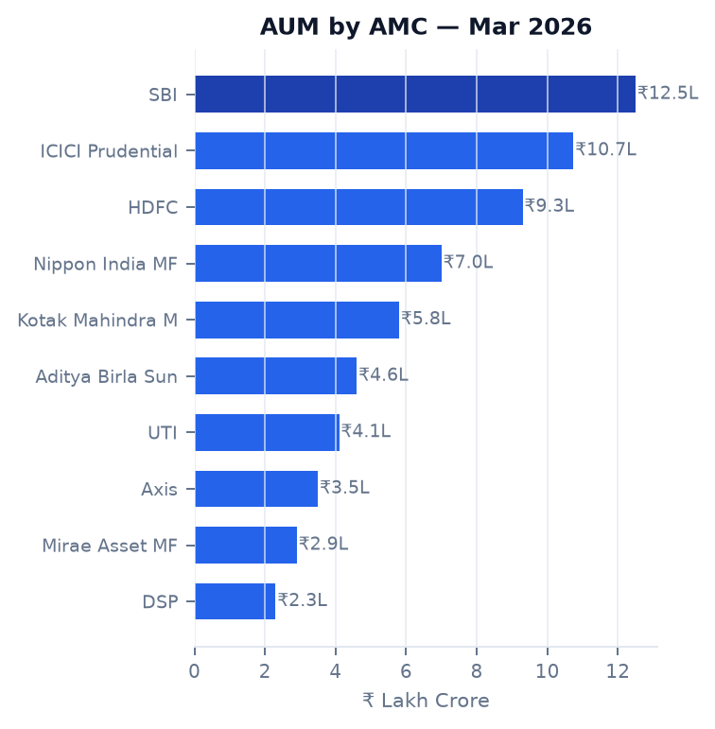
BLUESTOCK
|
Industry Overview
Mutual Fund Analytics | Bluestock Fintech Capstone
TOTAL INDUSTRY AUM
ANNUAL SIP INFLOWS
TOTAL FOLIOS
TOTAL SCHEMES
₹81L Cr
₹31K Cr
26.12 Cr
1,908
Mar 2026
FY2025
Q4 FY2026
Active

Slide 3
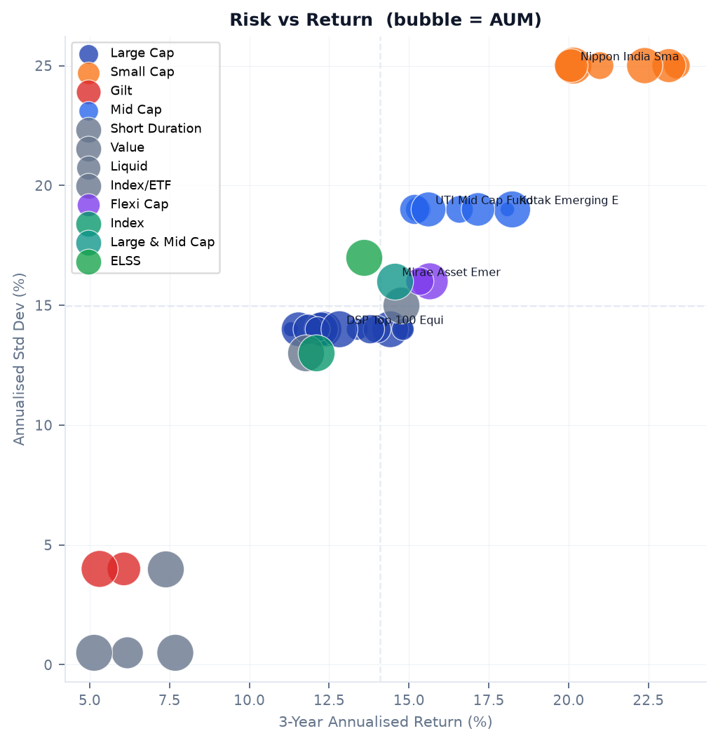
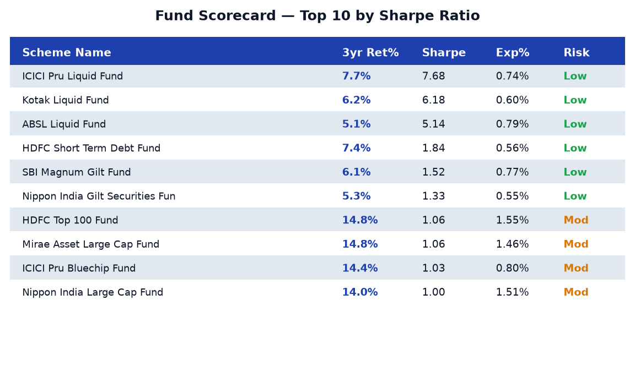
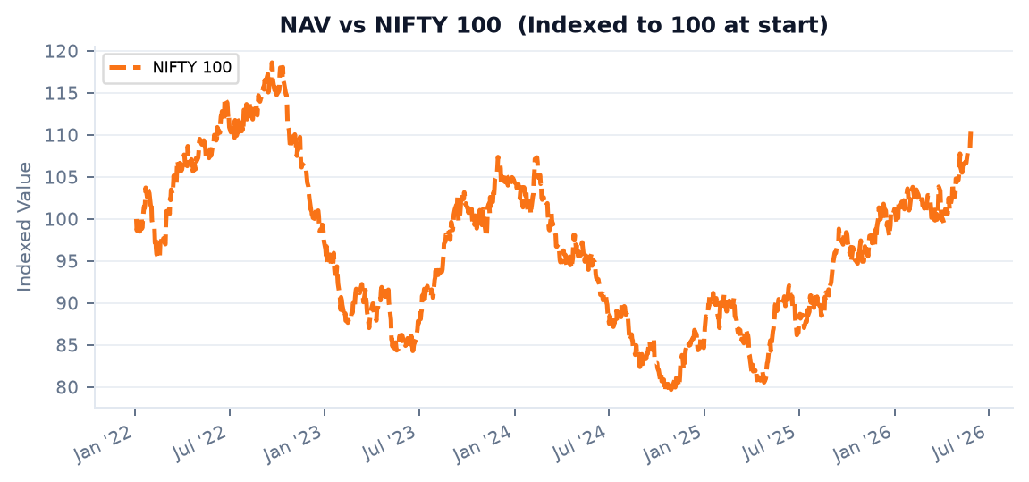
BLUESTOCK
|
Fund Performance
Mutual Fund Analytics | Bluestock Fintech Capstone
Slicers: Fund House | Category | Plan

Slide 4
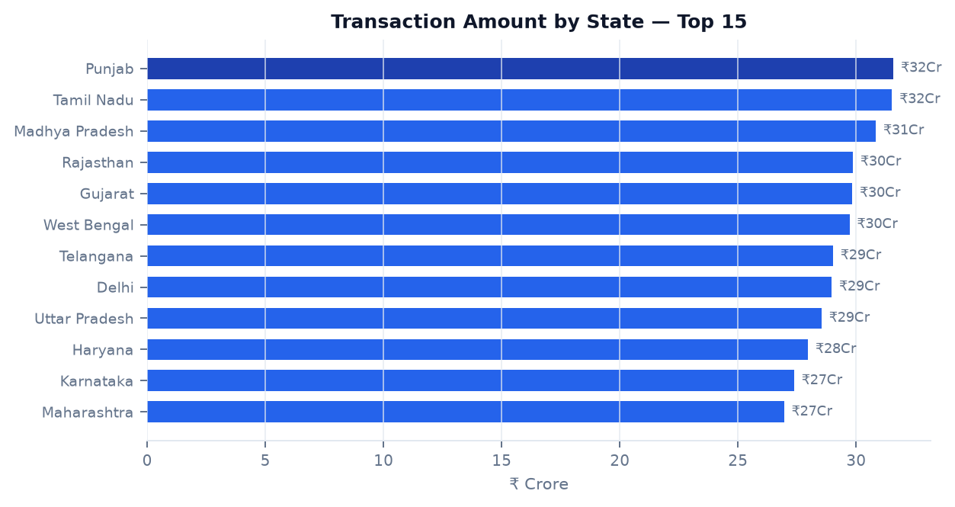
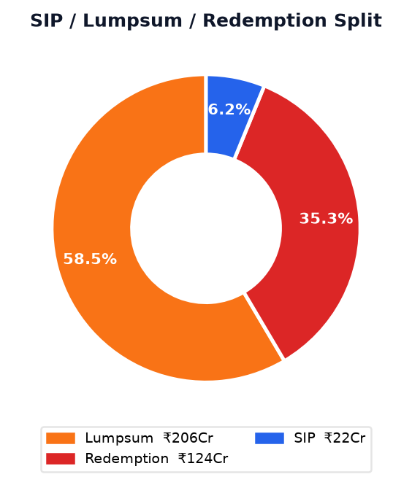
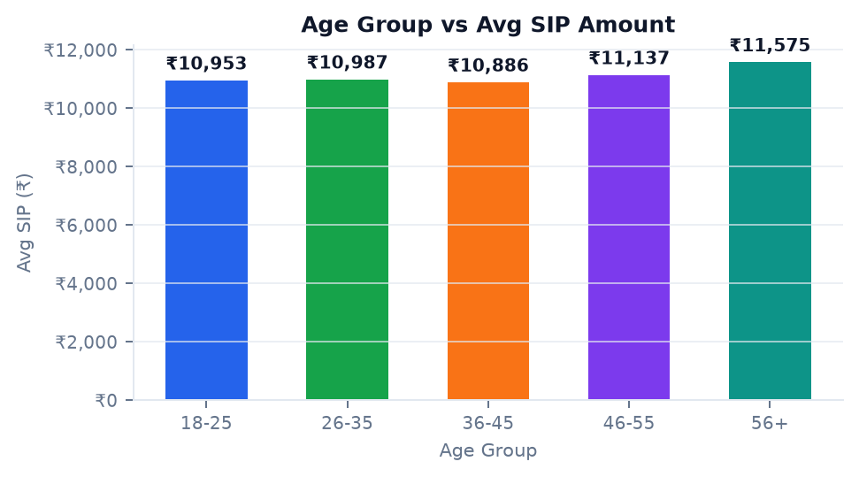
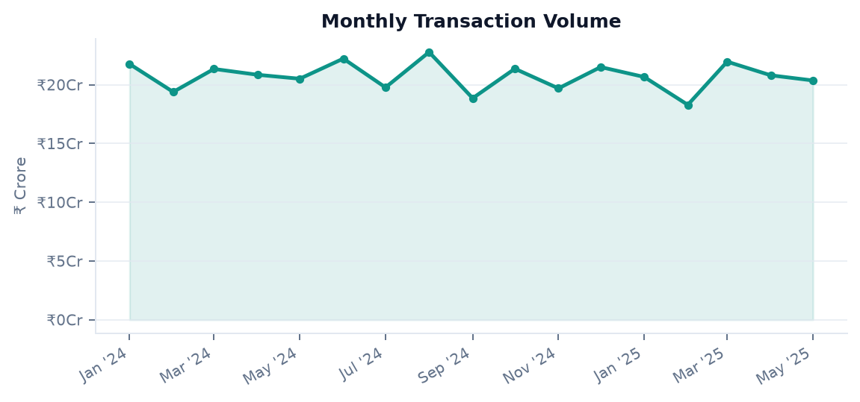
BLUESTOCK
|
Investor Analytics
Mutual Fund Analytics | Bluestock Fintech Capstone
Slicers: State | Age Group | City Tier

Slide 5
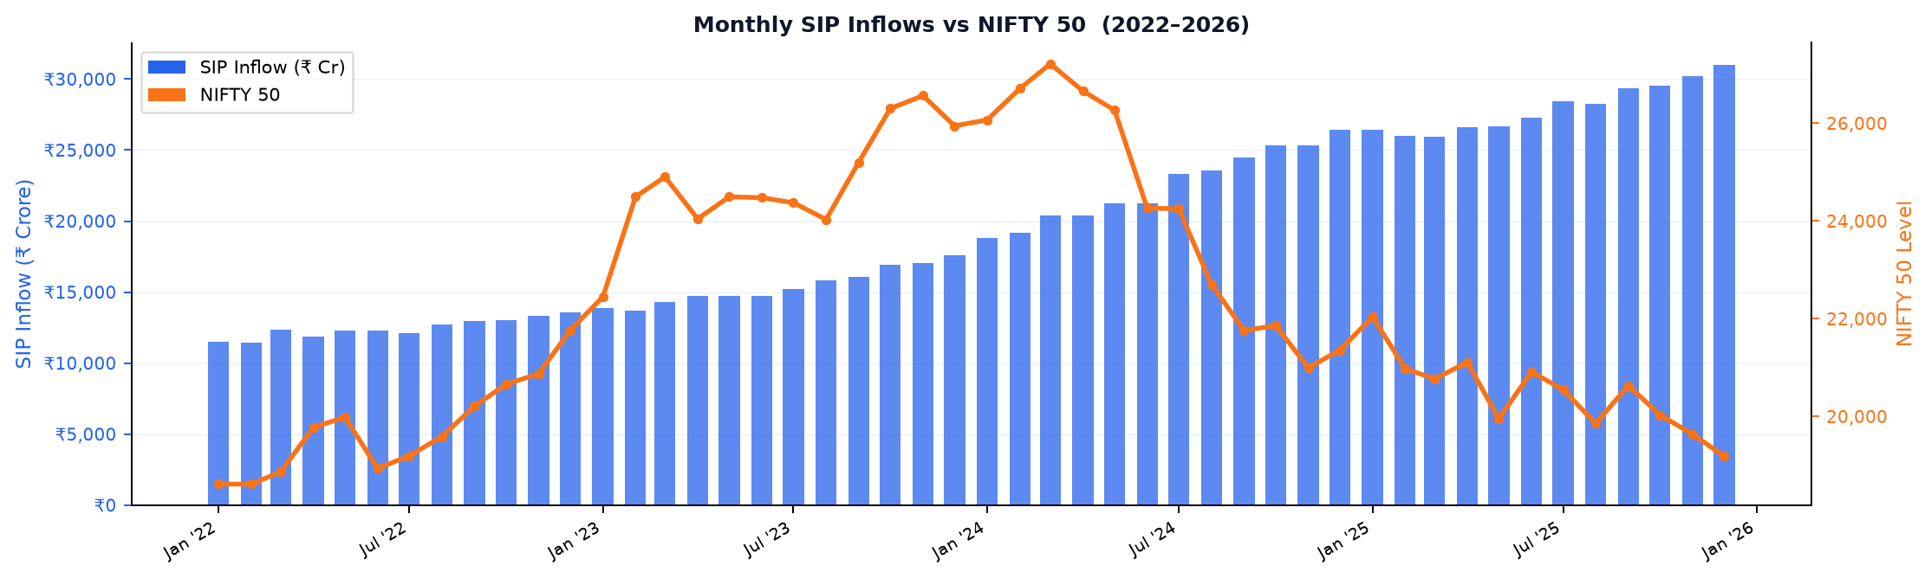
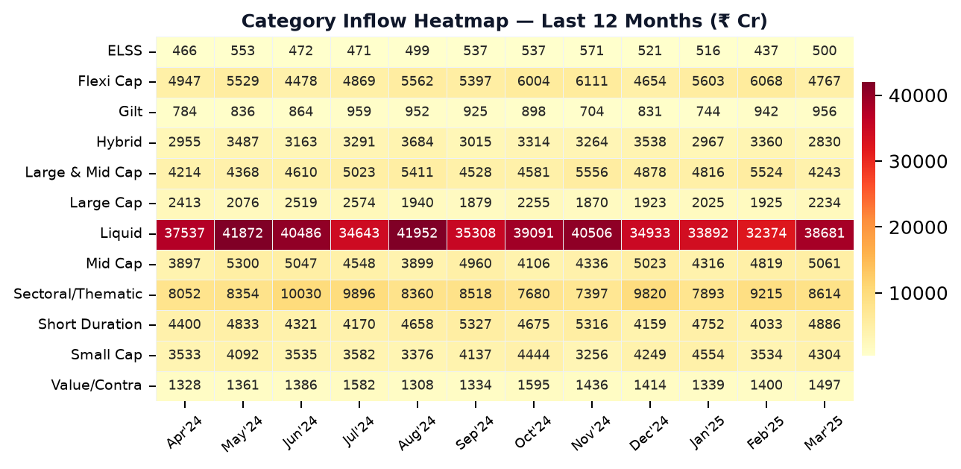
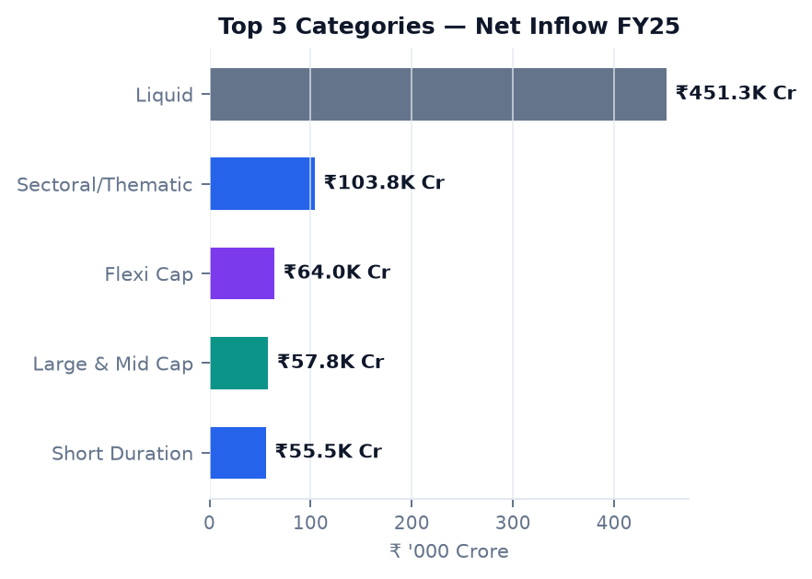
BLUESTOCK
|
SIP & Market Trends
Mutual Fund Analytics | Bluestock Fintech Capstone

