Slide 1
The Battle of Neighbourhoods

Slide 2
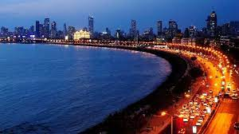
Introduction
Mumbai is the capital city of the Indian state of Maharashtra. It is the second-most populous city in the country after Delhi and the seventh-most populous city in the world with a population of roughly 20 million. It has the highest number of millionaires and billionaires among all cities in India and the eighth-highest number of billionaires of any city in the world. Mumbai is the financial, commercial, and the entertainment capital of India. It is also one of the world's top ten centres of commerce in terms of global financial flow. The city houses important financial institutions and the corporate headquarters of numerous Indian companies and multinational corporations. It is also home to some of India's premier scientific and nuclear institutes. The city is also home to Bollywood and Marathi cinema industries. Mumbai's business opportunities attract migrants from all over India.

Slide 3
Problem Statement
Business problem: Using the data sources mentioned in the data section, we are going to explore and analyse neighbourhoods in Mumbai to decide the best location for Italian cuisine in the city. In the process, we will explore areas populated with restaurants, areas with a large number of Italian restaurants, areas having less number of restaurants, areas with the best rated Italian restaurants, neighbourhoods with the best restaurants in Mumbai, the best neighbourhood to stay if you prefer Italian Cuisine.

Slide 4
Data
Data Acquisition:
For this project we will get data from the following datasets:
Mumbai Restaurants data that contains localities, restaurant names, restaurant rating along with their latitudes and longitudes:
Data source: Zomato kaggel dataset ("https://www.kaggle.com/shrutimehta/zomato-restaurants-data")
Data description: This dataset provides information about the cuisines of the countries and localities of said countries serving a given cuisine with maximum number of restaurants.
This dataset contains the information we need for analysis and we will use it to explore various localities of Mumbai.
Venues near each neighbourhood of Mumbai:
Data source: Foursquare API ( "https://developer.foursquare.com/")
Description: This Dataset will provide us with the location based data we need to explore neighbourhoods in Mumbai.By using this api, we will get the relevant venues in each neighborhood in Mumbai.

Slide 5

Approach
Strategy for problem solving:
We will collect the Mumbai city data from Zomato kaggel dataset
We will find the venues for each neighbourhood using FourSquare API
We will group the venues by nearby localities
We will find the best places to eat based on the basis of aggregate rating.
Using folium library, we will visualise the results.

Slide 6
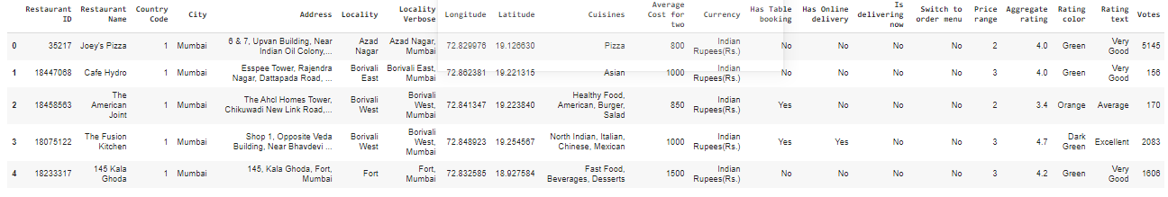
Data Cleaning:
Download Zomato kaggel dataset and select the restaurant data for Mumbai as a pandas DataFrame

Slide 7
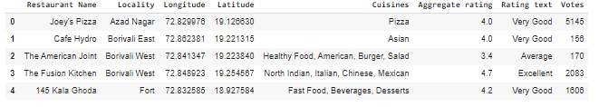
Data Cleaning:
Drop irrelevant columns and clean the downloaded DataFrame for Mumbai

Slide 8
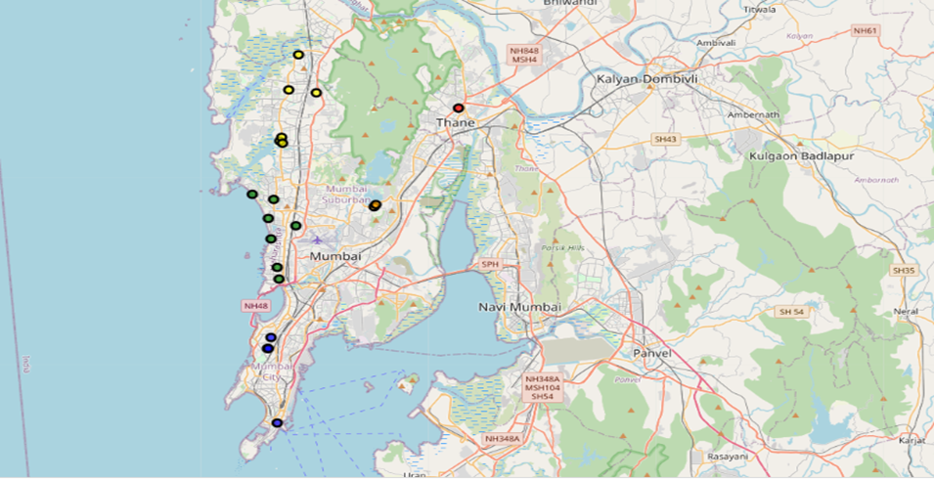
Exploration & Visualization
Create a Map and cluster the restaurants using k-means clustering

Slide 9
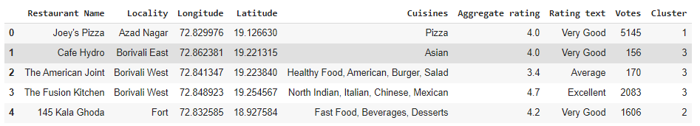
Exploration & Visualization
Clustered Mumbai restaurant data

Slide 10
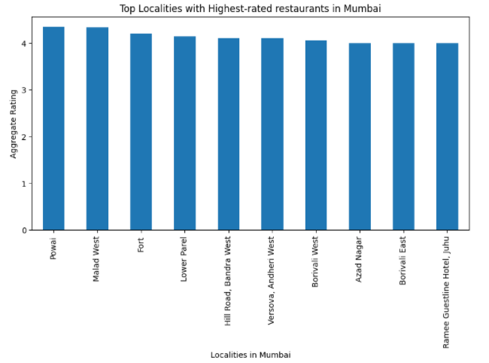
Exploration & Visualization
In this section, we explore various localities of Mumbai City and group them according to various characteristics
Localities with highest-rated restaurants in Mumbai:

Slide 11
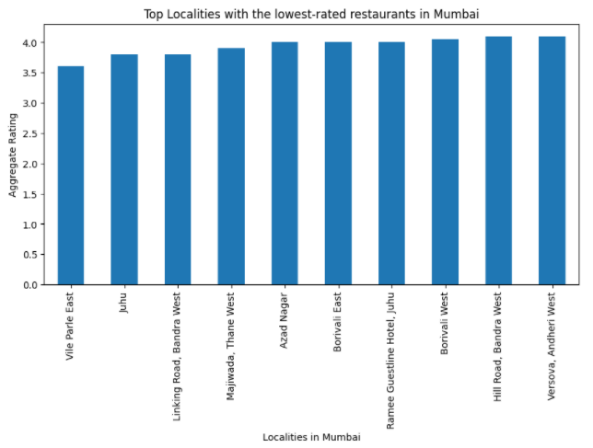
Exploration & Visualization
Localities with highest-rated restaurants in Mumbai:

Slide 12
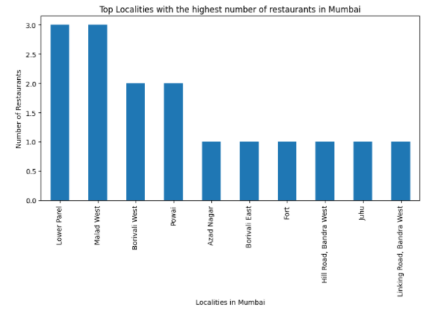
Exploration & Visualization
Localities best suited for foodies who prefer eating out frequently:
Top Localities with the highest number of restaurants in Mumbai:

Slide 13
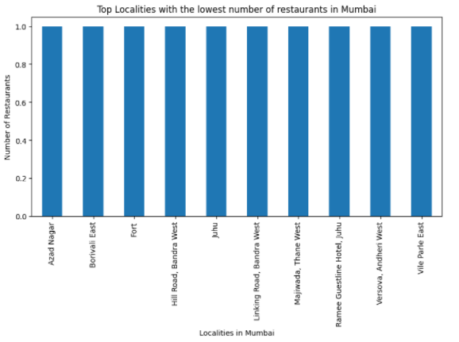
Exploration & Visualization
Top Localities with the lowest number of restaurants in Mumbai:

Slide 14
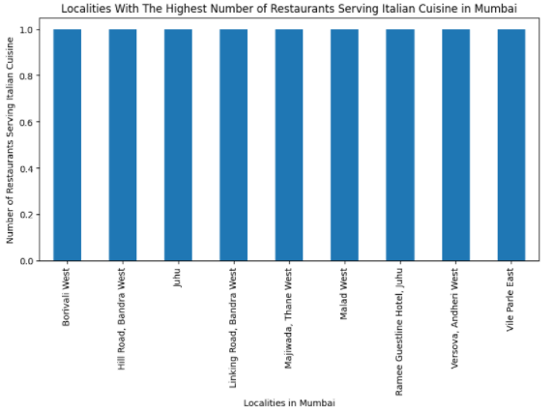
Exploration & Visualization
Best places for Italian cuisine in Mumbai:
Localities with the Highest Number of Restaurants Serving Italian Cuisine in Mumbai:

Slide 15
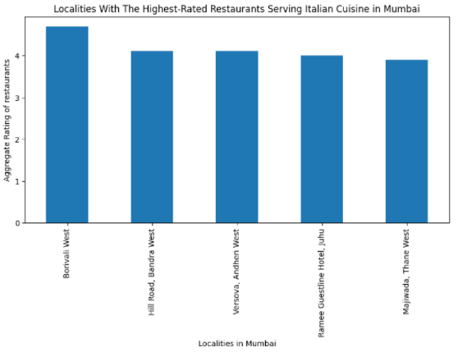
Exploration & Visualization
Localities with the Highest-Rated Restaurants Serving Italian Cuisine in Mumbai:

Slide 16
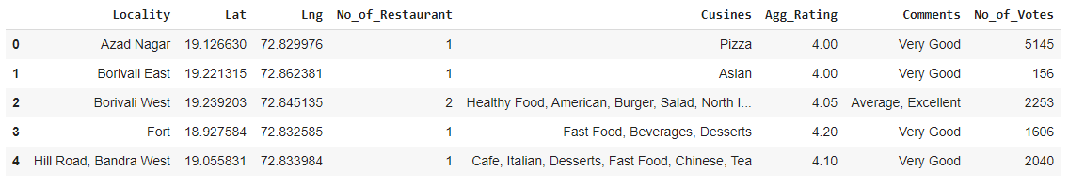
Data Transformation
Group the data according to locality

Slide 17
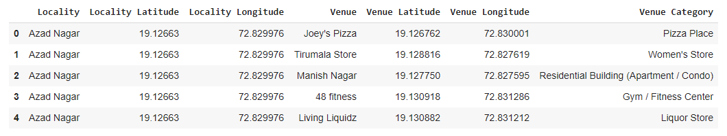
Data Transformation
Using Foursquare API and credentials, get venues from each of the Mumbai localities:

Slide 18
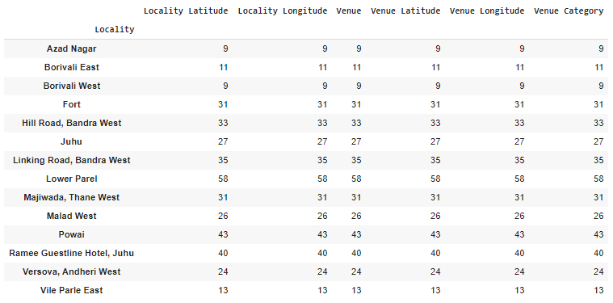
Data Transformation
Group different venues by localities

Slide 19
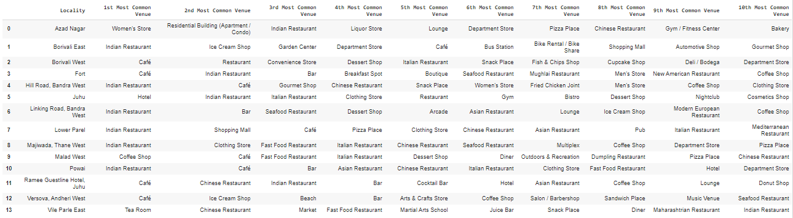
Data Transformation
Create new DataFrame and display the top 10 venues for each Locality:

Slide 20
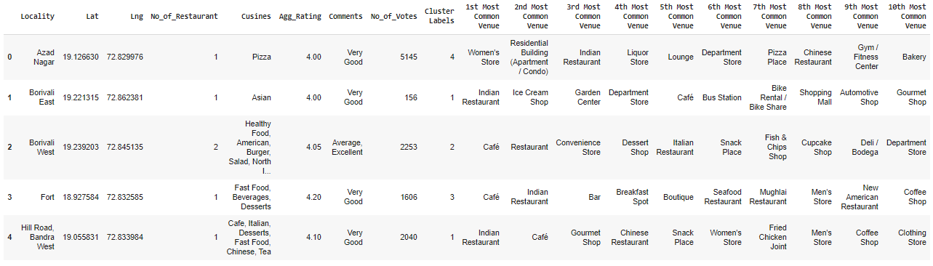
Data Transformation
Run k-means to cluster the Locality into 5 clusters:

Slide 21
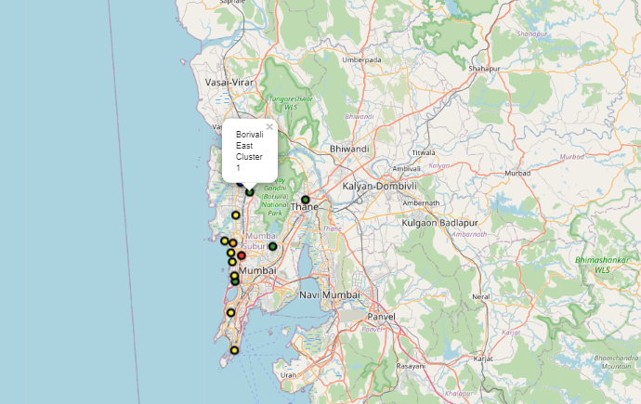
Data Transformation
Create a Map with Marker labels

Slide 22
Clusters
Cluster 1

Slide 23
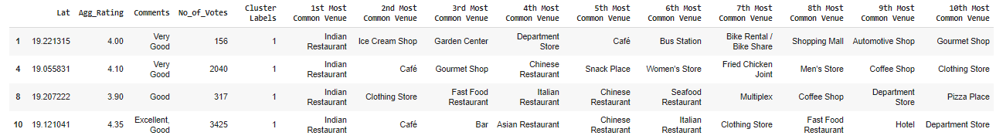
Clusters
Cluster 2

Slide 24
Clusters
Cluster 3

Slide 25
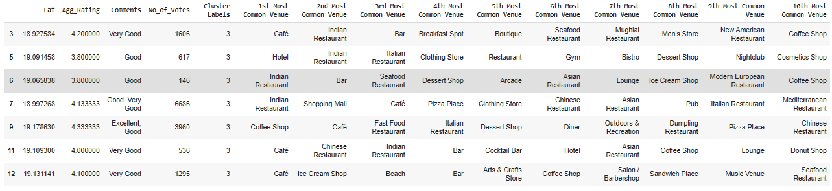
Clusters
Cluster 4:

Slide 26
Clusters
Cluster 5

Slide 27
Conclusion
Borivali west, Bandra West, Versova, Juhu are some of the best neighbourhoods for Italian cuisine.
Lower Parel, Malad West, Powai are the best places for foodies who like eating out frequently.
Powai, Malad West, Fort have the highest-rated restaurants in Mumbai.
Cluster 1, Cluster 3 & Cluster 4: It is most recommended for tea rooms & cafes
Cluster 2: It is most recommended for Indian Restaurants.
Cluster 5: It is most recommended for Stores.

Slide 28


