Slide 1

Sentiment Analysis
on evaluated tweets about multiple brands.
Team: TTN
Tanushree Khanduri
Tanvi Pradhan
Neha Bhojani
Masira Ansari

Slide 2
Problem Statement
- Perform sentiment analysis on evaluated tweets about multiple brands. The evaluators(random audience) were asked if the tweet expressed positive, negative, or no emotion towards a product/brand and labelled accordingly.
Why solve this problem?
- Monitoring Twitter allows companies to understand their audience
- keep on top of what’s being said about their brand
- Their competitors
- Discover new trends in the industry
- Are users talking positively or negatively about a product?
Potential Business Problems
- If a negative tweet is being classified as positive review it would lead to business hazards.

Slide 3
Potential Business Problems
Run optimized campaigns to bring in more customers, and thereby increase the bank revenue ?
Increase long-term holdings which can be further invested in different financial instruments?
Stakeholders
Chief Marketing Officer ?
Campaign Strategy Manager ?
Who else?

Slide 4
Why solve this problem?
Business Impact
Improve prediction -> identify common features of subscribing customers -> targeted campaigns
Improve prediction -> identify right target audience-> efficient budget for marketing
Improve prediction-> identify right frequency interval for campaign -> optimum campaign
-

Slide 5
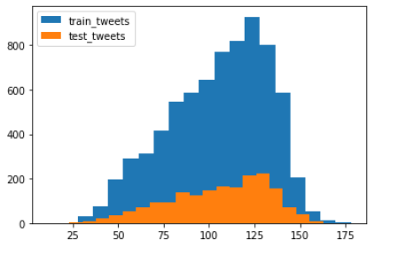
Data:
Dataset Information:
Training dataset contains around 7k tweet text with the sentiment label with 3 columns
Tweet_id - Unique id for tweets.
Tweet - Tweet about the brand/product
Sentiment –
0: Negative
1: Neutral
2: Positive
3: Can't Tell
The tweet limit is 280 characters, the most common length of a tweet is 100 - 125 character. Only 9% of tweets hit Twitter's 140-character limit.

Slide 6
Evaluation Metric
The evaluation metric for this project is F1 score.
F1 = 2 * (precision * recall) / (precision + recall)

Slide 7
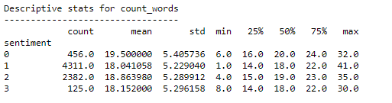
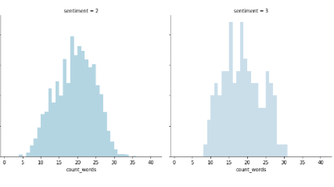
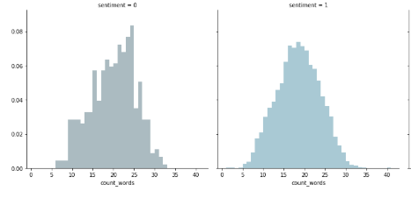
First steps - EDA - Count Words in sentiments

Slide 8
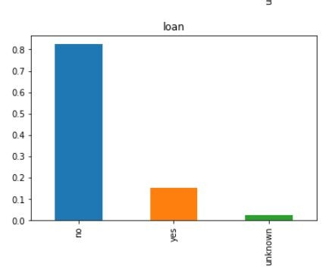
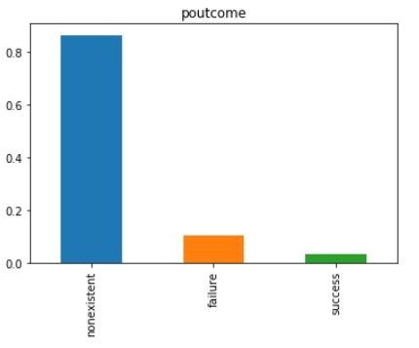

First steps - EDA
On the left is the univariate analysis of the feature poutcome and on the right is that of loan.
Most of the data is of customers where we are not sure about the outcomes of the previous campaign.
Most people already have a personal loan. (Will they be willing to commit to a term deposit?)

Slide 9
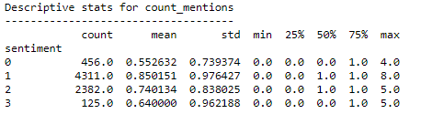
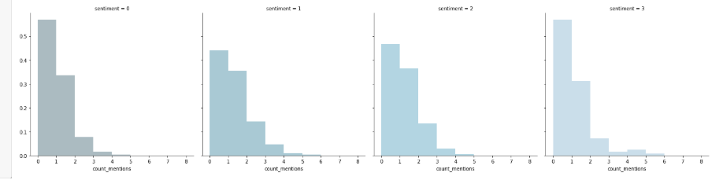
First steps – EDA Count of @mentions

Slide 10
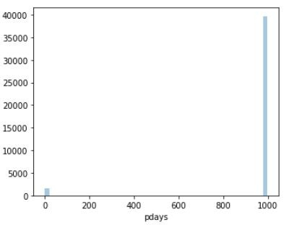
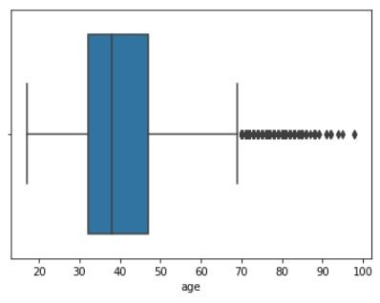
EDA - continuous - age, pdays - Bring out Key Insights
Age - many in the age bracket 30-40 i.e working population
Pdays - lot of previously non-contacted customers.

Slide 11
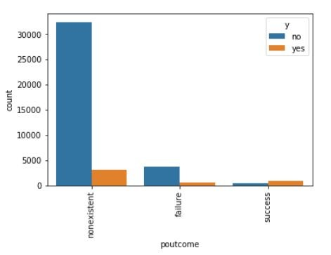
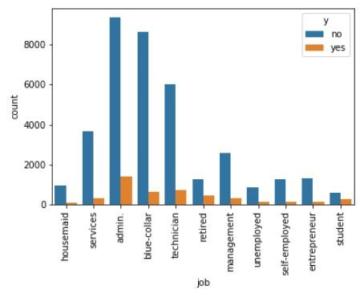
EDA - bivariate
Below are the bivariate analysis of features poutcome and job w.r.t the target.
Customers who have successfully connected in previous campaign tend to subscribe. But we are not capturing those learners.
Lot of people in admin tend to subscribe to a term deposit.

Slide 12
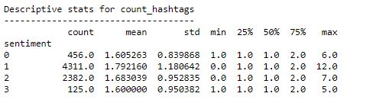
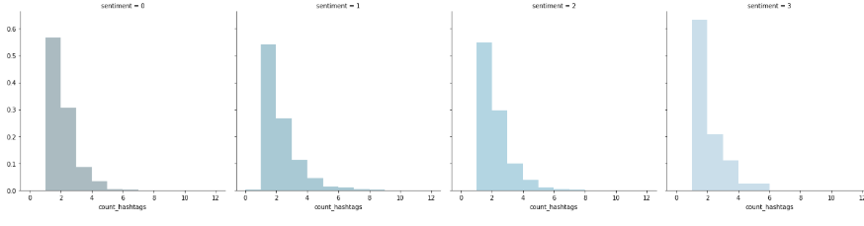
EDA - Count of #hashtags

Slide 13
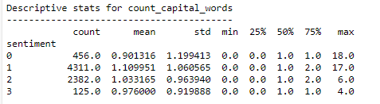
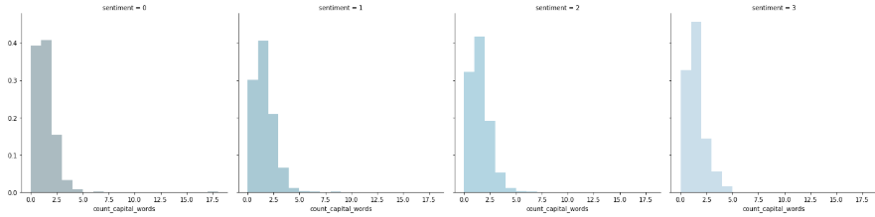
EDA - Count of Capital Words

Slide 14
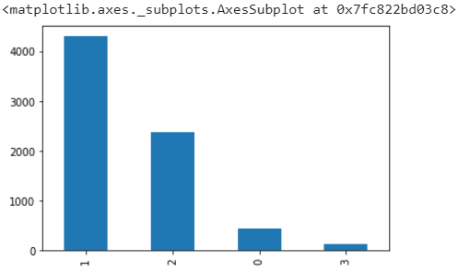
Pipeline
Missing Values :
There were no missing values in the continuous features (only 1 row )
Class Imbalance :

Slide 15
Models and Approaches
Models used for classification:
Logistic Regression
Random Forest Classifier
SVM
XGBoost Classifier
Methods used for converting raw text to numerical features (feature extraction):
Bag-of-Words
TF-IDF

Slide 16
Model Tuning:
Modelling Method | F1 score
Logistic Regression with BOW with ngram = 3 | 0.66
SVM oneVSrest with ngram 3 | 0.65
XGBoost Classifier with ngram 3 | 0.65
Random Forest | 0.6

Slide 17
Models and Approaches
Models Assessed : The vanilla models used yielded the following results below.
Modelling Method | Precision | Recall
Logistic Regression | 0 – 0.92 1- 0.44 | 0 – 0.84 1 – 0.65
Random Forest Classifier (Oob score – 0.94 ) | 0 – 0.96 1 – 0.84 | 0 – 0.97 1 – 0.79
XGBClassifier | 0 – 0.82 1 – 0.81 | 0 – 0.81 1 – 0.82
Gradient Boosting | 0 – 0.97 1 – 0.80 | 0 – 0.97 1 – 0.84

Slide 18
Next Steps
If time permitted, could have tried the following :
An ensemble of different models
Different undersampling, oversampling methods
A UI for a real user

