Slide 1
Credit Card Fraud Detection
CS5661 - Data Science
Final Project
Jesse Rodriguez
Naga Siri Chandana Vankina
Neha Das
Vaibhavi Buddhiraju
Ashkan Aledavoud

Slide 2
Fraud Detection
Fraud in credit card transactions is unauthorized and unwanted usage of an account by someone other than the owner of that account.
Necessary preventive measures can be taken to stop the behavior of such fraudulent practices by studying to minimize it and protect against similar occurrences in the future.
Fraud detection involves monitoring the activities of populations of users in order to estimate, perceive or avoid objectionable behavior, which consist of fraud, intrusion, and defaulting.

Slide 3
Objective
The Credit Card Fraud Detection Problem includes modelling past credit card transactions with the data of the ones that turned out to be fraud.
This model is then used to recognize whether a new transaction is fraudulent or not.
Our objective here is to detect fraudulent transactions while minimizing the incorrect fraud classifications.

Slide 4
Types of fraud
Skimming: Any scheme in which cash is stolen from an organization before it is recorded on the organization’s books.
Cash Larceny: Any cash which is stolen from an organization after it has been recorded on the organization’s books and records.
Billing: Any scheme in which a person causes his employer to issue a payment by submitting invoices for fictitious goods or services, inflated invoices or invoice for personal purchases.
Expense Reimbursements: Any claim in which an employee makes a claim for reimbursement of fictitious business expenses.
Check Tampering:Any scheme in which a person steals his employer’s funds by intercepting, forging or altering a check drawn on the organization’s account.

Slide 5
Conventional Fraud Detection:
The rules of making a decision on determining schemes should be set manually.
Takes an enormous amount of time
Multiple verification methods are needed; thus, inconvenient for the user
Finds only obvious fraud activities

Slide 6
ML fraud detection
Machine Learning-based Fraud Detection:
Detecting fraud automatically
Real-time streaming
Less time needed for verification methods
Identifying hidden correlations in data

Slide 7
Challenges
Keeping in view of the fraudulent transactions and scams happening in real-time, huge data is needed to be experimented every day to make the model successful.
As per the statistics, 99.98% of transactions are reported as not fraudulent, whereas they contain scams and other frauds, which makes the fraud detection very difficult.
Collecting data from different resources is mostly inaccessible, since the data is very secure and most of them are private.
Sometimes fraud and scams are in pennies, for which millions of them are not reported, so that falls into misclassified data, which makes the job more complex.

Slide 8
These are not the only challenges in the implementation of a real-world fraud detection system.
In real world examples, the massive stream of payment requests is quickly scanned by automatic tools that determine which transactions to authorize.
Machine learning algorithms are employed to analyze all the authorized transactions and report the suspicious ones.
These reports are investigated by professionals who contact the cardholders to confirm if the transaction was genuine or fraudulent.
The investigators provide a feedback to the automated system which is used to train and update the algorithm to eventually improve the fraud-detection performance over time.

Slide 9
Dataset
The dataset consists of 284,807 credit card transactions
Each transaction has 30 features and a label:
Features V1 - V28
Time
Amount
Class (label)

Slide 10
Dataset
The dataset is taken from Kaggle and per Kaggle’s privacy policies and confidentiality issues the original features were renamed V1 - V28 after performing Principal Component Analysis.
Time is the feature that indicates the interval between every transaction occurring and the first transaction.
Amount is the feature that indicates the amount of that specific transaction
Class is a binary label for the dataset, where 0 is a valid transaction and 1 is a fraud transaction

Slide 11
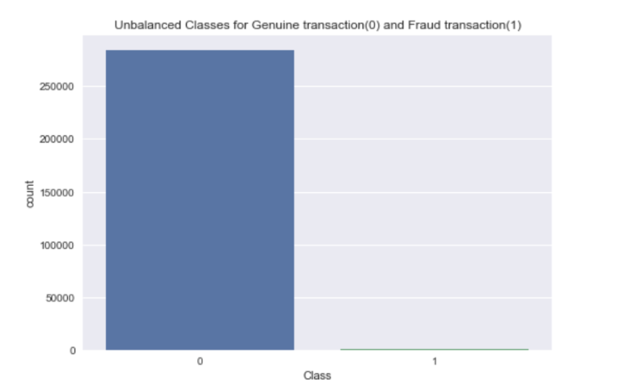
Data Visualization
Upon visualizing the dataset, we saw a huge difference between number of transactions from the dataset collected.
A SNS-countplot was done with respect to dataset to visualize the data and discriminate the fraud (492) and genuine transactions(284315).
From this figure we made two observations:
Dataset is completely imbalance, so balancing the dataset is our priority.
How should we balance the dataset?
Undersampling?
Oversampling?
But before moving to sampling, lets check whether features are scaled or not!

Slide 12
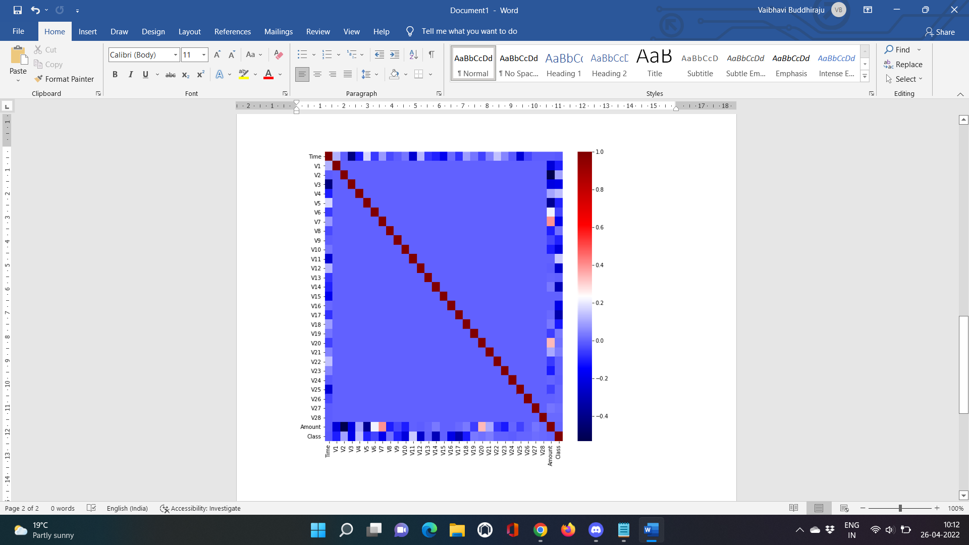
Whether scaled or not?
In order to perform scaling of the features, we used HeatMap, to see what features descript better correlation among each other.
From this heat map, we can observe that the highest correlations are between :
Time and V3[< -0.4]
Amount and V2[< -0.4]
Amount and V4[0.19].
Also, the features V1 - V28 somehow have close inter-connection with each other.
But the class feature has some positive and negative correlation with all V-features.
Class does not have any correlation with the Feature Time and Amount.
It also clearly indicates that V-features are scaled but Time and Amount are not scaled.

Slide 13
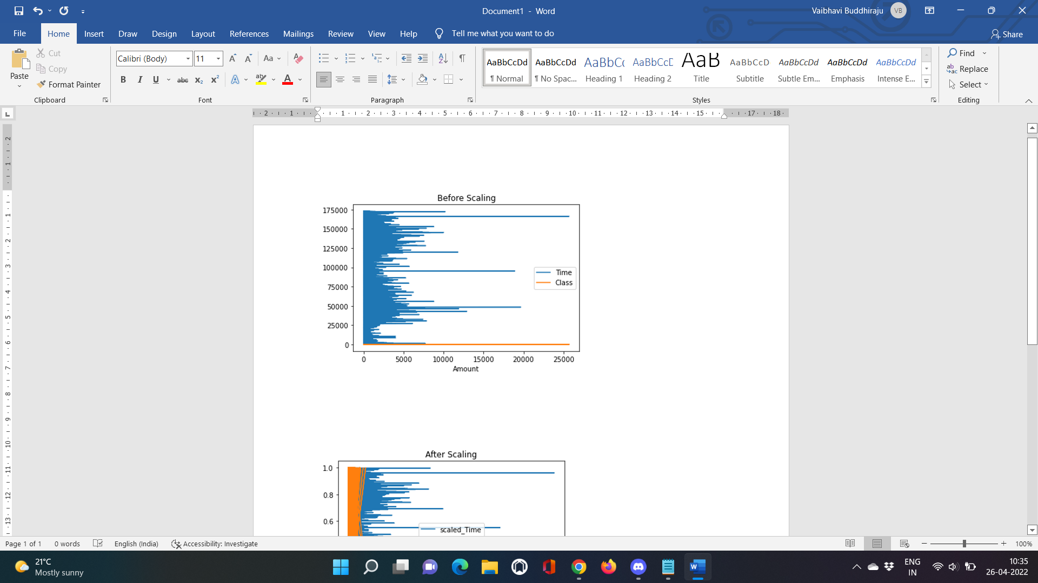
Data Scaling
We saw from the heat-map, that all V-features are scaled, but Time and Amount are not scaled.
Since we are scaling Time and Amount with respect to class, class is either 0 or 1, so the best way to perform the scaling of the two features is using MinMax Scaler.
MinMax scaler transforms each of the features we want to scale between the specific range as provided. And from the heat map we observed the range is [-1,1].
As you can see before scaling:
For the amount ranging between [0-25000], time is very high.
Class always stays at 0 or 1.
So we need to have scaled amount and scaled time.

Slide 14
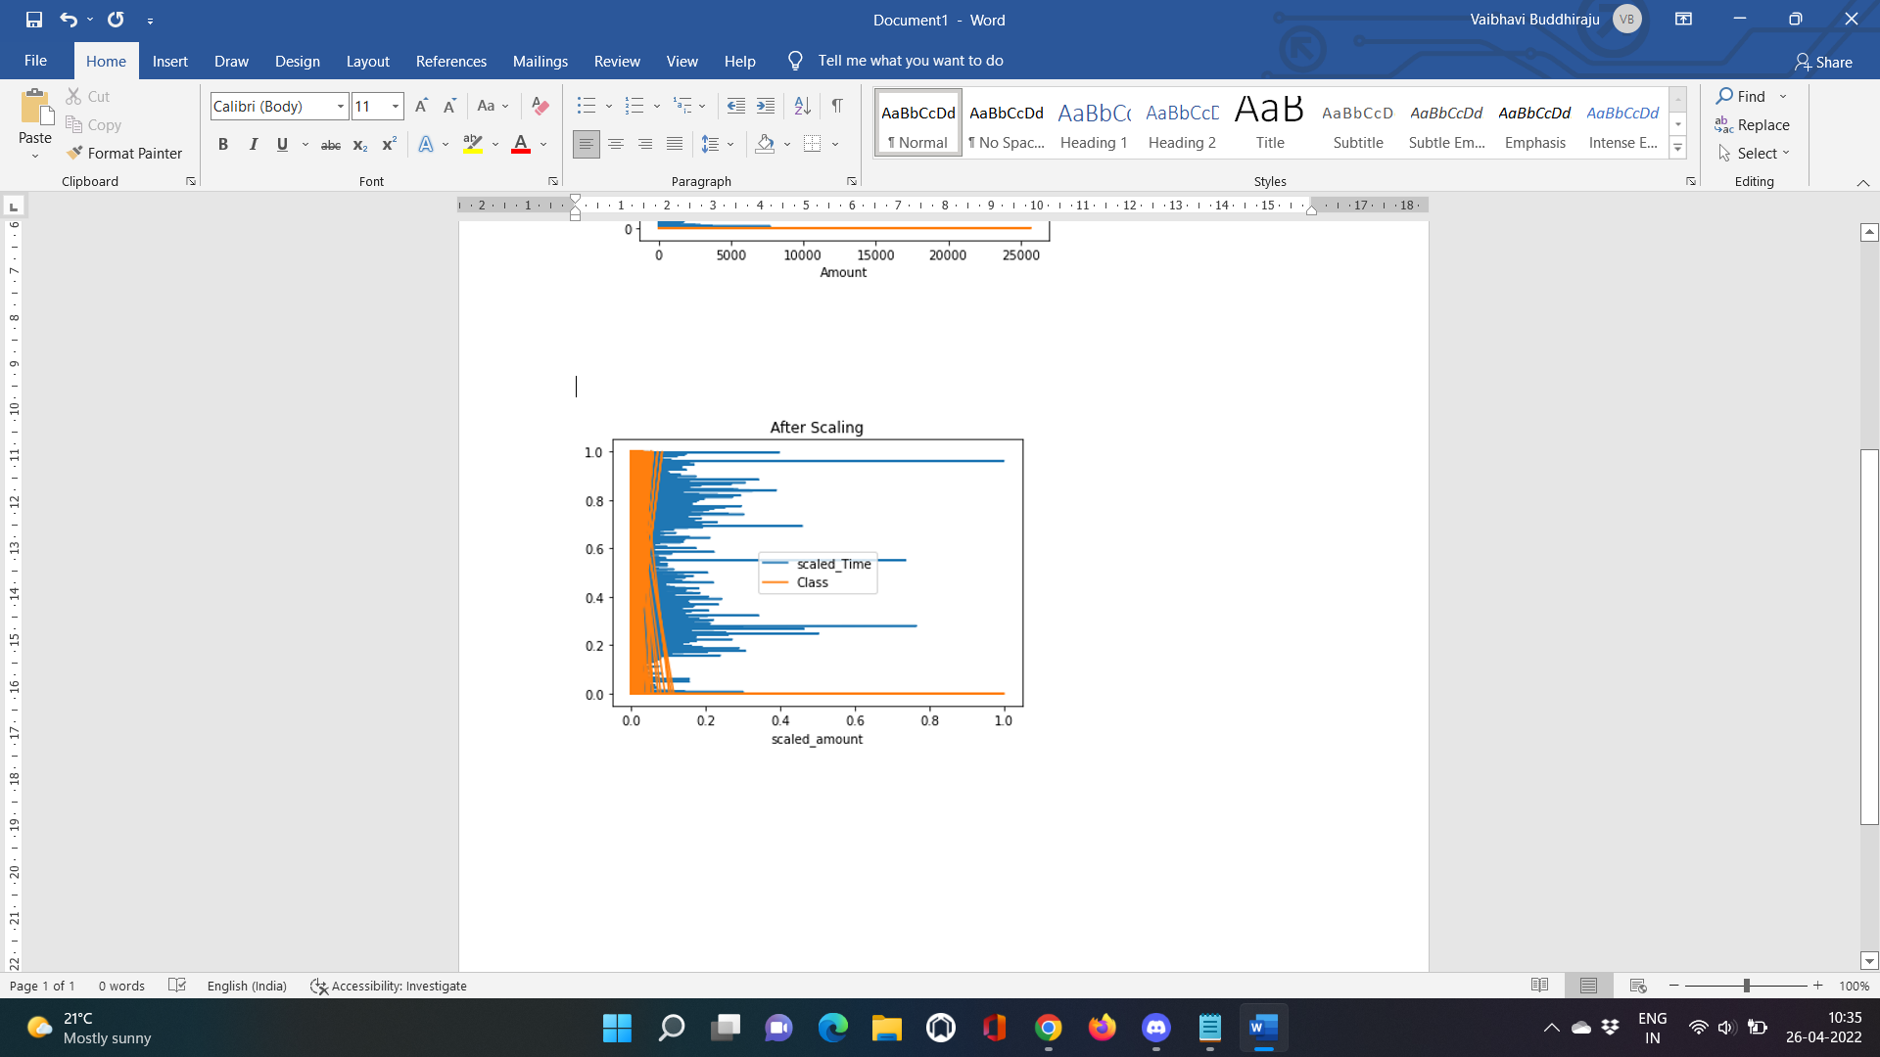
After Scaling
MinMax scaler is used to scale two features Amount and Time based on minimum and maximum value.
The amount ranges between [0-25000].
Whereas Time ranges between [0-175000].
To undermine this data, we thought of a way to eliminate the median values, instead consider the minimum and maximum values of the dataset.
After applying the MinMax scalar, we have the Time and Amount feature replaced with Scaled Amount and Scaled Time in the dataset.
Lets see the HeatMap of the dataset after scaling!
Notes:
I’m not sure how to explain heat maps - Ash

Slide 15
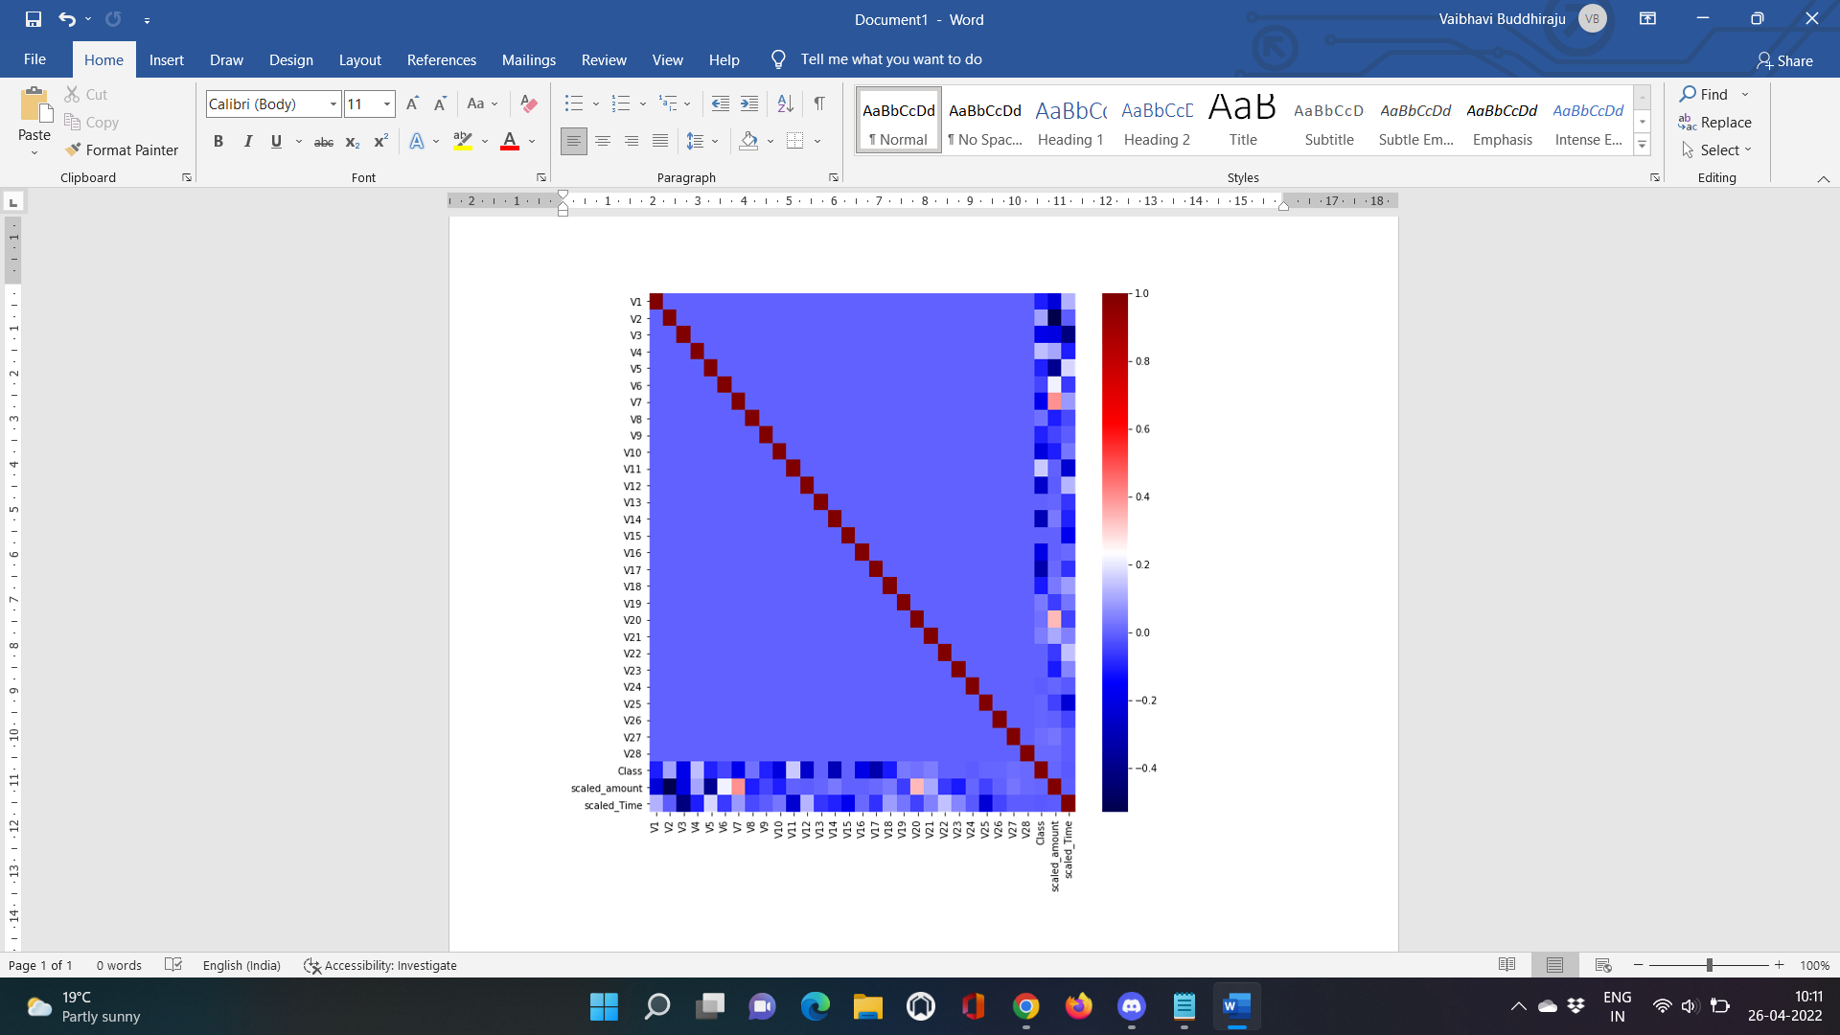
Heat Map - After Scaling
From this heat map we can see:
All V - features are scaled with each other.
Correlation is maintained between all features.
We have the time and amount scaled as well.
So now lets see how can handle the imbalance dataset.
Until the dataset is balanced, we cannot apply any algorithms.
So balancing the dataset is the next step.
Notes:
I’m not sure how to explain heat maps - Ash

Slide 16
Handling the imbalanced DataSet
We know we have a big difference between the number of genuine and fraud transactions.
So we have a question, whether we should use undersampling or oversampling?
Case-1 : OverSampling
If we use oversampling, we have to replicate the fraud transactions i.e. 492 transactions around 80 times to achieve the target of genuine transactions i.e. 284315 transactions, which can lead to overfitting the data.
Case-2 : UnderSampling
Approach 1: If we use Random undersampling, we can randomly select 492 transactions among the 284315 genuine transactions, to have both the fraud and genuine transactions at equal levels.
Approach 2: Use an algorithm called NearMiss used for undersampling.
And as per statistics, majority of data scientists prefer using undersampling to extract, because this provides the accurate data and there is no possibility of data replication.

Slide 17
Approach 1: Random UnderSampling
To perform random undersampling, we shuffled the whole dataset with a finite random state of 4.
Extracted the fraud transactions from the dataset, since they represent class=1 and describes the fraud data.
Extracted the Genuine transactions from the dataset, since they represent class=0 and describes the genuine data.
Now we have 492 fraud transactions separated, we have 284315 genuine transactions separated.
Fraud data belongs to class = 1 and genuine data belongs to class = 0.
So now we have selected 492 random transactions among the 284315 genuine transactions as genuine data.
Now we have 492 fraud data and 492 genuine data.
We can concatenate both fraud and genuine data into normalized data, which can be used in next steps for algorithms

Slide 18
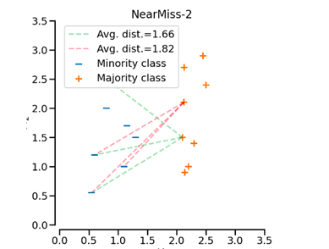
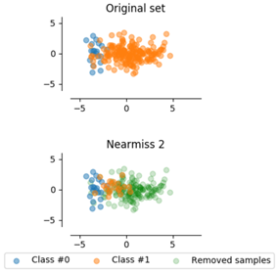
Approach 2: NearMiss-2 Undersampling

Slide 19
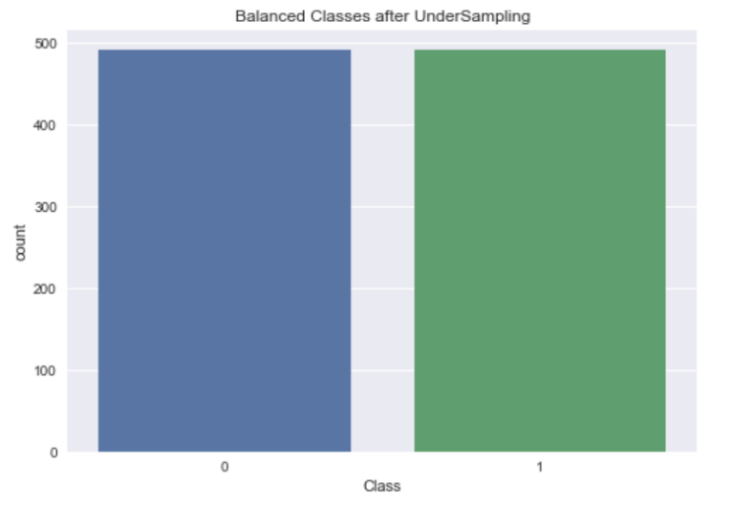
Balanced dataset
As seen we have the dataset balanced with 492 fraud data and 492 genuine data.

Slide 20
Divide the data into training and testing
Before we start training the data, we must extract the feature column and target column from the normalized data.
The class feature is considered as target column and labelled as Y.
Whereas X is labelled for the features except class.
Using machine learning library “SKlearn”, we are splitting the data into training and testing datasets with test size of 0.3 and random state of 42.
So this gives us X_train, X_test, Y_train and Y_test.
Lets go ahead and implement the algorithms.

Slide 21
Models and Algorithms
The team utilized 7 different models and algorithms to obtain the highest accuracy on the newly created dataset for both approaches of data balancing:
K-Nearest Neighbours (KNN)
Decision Tree
Random Forest
Logistic Regression
Artificial Neural Network (ANN)
Naive Bayes
Support Vector Machine (SVM)

Slide 22
Accuracy Scores
The following accuracy scores were achieved by each model:
Classifier | Random undersampling | NearMiss undersampling
KNN | 93.58% | 98.64%
Decision Tree | 90.54% | 97.29%
Random Forest | 93.24% | 99.32%
Logistic Regression | 94.59% | 93.24%
ANN | 95.27% | 98.64%
Naive Bayes | 91.21% | 88.17%
SVM | 94.25% | 96.28%

Slide 23
Precision Results
The following precision scores were achieved by each model:
Classifier | Random undersampling | NearMiss undersampling
KNN | 95.80% | 99.30%
Decision Tree | 89.61% | 98.59%
Random Forest | 93.91% | 99.31%
Logistic Regression | 96.52% | 93.75%
ANN | 96.57% | 100%
Naive Bayes | 97.69% | 92.36%
SVM | 97.84% | 93.54%
Notes:
Explain what precision is exactly.

Slide 24
Recall Results
The following recall scores were achieved by each model:
Classifier | Random undersampling | NearMiss undersampling
KNN | 91.33% | 97.94%
Decision Tree | 92% | 95.89%
Random Forest | 92.66% | 99.31%
Logistic Regression | 92.66% | 92.46%
ANN | 94% | 97.26%
Naive Bayes | 84.66% | 82.87%
SVM | 90.66% | 99.31%
Notes:
Explain what recall is exactly

Slide 25
F1-score Results
The following F1-scores were achieved by each model:
Classifier | Random undersampling | NearMiss undersampling
KNN | 93.51% | 98.62%
Decision Tree | 91.80% | 97.22%
Random Forest | 93.28% | 99.31%
Logistic Regression | 94.55% | 93.10%
ANN | 95.27% | 98.61%
Naive Bayes | 90.71% | 87.36%
SVM | 94.11% | 96.34%
Notes:
Explain what recall is exactly

Slide 26
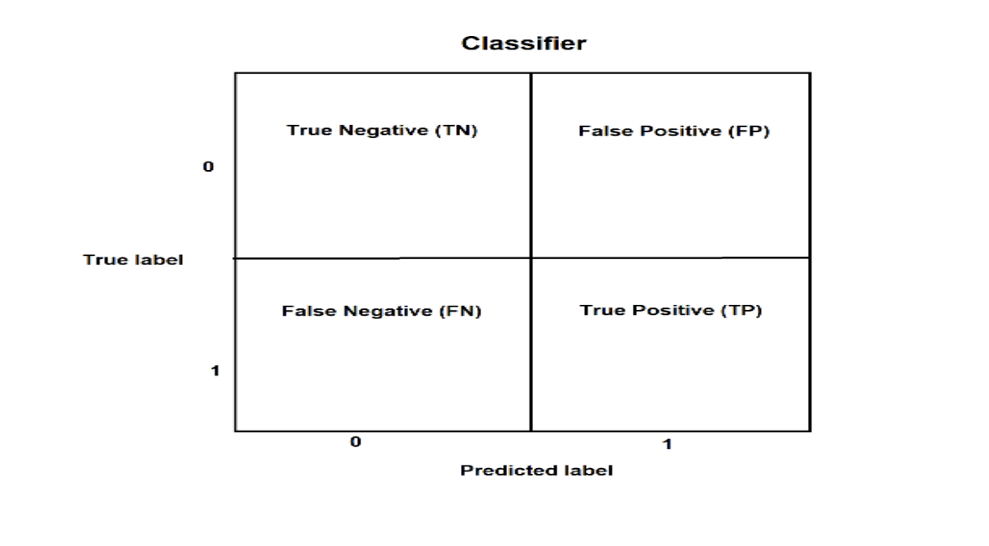
Confusion Matrix
The unequal number of data in each class can lead to inconsistent classification accuracy. Calculating a confusion matrix can help you figure out where your classification models are succeeding and where they are failing.
The true value of each row is connected and Columns are related to the predictions provided by the analyzed algorithm.
True positive (TP) = Correctly predicted as fraudulent and true value is fraudulent.
True negative (TN) = Classifier predicted not fraudulent and true value is not fraudulent.
False Negative (FN) = Classifier predicted not fraudulent but in fact it is fraudulent
False Positive (FP) = Not fraudulent but the classifier predicted as fraudulent

Slide 27
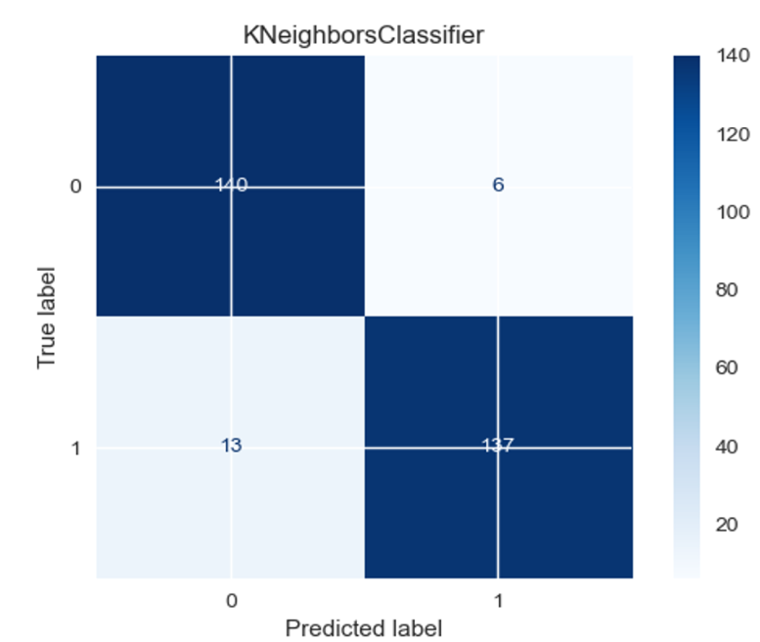
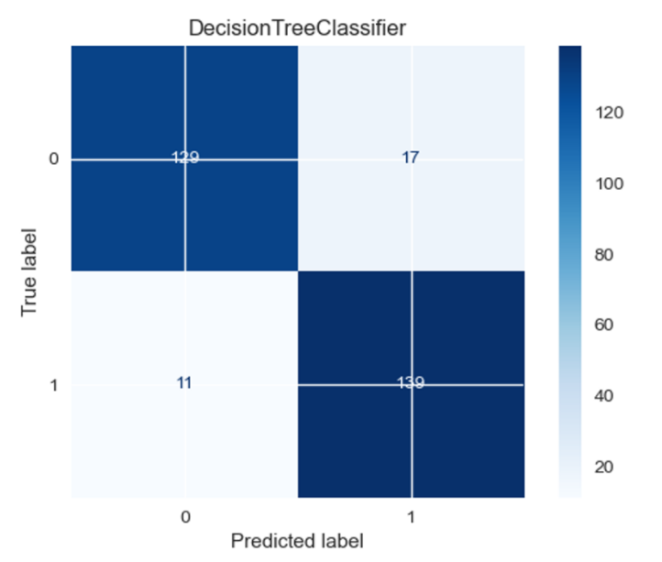
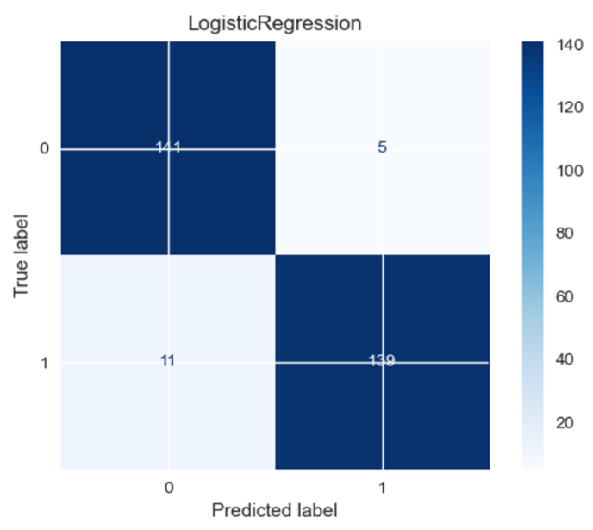
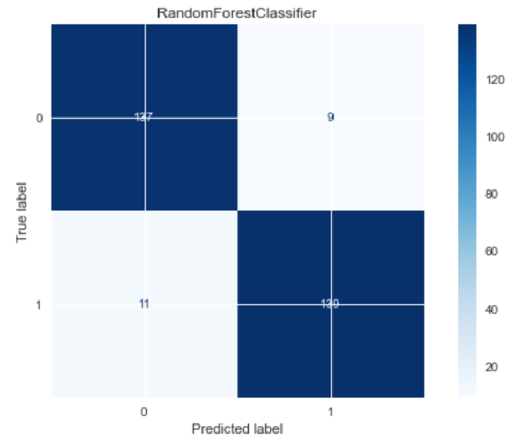
Confusion Matrix
For Approach 1

Slide 28
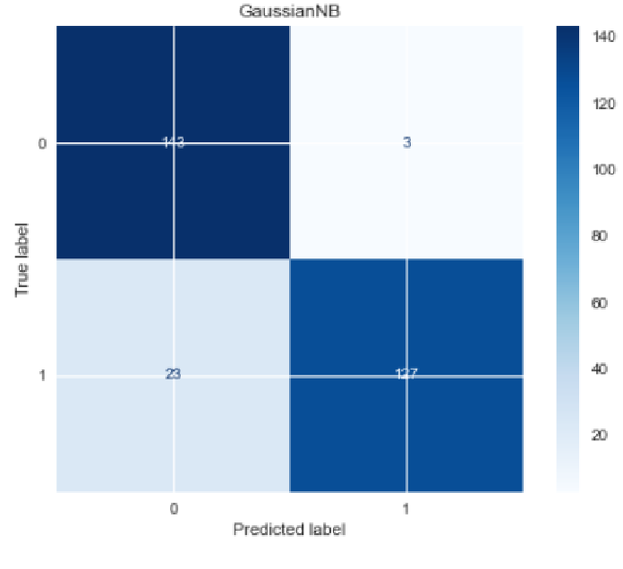
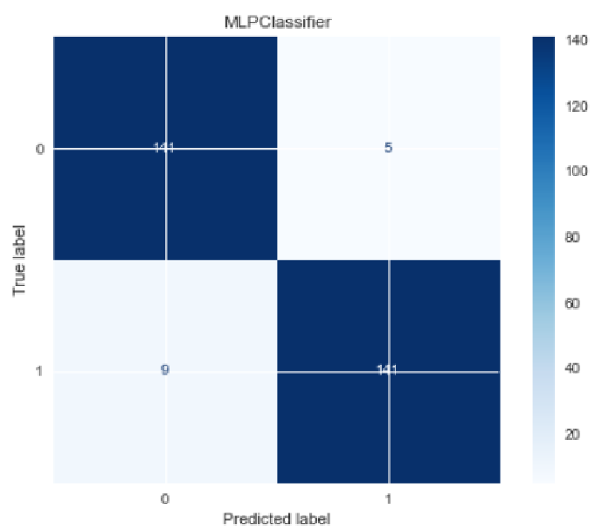
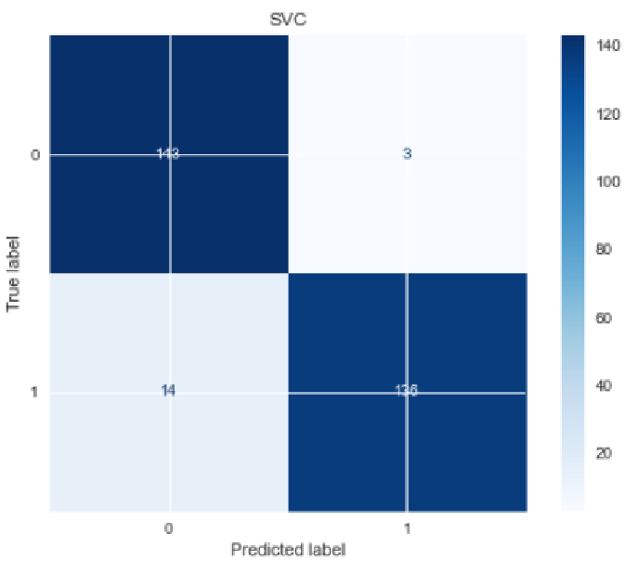
Confusion Matrix For Approach 1 (cont’d)

Slide 29
Looking at the Confusion Matrix for the seven algorithms that were implemented previously for approach 1.
KNN - correctly classified 137 as fraudulent and 140 as not fraudulent.
Decision Tree - correctly classified 139 as fraudulent and 129 as not fraudulent
Random Forest - correctly classified 139 as fraudulent and 137 as not fraudulent
Logistic Regression - correctly classified 139 as fraudulent and 141 as not fraudulent
ANN - correctly classified 141 as fraudulent and 141 as not fraudulent.
Naive Bayes - correctly classified 127 as fraudulent and 143 as not fraudulent
SVM - correctly classified 136 as fraudulent and 143 as not fraudulent

Slide 30
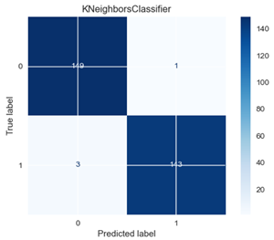
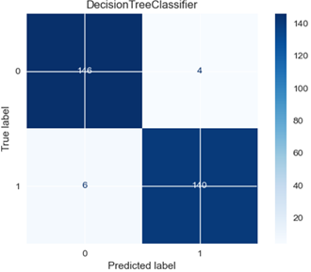
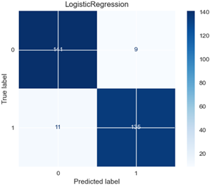

Confusion Matrix
For Approach 2

Slide 31
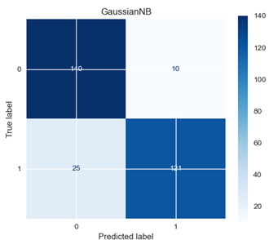

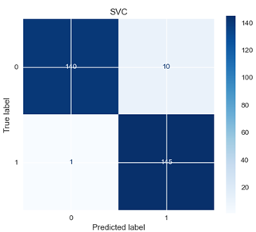
Confusion Matrix For Approach 2 (cont’d)

Slide 32
Looking at the Confusion Matrix for the seven algorithms that were implemented previously for approach 2.
KNN - correctly classified 143 as fraudulent and 149 as not fraudulent.
Decision Tree - correctly classified 140 as fraudulent and 146 as not fraudulent
Random Forest - correctly classified 145 as fraudulent and 149 as not fraudulent
Logistic Regression - correctly classified 135 as fraudulent and 141 as not fraudulent
ANN - correctly classified 142 as fraudulent and 150 as not fraudulent.
Naive Bayes - correctly classified 121 as fraudulent and 140 as not fraudulent
SVM - correctly classified 145 as fraudulent and 140 as not fraudulent
We know the confusion matrices are sometimes not helpful to represent the perfect data classification, which makes the job difficult to choose accurate ML algorithm.
So we implemented ROC curve - AUC to make decision faster for understanding the right algorithm.

Slide 33
ROC Curve
An ROC curve (receiver operating characteristic curve) is a graph showing the performance of a classification model at all classification thresholds.
The curve is constructed by plotting the sensitivity by (1- specificity) for different classification thresholds.
The curves that are closer to 1 for y-axis (top right corner) have higher specificities associated with higher sensitivities.
The y-axis shows the true positive rate (same thing as sensitivity)
True Positive Rate = TPR = TP / (TP + FN)
The x-axis shows the false positive rate (same thing as 1-specificity)
False Positive Rate = FPR = FP / (FP + TN)

Slide 34
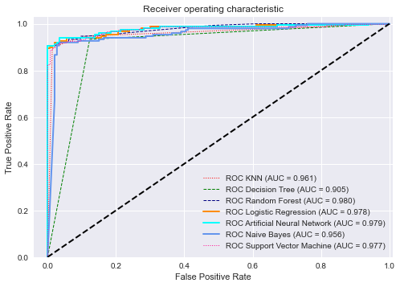
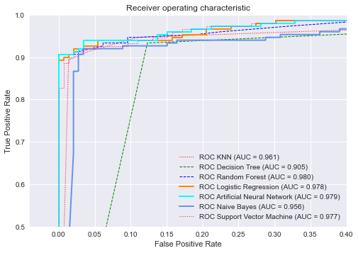
ROC Plot for approach 1
We can observe from the plots below that achieved the best area under the curve with our ANN model Zoomed in plot for better visualization

Slide 35
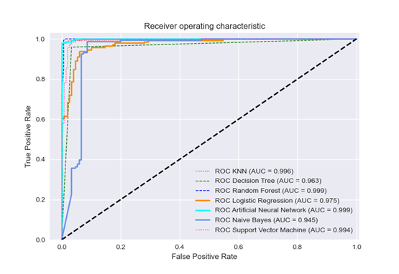
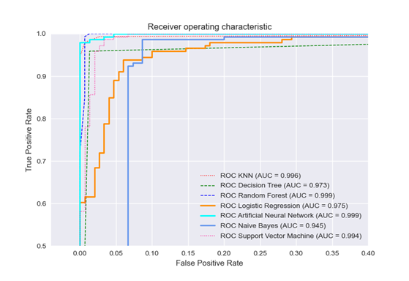
ROC Plot for approach 2
We can observe from the plots below that achieved the best area under the curve with our ANN model Zoomed in plot for better visualization

Slide 36
Area Under Curve (AUC)
The area under the curve is the measure of the ability of the Classifier to distinguish between the classes and is used as a summary for ROC.
The higher is the AUC or Area under the curve, the better is the performance of the model at distinguishing between the positive and negative class.
Classifier AUC | Random undersampling | NearMiss undersampling
AUC KNN | 0.961 | 0.996
AUC Decision Tree | 0.912 | 0.973
AUC Random Forest | 0.980 | 0.999
AUC Logistic Regression | 0.978 | 0.975
AUC ANN | 0.979 | 0.999
AUC Naive Bayes | 0.956 | 0.945
AUC SVM | 0.977 | 0.994

Slide 37
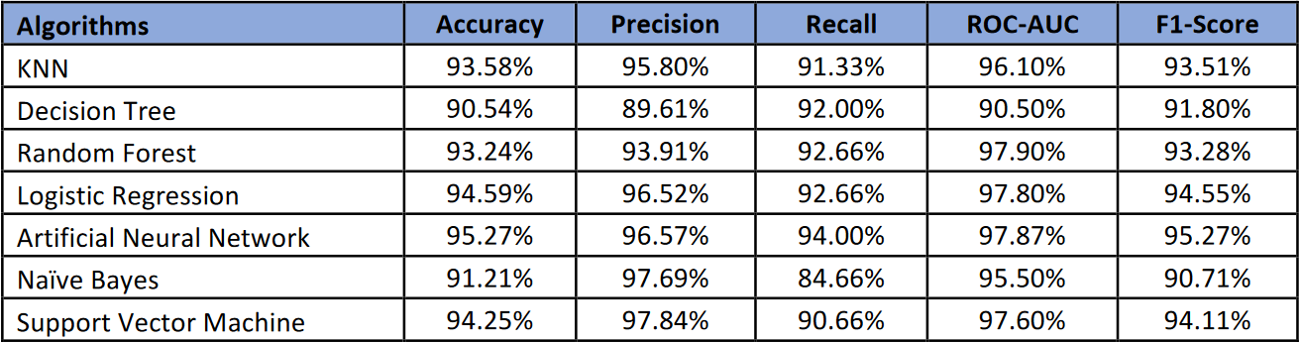
Observations from 7-algorithms for undersampling approach 1
Below is the table where accuracy, precision, recall, ROC-AUC and F1-score as calculated for the 7-algorithms is collected to determine the best algorithm.

Slide 38
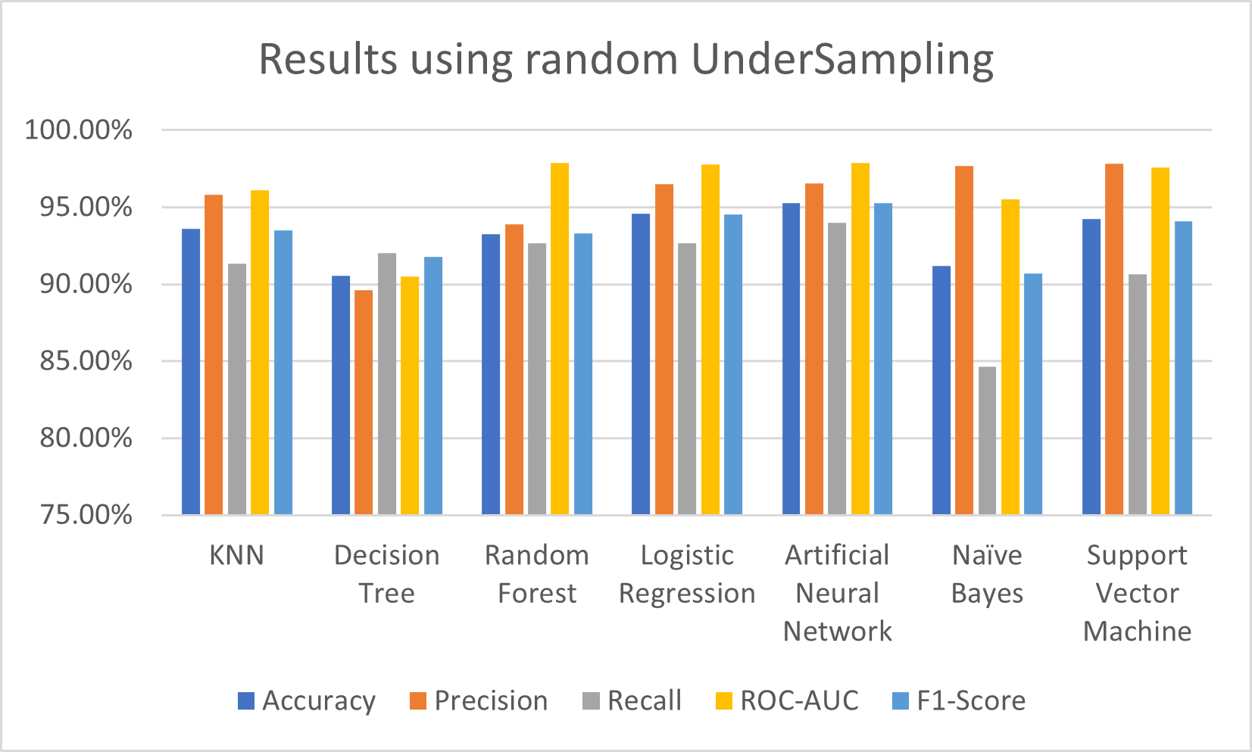

Slide 39
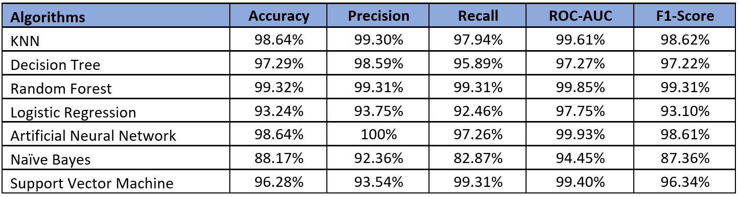
Observations from 7-algorithms for undersampling approach 2
Below is the table where accuracy, precision, recall, ROC-AUC and F1-score as calculated for the 7-algorithms is collected to determine the best algorithm.

Slide 40
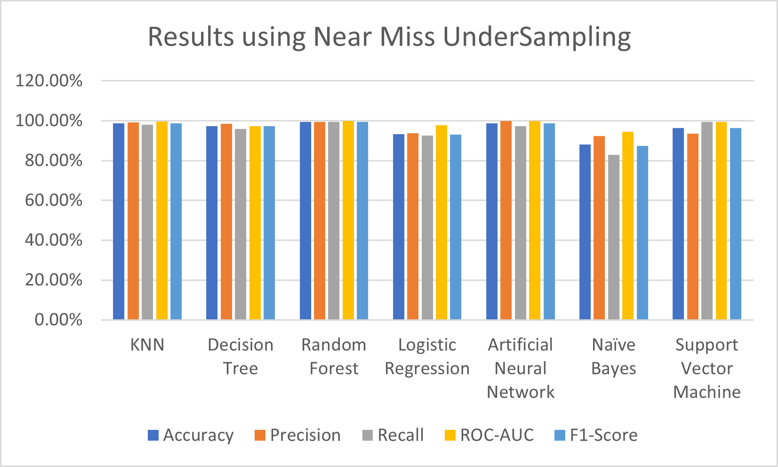

Slide 41
Conclusion
Database optimization and scaling should not be relied on solely. We need to understand the foundations of database management, such as normalizing and scaling the quantity and time of characteristics in relation to the target column.
We plotted the confusion matrix to demonstrate predictive analytics, but because both confusion matrices are so similar, it's impossible to identify whether classifier is a better fit for our current data sets. We calculated the AUC and ROC curve to get a better result.
From the above histogram we observed the results and picked the algorithm which gave the best results above 95% for approach 1 and above 99% for approach 2.

Slide 42
So we found the ANN (Artificial Neural Network) delivered the greatest results, with accuracy of 95.27 %, precision of 96.57 %, recall of 94 %, ROC-AUC of 97.87 %, and F1-score of 95.27 % for approach 1 (Random undersampling of the unbalanced data).
we also found the Random Forest Classifier delivered the greatest results, with accuracy of 99.32%, precision of 99.31%, recall of 99.31%, ROC-AUC of 99.85%, and F1-score of 99.31% for approach 2 (NearMiss-2 undersampling of the unbalanced data).
As a result, we can say that the ANN algorithm is the most successful at detecting credit card fraud for approach 1 and Random Forest was the most successful for undersampling approach 2.

Slide 43
Looking at both histograms we can determine that using NearMiss for balancing the data set gives more successful results over using random undersampling.
We also determined that random forest is the most prominent classifier for approach-2
and ANN gives the most prominent result with approach-1.

Slide 44
Thank You

