Slide 1







LOAN MANAGEMENT SYSTEM

Slide 2

Problem Statement
Getting a loan is very tiring and complicated process in India. It may take weeks or months for loan to get approved and people have to visit the loan office again and again. “LBI” portal is a web application that can be used for applying for loan online without visiting any bank branch. Applying for loan online helps people get around despite the fact that they have to visit branch for any bank related work. The individual who needs loan can just visit our online portal. This system increases customer retention and simplify loan and EMI management. This project is designed to be used by any individual for home loan, Vehicle loan or Education loan. It is an online system through which customer can view available services its benefits and other information related to loan. The system will be based that takes the individual information and then verify if user meets the eligibility criteria. If user is satisfying all the requirements, then loan gets approved.

Slide 3
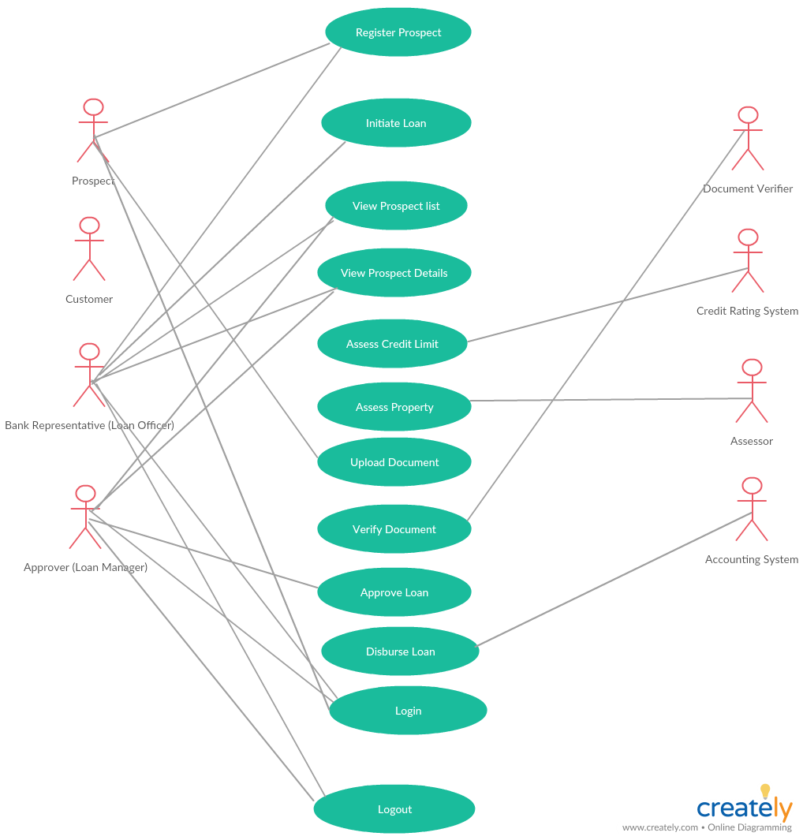

Slide 4
ER Diagram

Slide 5
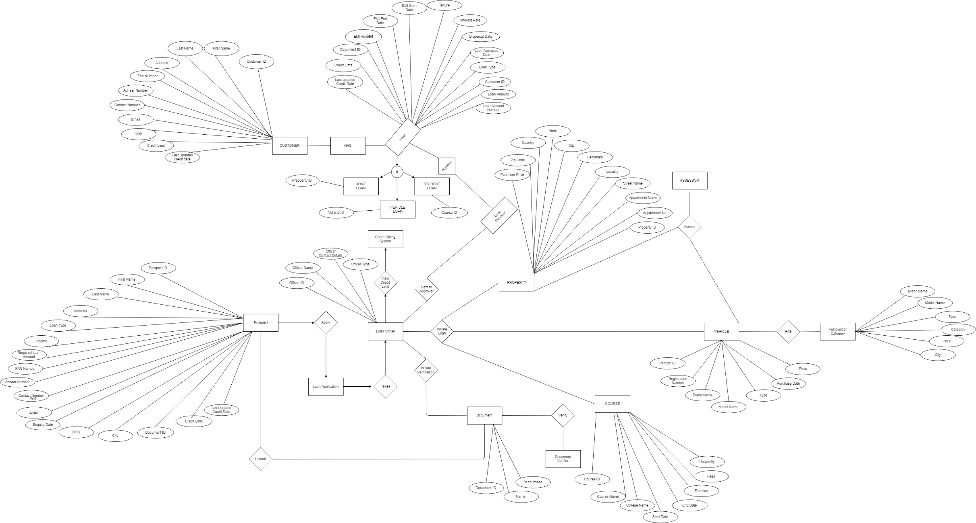

Slide 6

Class Diagram

Slide 7
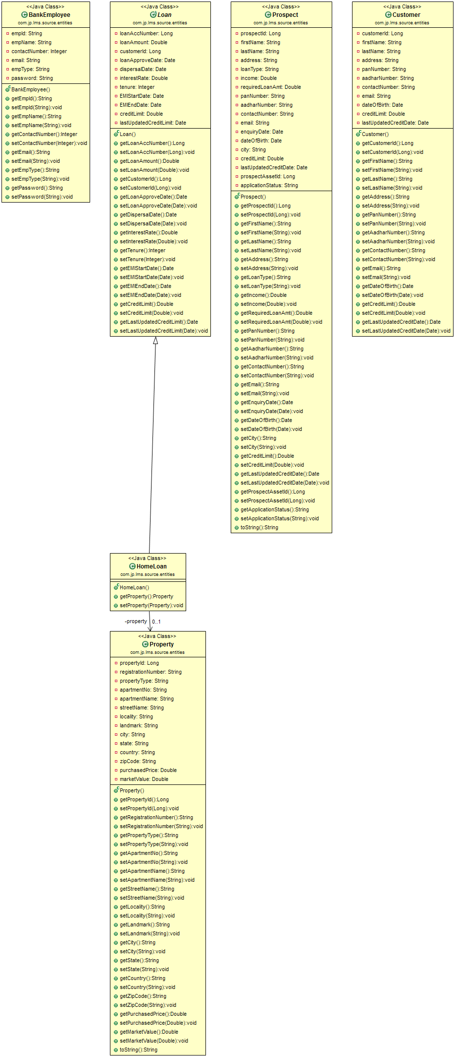
ENTITIES

Slide 8
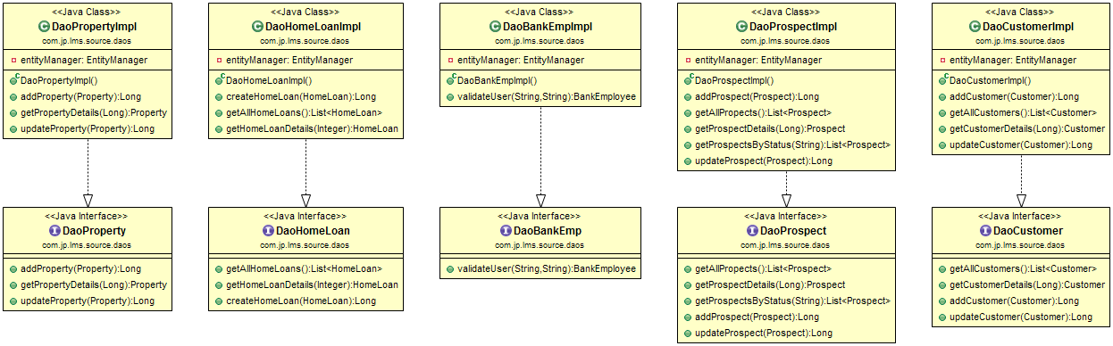
DAOS

Slide 9
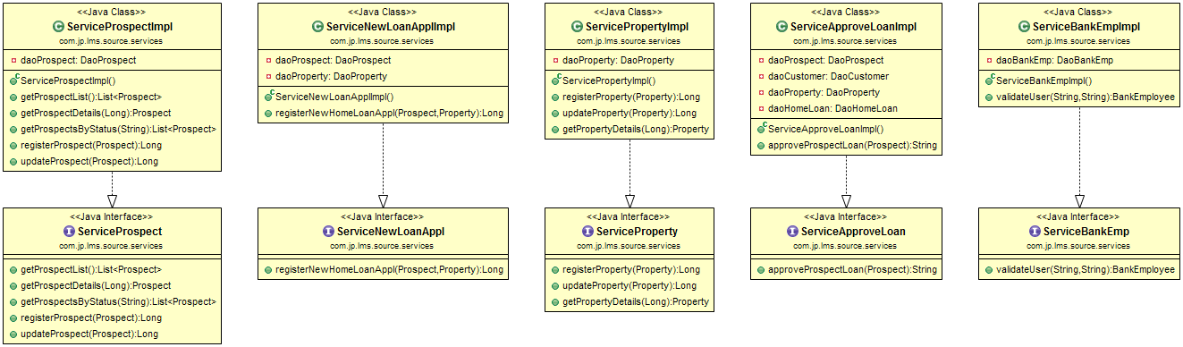
SERVICES

Slide 10
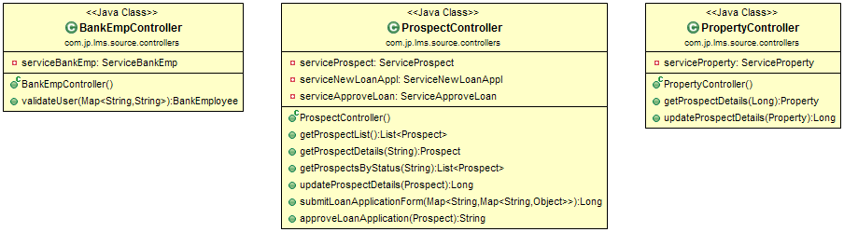
CONTROLLERS

Slide 11
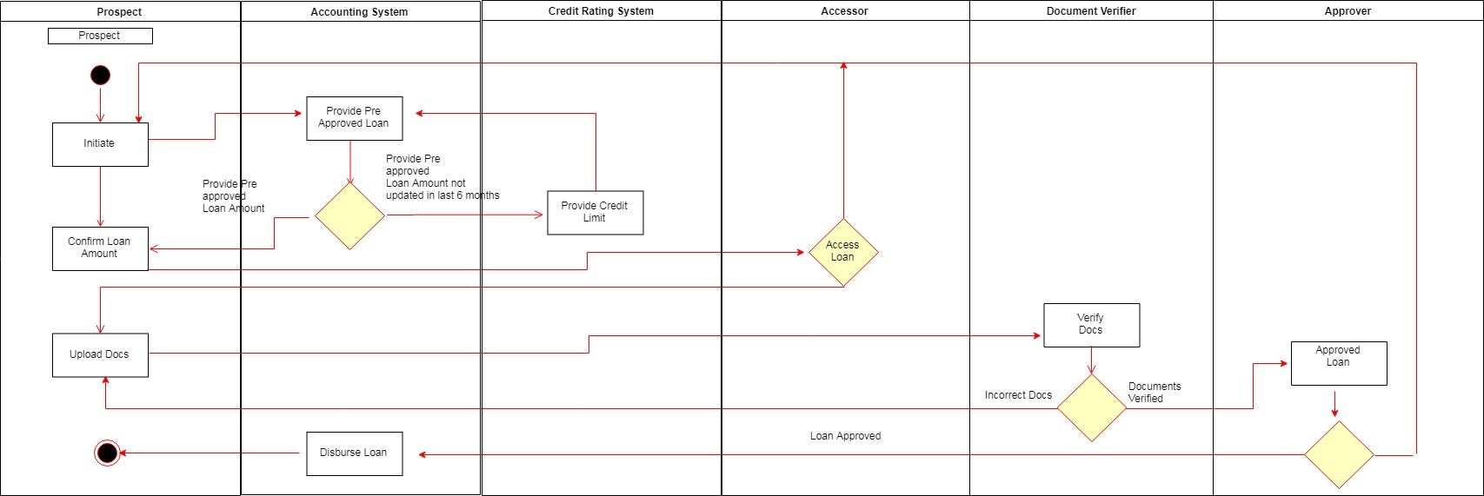
Swim Lane Activity Diagram

Slide 12
Assumptions and Scope of project
Assumptions
Credit Limit System, Document Verifyier and Property Assessor Systems are third party systems
Scope of the Projects
Online Application Process
Offline Application submitted by Bank Officer
Assessing the Credit history of the Prospect
Assessing the property against which the loan is taken

Slide 13


TECHNOLOGIES AND FRAMEWORKS
FRONTEND TECHNOLOGIES & FRAMEWORKS
Angular 7.0.6
HTML5
Bootstrap v3.4.0
CSS
BACKEND TECHNOLOGIES & FRAMEWORKS
JAVA 1.8
SpringBoot Framework – 2.1.1
JPA
Oracle 11G

Slide 14
Salient features of the project
Online Loan Application by Prospect
View Prospect List by the Bank Officer
View Prospect's Details
Retrieve Applicant’s Credit History
Approving the Credit Limit by Bank Officer
Retrieving the Property Valuation from the Assessor
Approving Loan Application based on the Assessment
Rejecting the Loan Application based anytime based on Credit and property assessment

Slide 15
APPLICATION ARCHITECTURE
ANGULAR
JSON
REST CONTROLLER
SERVICE LAYER
BUSINESS LOGIC LAYER
DAO LAYER
JPA
ORACLE DB
MVC
CORS

Slide 16

What next? Future plan
Implement the Document Verification Module
Implement User, Customer and Bank employee login

Slide 17


Application Demo & Feedback

Slide 18
Thank you

