Slide 1

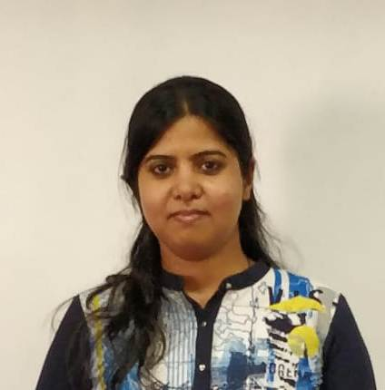





NEHA DAWDA
SWATI DESHPANDE
ANIL AWASTHI

Slide 2

Problem Statement
Getting a loan is very tiring and complicated process in India. It may take weeks or months for loan to get approved and people have to visit the loan office again and again.
Design a online loan application form for an applicant
Manage the loan processing by the loan officer
Approval of the loan

Slide 3
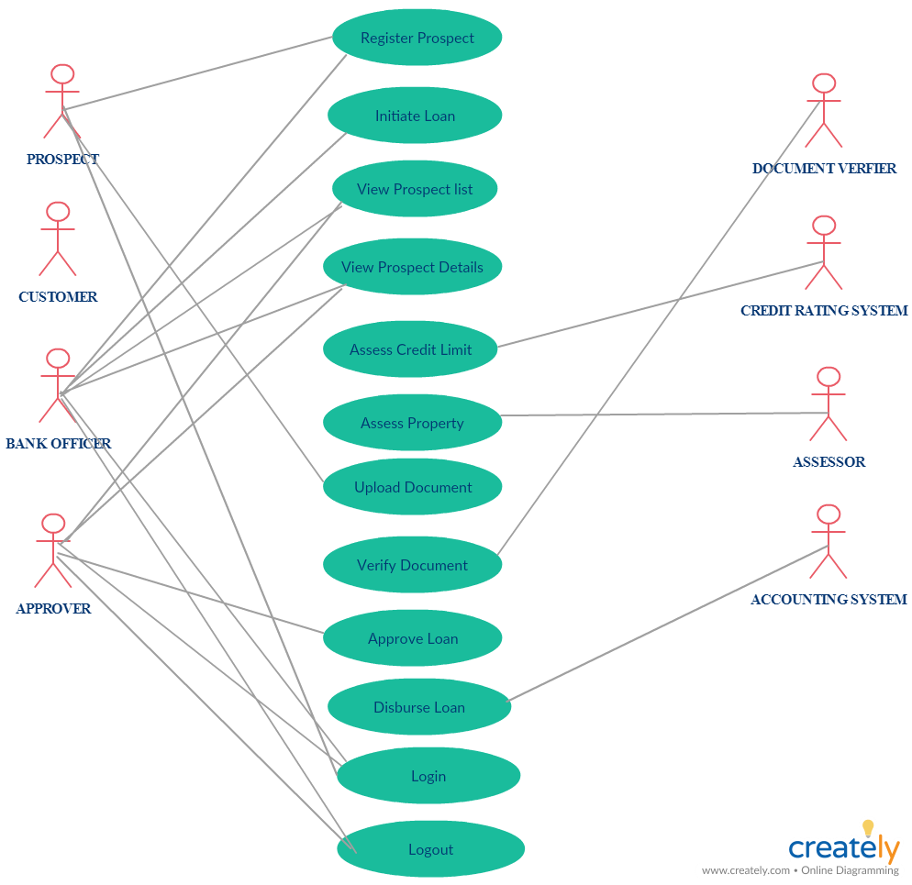

Slide 4
ER Diagram

Slide 5
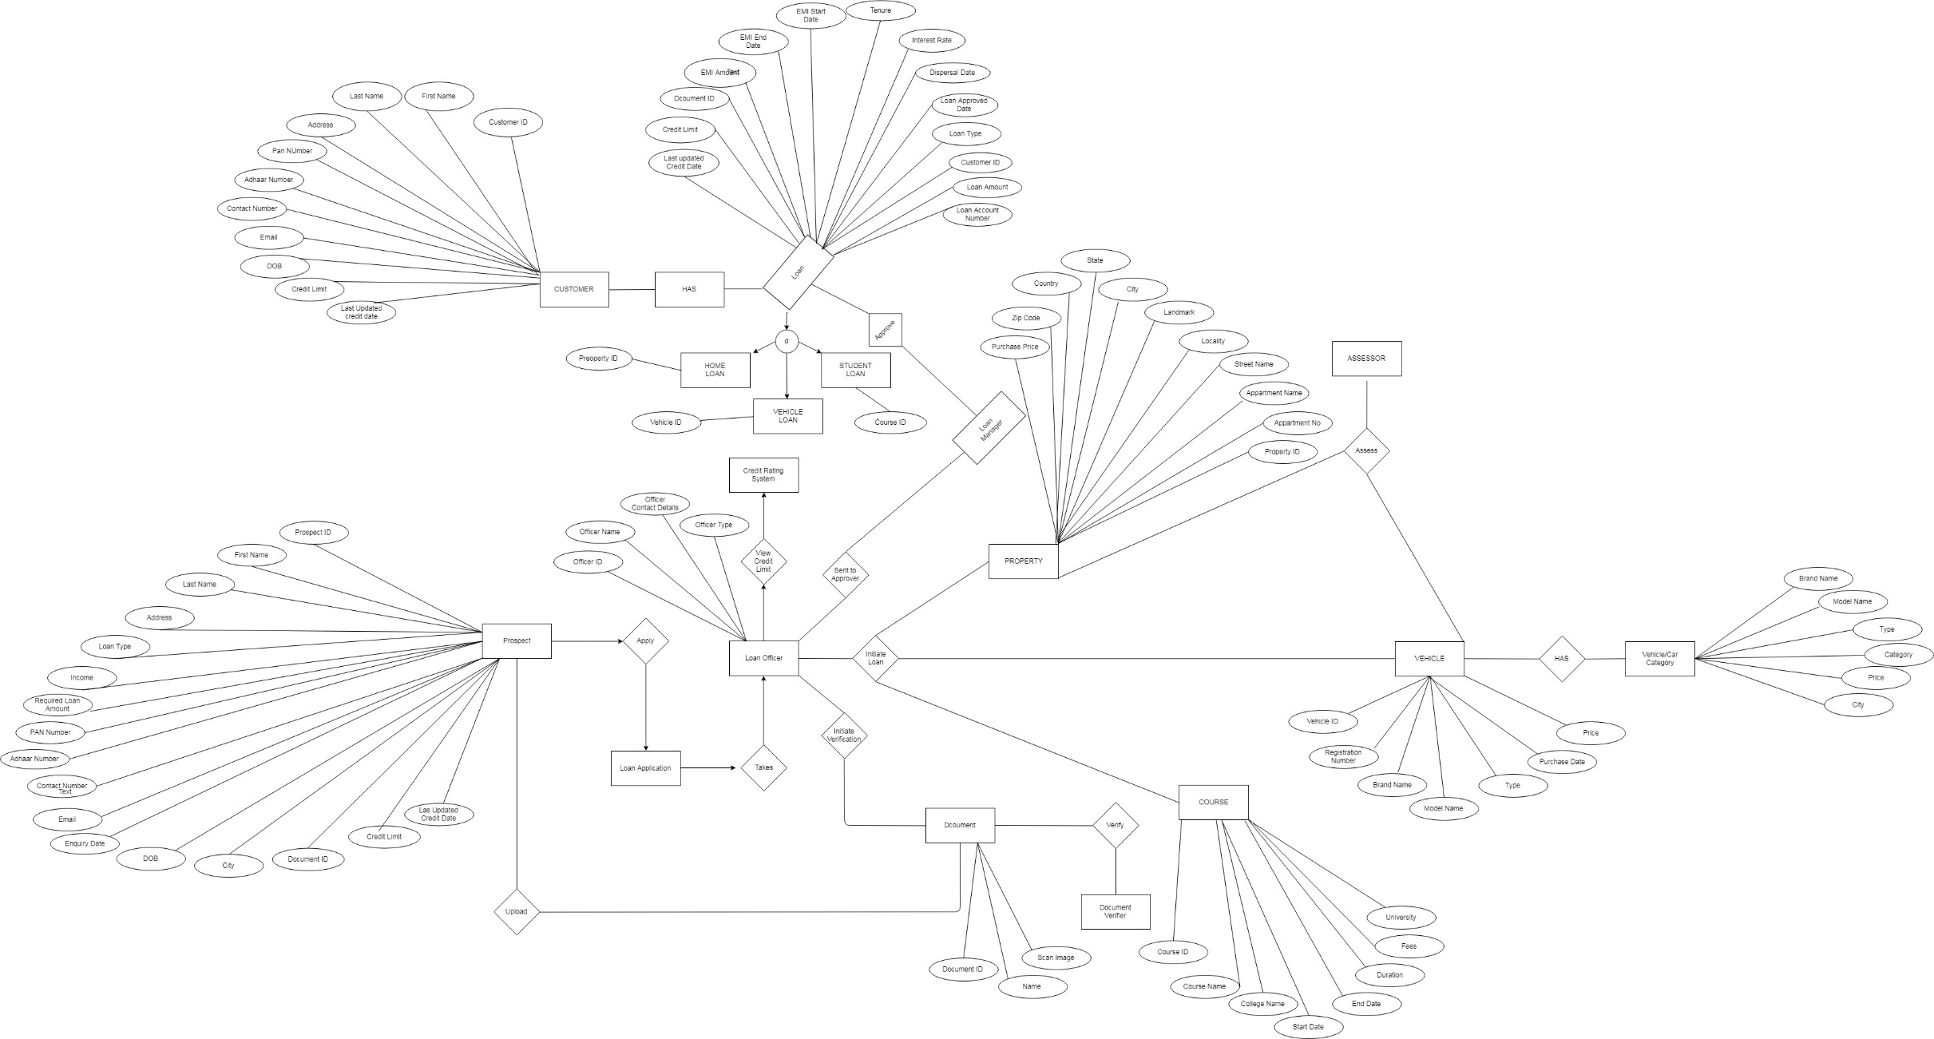

Slide 6
APPLICATION ARCHITECTURE
JSON Server
SERVICE/ BUSINESS LOGIC LAYER
DAO LAYER
JPA
ORACLE DB
JSON
REST CONTROLLER
MVC
CORS
ANGULAR

Slide 7
Class Diagram
Entities
Daos
Services
Controllers

Slide 8
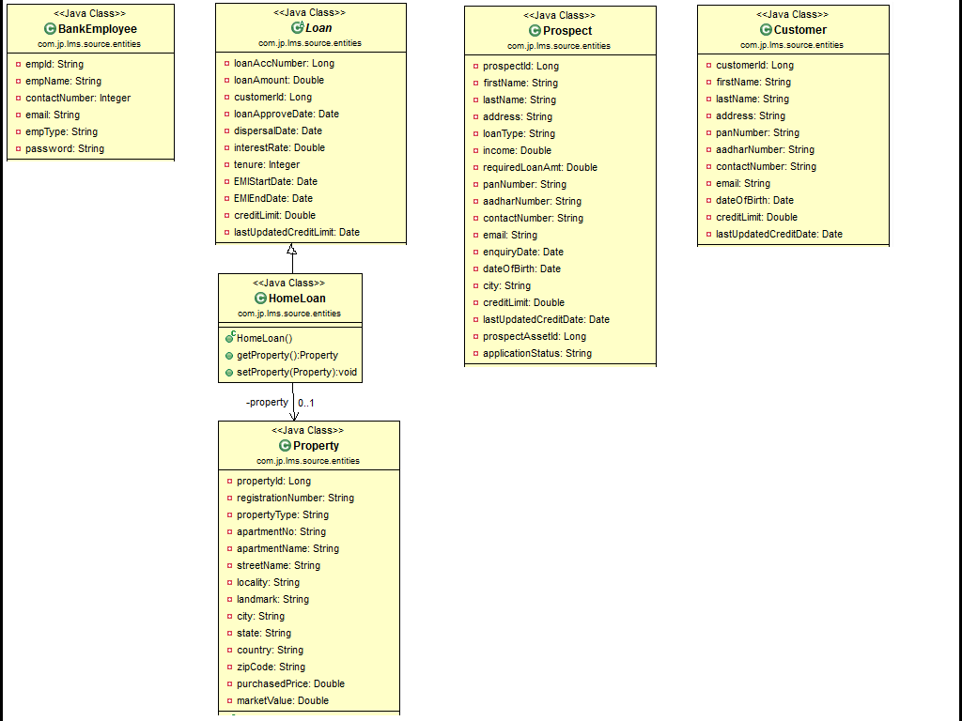
ENTITIES

Slide 9
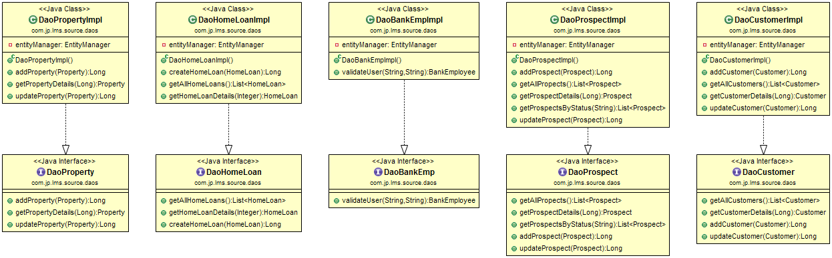
DAOS

Slide 10
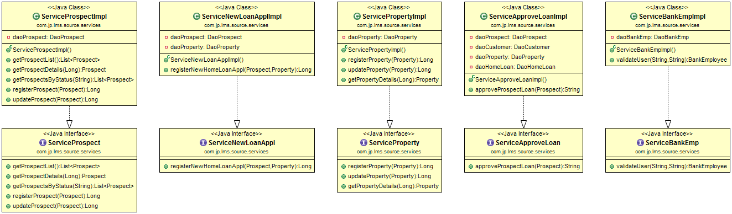
SERVICES

Slide 11
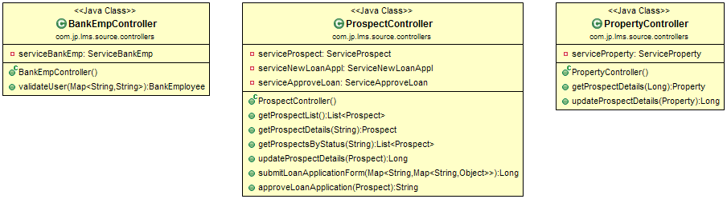
CONTROLLERS

Slide 12
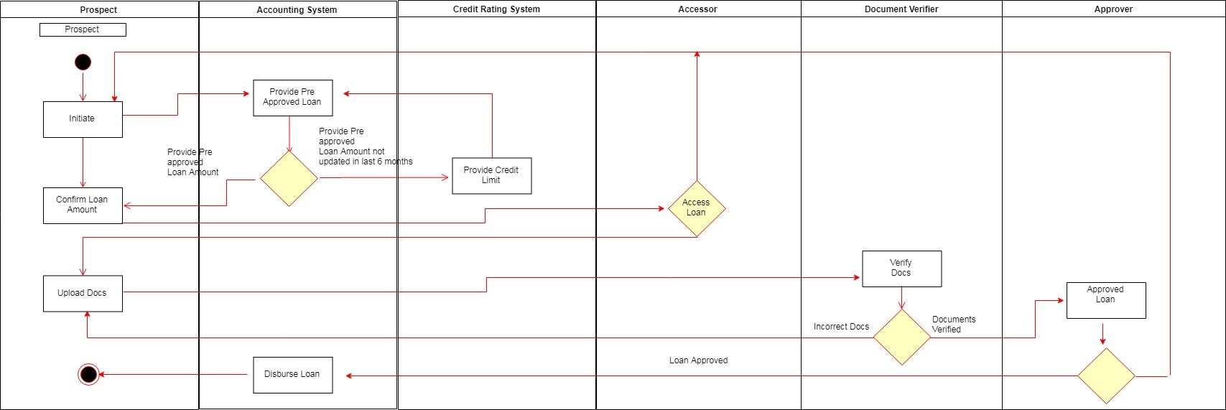
Swim Lane Activity Diagram

Slide 13
Assumptions and Scope of project
Assumptions
Credit Limit System, Document Verifier and Property Assessor Systems are third party systems
Scope of the Projects
Online Loan Application for Home Loan Process
Offline Application submitted by Bank Officer
Assessing the Credit history of the Prospect
Assessing the property against which the loan is taken
Employee login and role based security

Slide 14


TECHNOLOGIES AND FRAMEWORKS
FRONTEND TECHNOLOGIES & FRAMEWORKS
Angular 7.0.6
HTML5
Bootstrap v3.4.0
CSS
BACKEND TECHNOLOGIES & FRAMEWORKS
JAVA 1.8
SpringBoot Framework – 2.1.1
JPA
Oracle 11G
JSON Server

Slide 15
Salient features of the project
Online Loan Application by Prospect
View Prospect List by the Bank Officer
View Prospect's Details
Retrieve Applicant’s Credit History
Approving the Credit Limit by Bank Officer
Retrieving the Property Valuation from the Assessor
Approving Loan Application based on the Assessment
Rejecting the Loan Application
Employee Login and Role based Security

Slide 16

What next? Future plan
Implement the Document Verification Module
Applications for Vehicle and Education Loans
Implement Customer workflows

Slide 17


Application Demo & Feedback

Slide 18
Thank you

