Slide 1
ChatGpt

Slide 2
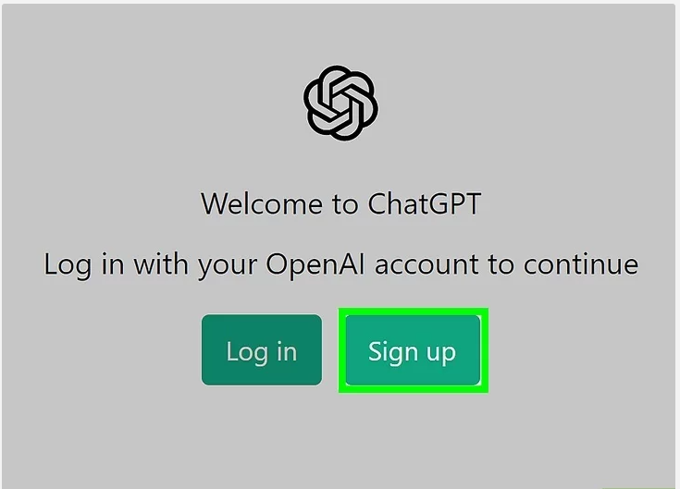
Step 1 - Create a free ChatGPT account at https://chat.openai.com/auth/login.
You can register for ChatGPT using an email address, Google account, Microsoft account, or Apple account.
You will need to verify your phone number to create an account.

Slide 3
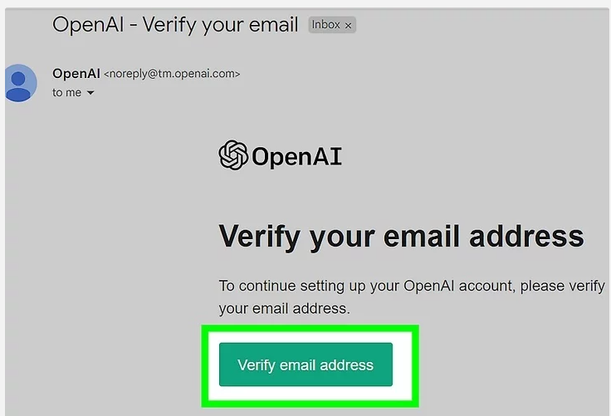
Step 2- You will receive an email with password reset instructions. Follow the steps given in the email to reset your password.

Slide 4
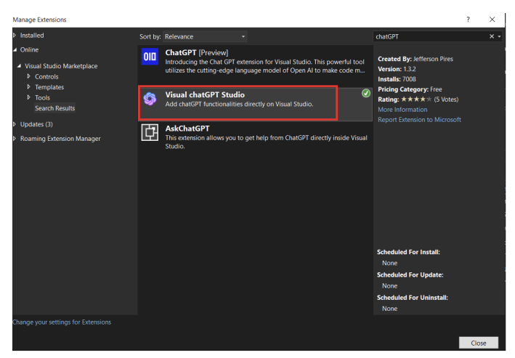
Step 3 - Open Visual Studio, go to Extensions > ManageExtensions, and search for “Visual ChatGPT Studio.”

Slide 5
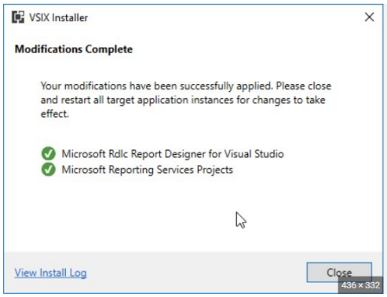
Download and Install the “Visual ChatGPT Studio” extension. Before install this extention, please close all visual studio extensions.

Slide 6
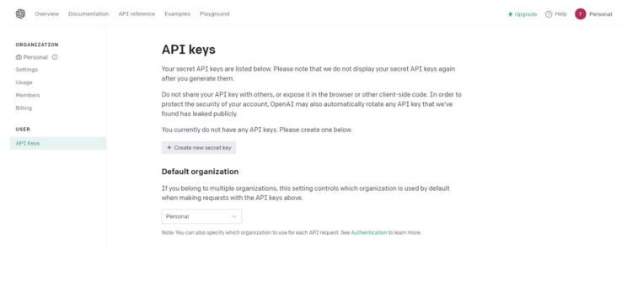
Step 4 - Download the OpenAI key from OpenAI Website by using the following link. https://platform.openai.com/account/api-keys

Slide 7
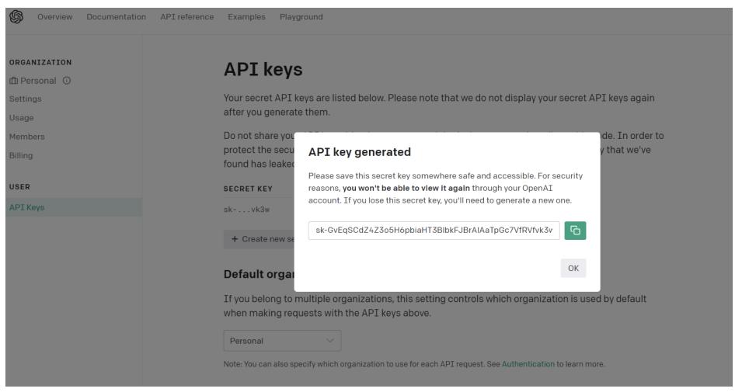
Step 5 - Create a new secret key. Copy the secret key in Visual Studio 2022.

Slide 8
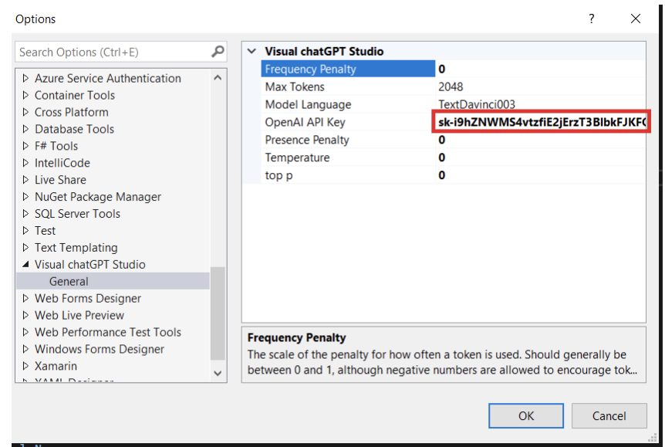
Step 6 - Open Visual Studio 2022 and go to the “Tools” menu. 1. Select “Options” from the drop-down menu. 2. In the “Options” window, navigate to “Visual ChatGPT Studio.” the OpenAI Key has already been copied. Now, paste it into the OpenAI API Key field.

Slide 9
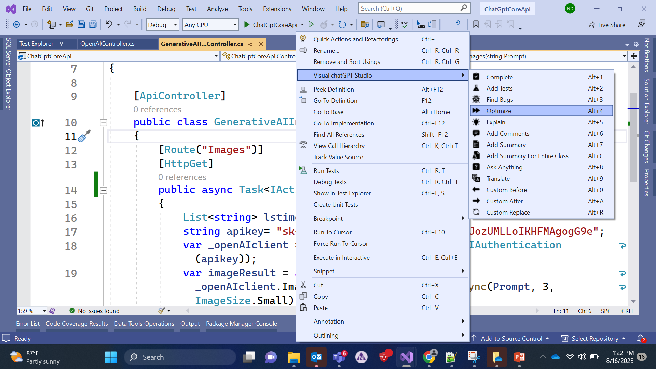
Step 7 - Finally, select the code you want to optimize, add comments to, etc. The content below displays the available features from ChatGPT.

Slide 10
.
The Visual ChatGpt Studio provides a set of new ChatGPT commands that can be accessed by selecting a method and right-clicking on the text editor. These commands include asking for complete, creating unit tests, finding bugs, optimizing, explaining, adding comments or Summaries for C# methods, asking anything, creating custom commands.
Complete- Write a method, select it, and ask for completion.
Add Tests- Create unit tests for the selected method.
Find Bugs- Find bugs for the selected method.
Optimize- Optimize the selected method.
Explain- Write an explanation of the selected method.
Add Comments- Add comments for the selected method.
Add Summary- Add Summary for C# methods.
Ask Anything- Write a question on the code editor and wait for an answer.
Custom Before- Create a custom command through the options that insert the response before the selected code.
Custom After- Create a custom command through the options that insert the response after the selected code.
Custom Replace- Create a custom command through the options that replace the selected text with the response.

Slide 11
Reference
Create API Key :
https://chat.openai.com/auth/login
https://platform.openai.com/account/api-keys
Example : https://www.youtube.com/watch?v=6e-Kp9E-bJg
https://www.youtube.com/watch?v=1XF6zp6qz7I

