Slide 1

Pawsitive Pet Academy
Website and mobile app
XHAW5112 · Task 3
Neha Haripasath (ST10512418) · Sivanesan Rasen (ST10514044) · Haylee Alexander (ST10504600) · Ali Gaffar (ST10497389)
nehaharipasath.github.io/XHAW_FINAL_WEBSITE_ST10512418
Notes:
Neha opens (about 20 seconds).
"Good day. We are Neha, Sivanesan, Haylee and Ali, and this is our website and mobile app for Pawsitive Pet Academy, a pet care academy in Durban founded by Sarah Smith."

Slide 2







What we will cover
Project overview and design
Neha
1.5 min
Logo and wireframes
Haylee
1 min
Development, testing and debugging
Sivanesan
1.5 min
Website: drop-downs, errors, quote table
Ali
1.5 min
Mobile app
Haylee
1 min
Lessons learnt and future plans
Ali · Sivanesan
1 min
Video demo
Neha
11 min
About 8 minutes of talking and an 11-minute video: 20 minutes in total.
Notes:
Sivanesan: "Thanks, Ali. Next we'd add online enrolment and payment, learner accounts with progress and certificates, reminders in the app, and an app store release. Because every course lives in one list, the site is built to grow.
Neha will introduce the video."

Slide 3
The project at a glance
Neha
Client: Sarah Smith, founder of Pawsitive Pet Academy in Durban (est. 2023).
Courses offered
The problem: many people own pets without knowing proper care, training, nutrition or first aid.
Six-month programmes · R1 500
Canine Obedience Training
Pet Grooming
Animal Behaviour
Pet Business Management
What we built: a responsive website and a matching mobile app where people can learn about the academy, browse the courses and get an instant fee quote.
7
2
Six-week short courses · R750
Puppy Care
Pet First Aid
Basic Dog Walking
courses
platforms
6
15%
pages / screens
VAT applied
Notes:
Neha: "Many pet owners don't know enough about care, training or first aid, so Sarah started the academy. It offers four six-month programmes at R1 500 and three six-week short courses at R750.
We built a responsive website and a matching app. Both let people find a course and get an instant quote with the discount and VAT."

Slide 4
Caring, trustworthy and professional
Neha
The client asked for a site that feels caring and trustworthy, so every design choice serves one of these three words.
#0B5E5E
#0F7C7C
#F4A259
#FAF6F0
Deep Teal
Teal
Warm Coral
Soft Cream
Header, headings
Links, icons
Buttons, highlights
Page background
Trust and calm
Health and care
Warmth and energy
Soft and friendly
Font: Trebuchet MS, rounded and friendly but easy to read. Shapes: rounded cards and pill buttons echo the soft shapes of the logo.
Notes:
Neha: "Sarah wanted the academy to feel caring, trustworthy and professional. Deep teal builds trust, so it's our main colour. Warm coral is friendly and marks every main button. The soft cream background is gentler than white, and the rounded shapes match our logo."

Slide 5
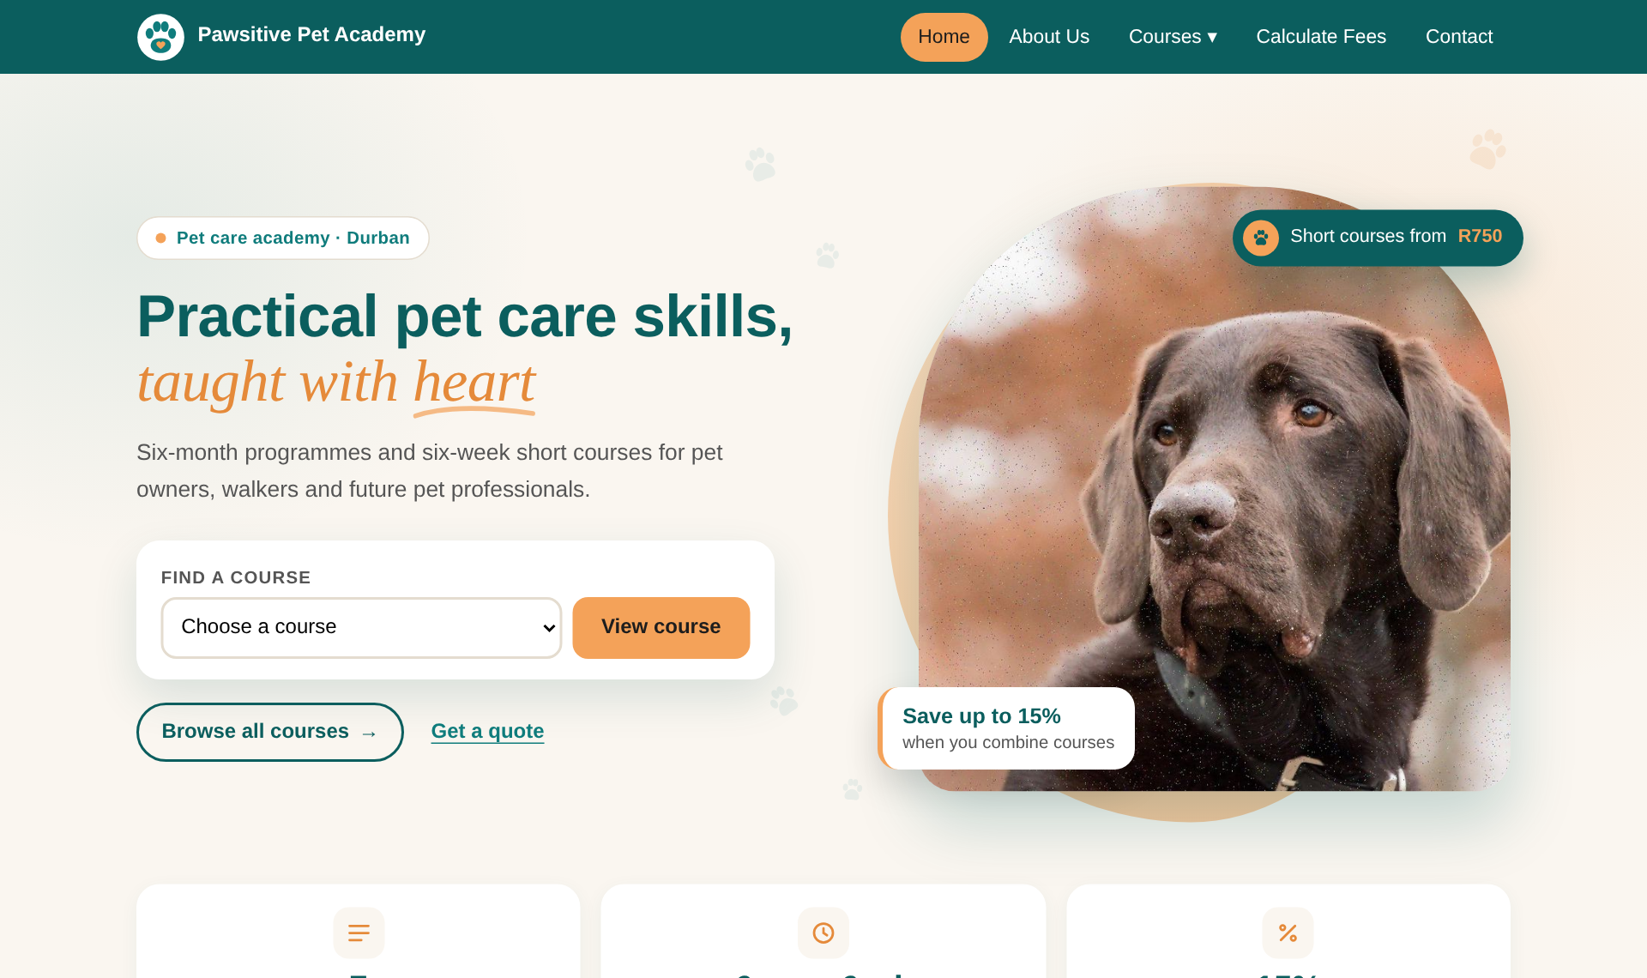

One design, two screens
Neha
Same seven courses and fees
Same discount tiers and VAT
Same colours, logo and icons
Same order of screens
Website on a computer
Mobile app
Notes:
Neha: "The website and app share one design: same courses, prices, colours and logo, and the same Find a course drop-down on the home page. Only the layout changes: two columns on a computer, one column and a bottom tab bar on a phone.
Haylee will now show the logo and wireframes."

Slide 6



A paw that holds a heart
Haylee
Paw print
Says “pets” at a glance, even as a tiny app icon.
Coral heart
Care and kindness: the academy’s promise.
Circle badge
A seal of quality: professional and trustworthy.
Two colours only
Clear in the header, on a phone and in print.
Notes:
Haylee: "Thanks, Neha. Our logo is a paw print with a coral heart in the pad. The paw says 'pets', the heart says 'care', and the white circle works like a badge of quality. It uses only two colours so it stays clear even as a small app icon."

Slide 7
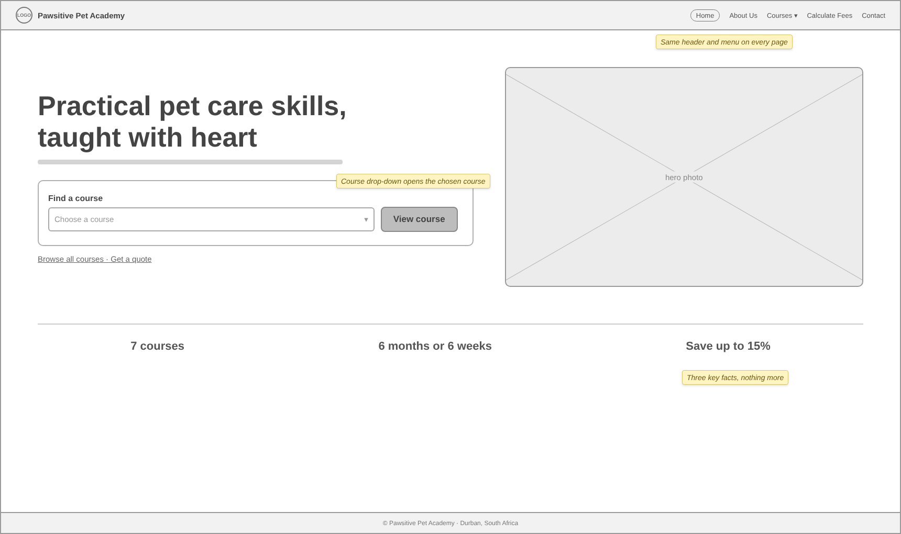
From wireframe to web page
Haylee
Wireframe
Built page
Kept from the wireframe: header and menu, one headline, the Find a course drop-down, a hero photo and three key facts.
Notes:
Haylee: "We planned every screen as a wireframe before building it. On the left is the home page wireframe, on the right the finished page. We kept it simple: a headline, a Find a course drop-down, one photo and three key facts."

Slide 8
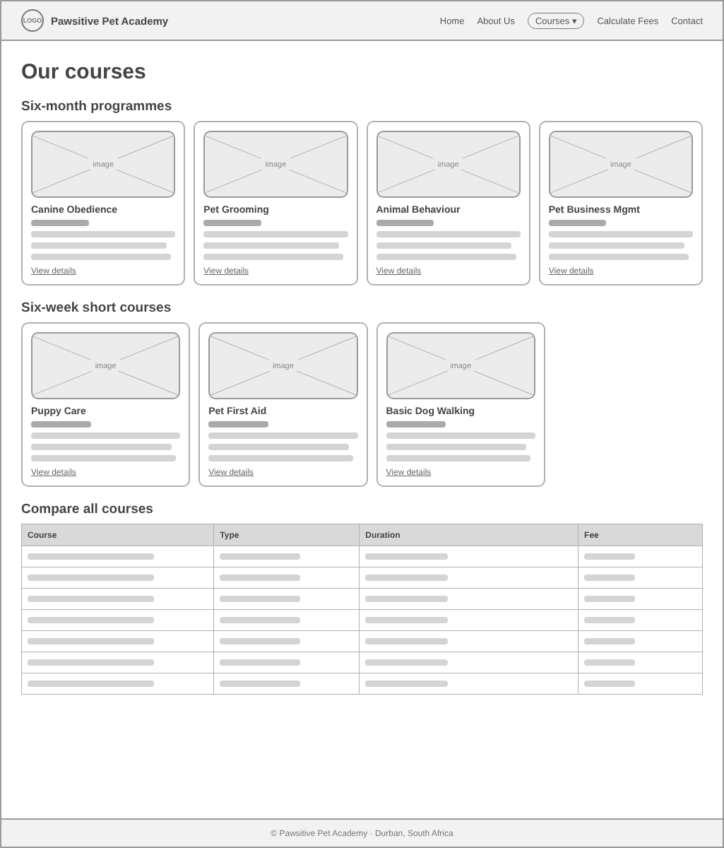
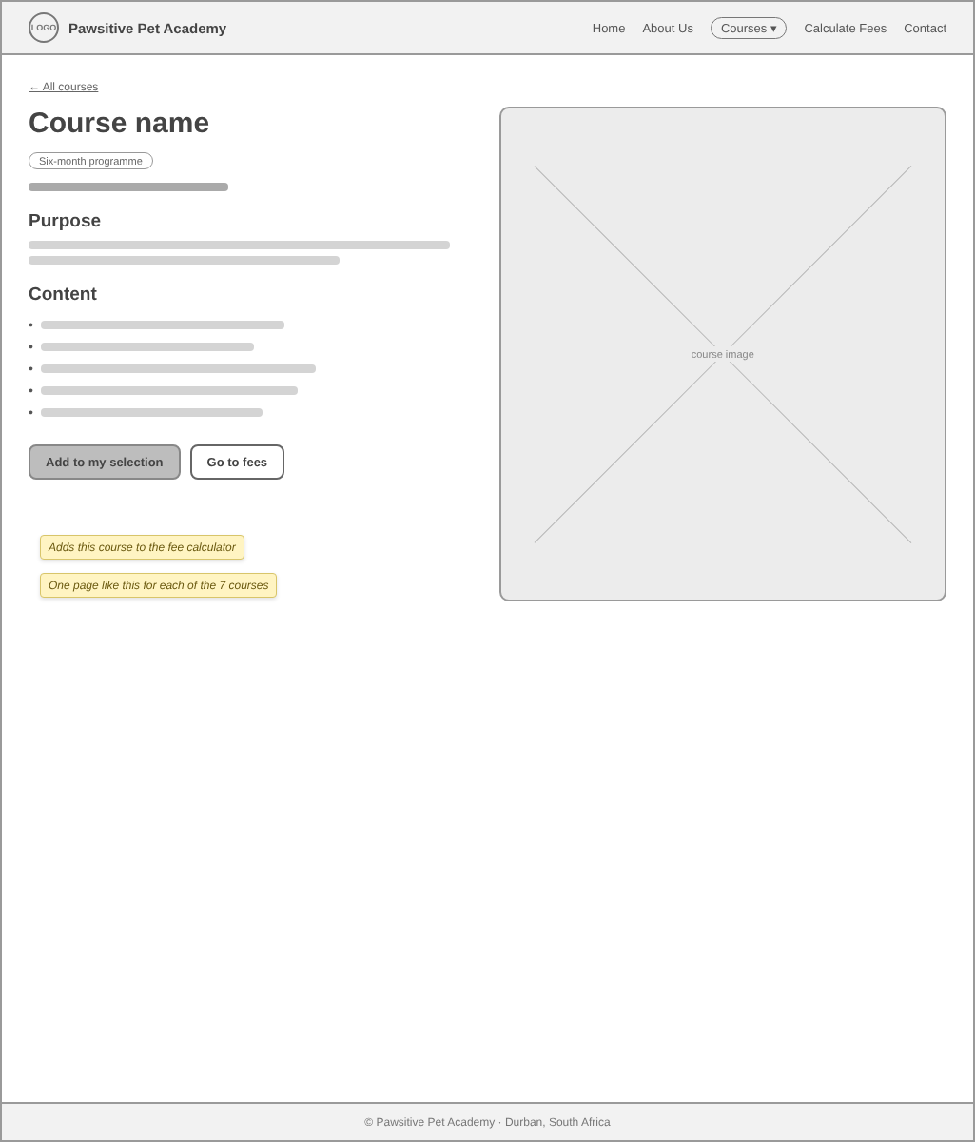
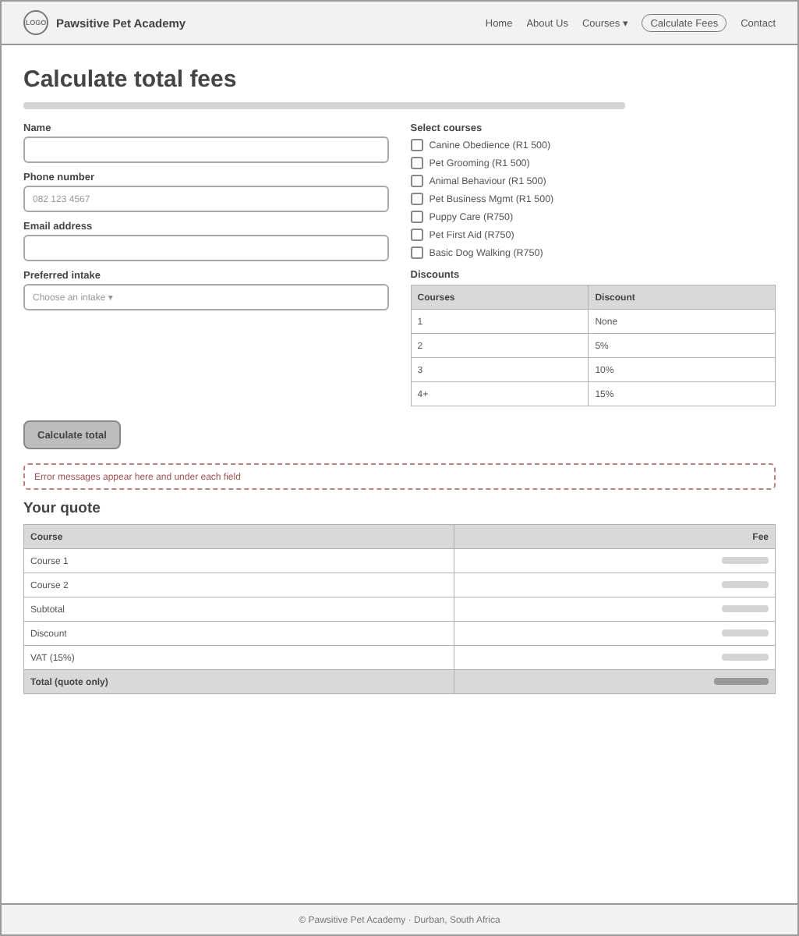
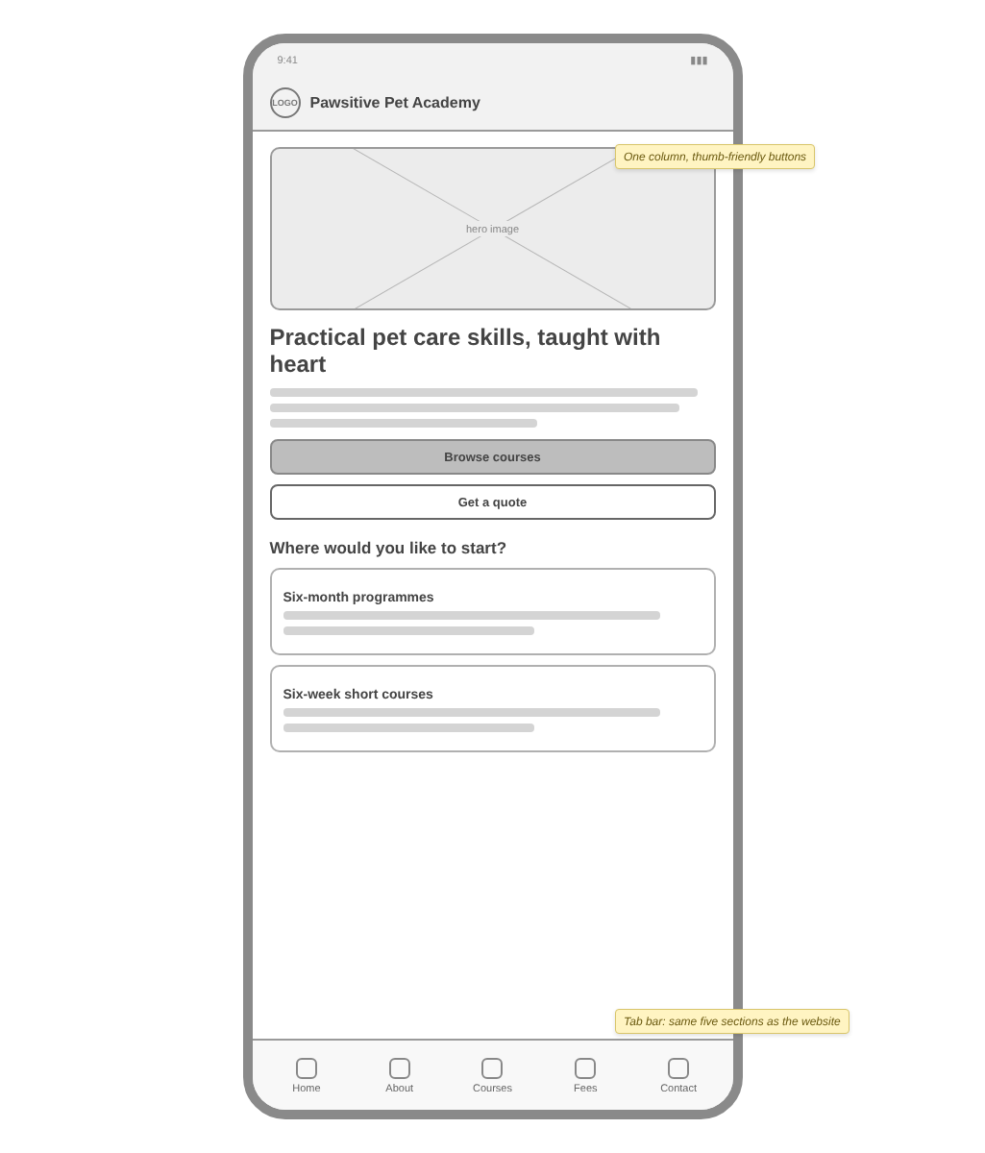
Every screen was planned first
Haylee
Courses
Course page
Calculate Fees
Mobile app
Two lists + compare table
Purpose, content, fee
Form, ticks, quote table
Same flow, one column
Notes:
Haylee: "We did the same for the course lists, the course pages, the fee calculator and the app, so the website and the app follow the same flow.
Sivanesan will explain how we built it."

Slide 9








What we built it with
Sivanesan
Website
Mobile app
HTML5
React Native 0.86
Structure of all six pages
One codebase for Android and iPhone
CSS3
Expo SDK 57
Layout, colours, responsive rules
Run on a phone by scanning a QR code
JavaScript
WebView
Menus, validation, calculator, routing
Shows the map on the Contact screen
GitHub Pages
Safe-area support
Free hosting from our repository
Clears notches and gesture bars
Notes:
Sivanesan: "Thanks, Haylee. The website is plain HTML, CSS and JavaScript, hosted free on GitHub Pages. The app is built with React Native and Expo, so one codebase runs on Android and iPhone."

Slide 10



How the key features work
Sivanesan
One course list
Pages without reloading
All seven courses live in one array. Cards, menus, tables and the calculator are all built from it, so nothing goes out of date.
The website shows one section at a time based on the web address, so links, bookmarks and the back button all work.
Money in whole cents
Checks before every quote
Fees are calculated in cents and rounded once per line, so every row of the quote adds up exactly.
Name, SA phone number, email, intake and at least one course are checked; each problem gets its own message.
The fee formula
Subtotal − discount (2 courses 5% · 3 courses 10% · 4+ courses 15%) + 15% VAT = total
Notes:
Sivanesan: "All seven courses live in one list, and the cards, menus, drop-downs, tables and calculator are built from it. Pages change without reloading. Money is worked out in whole cents, and every field is checked before a quote is shown. The rule is: subtotal, minus the multi-course discount, plus 15% VAT."

Slide 11
How we tested it
Sivanesan
0
0
~90
2
HTML, CSS and JavaScript errors
accessibility problems found
automated website checks passed
platforms the app builds for
Every page and course address, including broken links falling back to Home
Names, phone numbers and emails, both valid and invalid
Every discount tier, checked against hand-worked totals
Drop-down with mouse and keyboard; no sideways scrolling on a 320 px phone
Validators: html-validate, stylelint, ESLint
Accessibility: axe-core scan of every page and state
App: Android and iOS builds, Expo Doctor, Expo lint rules
App: every tab, the form and all quote totals tested
Notes:
Sivanesan: "Both products pass HTML, CSS and JavaScript checks with zero errors, and an accessibility scan found zero problems. About ninety automated checks test every page, the drop-downs, good and bad form input, and every discount tier. The app builds for Android and iOS."

Slide 12

How we debugged two errors
Sivanesan
Bug 1: typing stopped after one letter
Bug 2: total one cent out
Mobile app, fee form
Mobile app, quote table
Saw
Typing a name stopped after one letter; you had to tap the box again for every letter.
Saw
For all seven courses the app showed R8 064.37, but the website showed R8 064.38.
Cause
Each screen was built inside the main App, so React rebuilt the form on every key press and the box lost focus.
Cause
The app worked in rands with decimals; the computer stored R1 051.875 as slightly less, so it rounded down.
Fix
Moved the fee form into its own component, so it stays in place while you type.
Fix
Calculated every amount in whole cents and rounded once per line, the same way as the website.
Checked
Typed “Thandi Nkosi” in one go and the full name stayed in the box.
Checked
Tested every discount tier on both; all totals now match to the cent.
Notes:
Sivanesan: "Testing found two bugs in the app. First, typing in the fee form stopped after one letter, because the form was rebuilt on every key press. We moved it into its own component.
Second, the seven-course total was one cent too low because of decimal rounding. We switched to whole cents and checked every tier."

Slide 13
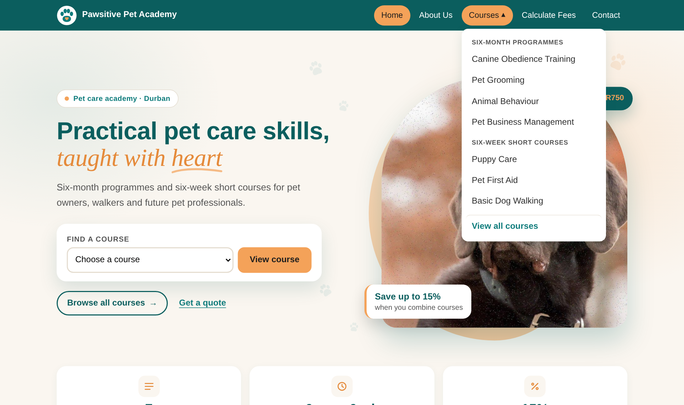
Two drop-downs to find a course
Ali
Home page: Find a course drop-down
Main menu: Courses drop-down
Pick a course and press View course to open its page; an error shows if none is chosen
Both list all seven courses, grouped by type, and work with the mouse or keyboard
Notes:
Ali: "Thanks, Sivanesan. I'll walk you through the website. The quickest way to a course is the Find a course drop-down on the home page: pick a course and press View course. If you press it without choosing, you get an error message. There is also a Courses drop-down in the main menu that works with the mouse or the keyboard."

Slide 14
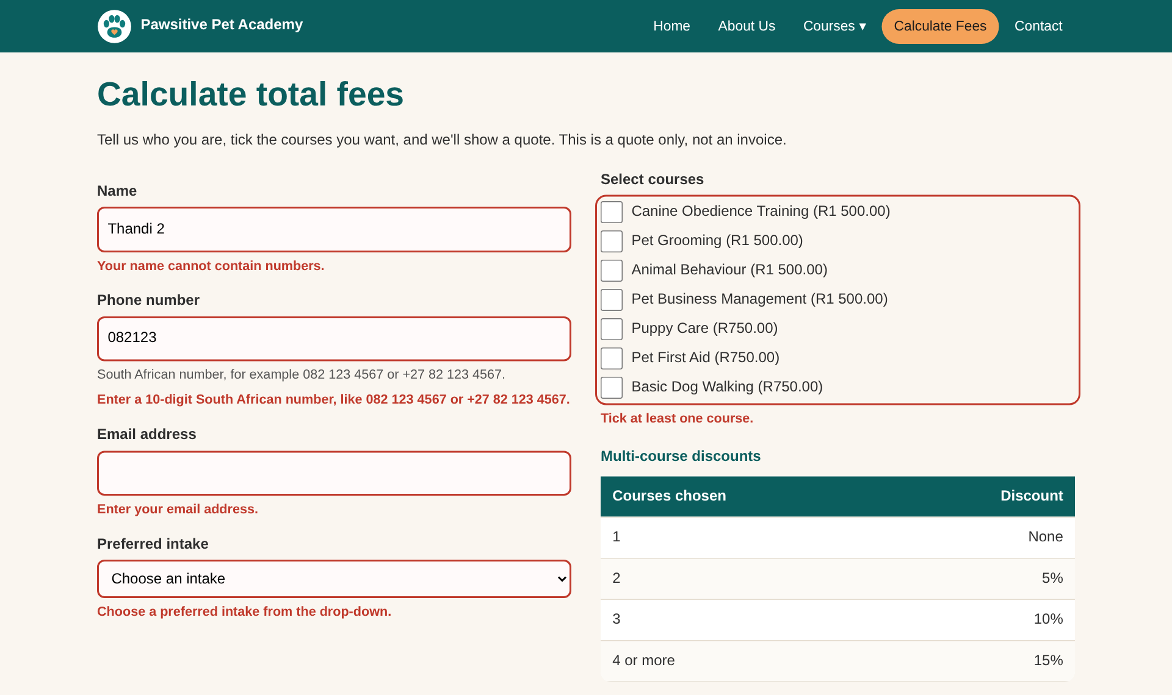
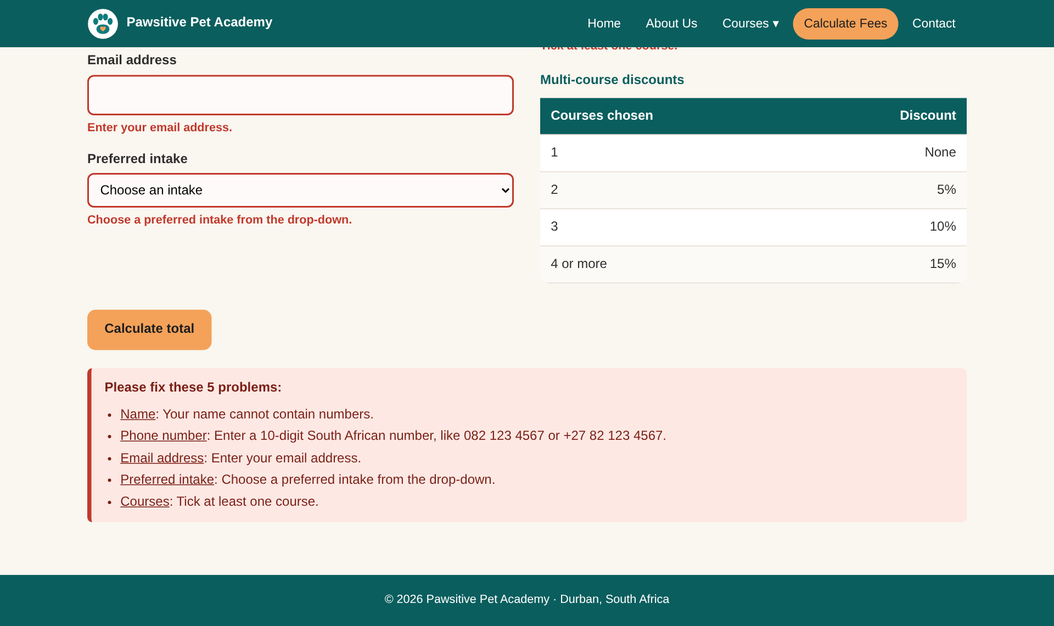
Error handling
Ali
A message under each field
A summary that links to each problem
Checked: name (letters only), SA phone number, email format, intake chosen, at least one course. Errors clear as soon as they are fixed.
Notes:
Ali: "On Calculate Fees, every field is checked before a quote is shown. The messages are specific, for example 'your name cannot contain numbers'. Each problem is outlined in red with a message underneath, and the summary links to it. The error clears as soon as it's fixed."

Slide 15
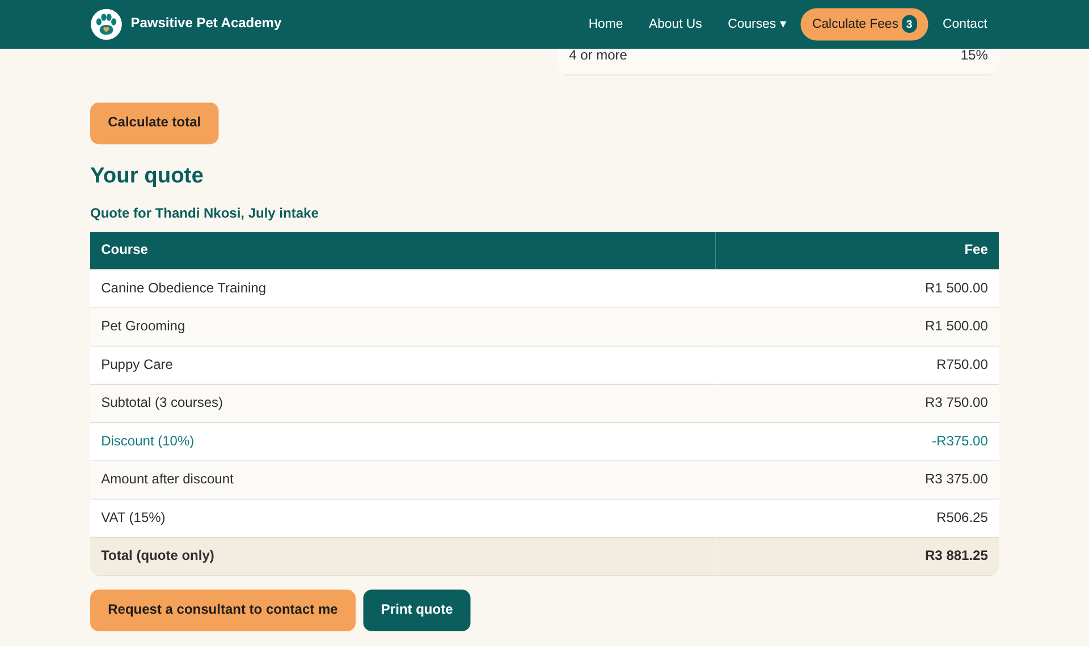
The quote table
Ali
R3 750.00
3 courses · subtotal
-R375.00
10% · discount
R506.25
15% VAT · on the discounted amount
R3 881.25
Total · quote only
Notes:
Ali: "Here's a quote for three courses: R3 750, minus 10% is R3 375, plus 15% VAT of R506.25, so the total is R3 881.25.
Haylee will show the same thing in the app."

Slide 16
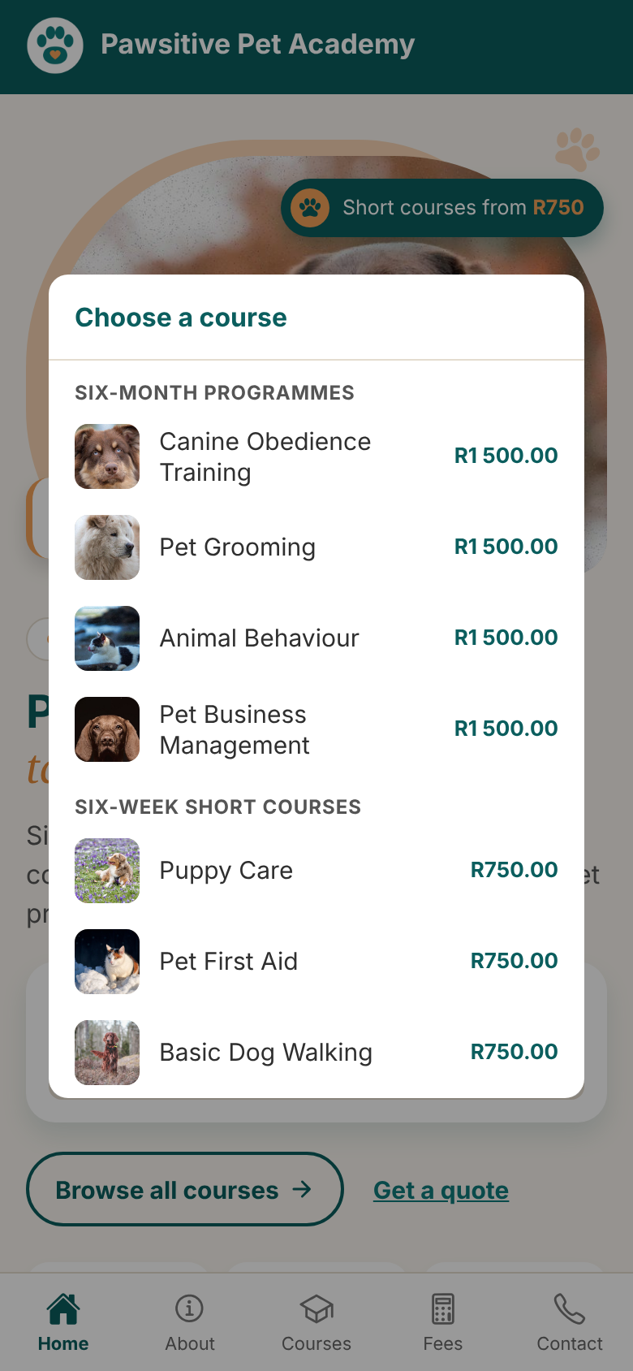
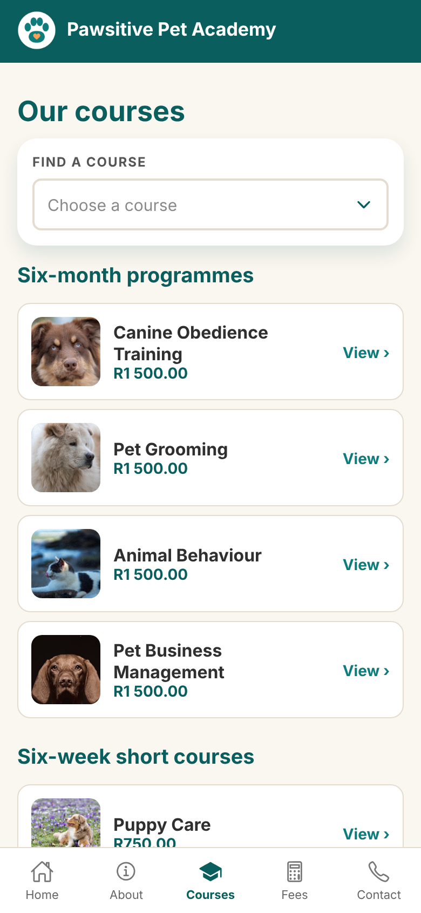
Browsing courses in the app
Haylee
Find a course drop-down on Home and Courses
Grouped list with a photo and fee for each course
Tap a course to open its page
Tab bar with icons for all five screens
Home
Find a course
Courses
Notes:
Haylee: "Thanks, Ali. The app has the same Find a course drop-down on its home screen. It opens a list grouped by type, with a photo and fee for every course, and tapping one opens that course. A tab bar at the bottom reaches all five screens."

Slide 17
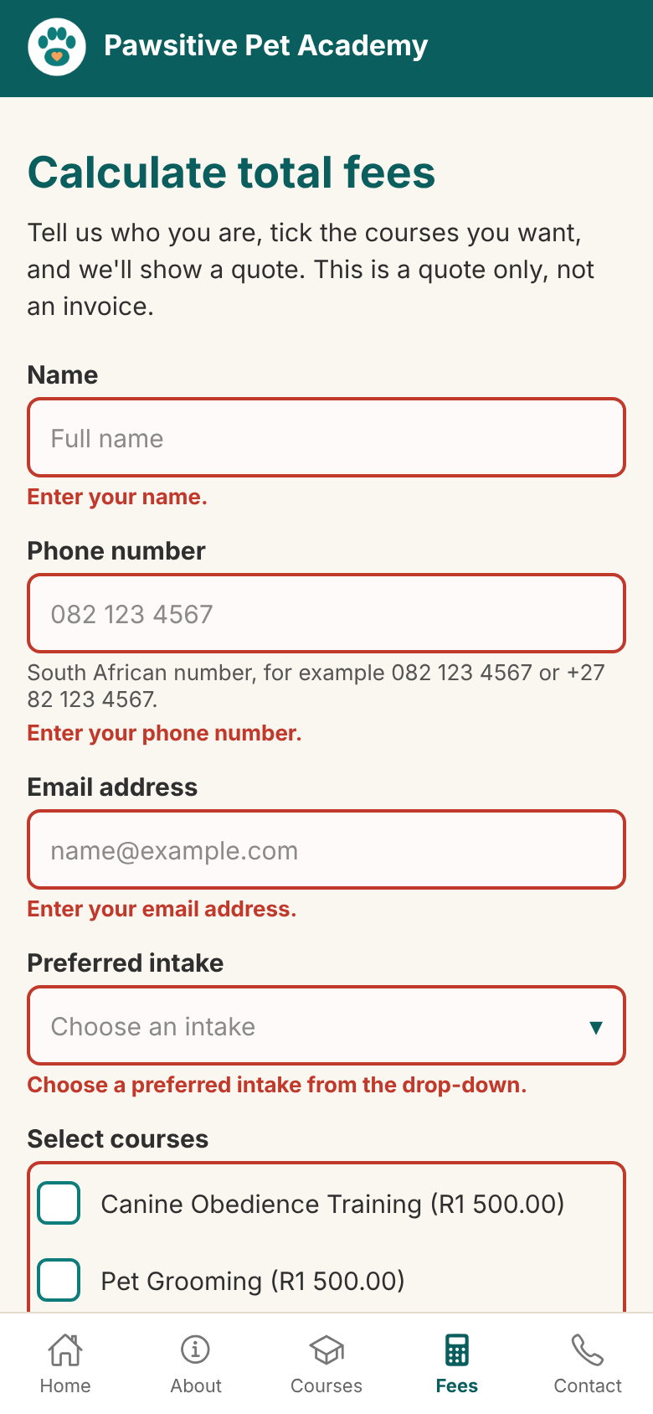
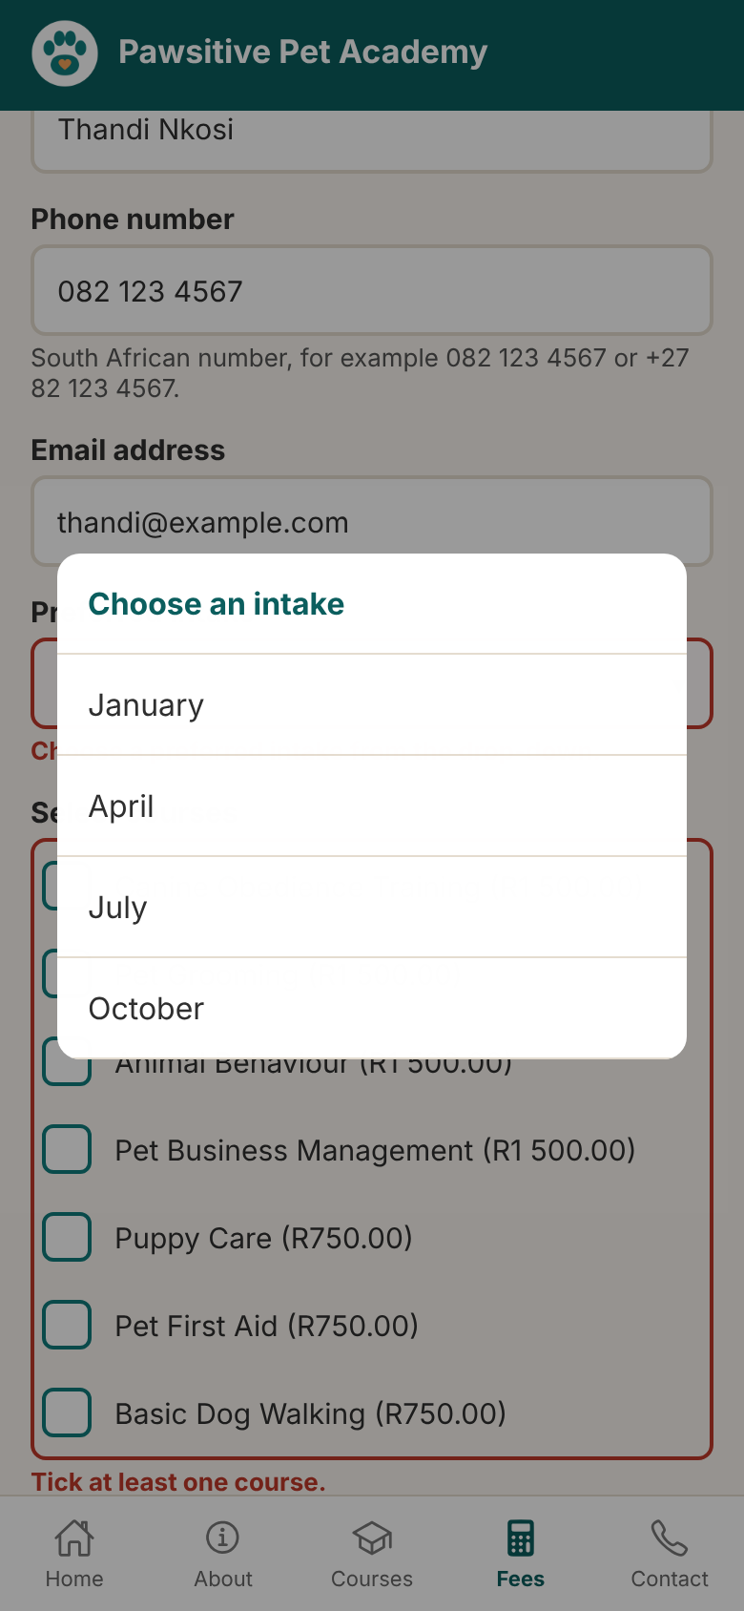
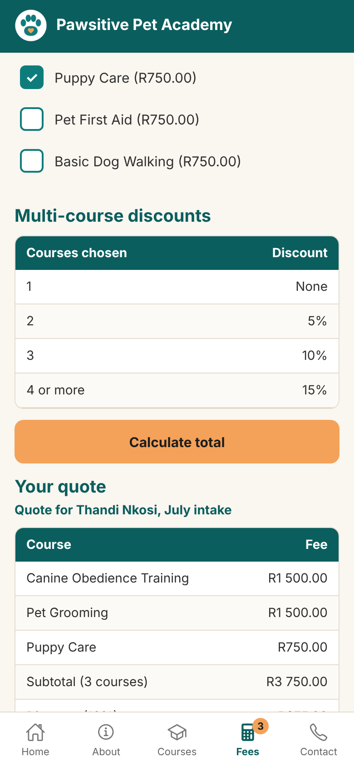
Getting a quote in the app
Haylee
Same checks and messages as the website
Intake chosen from a drop-down list
Old quote clears when courses change
Totals match the website to the cent
Errors under each field
Intake drop-down
Quote table
Notes:
Haylee: "The Fees screen uses the same rules as the website. Errors appear under each field, the intake month is picked from a drop-down, and the quote matches the website to the cent.
Ali will share what we learnt."

Slide 18



Lessons learnt
Ali
Plan before you build
Test like a real user
Drawing wireframes first meant we sorted out the layout on paper, not in code.
Typing real names, wrong numbers and +27 phone numbers found problems we didn't expect.
Keep data in one place
Small errors add up
One course list feeds the cards, menu, tables and calculator, so a change is made once.
A one-cent rounding error taught us to work in whole cents and to check totals by hand.
Our biggest lesson
Agreeing on one design early, and sharing one repository, let four people build a website and an app that feel like one product.
Notes:
Ali: "We learnt four things. Plan before you build. Test like a real user. Keep data in one place. And small errors add up, like our one-cent bug. Most of all, agreeing on one design early let four of us build two products that feel like one.
Sivanesan will share our future plans."

Slide 19



Future plans
Sivanesan
The website and app are built to grow with Pawsitive Pet Academy. These are the next features we would add.
Online enrolment and payment
Learner accounts
Learners pay a deposit and secure their place for an intake, all online.
Each learner logs in to see their courses, progress and certificates.
Reminders in the app
App store release
Notifications remind learners about intake dates and class times.
Publish the app on Google Play and the App Store so anyone can download it.
Built to grow
Every course lives in one list, so a new course shows up on every page, menu and table at once.
Notes:
Sivanesan takes over. "Thanks, Ali. To finish our part, here's where the project can go next.
We'd add online enrolment and payment, so learners can secure their place for an intake online. Learner accounts would let each person see their courses, progress and certificates. The app could send reminders about intake dates and class times, and we'd publish it on Google Play and the App Store.
The good news is that it's built to grow: every course lives in one list, so adding a course updates every page, menu and table at once.
Neha will close."

Slide 20
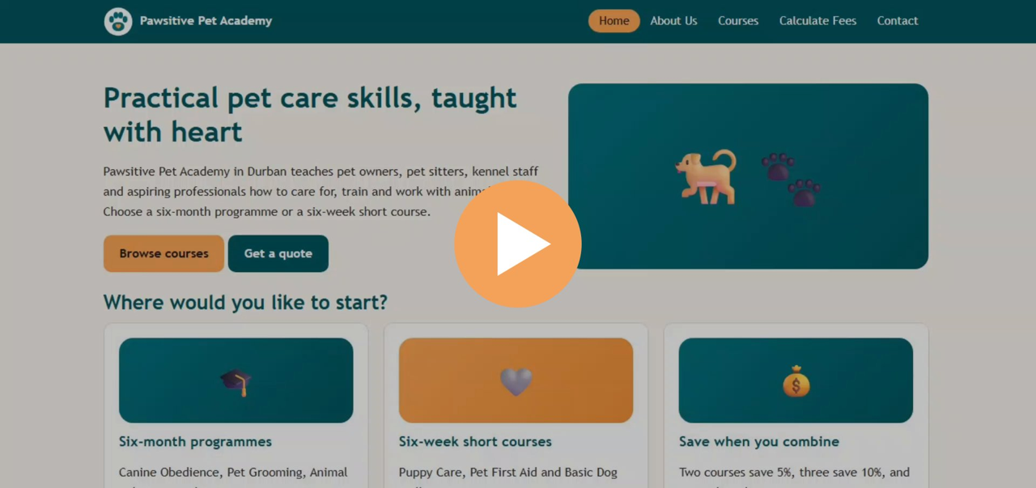
Watch our video demo
Neha
Our video demo
An 11-minute walkthrough of the website and the app
Plays straight after our talk
Click the video to play it here
Also on YouTube:
youtu.be/JgIASkczmog
Plays inside the slide; no internet needed.
Notes:
Neha: "Thanks, Sivanesan. Here is our video demo, which walks through the website and the app."
Click the video in the phone to play it; it runs about 11 minutes. If time is short, stop it early and go to the next slide. If it won't play, click the YouTube link.

Slide 21


Thank you
Live website
nehaharipasath.github.io/XHAW_FINAL_WEBSITE_ST10512418
GitHub repository
github.com/NehaHaripasath/XHAW_FINAL_WEBSITE_ST10512418
Mobile app
Questions?
In the mobile-app folder · open with Expo Go
Wireframes (Figma)
Website: comic-mesh-29595720.figma.site
App: blurry-clip-31638226.figma.site
Video demo (YouTube)
youtu.be/JgIASkczmog
Neha Haripasath · Sivanesan Rasen · Haylee Alexander · Ali Gaffar
Notes:
Neha: "Thank you for watching. All our links are on this slide. We're happy to take questions."

