Slide 1
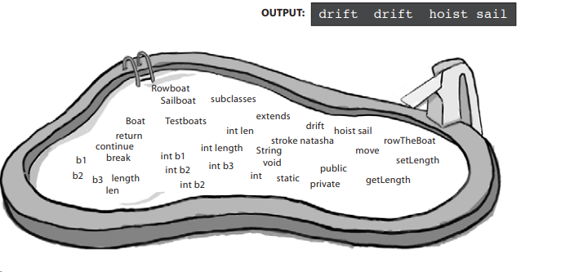
An overloaded method is just a different method that happens to have the same method name. It has nothing to do with inheritance and polymorphism. An overloaded method is NOT the same as an overridden method

Slide 2
An overloaded method is just a different method that happens to have the same method name. It has nothing to do with inheritance and polymorphism. An overloaded method is NOT the same as an overridden method

