Slide 1

Capstone Project Presentation
Dec 2020 - Apr 2021
TeFaRec
Smart Security System for housing societies based on Deep Learning and IoT

Slide 2
Contributors
Mentors
Mentees
Prof. Pranav Nerurkar
(Faculty Mentor)
Mr. Yash Tomar
(Project Deep Blue Mentor)
Ms. Neha Koppikar
(Software)
Ms. Nidhi Koppikar
(Hardware)

Slide 3
Introduction
Background
Motivation

Slide 4
Research
Referred 24 papers on various parameters
Link to Spreadsheet

Slide 5
Problem Statement
Automation of Society Security Tasks
- Visitors in a housing society fall under 3 categories: residents, frequent visitors, non-residents.
- Record all the visits with timestamp and name
Check body temperatures
The temperatures can be categorized into 3 zones: safe, caution and danger.
Develop an output source to know this information

Slide 6
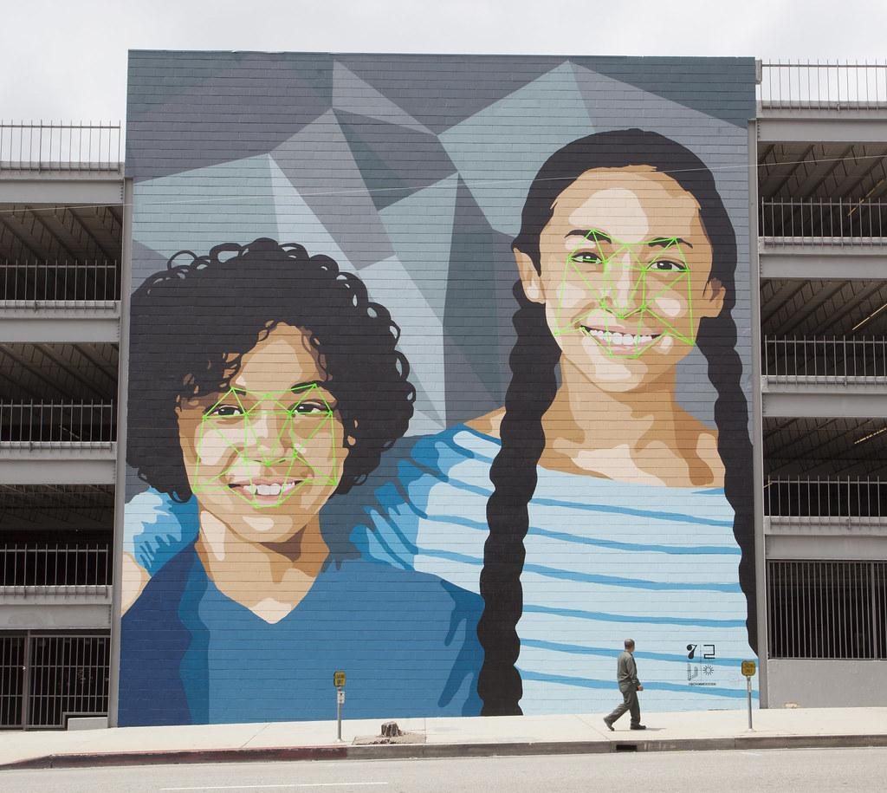

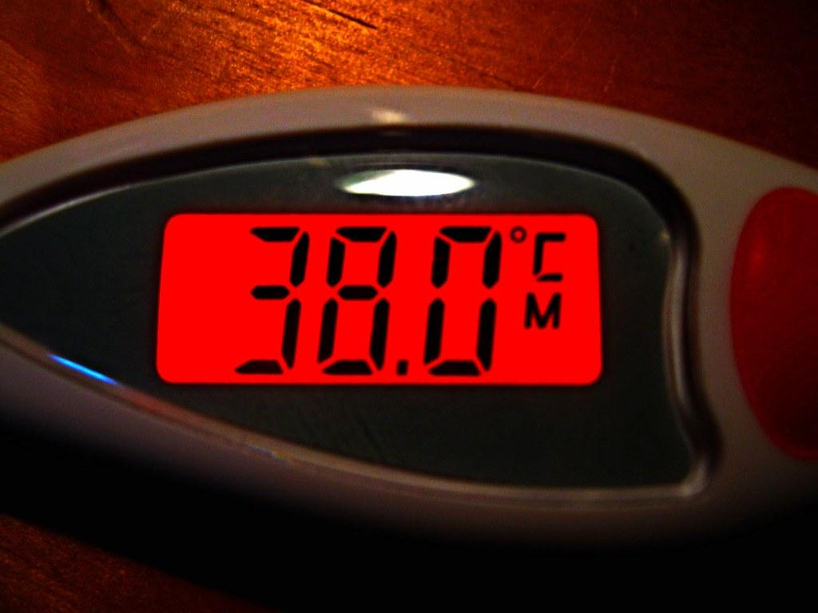
Objectives

Slide 7
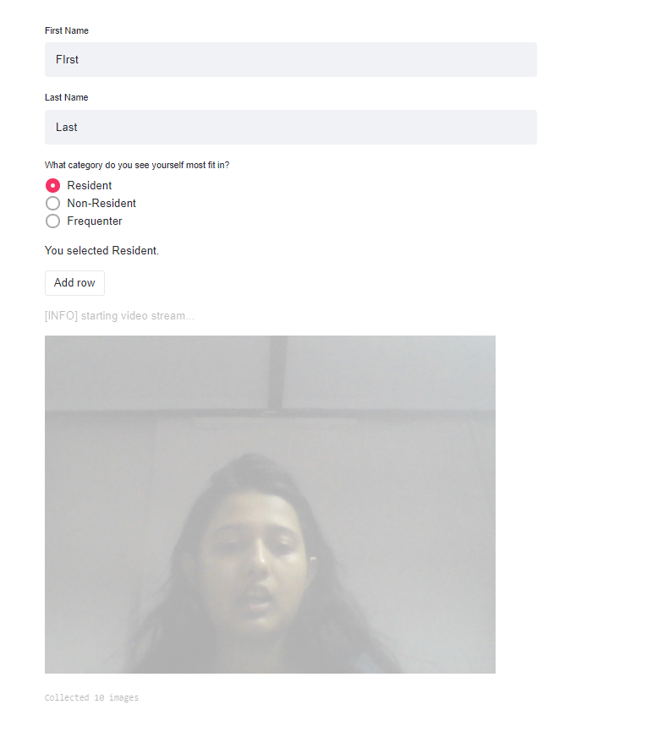
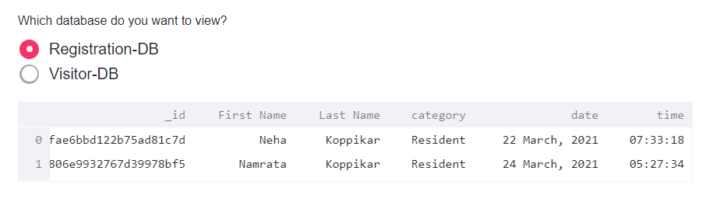
First-Time Registration
Significance
How it works

Slide 8
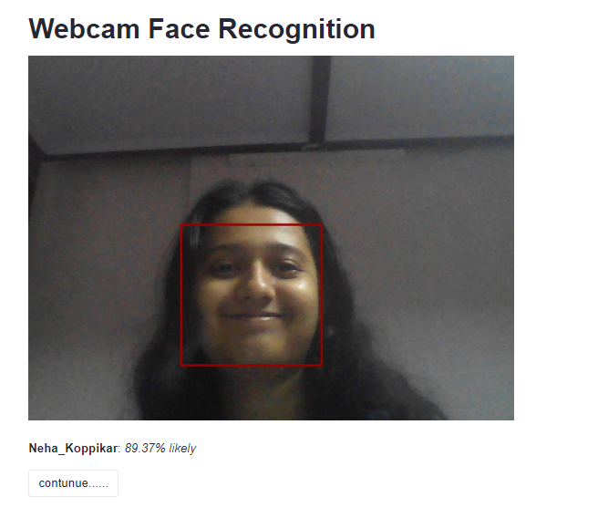
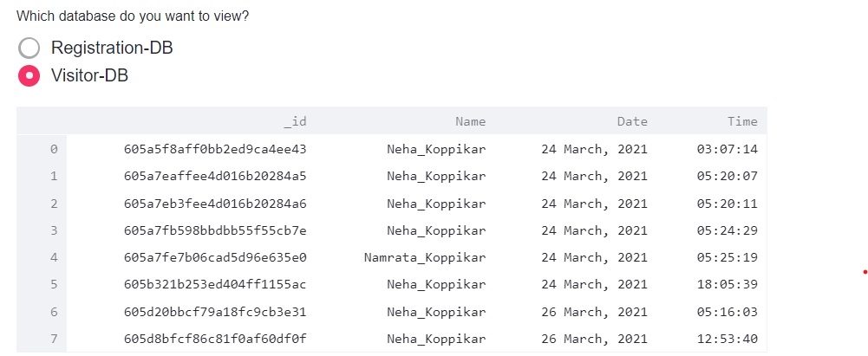
Face-Recognition
Significance
How it works

Slide 9
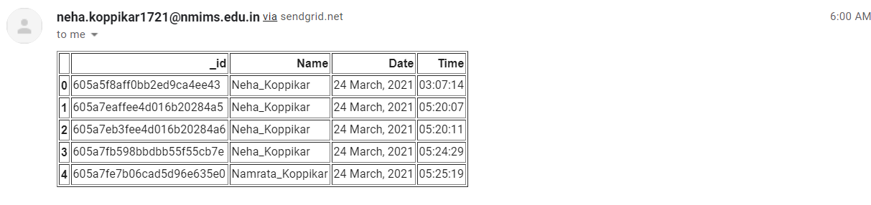
Send Email Reports
Significance
How it works

Slide 10
Body Temperature Sensing
Significance
How it works

Slide 11



Implementation details of proposed work
Hardware
Raspberry Pi 4 Model B (4GB)
Raspberry Pi 5MP Camera Board Module
LED Bulbs (Red, Yellow, and Green)
1 kilo ohm resistors
Breadboard
Female to female wires (Infrared Sensor and Raspberry Pi Connection)
Male to female wires (LEDs and resistor connections on breadboard)
BIS 3Amps Charger, USB C Cable
Ethernet cable
Software
Streamlit (Framework for webapp deployment)
Pandas
Numpy
OpenCV/Imutils
PyMongo
Pickle
Datetime
Face_Recognition (Adam Geitgey)
OS
SendGrid (Email API)

Slide 12
My Contributions
Automating Image Collection Process
Live streaming in streamlit
Database
Generating and saving face encodings
Web-application (Front-end and backend communication)
Sending Reports via email
Going through all the research papers

Slide 13
Novelty and Significance
The web application has been from scratch
This may be one of the first security systems built on the streamlit web framework
The web application has been deployed on raspberry pi as well
Image Collection and storage is so fast that the person may not even realize it happened
Data Collection is part of the system. It fits into the end-to-end bucket for the user
Changes happening can be viewing live and in real time
Database can be validated by the security guard from the application itself (though making an changes is not possible, for security reasons)
Minimum involvement requirement once a person is registered into the system
Email reports make it easier for the secretary of the society to keep track without leaving his/her home.

Slide 14
Limitations
The body temperature system is highly dependent on the raspberry pi. If it loses connection, it will not work. The connection is made possible using Remote Desktop Connection (windows system) and the session gets terminated at times
Streamlit is still in its early stages and the application crashes as times, especially in the Raspberry Pi
To start the application, a command has to be given from the command prompt. This makes the initialization of the application not user friendly in nature.
If a person is not facing a camera, the person will not get detected.
If a person is wearing a mask, the person will not get recognized as I have used the frontal face detection module to trigger the face recognition algorithm.
The application is not spoof proof
Body temperature cannot be backtracked

Slide 15
Future Scope
Face-Recognition with Mask
Detecting mask positioning anomalies (uncovered chin, uncovered nose, or uncovered nose and mouth)
Reduce Application Crashing
Making the application initialization more user friendly
Send Report feature in the GUI (choosing/changing the receiver’s email address(es), triggering)

Slide 16
Thank you!

