Slide 1
Disability Recognition Site
Team Name:
Team Number-07:
Team Members: Anusha Jammalamadaka-11708020 Sai Teja Uppu-11691244 Suraj Kumar Panchakarla-11719347 Neha Nadiminti-11704176 Chittemreddy Gnananendrareddy-11699029 Swapna Dabburi-11708640 Bindu Madhavi Busanagari-11712816

Slide 2
Abstract:
Our team aims to develop a web-based site for identifying people with disabilities. The site uses image recognition technology to identify external disabilities in a person. This technology aligns well with our stakeholders' needs as identified through a series of comprehensive surveys to understand their concerns and how best the site can address them.

Slide 3
OBJECTIVES
Enhance accessibility of digital content to people with disabilities tailored to meet their needs.
Aid in identifying the disabilities in a person for early intervention and support.
Provide valuable information to caregivers, policymakers, and other players to make informed decision-making regarding the provision of accommodation to the disabled.
Promote inclusivity in society by ensuring people with disabilities have access to opportunities.
Provide data for research in public health to better understand the prevalence and impact of various disabilities.
The system will be implemented in a web-based system where users will be required to sign up and upload their images so that the system can identify their disabilities. Those authorized as admin can create, update, and delete resource materials on disability available on the landing page of the site.

Slide 4
Technologies and Database Used:
Python django - used as a programming language.
HTML - used as a markup language.
CSS Bootstrap - used for styling web pages.
Project shall be compatible with all types of web browsers.
Visual studio code - used as a code editor.
My SQL Database: used to store the users Data

Slide 5
DASHBOARD
The user can easily interact with the interface and can access home page and get started easily for login or registration.

Slide 6
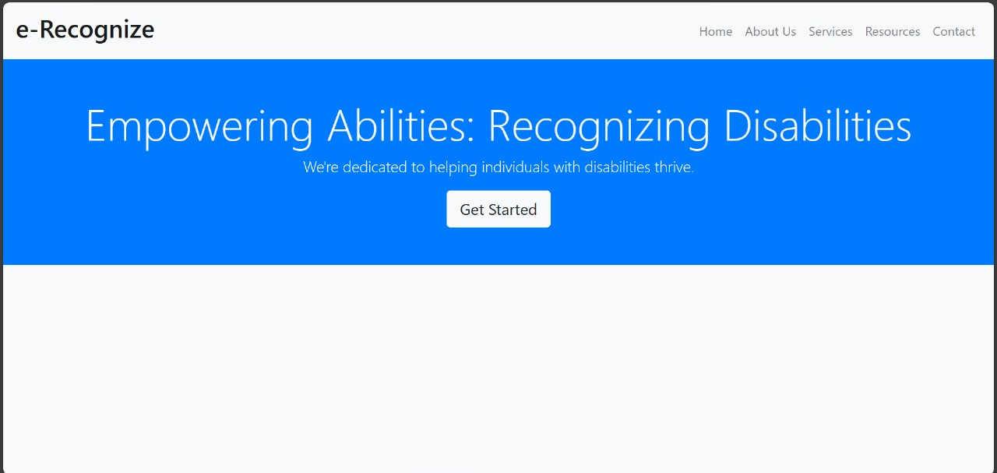

Slide 7
REGISTERATION PAGE:
Registration Page - The system shall allow the user to register by providing his personal information (First Name, Last Name, date of birth, Phone number, and email address) and also set credentials ( password). Upon registration, the system will associate the user credentials with the user account information that already exists.

Slide 8
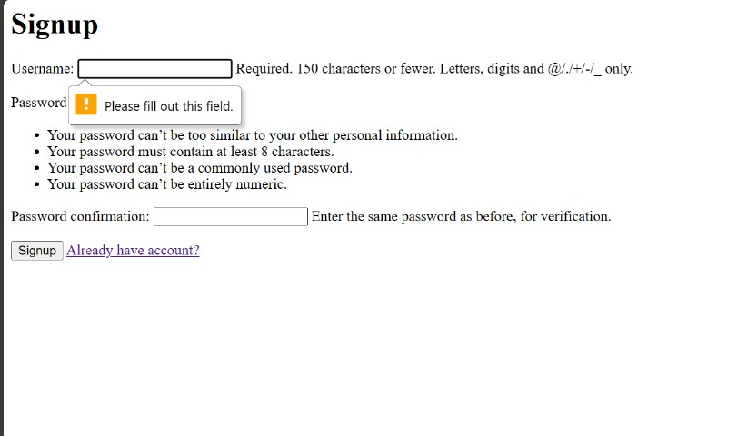

Slide 9
Login
The user shall be able to sign in to his account by providing an email address and password.

Slide 10
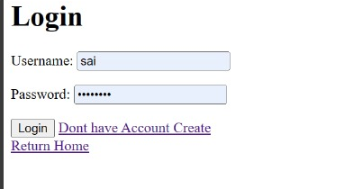

Slide 11
Upload IMage
A user should be able to upload an image for disability analysis.

Slide 12
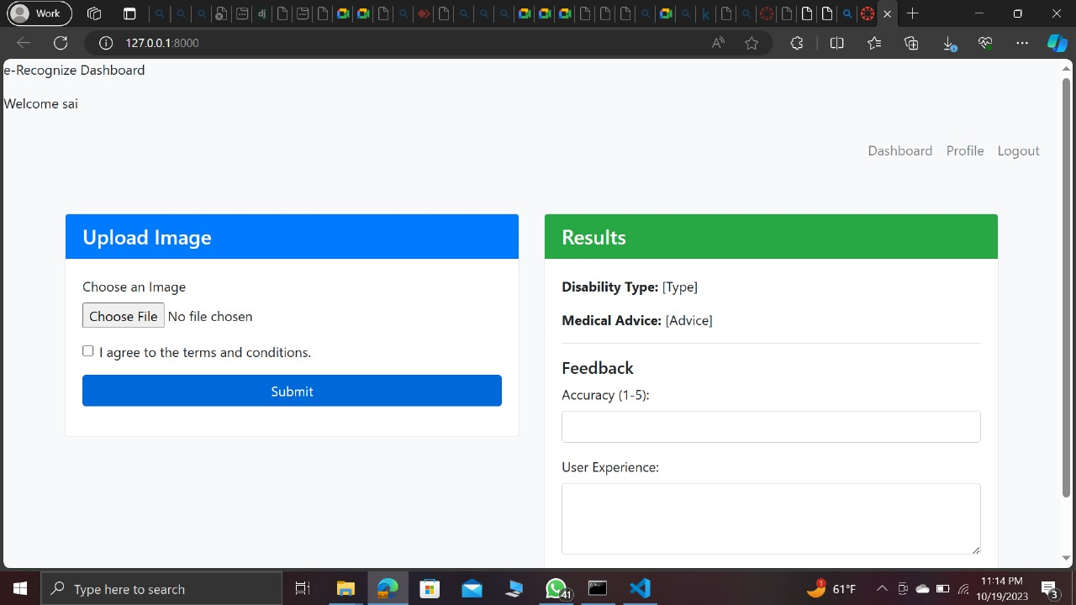

Slide 13
RESULTS
The system shall display the list of disabilities associated with the current user.
The system will utilize machine learning and computer vision algorithms to detect the availability of any disability in an image

Slide 15
FEEDBACK
The site will allow the user to provide feedback on the accuracy of the disability detected.

Slide 17
LOGOUT
Users and admin shall logout upon ending their activities while logged in.

Slide 20
Further Features to be implemented
Admin- Create, Update and delete
Disability Presentation
User Consent
Disability Classification
Medication Advice
Type of Device being used

Slide 21
Github and Trello linksc
https://github.com/NehaNadiminiti/DisabiltyDetectionsite.git
https://trello.com/b/ObotqnNM/se7

Slide 22
Individual Contributions:
Anusha Jammalamadaka- Login
Sai Teja Uppu- Registeration
Suraj Kumar Panchakarla- Upload Image
Neha Nadiminti- Results
Chittemreddy Gnananendrareddy- Feedback
Swapna Dabburi- Dashboard
Bindhu Madhavi Busanagari- Logout

