Slide 1

Final Presentation
VipraHub

Slide 2
Motivation:
There are many model repository sites and hosting sites available but there is no one stop place for the end user to have both the features. In order to overcome this problem, we are motivated to create a single application with high end features like share, test, deploy and visualize the output online.
Objective:
Our objective is to design an open source application with maximum features which promote users to do reproducible research, manage all their models at one place. Moreover, this will also provide great visualization and exposure of contributor’s work.
2

Slide 3
PREJECT JOURNEY
Wireframes
Implemented Home Page
Dashboard
Login and Registration
INCREMENT-1
Jan 29th,2019
1
Feb 25th,2019
Start
Download Model from File System
Advanced search for Model
View Model
UI level Enhancements
Model Repository
2
Mar 18th,2019
Upload Model to Mongo and File System
Search , Filter and Sorting of Model
Enhancements of Increment-1 features
Bug Fixes
April 18th,2019
INCREMENT-3
3
VipraHub
INCREMENT-2
Feb 15th 2019 to
May 7th 2019
Download Model from MongoDB
Experiment Rating and Comments
Meta Data Extraction from MongoDB
Testing and Bug Fixing
Deployed application in Heroku
Upcoming features
May 06th,2019
4
X
XX
Presentation on May 07th,2019
INCREMENT-4
Journey Continues…..

Slide 4
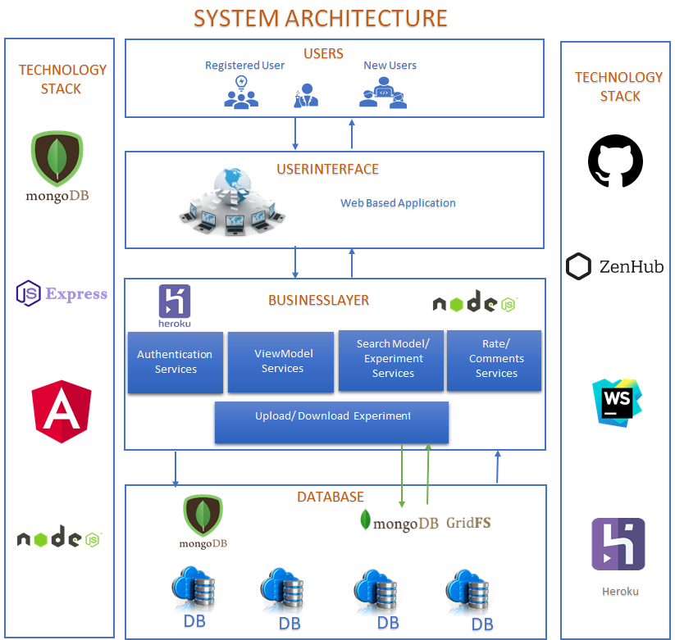
System Architecture

Slide 5
Demo
Application- VipraHub

Slide 6
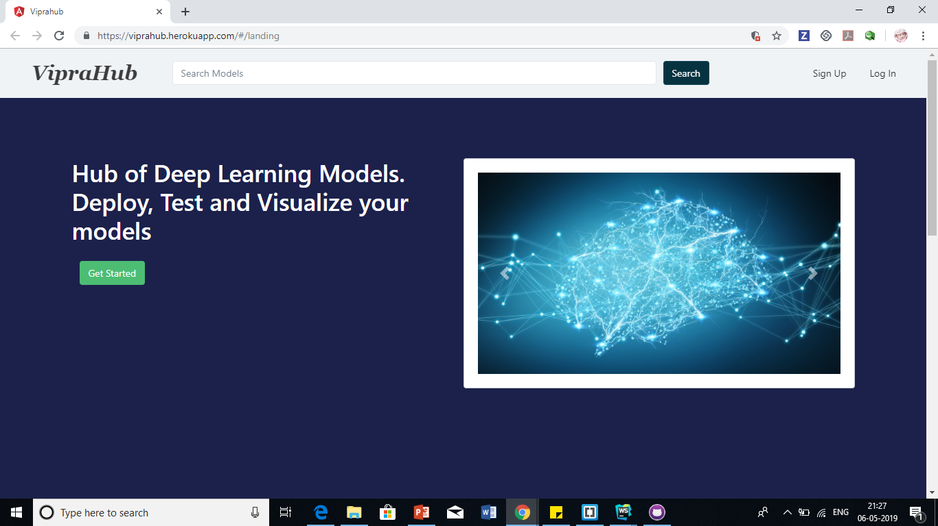
Home Page

Slide 7
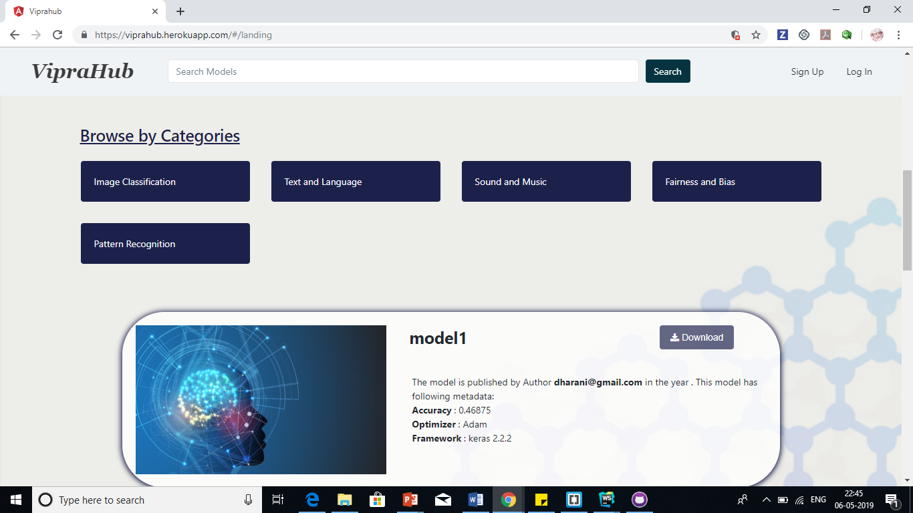
Home Page

Slide 8
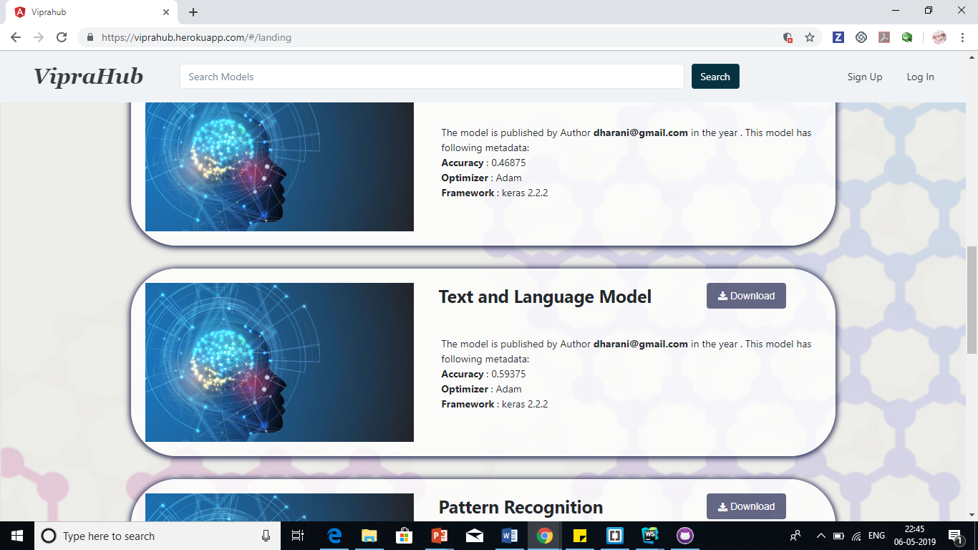
Home Page

Slide 9
Home Page

Slide 10
Home Page

Slide 11
Home Page

Slide 12
Home Page

Slide 13
Home Page

Slide 14
Home Page

Slide 15
Home Page

Slide 16
Home Page

Slide 17
Home Page

Slide 18
Home Page

Slide 19
Home Page

Slide 20
Home Page

Slide 21
Home Page

Slide 22
Home Page

Slide 23
VipraHub
Thank you

