Slide 1
HACKATHON – 2019
Courtesy Shuttle App

Slide 2
Built a uber style hailing app that allows patrons to request a pickup.
It eliminates the need for dispatchers and increases customer satisfaction.
The app will provide real-time tracking of the shuttle location.
The app should allow the user to request a ride right away or to schedule a ride at a later time.

Slide 3
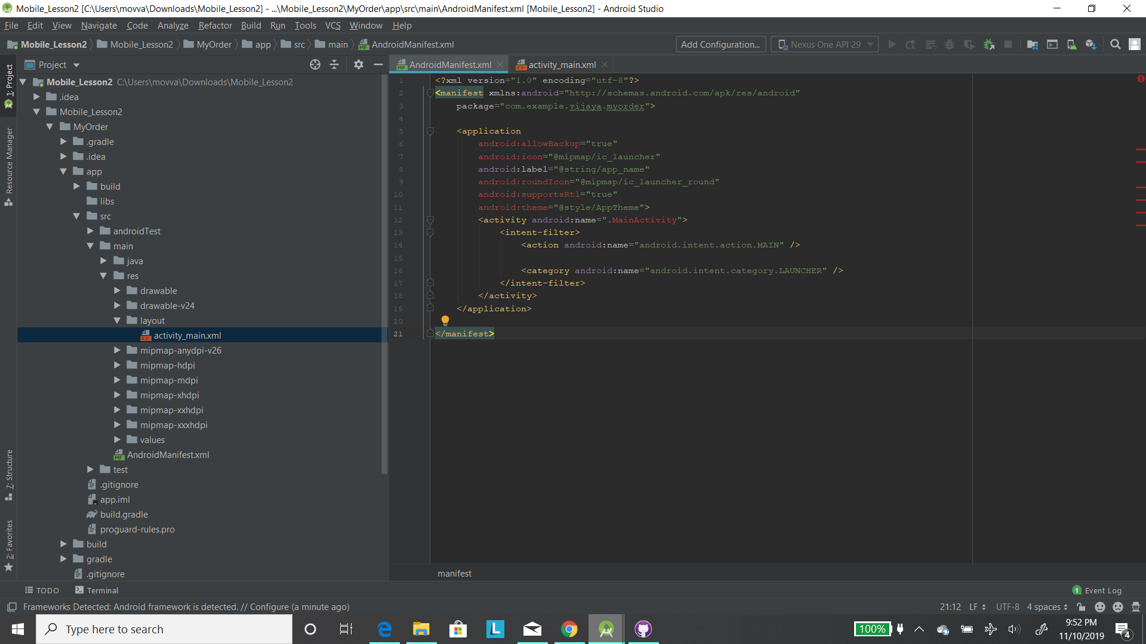

Slide 4
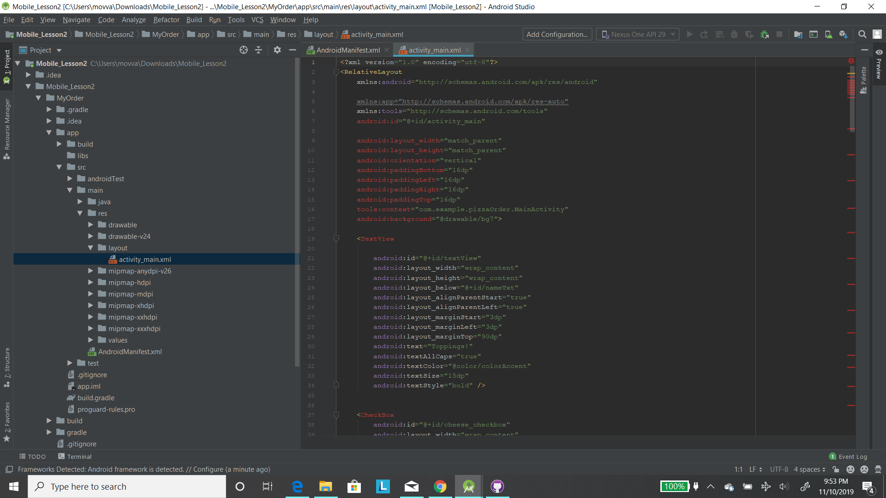

Slide 5
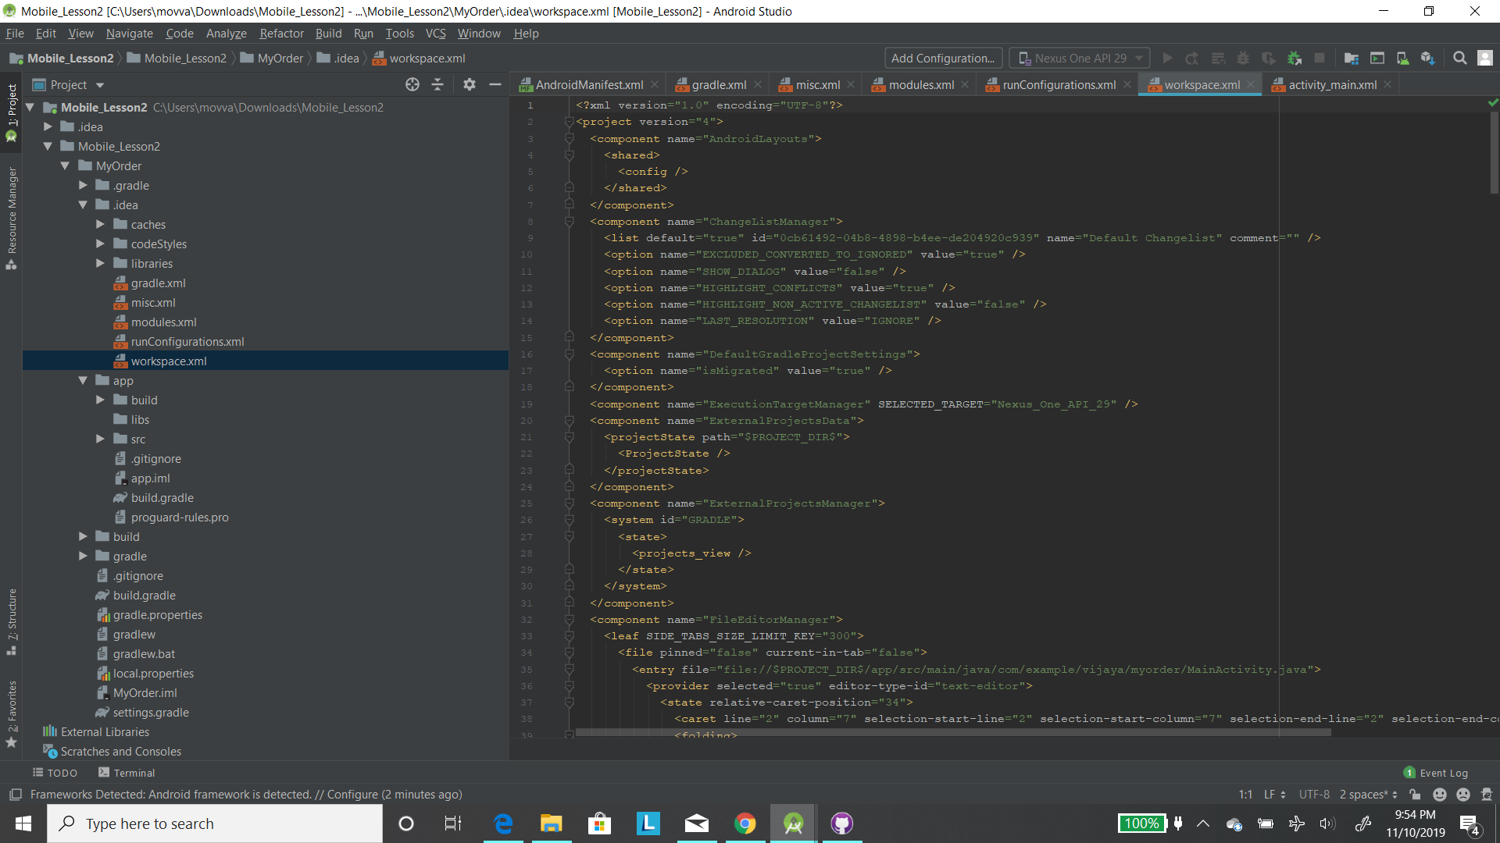

Slide 6
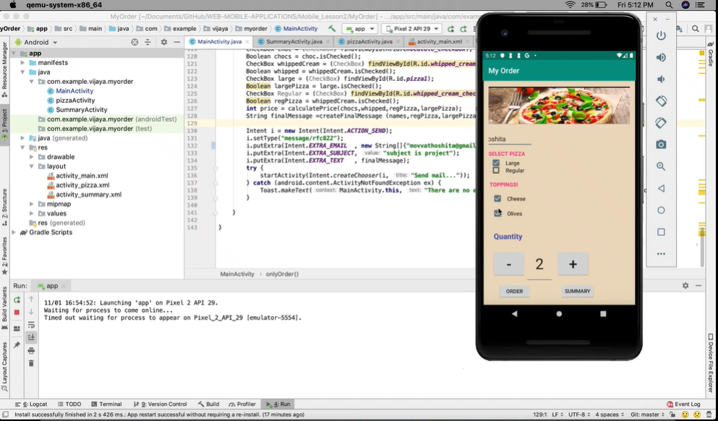

Slide 7
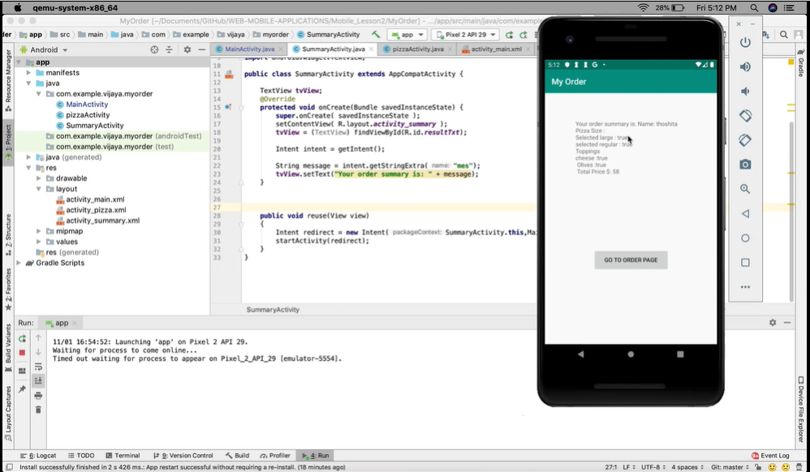

Slide 8
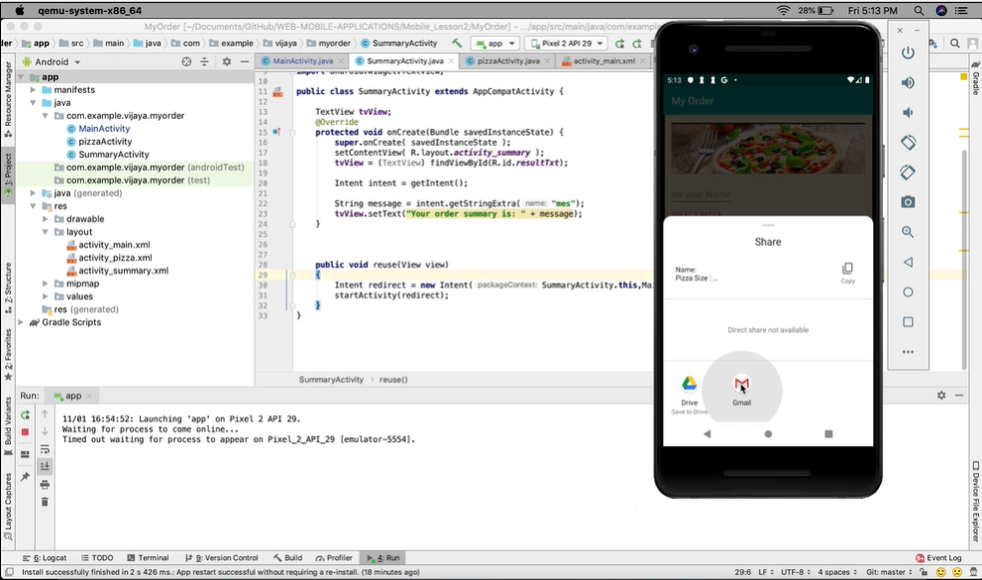

Slide 9
THE END

