Slide 1



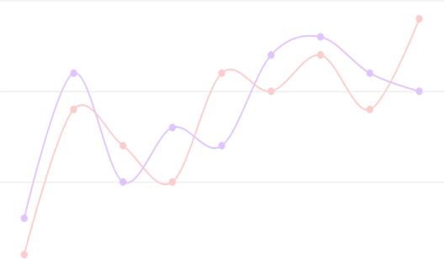

How Twitter Sentiments Affects Stock
Market?

Slide 2





What is a stock?
Raise Funds
Corporation’s motives
for selling stocks
Stock
A form of security indicating owner’s proportionate ownership
Historically outperformed other forms of investments over the long run
Stock Exchanges
Platform to sell and buy stocks

Slide 3





What is a stock market?
Venues
Buying, selling and issuance of shares
Free Market Economy
Democratized access
to trading
01
02
Stock Market
Functions
Efficient price
discovery and dealing
“Stock exchange”?
Subset of
“stock market”
03
04

Slide 4



Public Sentiments and Stock Market
Crucial Aspect
Stock Market Stakeholders
Twitter
Rich Source
Stock Demand
Sentiments drives demand
Real time public opinions
Sentiments
Stock markets
Affected by public feelings
Stock Market is a complex environment
Large number of factors having
direct or indirect effects
Price Impact

Slide 5







What we did?
Analyse correlation
Sentiment values & stock price attributes
Understand Impact
Twitter sentiments on stock prices
Duration of Tweets data
Same day, previous day, last 3 days
Forecasting Potential
Predicting next day’s stock price
Tuning predictive models
Experimenting with hyperparameters
01
02
Research aspects addressed:
03
04
05

Slide 6




Dataset
Dataset Source: Kaggle
‘Speculator and Influencer Evaluation in Stock Market by Using Social Media’ - Mustafa et al. (2020)
Company.csv
ticker symbols of the companies
Company_Tweet.csv
unique tweet id and the companies linked with tweet id
Tweet.csv
different features of tweets. For example, tweet id, author, post date, tweet text, comments number, etc.
CompanyValues.csv
stock market data of different companies. For example, open value, etc.

Slide 7
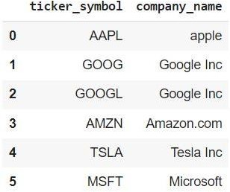
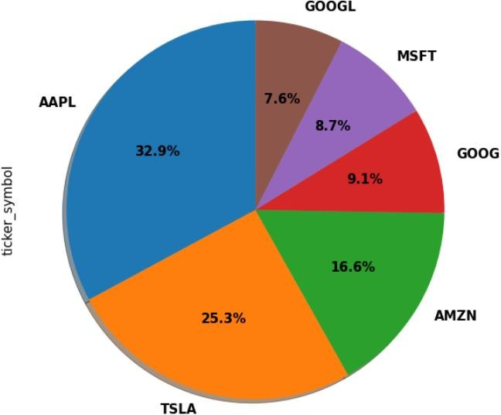
Dataset cont.
Stock Price | Description
open_value | Price at which the first stock is traded
close_value | Price at which the last stock is traded
low_value | Lowest price at which the stock is traded
high_value | Highest price at which the stock is traded
Figure 1:
Ticker Symbols
Table 1: elements of stock market prices
Feature | Description
tweet_id | Unique tweet id of a tweet
writer | Username of the author
post_date | Date on which the tweet was posted (in form of seconds since epoch)
body | Text of the tweet
comment_num | Number of comments
retweet_num | Number of retweets
like_num | Number of thumb-up
Figure 2:
Tweets Distribution
Table 2: Attributes associated with each tweet

Slide 8












Methodology
05
04
03
02
01
Dataset Preparation
Same day tweets, previous day tweets, last three days tweets
Sentiment Analysis & Feature Engineering
Positivity, negativity, neutrality, polarity, subjectivity, compound
Correlation
Spearman Correlation Tweets sentiments & Stock prices
Stock price prediction
Multi-variate time series forecasting
Model Tuning
Observing effects of varying parameters

Slide 9

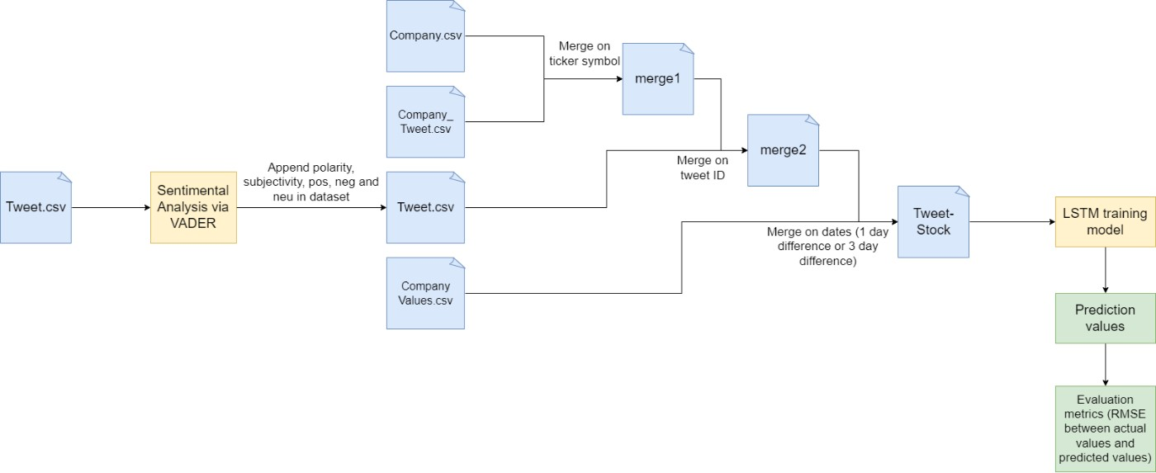
Process Flow

Slide 10


Sentiments
Subjectivity
Quantifies personal opinion & factural information
Positivity
Percentage of positive content
Negativity
Percentage of negative content
Higher subjectivity means higher personal opinion based content and lesser factual information based
content
More the positivity means more positive words with higher positive evaluations
More the negativity means more negaive words with higher negative evaluations

Slide 11

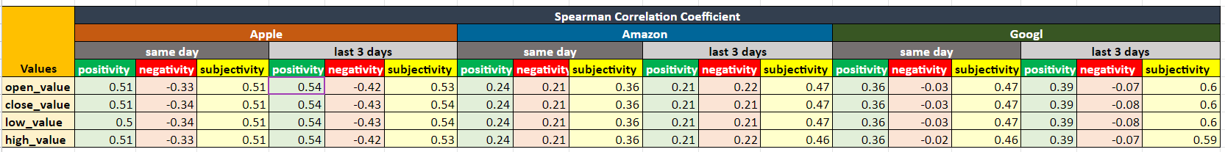

Correlations and Significance
Table 3: Apple (AAPL), Amazon (AMZN) and Google (GOOGL) showing significant Spearman Correlation Coefficient
3 Companies
Significant correlation
Spearman correlation coefficient
95 %
Confidence level Statistically significant
subjectivity
Highly correlated Followed by positivity and negativity

Slide 12
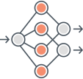



Model Training
Stock Price Forecasting
Predict next day’s stock price based on previous day’s stock price combined with Twitter sentiment values
Model Selection
Baseline LSTM
Changing LSTM Configurations
Multi-variate time series
ARIMA and SARIMAX can’t
LSTM is a suitable choice
Long-Short Term Memory
70% training data, 30%
Visible layer with 4 inputs, hidden layer with 50 LSTM blocks, output layer with single prediction value
Impact of increasing LSTM
forecasting
blocks in hidden layer
testing data
Impact of adding a dropout layer
be used
Total 6 configurations
Total 144 models trained

Slide 13

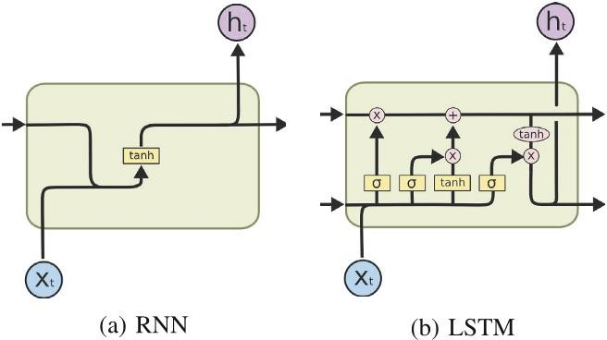
RNNs and LSTMs
A simple recurrent network suffers from a fundamental problem of not being able to capture long-term dependencies in a sequence.
Figure 3:
Structure of an RNN Cell and an LSTM cell
RNN:
Recurrent
Neural Networks
Single Layer
4 interactive Layers
When dealing with a time series, RNN tends to forget old information. Thus, resulting in Vanishing gradient problem.
LSTM:
Long-Short Term Memory
Hence, when there is a distant relationship of unknown length, we wish to have a “memory” to it.

Slide 14

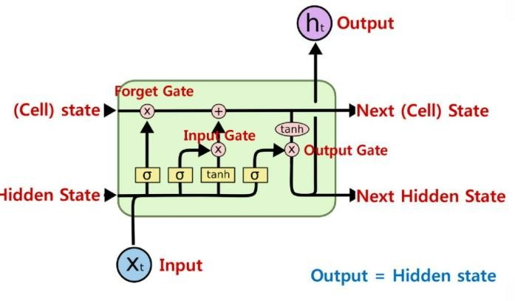
LSTM architecture
Figure 4:
Components of an LSTM block
Long Short-Term Memory
An RNN architecture which addresses the
problem of training over long sequences and
retaining memory.
Cell state
A memory which helps LSTMs to selectively
remember or forget things.
Gates
LSTM adds 3 gates to control cell states
such as Forget Gate, Input gate, Output gate.
Forget Information Add new information Update cell state Create output
Mechanisms:

Slide 15

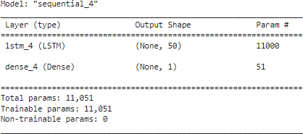
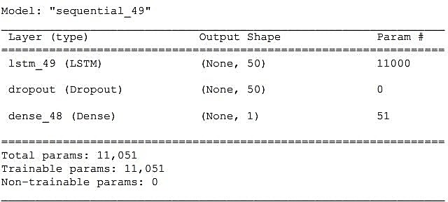
LSTM configurations
Different LSTM configurations used
LSTM | Configuration
LSTM – 1 | 50 LSTM blocks (hidden layer)
LSTM – 2 | 100 LSTM blocks (hidden layer)
LSTM – 3 | 200 LSTM blocks (hidden layer)
LSTM – 4 | 50 LSTM blocks (hidden layer), 1 Dropout Layer
LSTM – 5 | 100 LSTM blocks (hidden layer), 1 Dropout Layer
LSTM – 6 | 200 LSTM blocks (hidden layer), 1 Dropout Layer
Figure 5:
Example of LSTM – 1 model summary
Figure 6:
Example of LSTM – 4 model summary

Slide 16

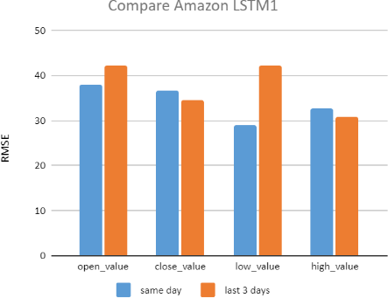
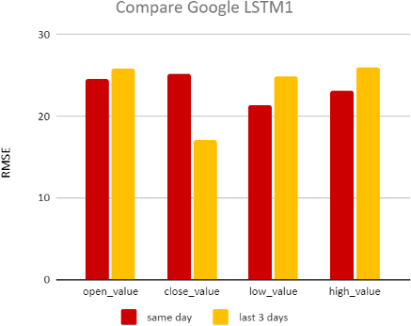

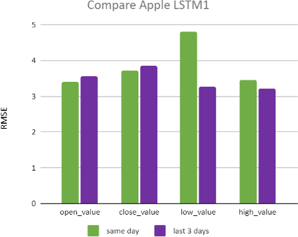
Results
RMSE below 5.0
Apple
(in the scale of 100 dollars)
Apple’s current stock price:
$ 174.86 (9/Dec/2021)
Figure 7: Baseline model comparison
for Amazon
Figure 8: Baseline model comparison for Google
RMSE below 40.0 & 30.0
Amazon & Google
(in the scale of 1000 dollars)
Amazon’s current stock price:
$ 3511.32 (9/Dec/2021)
Google’s current stock price:
$ 2971.85 (9/Dec/2021)
Figure 9: Baseline model comparison for Apple

Slide 17

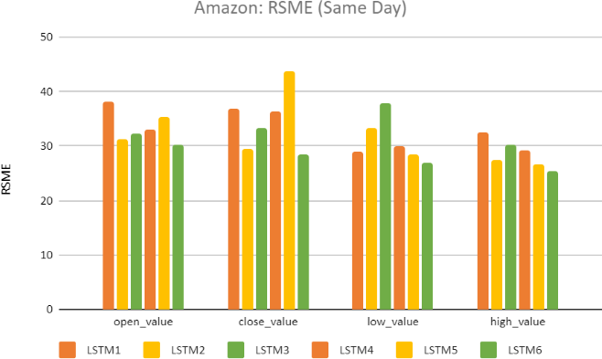

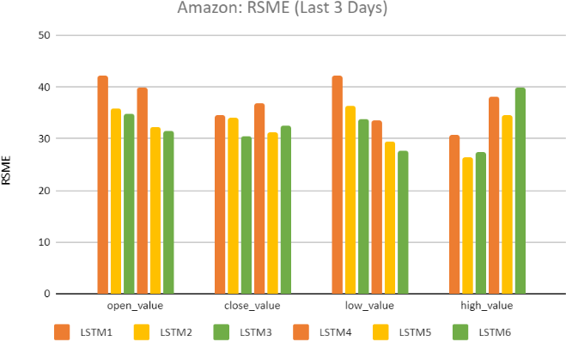
LSTM model comparison for Amazon
Best performing
In most of the cases
LSTM 6
Varies from 26.0 to 43.0
(in a scale of 1000 dollars)
RMSE
Figure 10: LSTM model results for Amazon

Slide 18

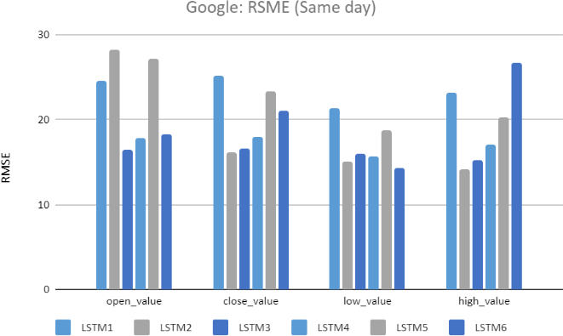

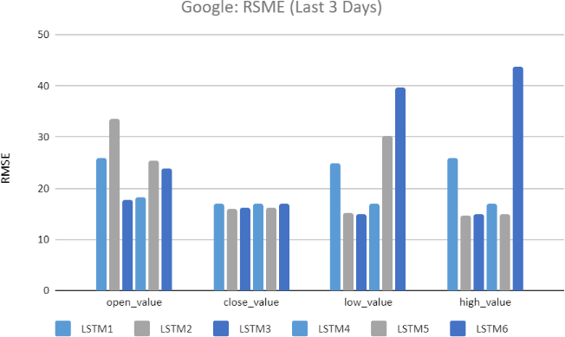

LSTM model comparison for Google
Best performing
In most of the cases
LSTM 3
Varies from 14.0 to 43.0
(in a scale of 1000 dollars)
RMSE
Figure 11: LSTM model results for Google

Slide 19

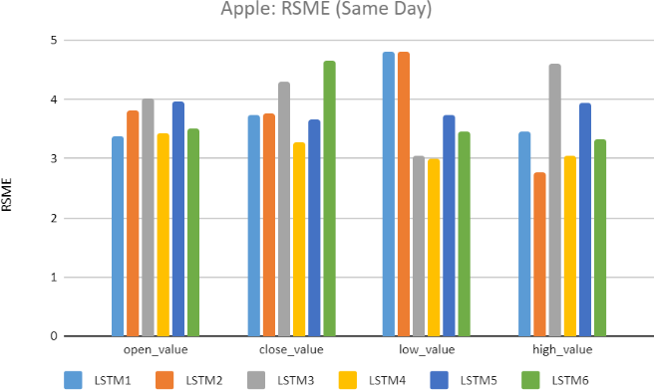
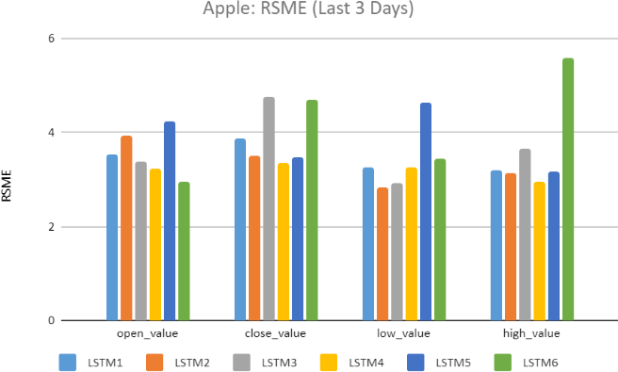

LSTM model comparison for Apple
Best performing
In most cases
LSTM 4
Varies from 2.5 to 5.8
(in a scale of 100 dollars)
RMSE
Figure 12: LSTM model comparison for Apple

Slide 20



Voila!!!

Slide 21



Conclusion & Future Scope
Conclusion 1
‘positivity’, ‘negativity’ and ‘subjectivity’ correlated with stock price movements
Future Scope 1
The inverse relation can be investigated, i.e. , stock price movements’s impact on twitter
sentiments
Conclusion 2
Higher the correlation between twitter sentiments and stock price, higher the predictive capability
Future Scope 2
Different social media platforms
and other sources like newspapers, Reddit can also be
included
Opportunities in Future
Many other aspects can be researched and explored
Future Scope 3
Number of companies and industries can be increased for
exhaustive analysis
Conclusion 3
Significant for investors, portfolio management companies, entrepreneurs and other stock market stakeholders

Slide 22







References
These are the research papers we referred for our project:
Bollen, J., Mao, H., & Zeng, X. (2011, March). Tw itter mood predicts the stock market. Journal of Computational Science, 2(1). doi:https://doi.org/10.1016/j.jocs.2010.12.007
Dickinson, B., & Hu, W. (2015, January). Sentiment Analysis of Investor Opinions on Tw itter. Social Netw orking, 04(03), 62-71. doi:10.4236/sn.2015.43008
Doğan, M., Metin, Ö., Tek, E., Yumuşak, S., & Öztoprak, K. (2020). Speculator and Influencer Evaluation in Stock Market by Using Social Media. 2020 IEEE International Conference on Big Data (Big Data), (pp. 4559-4566).
doi:10.1109/BigData50022.2020.9378170
Hu, D., Jones, C., Zhang, V., & Zhang, X. (2021). The rise of reddit: How social media affects retail investors and short-sellers’ roles in price discovery. SSRN Electronic Journal. doi:https://doi.org/10.2139/ssrn.3807655
Ko, C.-R., & Chang, H.-T. (2021, March 11). LSTM-based sentiment analysis for stock price forecast. PeerJ Computer Science.
doi:10.7717/peerj-cs.408
Kordonis, J., Symeonidis, S., & Arampatzis, A. (2016). Stock Price Forecasting via Sentiment Analysis on Tw itter. Proceedings of the 20th Pan-Hellenic Conference on Informatics.
Mao, H., Counts, S., & Bollen, J. (2011). Predicting Financial Markets: Comparing Survey, New s, Tw itter and Search Engine Data.
Papers 1112.1051, arXiv.org. Retrieved from https://arxiv.org/abs/1112.1051v1
Mao, Y., Wei, W., Wang, B., & Benyuan, L. (2012). Correlating S&P 500 Stocks w ith Tw itter Data. HotSocial '12: Proceedings of the First ACM International Workshop on Hot Topics on Interdisciplinary Social Netw orks Research. Association for Computing Machinery. doi:10.1145/2392622.2392634
Nisar, T. M., & Yeung, M. (2018, June). Tw itter as a tool for forecasting stock market movements: A short-w indow event study. The Journal of Finance and Data Science, 4(2), 101-119. doi:https://doi.org/10.1016/j.jfds.2017.11.002
Pagolu, V. S., Challa, K., Panda, G., & Majhi, B. (2016). Sentiment Analysis of Tw itter Data for Predicting Stock Market
Movements. 2016 International Conference on Signal Processing, Communication, Pow er and Embedded System (SCOPES), (pp. 1345-1350). doi:DOI:10.1109/SCOPES.2016.7955659

Slide 23
References
Ruiz, E., Hristidis, V., Castillo, C., & Gionis, A. (2012). Correlating Financial Time Series w ith Micro-Blogging Activity. Proceedings of the Fifth International Conference on Web Search and Web Data Mining, WSDM 2012. Seattle, WA, USA. doi:10.1145/2124295.2124358
Selvin, S., Ravi, V., Gopalakrishnan, E., & Menon, V. K. (2017). Stock price prediction using LSTM, RNN and CNN-sliding w indow model. 2017 International Conference on Advances in Computing, Communications and Informatics (ICACCI).
doi:0.1109/ICACCI.2017.8126078
Shah, D., Isah, H., & Zulkernine, F. (2019, May 27). Stock Market Analysis: A Review and Taxonomy of Prediction Techniques. International Journal of Financial Studies, 7(2). doi:https://doi.org/10.3390/ijfs7020026
Siami-Namini, S., Tavakoli, N., & Siami Namin, A. (2019). A Comparison of ARIMA and LSTM in Forecasting Time Series. In M. A. Wani, M. Sayed-Mouchaw eh, E. Lughofer, J. Gama, & M. Kantardzic (Eds.), Proceedings - 17th IEEE International Conference on Machine Learning and Applications, ICMLA 2018 (pp. 1394-1401). [8614252] Institute of Electrical and Electronics Engineers. doi:https://doi.org/10.1109/ICMLA.2018.00227
Tetlock, P. C. (2007). Giving Content to Investor Sentiment: The Role of Media in the Stock Market. Journal of Finance,
Forthcoming, 62(3). doi:http://dx.doi.org/10.2139/ssrn.685145
Xia, Y., Liu, Y., & Chen, Z. (2013). Support Vector Regression for prediction of stock trend. 2013 6th International Conference on Information Management, Innovation Management and Industrial Engineering (ICIII). doi:10.1109/ICIII.2013.6703098
Yadav, A., Jha, C., & Sharan, A. (2020). Optimizing LSTM for time series prediction in Indian stock market. Procedia Computer Science, 167, 2091-2100. doi:https://doi.org/10.1016/j.procs.2020.03.257

Slide 24

Thank You

