Slide 1
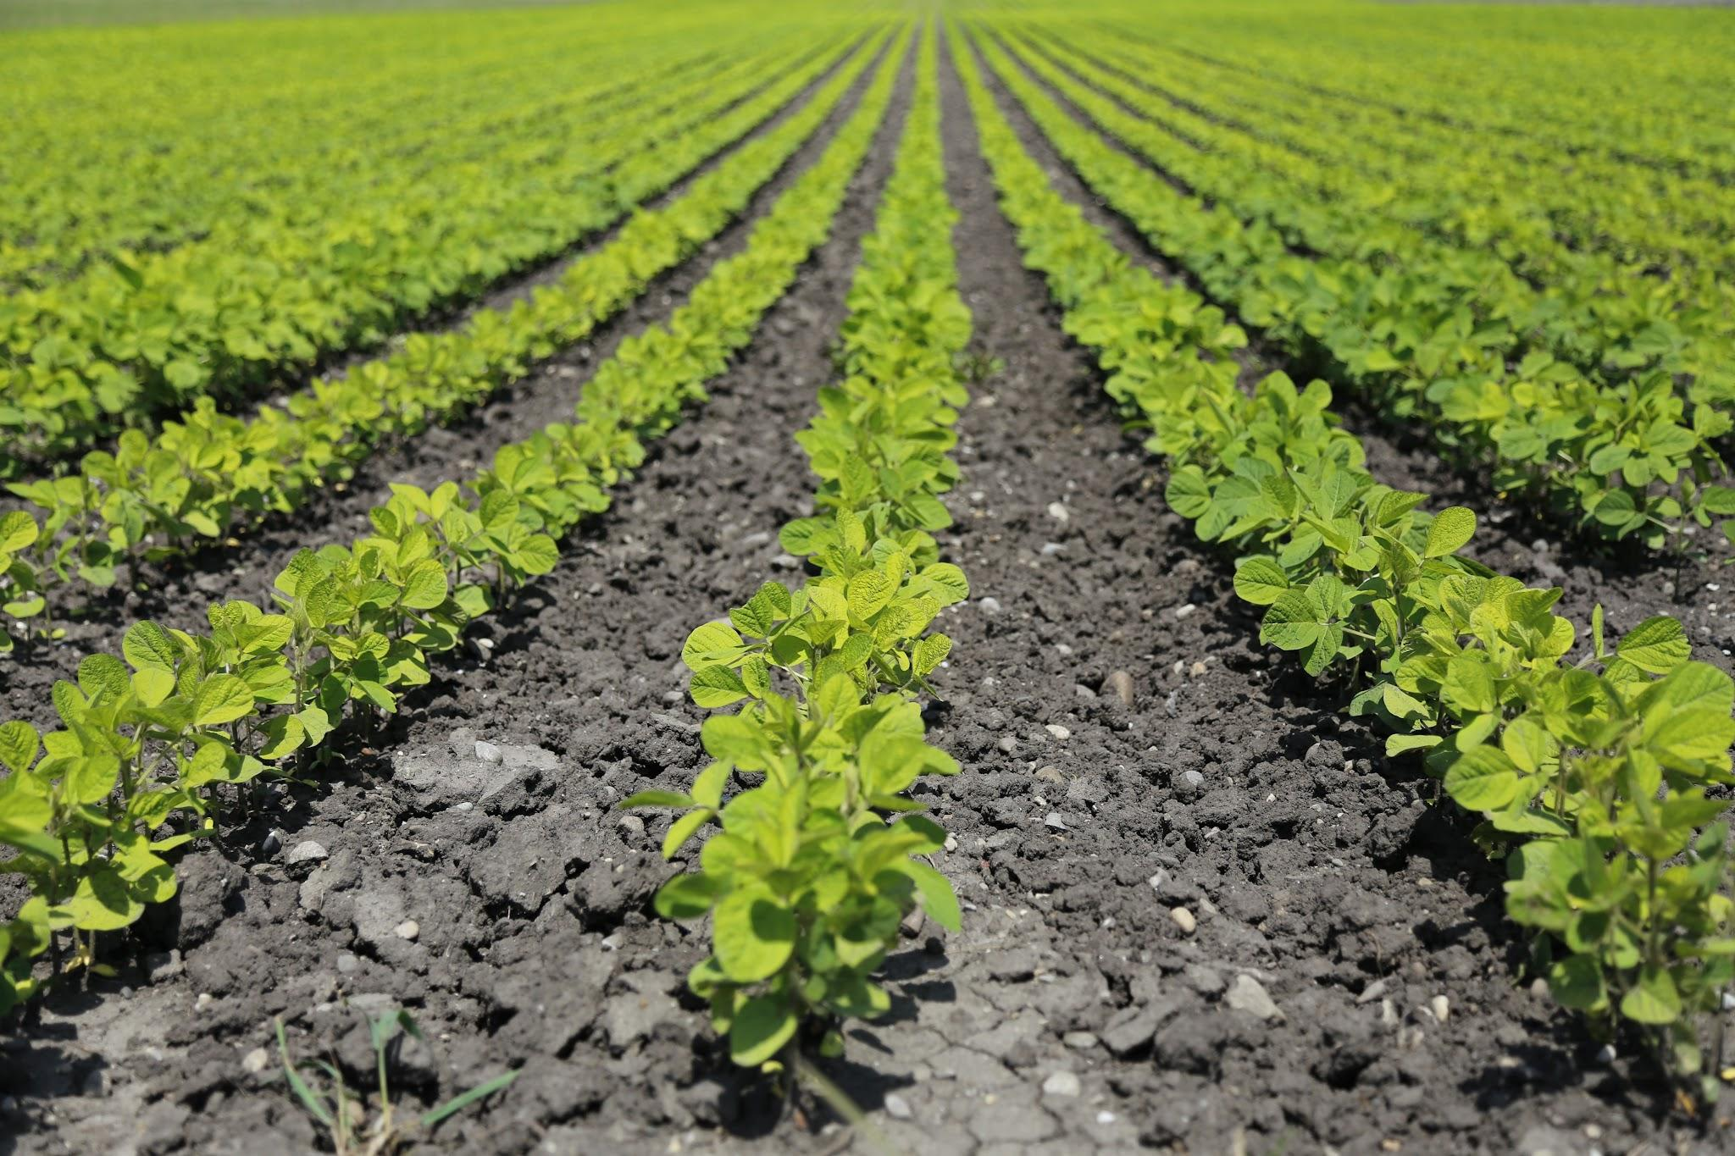

Factors Impacting Crop Yield Prediction
Team F
Neha Nooka
Chaturya Gajula
Harshali Narkhede

Slide 2
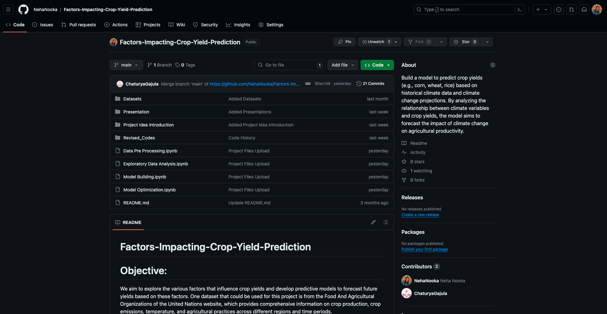
Github Page (Link)

Slide 3
Project Introduction
Crop yield prediction is vital for agricultural planning and resource allocation, guiding decisions from crop selection to market strategies.
Understanding the diverse factors affecting crop yields is pivotal for sustainable and efficient agricultural practices.
Our project's main goal is to identify and analyze key factors impacting crop yields across regions and timeframes.
Through thorough data analysis and modeling techniques, we aim to predict future crop yields accurately and uncover insights into the relationships between agricultural and environmental factors.

Slide 4
Datasets (Link)
The time span for all the tables are from 2000-2021.
Countries: China, United States, Brazil and Indonesia
Crops: Rice, Wheat, Maize (Corn), Soya Beans
Tables:
Crop Production
Pesticides Use
Crop Trade
Land Use
Emission from Crops
Value of Agricultural Production
Cropland Nutrient Balance

Slide 5
Dataset Descriptions
After merging all the 7 tables, we have total of 59,076 rows and 35 columns.
The main features from each tables are:
Crop Production
Area Harvested, Yield and Production Quantity
Pesticides Use
Pesticides, Insecticides, Fungicides and Bactericides
Crop Trade
Import Quantity, Import Value, Export Quantity, Export Value
Land Use
Land Area, Cropland
Emission from Crops
Emissions N20, Emissions CH4
Value of Agricultural Production
Gross Production Value (Current thousand US $)
Cropland Nutrient Balance
Fertilizers Usage

Slide 6
Previous Projects on the Topic
In recent years, several approaches have been explored in the field of Crop Yield Prediction, each aiming to improve the accuracy and efficiency of crop yield forecasting. Here are some examples of what others have done and the current state of the art:
Assessing the Impact of Climate Change on Maize Yield Prediction using Machine Learning
Models: Random Forest, SVM, GBM
Approach: Used climate data and crop practices to predict maize yields.
2. Integration of Remote Sensing Data for Crop Yield Prediction
Models: CNN, LSTM
Approach: Utilized satellite imagery to forecast crop yields.

Slide 7
Previous Projects on the Topic
3. Exploring Socioeconomic Factors in Crop Yield Prediction: A Bayesian Approach
Models: Bayesian regression
Approach: Explored land tenure and credit access effects on yields.
4. Hybrid Approach for Crop Yield Prediction using Ensemble Learning
Models: Random Forest, XGBoost
Approach: Combined models for accurate yield estimation.

Slide 8
Literature Review
Traditional Approaches
Historical reliance on statistical methods and empirical models.
Limited precision and struggle with complex interactions.
Machine Learning Techniques
Recent ML advancements revolutionized crop yield prediction.
Regression, decision trees, random forests, neural networks applied.
Integration of Remote Sensing Data
Utilization of satellite imagery and UAV observations.
Enhances prediction capabilities with valuable environmental insights.
Climate Change Impacts
Challenges crop yield prediction due to temperature and precipitation shifts.
Extreme weather events adversely affect productivity.
Socioeconomic Factors
Influence from land tenure, resource access, market conditions, and policies.
Crucial role in agricultural outcomes and yield determination.

Slide 9
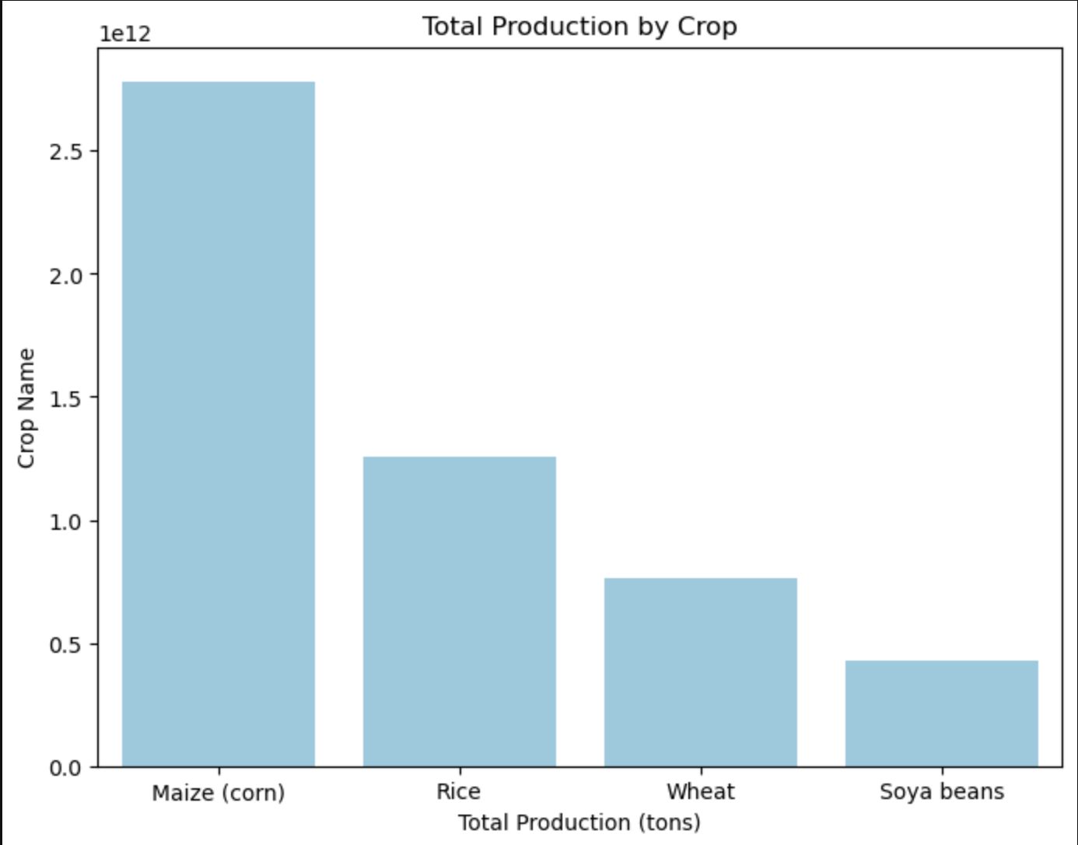
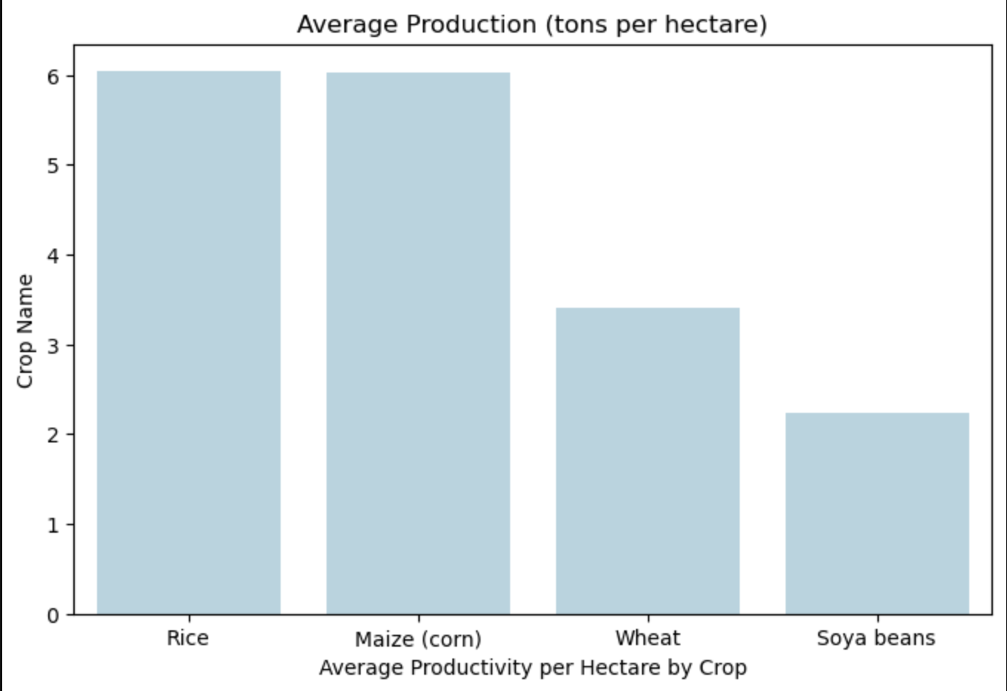
Exploratory Data Analysis(EDA)

Slide 10
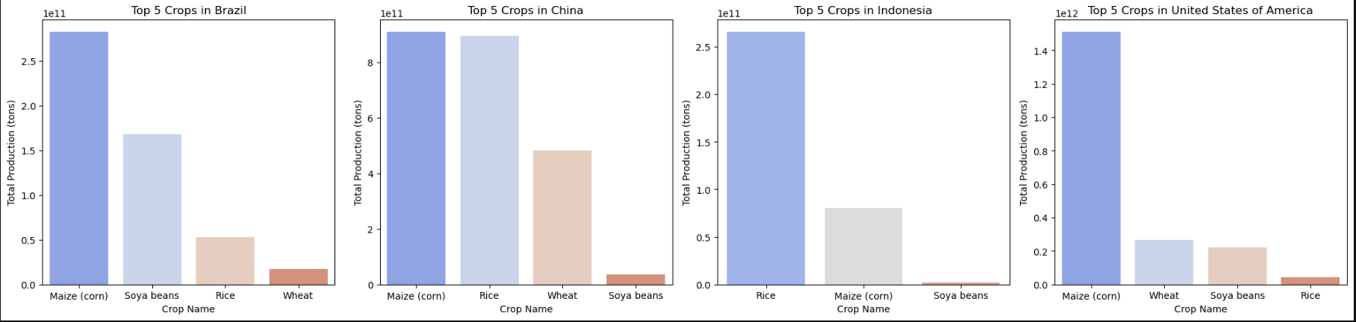
Exploratory Data Analysis(EDA)

Slide 11
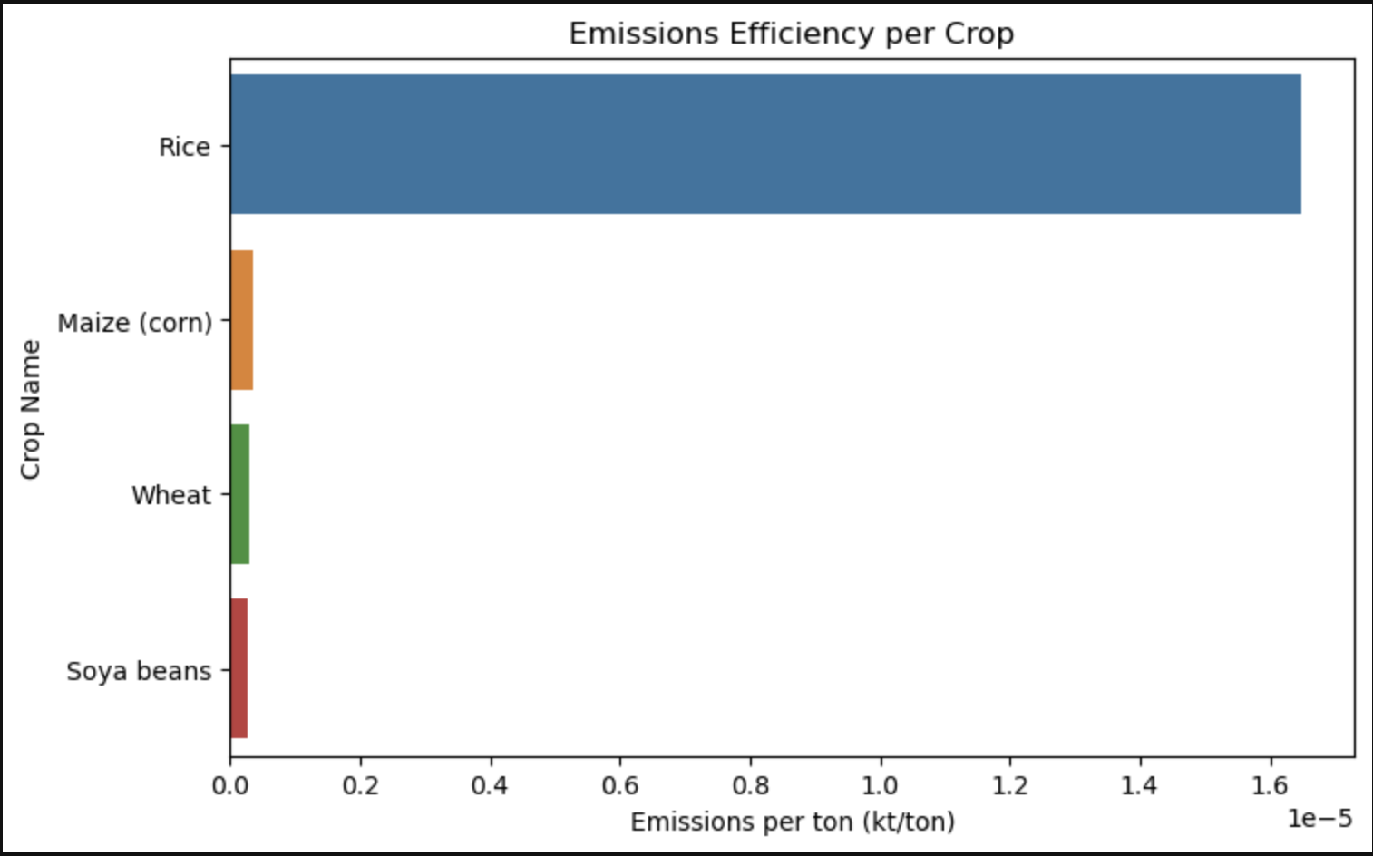
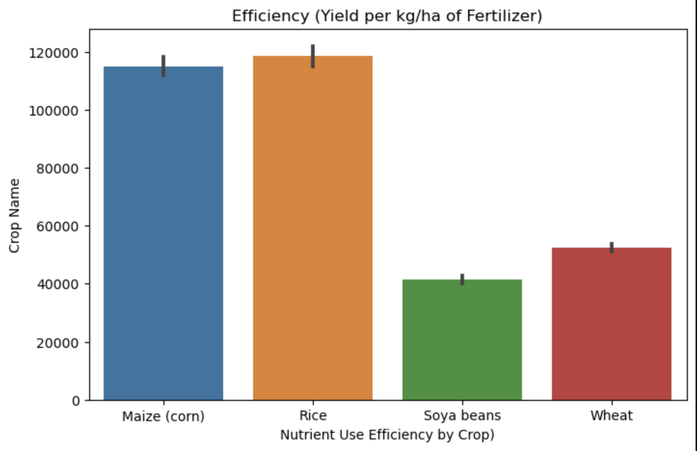
Exploratory Data Analysis(EDA)

Slide 12
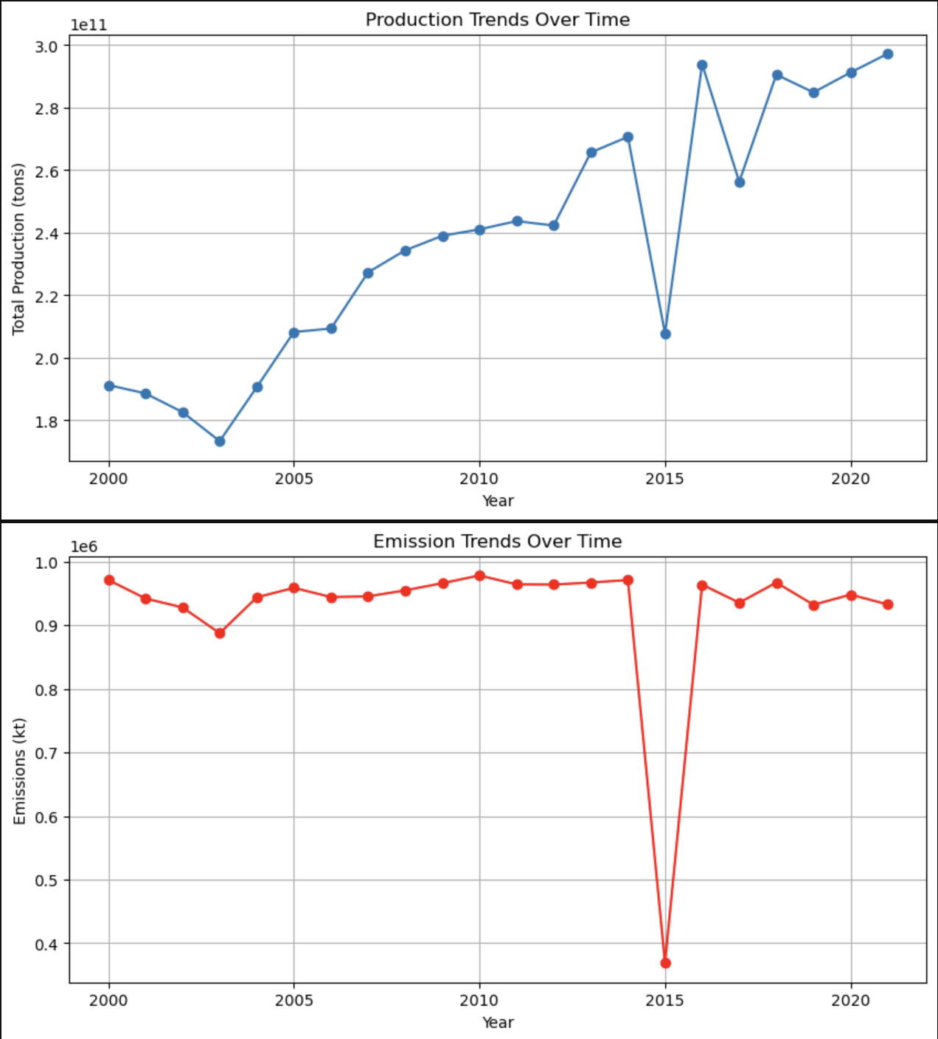
Exploratory Data Analysis(EDA)

Slide 13
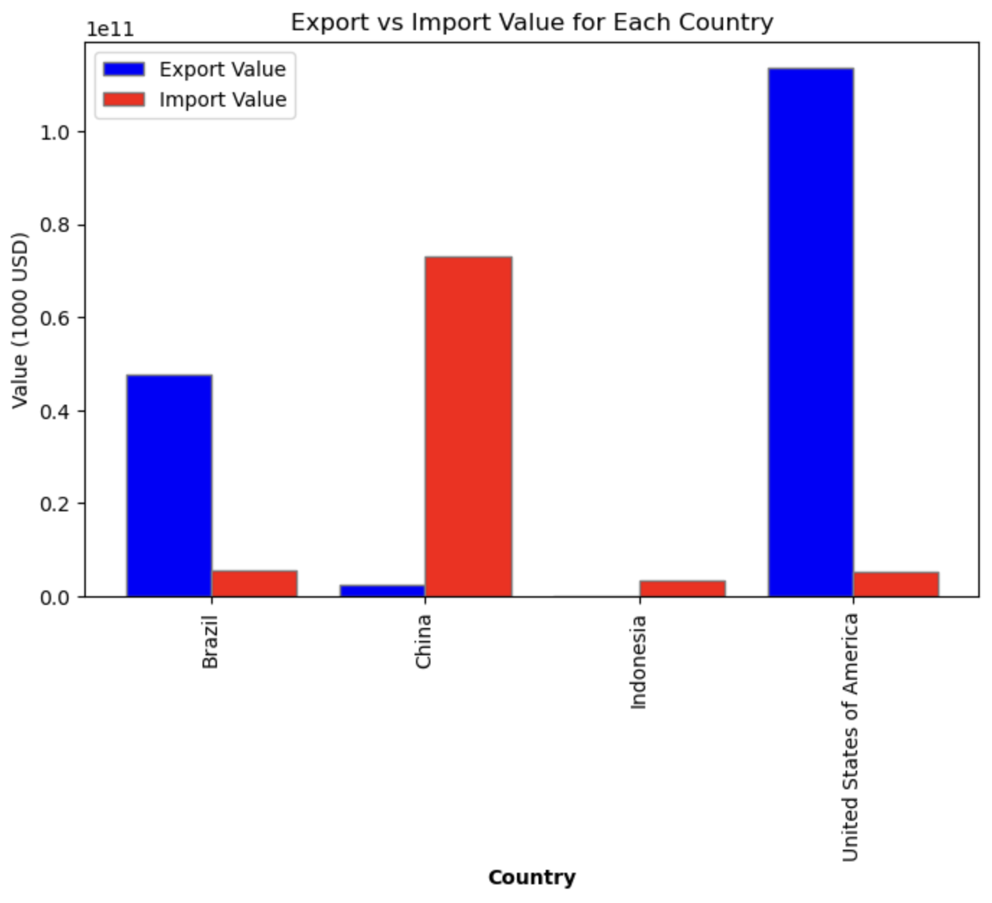
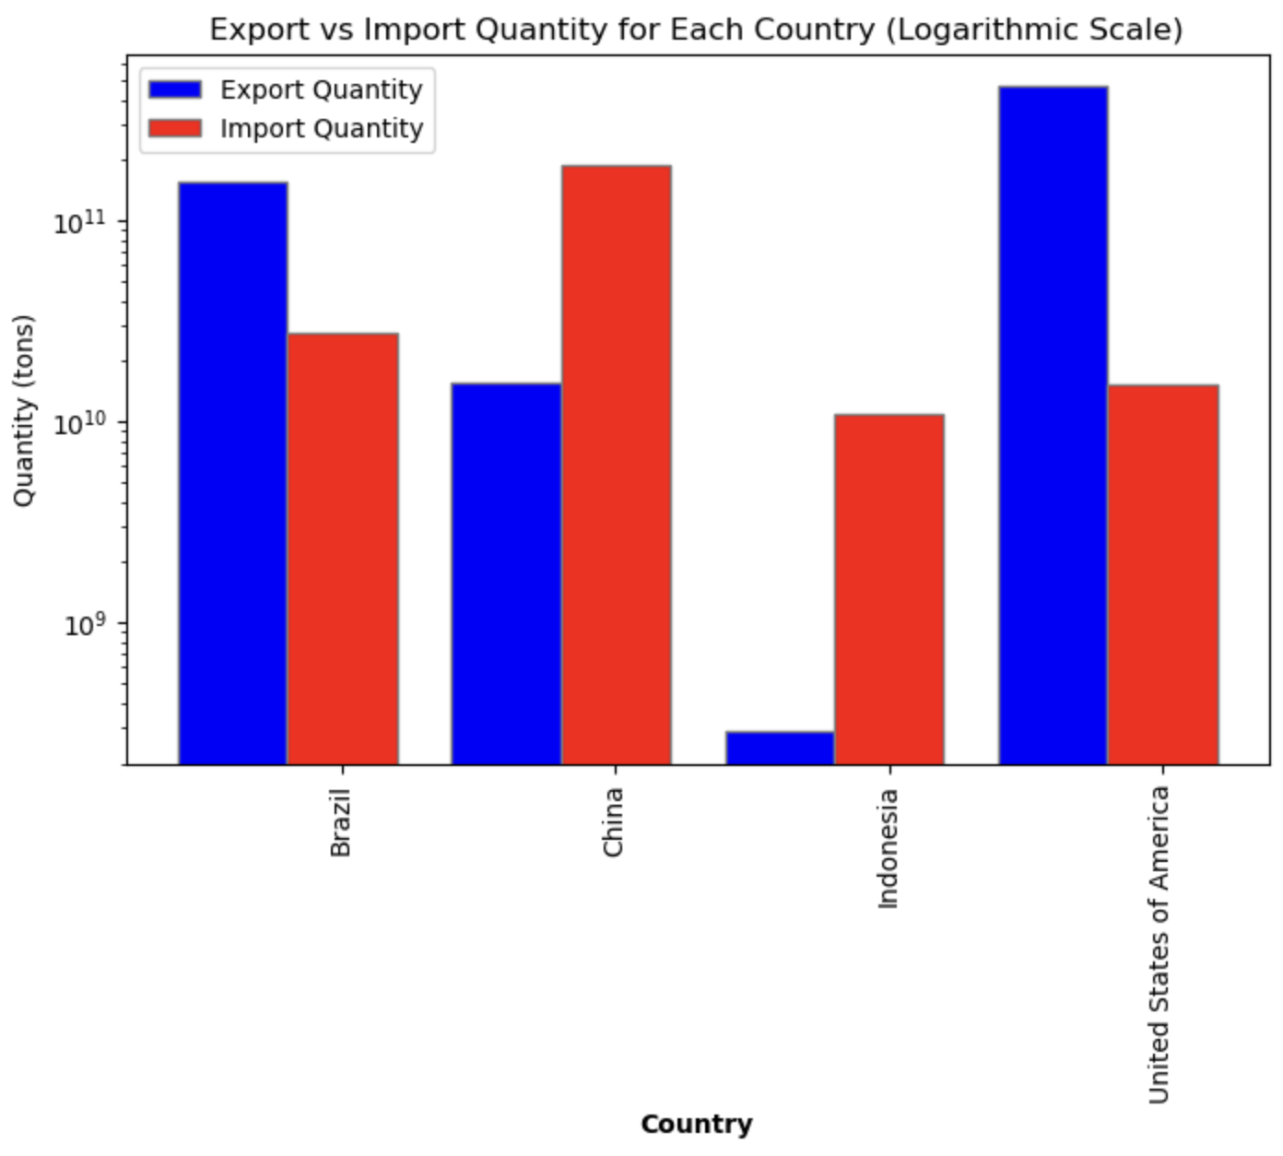
Exploratory Data Analysis(EDA)

Slide 14
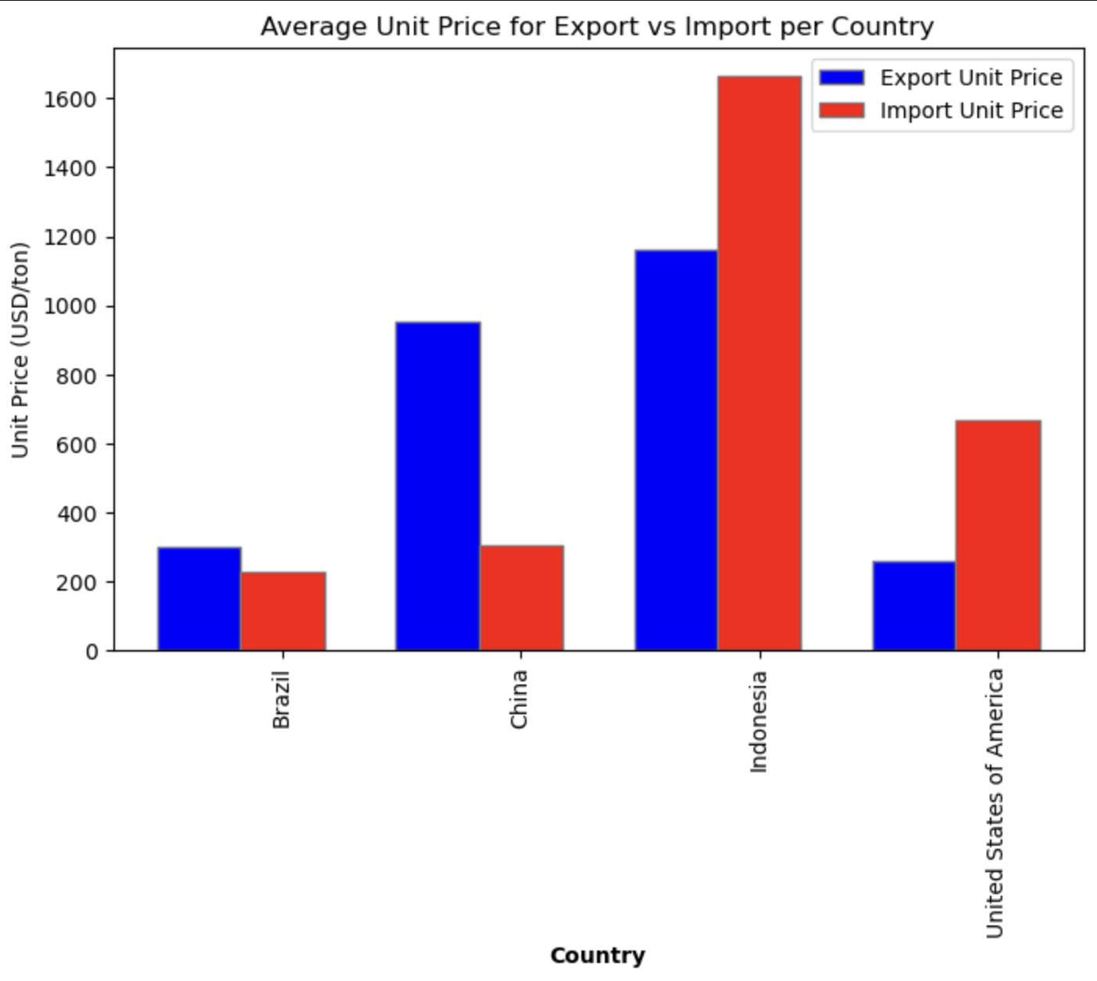
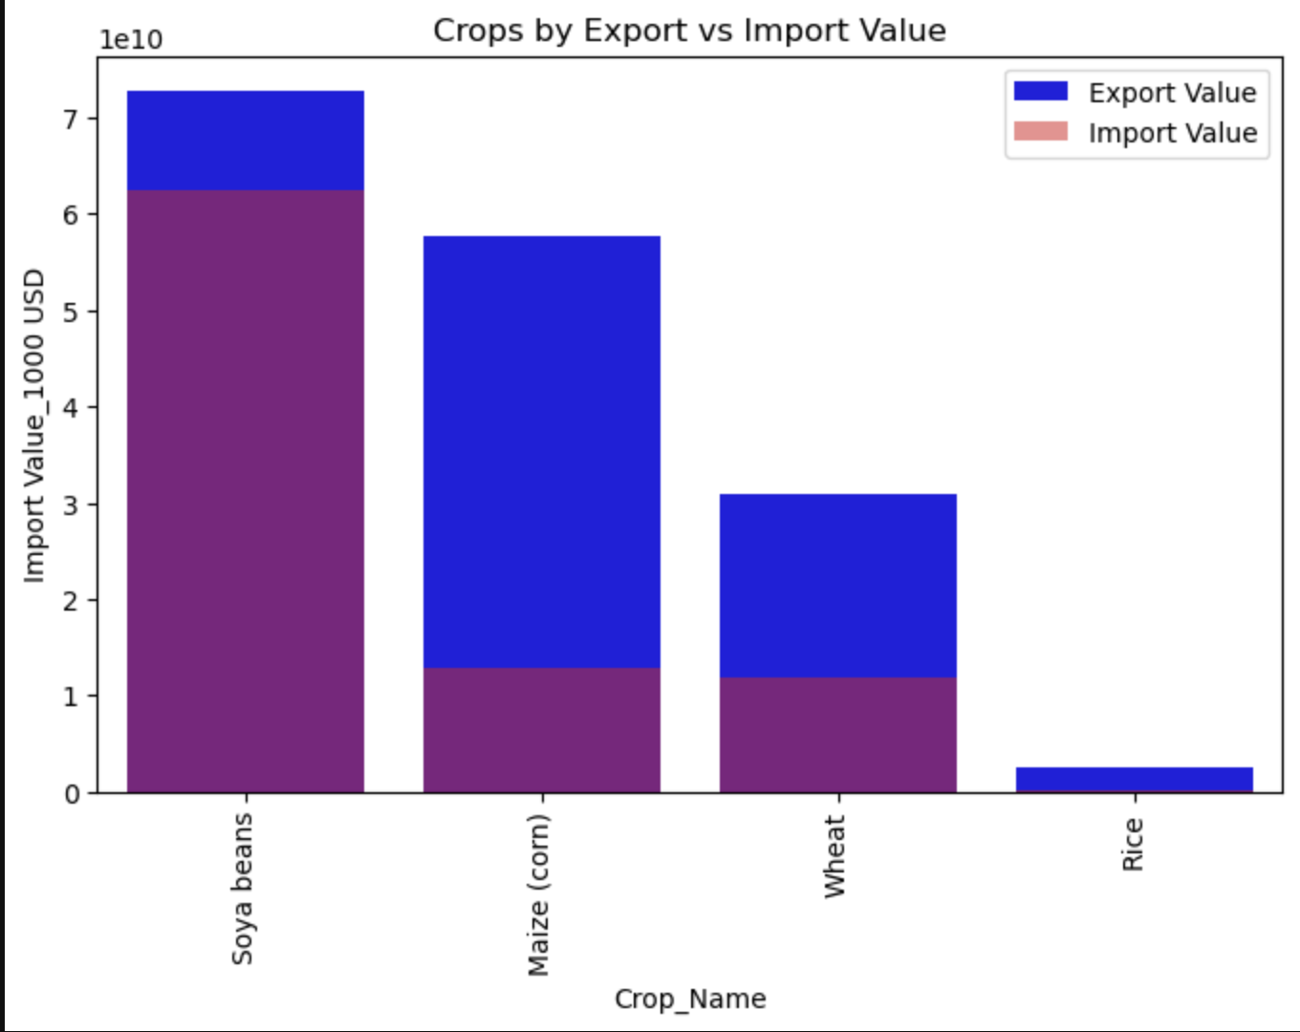
Exploratory Data Analysis(EDA)

Slide 15
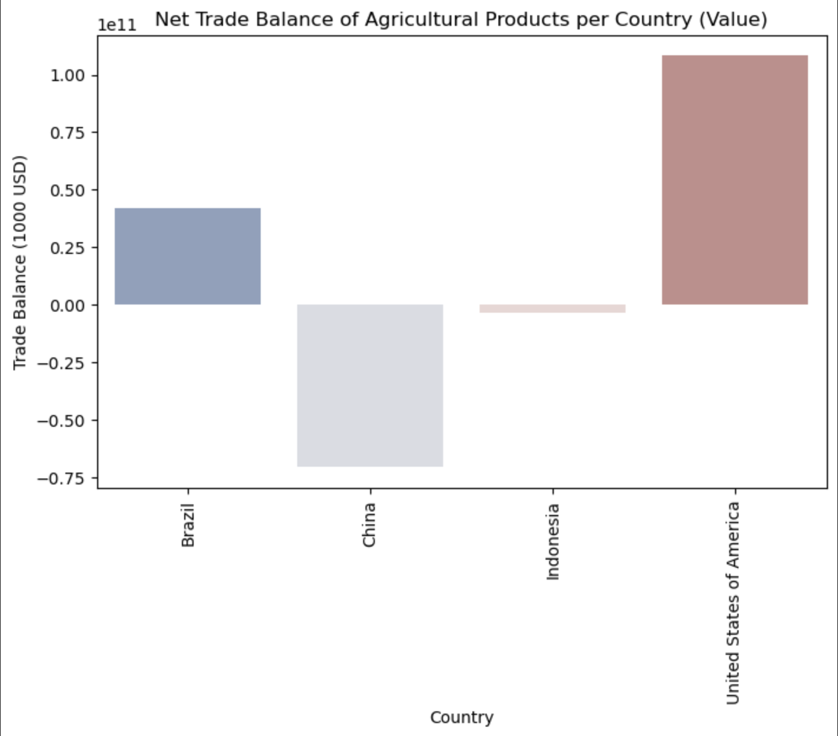
Exploratory Data Analysis(EDA)

Slide 16
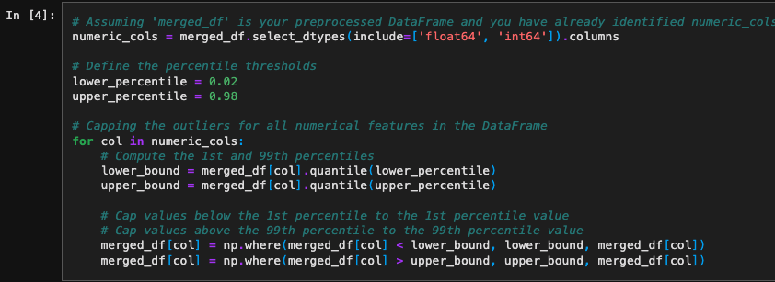
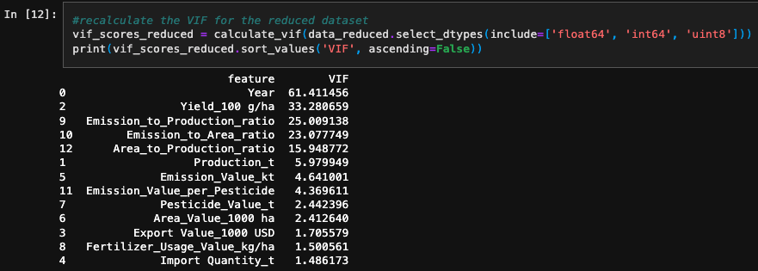
Splitting the Data

Slide 17
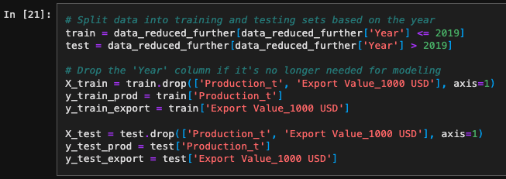
Splitting the Data

Slide 18
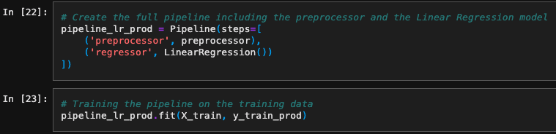
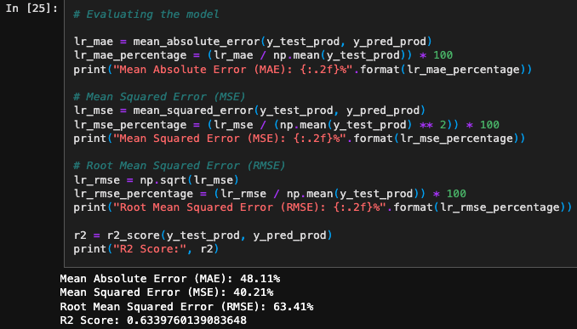
Linear Regression

Slide 19
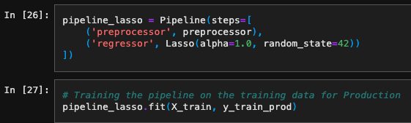
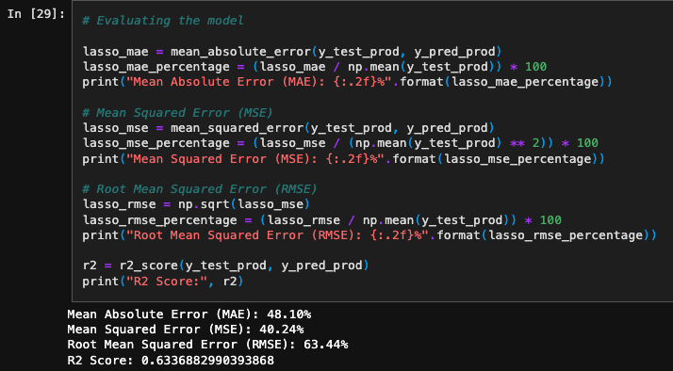
Lasso Regression

Slide 20
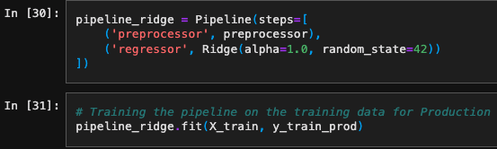
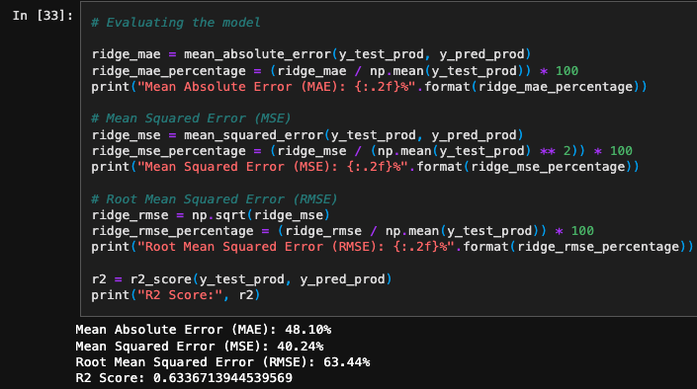
Ridge Regression

Slide 21
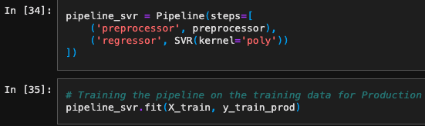
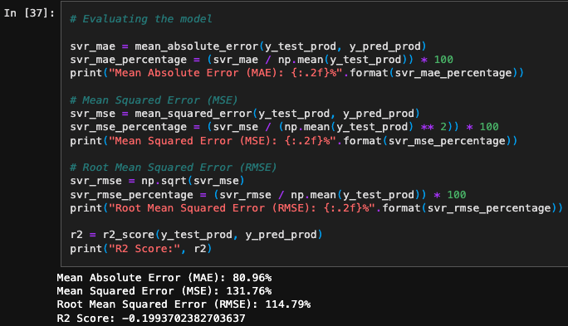
Support Vector Machine(SVM)

Slide 22
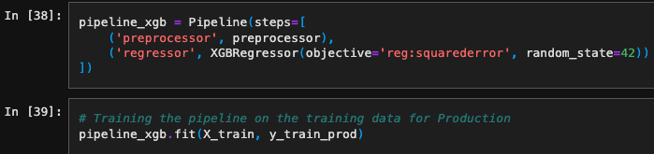
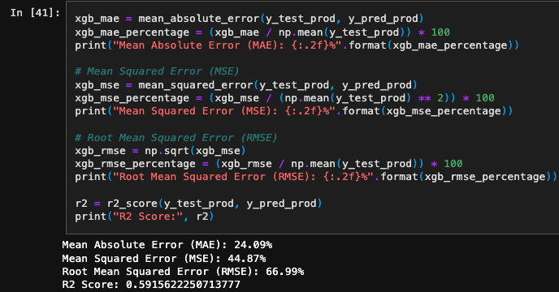
XGBoost

Slide 23
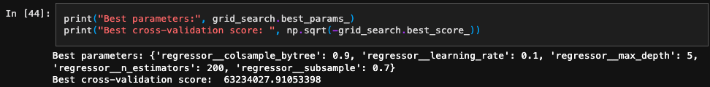
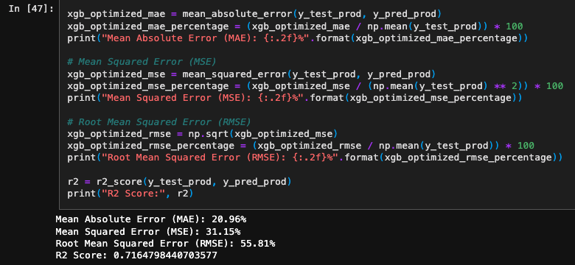
GridSearch - XGBoost

Slide 24
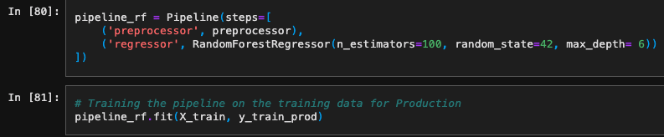
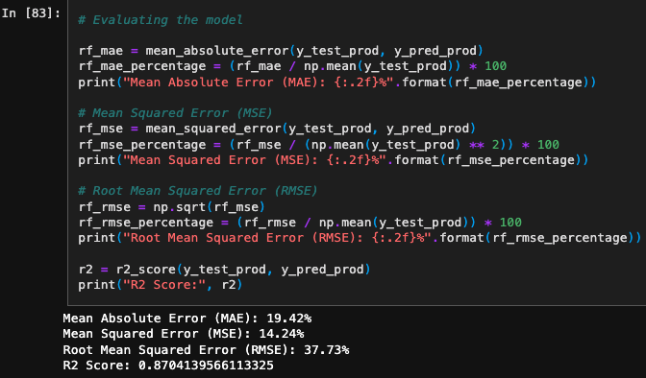
Random Forest

Slide 25

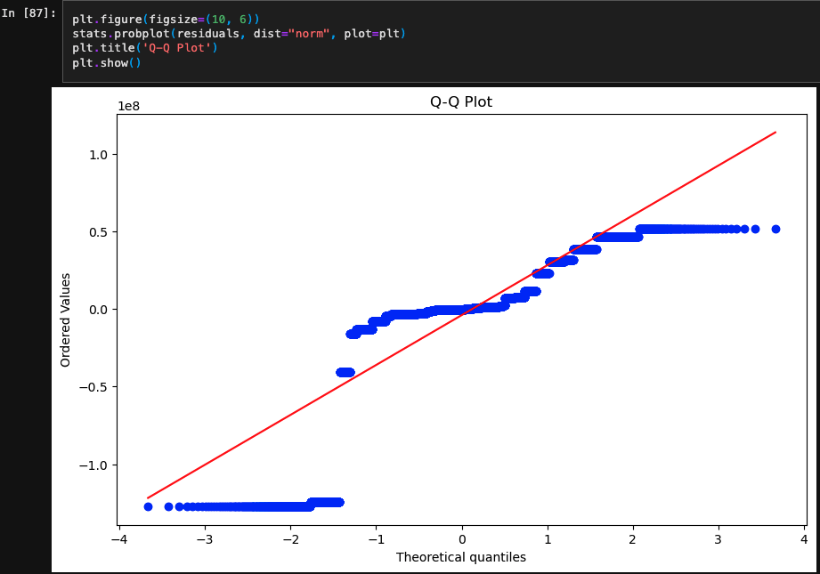
Residuals

Slide 26
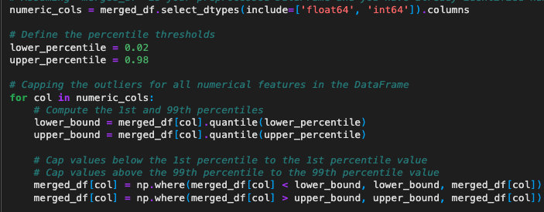
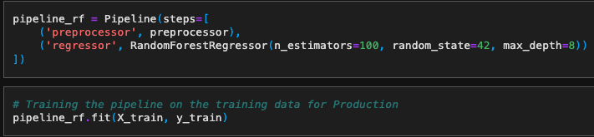
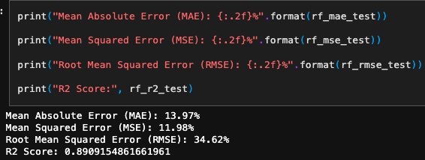
Model Optimization - Outlier Trimming

Slide 27
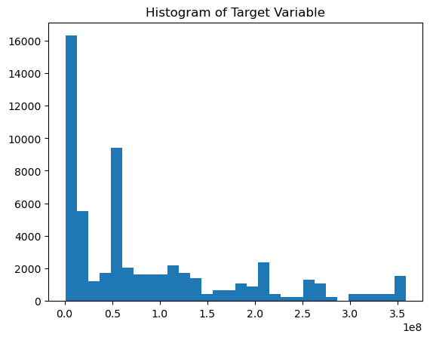
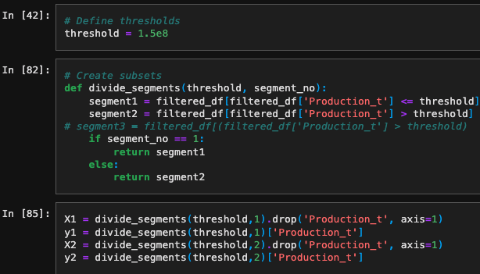
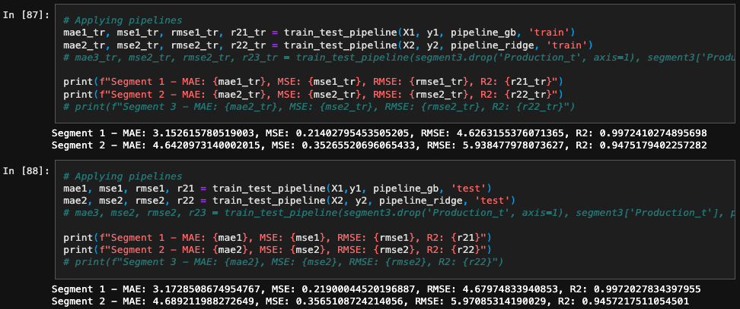
Model Optimization - Target based Segmentation

Slide 28
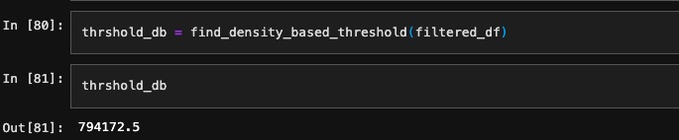
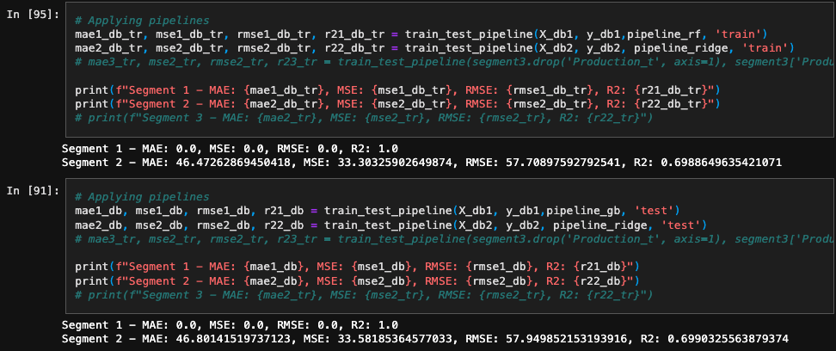
Finding Threshold - DBSCAN

Slide 29
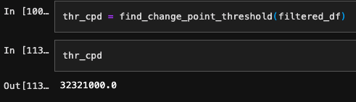
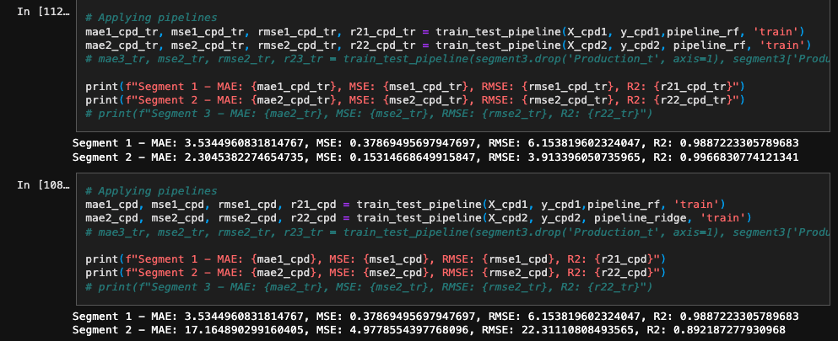
Finding Threshold -Change Point Detection

Slide 30
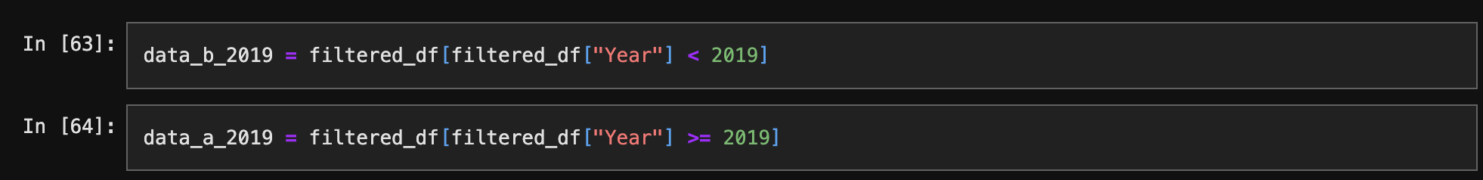
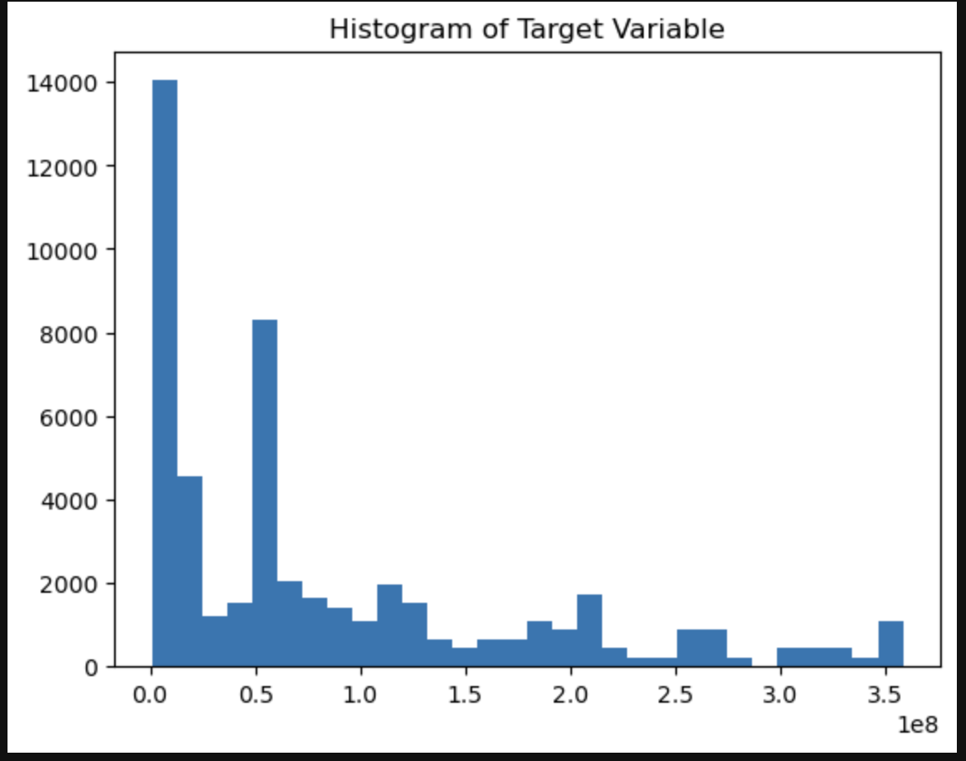
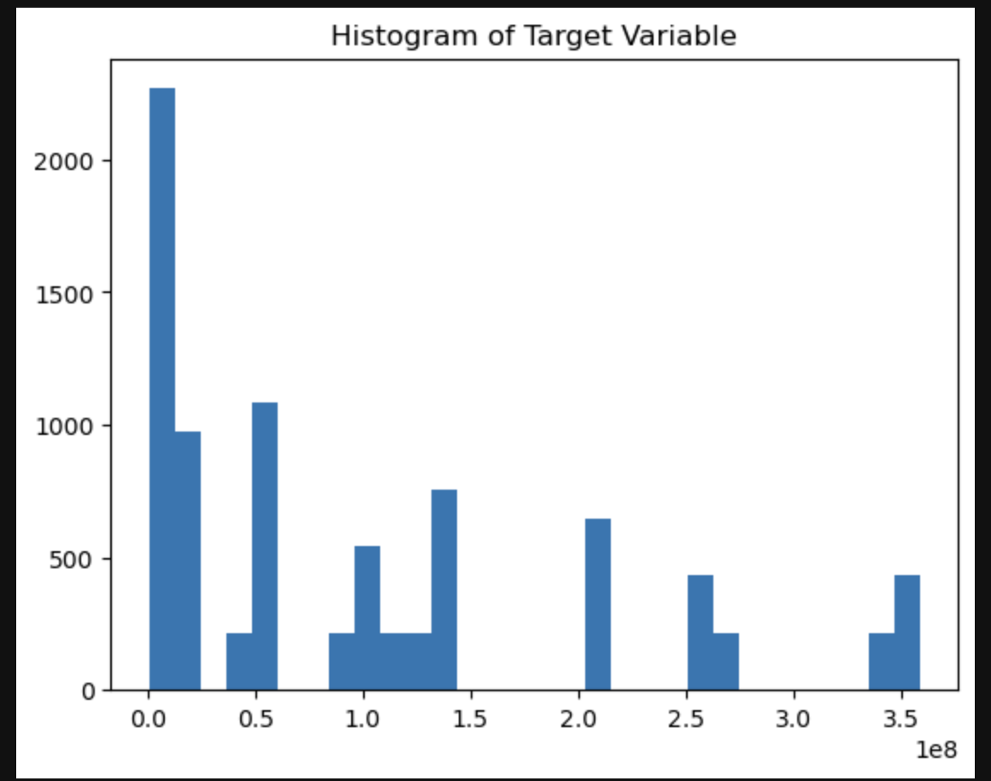
Segregation Train and Test Based on Years

Slide 31
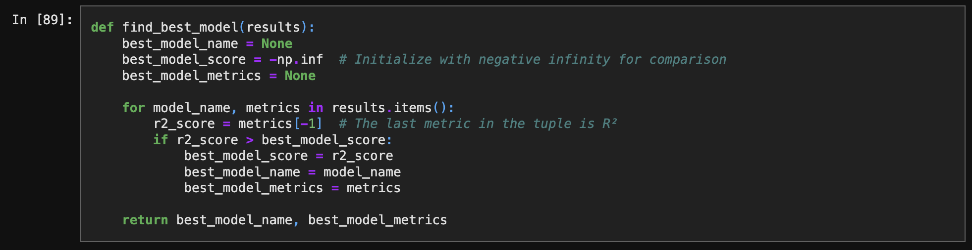
Finding the Best Model

Slide 32
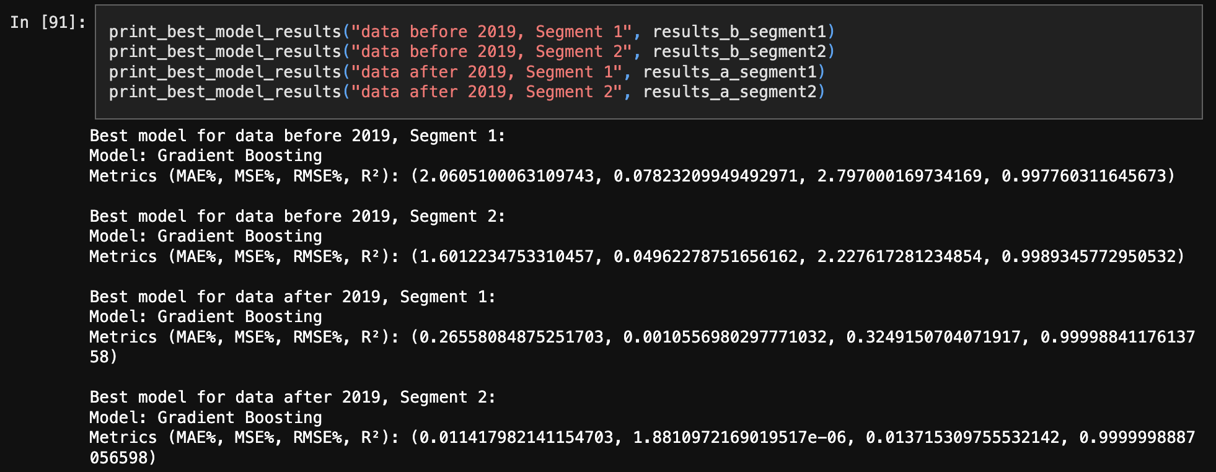
Final Results

Slide 33
Conclusion
The project successfully demonstrated the importance of data segmentation and model selection in improving prediction accuracy for agricultural production.
Ensemble methods, particularly Gradient Boosting and Random Forest, showed exceptional performance across different data segments, highlighting their suitability for this type of predictive modeling.
This approach provides a robust framework for developing predictive models in agricultural and other domains with high data variability.

Slide 34
References
1. Lobell, D. B., & Field, C. B. (2007). Global scale climate–crop yield relationships and the impacts of recent warming. Environmental Research Letters, 2(1), 014002. [DOI: 10.1088/1748-9326/2/1/014002]
2. Ray, D. K., West, P. C., Clark, M., Gerber, J. S., Prishchepov, A. V., & Chatterjee, S. (2019). Climate change has likely already affected global food production. PLoS One, 14(5), e0217148. [DOI: 10.1371/journal.pone.0217148]
3. Rosenzweig, C., Elliott, J., Deryng, D., Ruane, A. C., Müller, C., Arneth, A., ... & Jones, J. W. (2014). Assessing agricultural risks of climate change in the 21st century in a global gridded crop model intercomparison. Proceedings of the National Academy of Sciences, 111(9), 3268-3273. [DOI: 10.1073/pnas.1222463110]
4. Zhao, C., Liu, B., Piao, S., Wang, X., Lobell, D. B., Huang, Y., ... & Zeng, Z. (2017). Temperature increase reduces global yields of major crops in four independent estimates. Proceedings of the National Academy of Sciences, 114(35), 9326-9331. [DOI: 10.1073/pnas.1701762114]

Slide 35
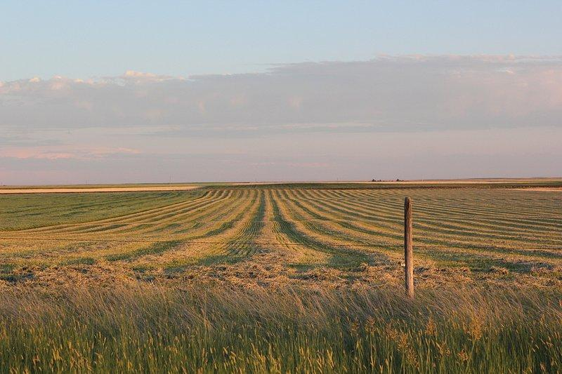
Thank You

