Slide 1
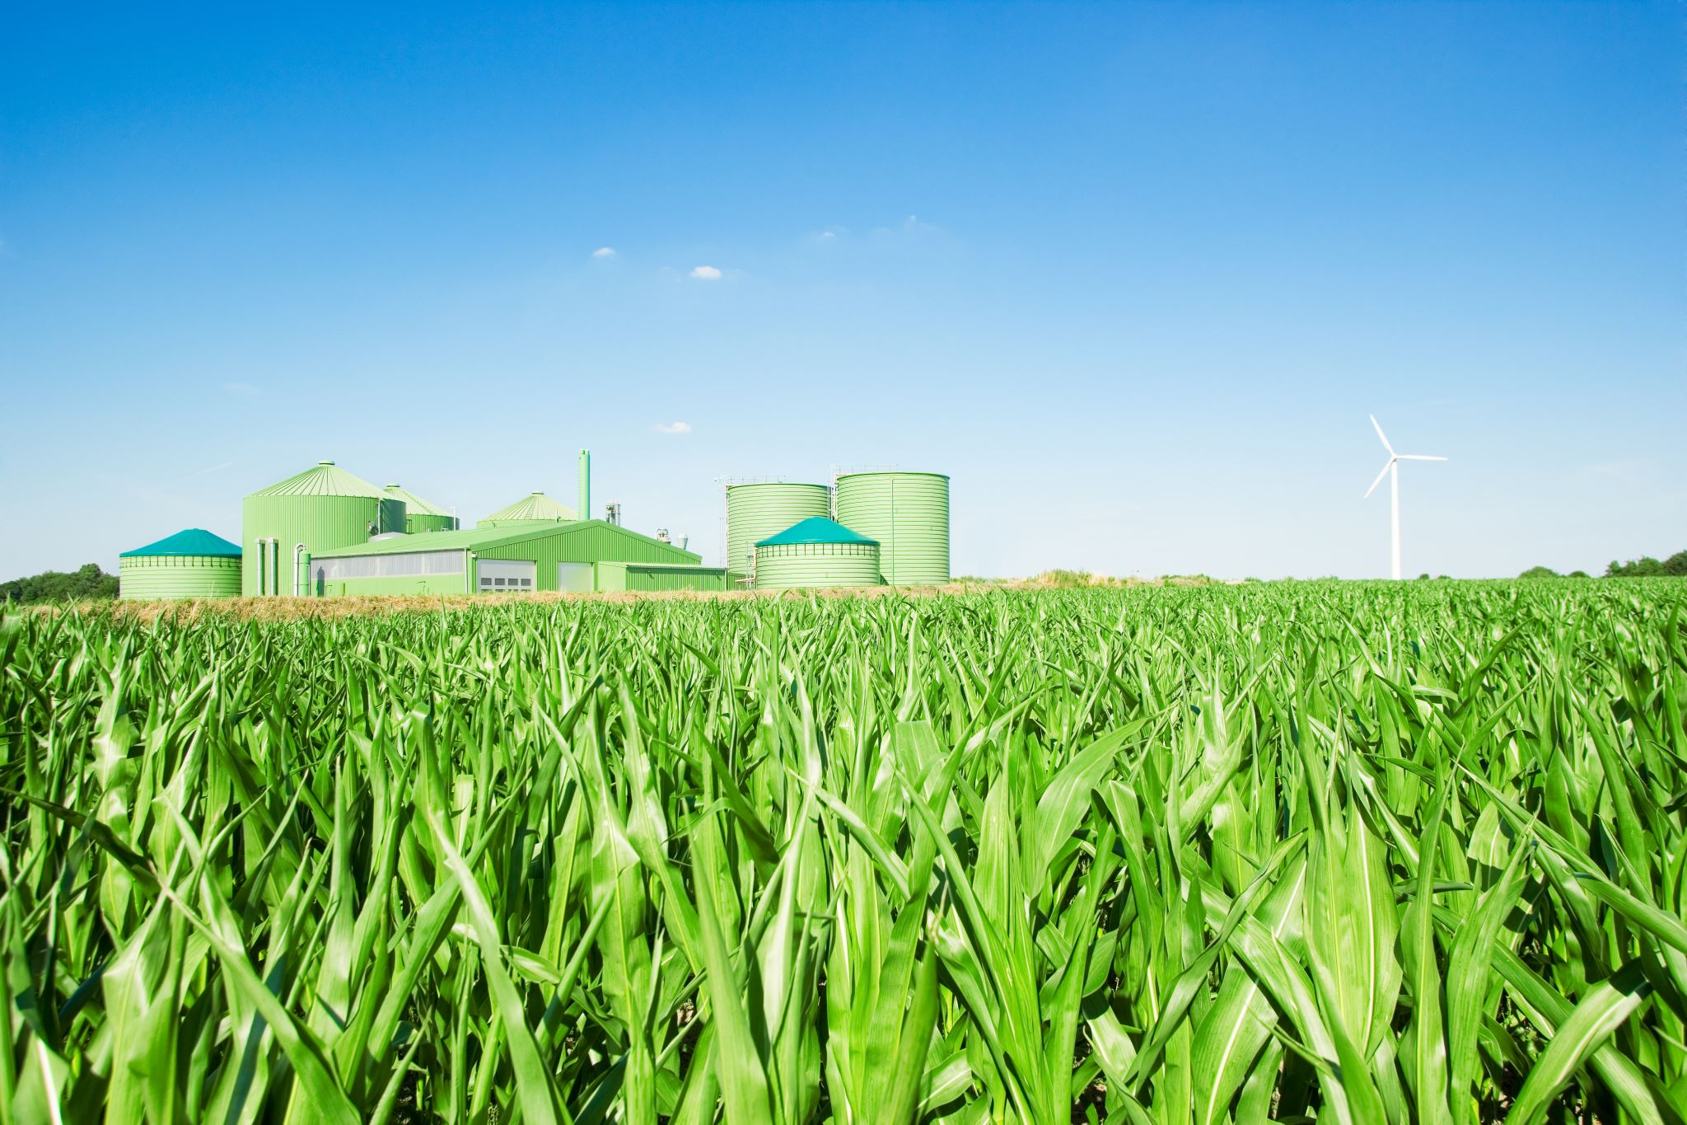
Factors Impacting Crop Yield Prediction
Team F
Neha Nooka
Chaturya Gajula
Harshali Narkhede

Slide 2
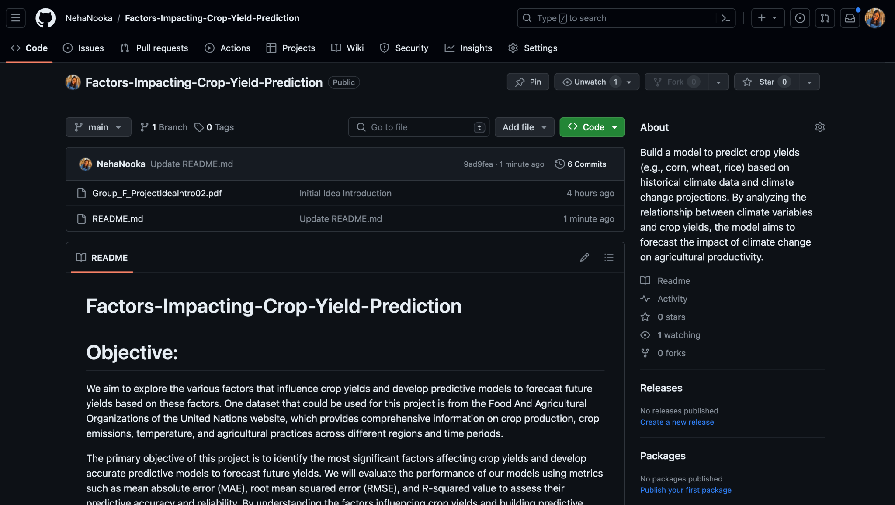
Github Page (Link)

Slide 3
Project Introduction
To explore the various factors that influence crop yields and develop predictive models to forecast future yields based on these factors. One dataset that we will be using for this project is the FAO website, which provides comprehensive information on crop production, crop emissions, temperature and agricultural practices across different regions and time periods.
The primary objective of this project is to identify the most significant factors affecting crop yields and develop accurate predictive models to forecast future yields. We will evaluate the performance of our models using metrics such as mean absolute error (MAE), root mean squared error (RMSE), and R-squared value to assess their predictive accuracy and reliability.

Slide 4
Introduction
This project is chosen due to its significant real-world implications and the potential to address critical agricultural challenges. Crop yield prediction plays a crucial role in optimizing agricultural practices, ensuring food security, and mitigating the impact of environmental factors such as climate change. By understanding the factors influencing crop yields and developing accurate predictive models, farmers, policymakers, and other stakeholders can make informed decisions to enhance agricultural productivity and sustainability.
The research question/hypothesis of this project revolves around identifying the key factors that impact crop yields and assessing their predictive power. Specifically, the project aims to investigate:
1. What are the primary factors influencing crop yields, including weather conditions, soil characteristics, agricultural practices?
2. Can we develop predictive models that accurately forecast crop yields based on these factors?
3. How do different machine learning algorithms perform in predicting crop yields, and which algorithm yields the most accurate results?
4. What insights can be gained from the predictive models to optimize agricultural practices and improve crop yield outcomes?

Slide 5
Datasets (Link)
We are planning on using six datasets given below, which includes only rice crop(for now), for top 5 rice producing countries in the world namely, India, Indonesia, Vietnam, Bangladesh, China.
The time span is from 1961-2015.
All the datasets are collected from FAO website.
After merging all the tables, we have 5,89,248 Rows and 80 Columns before preprocessing and EDA.
Tables:
Crop Production
Cropland Nutrient Balance
Temperature change on land
Land Use
Emissions totals
Value of Agricultural Production

Slide 6
Dataset Attributes
These are the main features from each datasets which we are most likely to use in the final dataset.
Crop Production
Area Harvested, Yield and Production Quantity
Cropland Nutrient Balance
Cropland Nitrogen, Phosphorus and Potassium
Temperature change on Land
Temperature Change and Standard Deviation
Land Use
Area
Emissions totals
CH4, N20, C02 Direct and Indirect Emissions
Value of Agricultural Production
Gross Production Value (Current thousand US $)

Slide 7
Literature Review
Crop Yield Analysis:
Studied 8,000+ global crop yield time series.
50% showed slowed growth due to maximum yields and sustainable policies.
25% saw increased variability from climate change.
Agricultural Emissions:
Annual emissions rose 1.1%, reaching 4.6 gigatons CO2 in 2010.
Agriculture's share dropped from 17.2% to 13.7% from 2000 to 2010.
Call for Updates:
Studies urge updates every 5 years for emissions reporting.
Crucial for policy decisions, especially in developing countries.
Agriculture contributes 10-15% of total emissions.

Slide 8
Proposed Work
Utilize advanced data fusion techniques such as ensemble learning and deep learning architectures to harness the synergies between disparate datasets, enabling a comprehensive understanding of agricultural dynamics.
Aiming to understand the interconnectedness of factors like crop production, land use, and emissions.
Use techniques such as linear regression, time series analysis, SVM, LSTM, and PCA to forecast future crop yield, emissions, and production levels
Explore advanced optimization algorithms such as genetic algorithms and Bayesian optimization to fine-tune model parameters and enhance the accuracy of predictive analytics in the agricultural domain.
While past research predominantly relied on historical analysis, we prioritize predictive analytics.

Slide 9
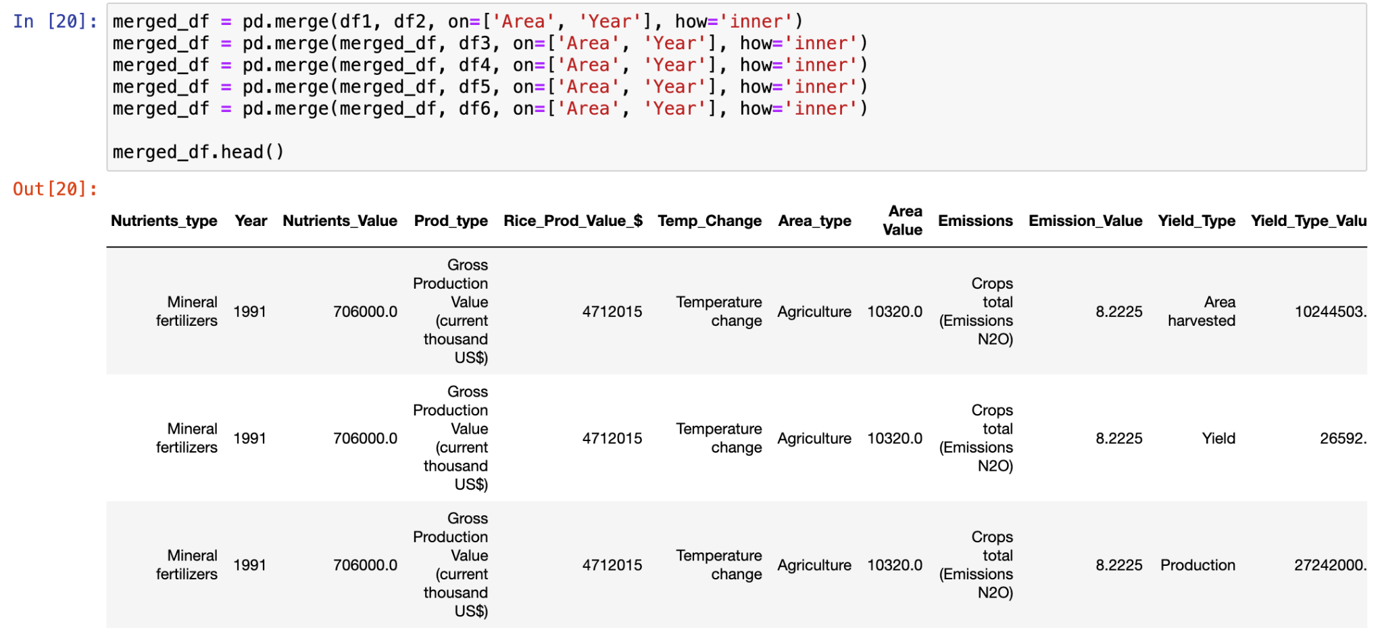
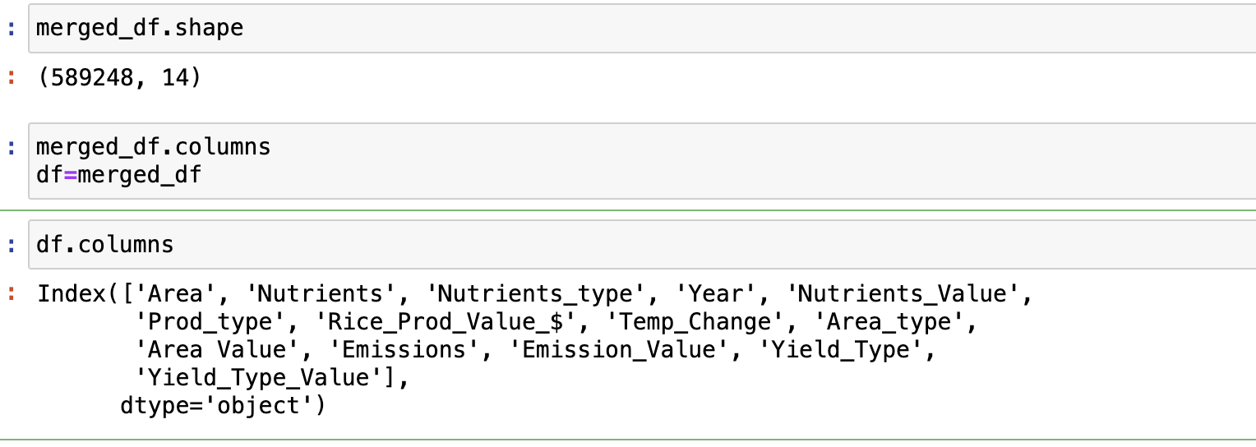
Exploratory Data Analysis

Slide 10
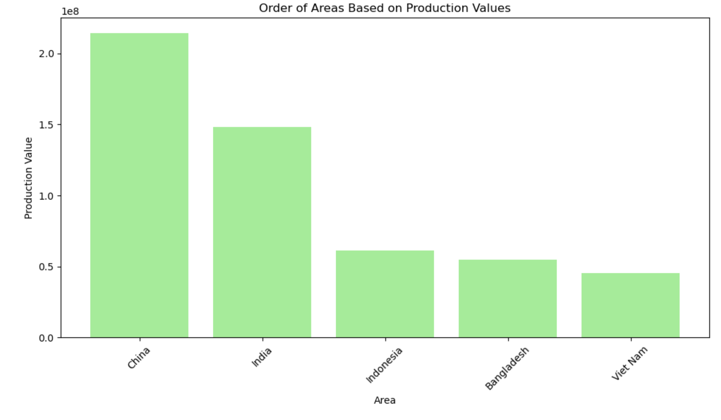
Visualizations
Figure: Order of Countries based on Rice Production Values

Slide 11
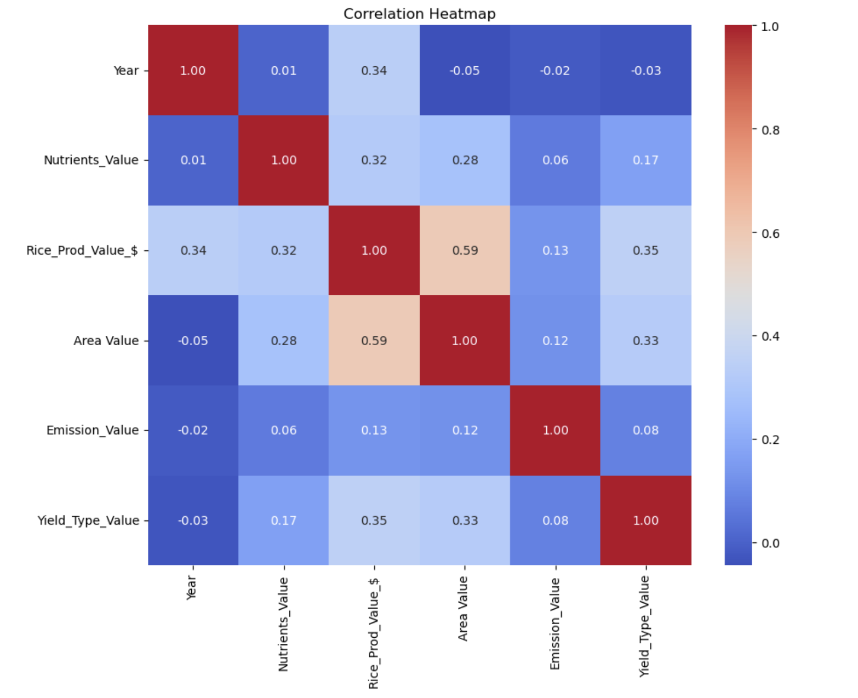
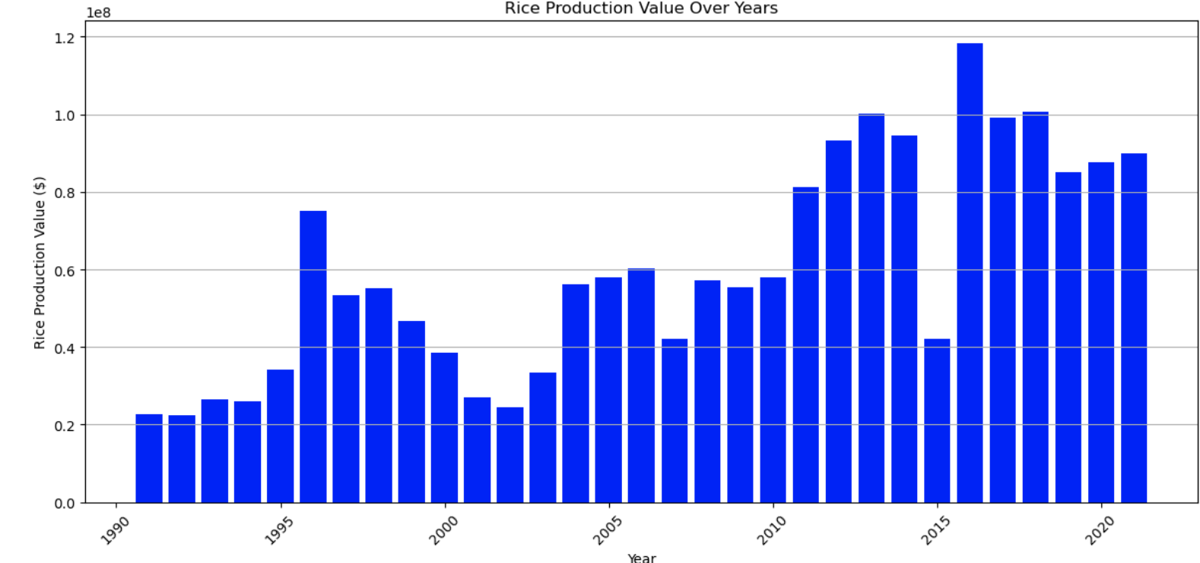
Visualizations
Figure: Total Rice Production over the years
Figure: Heatmap showing Correlation b/w columns

Slide 12
References
1. Lobell, D. B., & Field, C. B. (2007). Global scale climate–crop yield relationships and the impacts of recent warming. Environmental Research Letters, 2(1), 014002. [DOI: 10.1088/1748-9326/2/1/014002]
2. Ray, D. K., West, P. C., Clark, M., Gerber, J. S., Prishchepov, A. V., & Chatterjee, S. (2019). Climate change has likely already affected global food production. PLoS One, 14(5), e0217148. [DOI: 10.1371/journal.pone.0217148]
3. Rosenzweig, C., Elliott, J., Deryng, D., Ruane, A. C., Müller, C., Arneth, A., ... & Jones, J. W. (2014). Assessing agricultural risks of climate change in the 21st century in a global gridded crop model intercomparison. Proceedings of the National Academy of Sciences, 111(9), 3268-3273. [DOI: 10.1073/pnas.1222463110]
4. Zhao, C., Liu, B., Piao, S., Wang, X., Lobell, D. B., Huang, Y., ... & Zeng, Z. (2017). Temperature increase reduces global yields of major crops in four independent estimates. Proceedings of the National Academy of Sciences, 114(35), 9326-9331. [DOI: 10.1073/pnas.1701762114]
5. Ruiz-Ramos, M., Ferrise, R., Rodríguez, A., Lorite, I. J., Bindi, M., & Carter, T. R. (2019). Adaptation responses of European maize and wheat yields to climate change in different scenarios. European Journal of Agronomy, 105, 25-37. [DOI: 10.1016/j.eja.2019.02.001]
6. Minoli, S., & Nendel, C. (2019). Climate change impact and adaptation strategies in crop production systems. In Climate Change and Agricultural Ecosystems (pp. 53-78). Academic Press. [DOI: 10.1016/B978-0-12-816524-3.00003-4]

Slide 13
Thank You
Questions?

