Slide 1
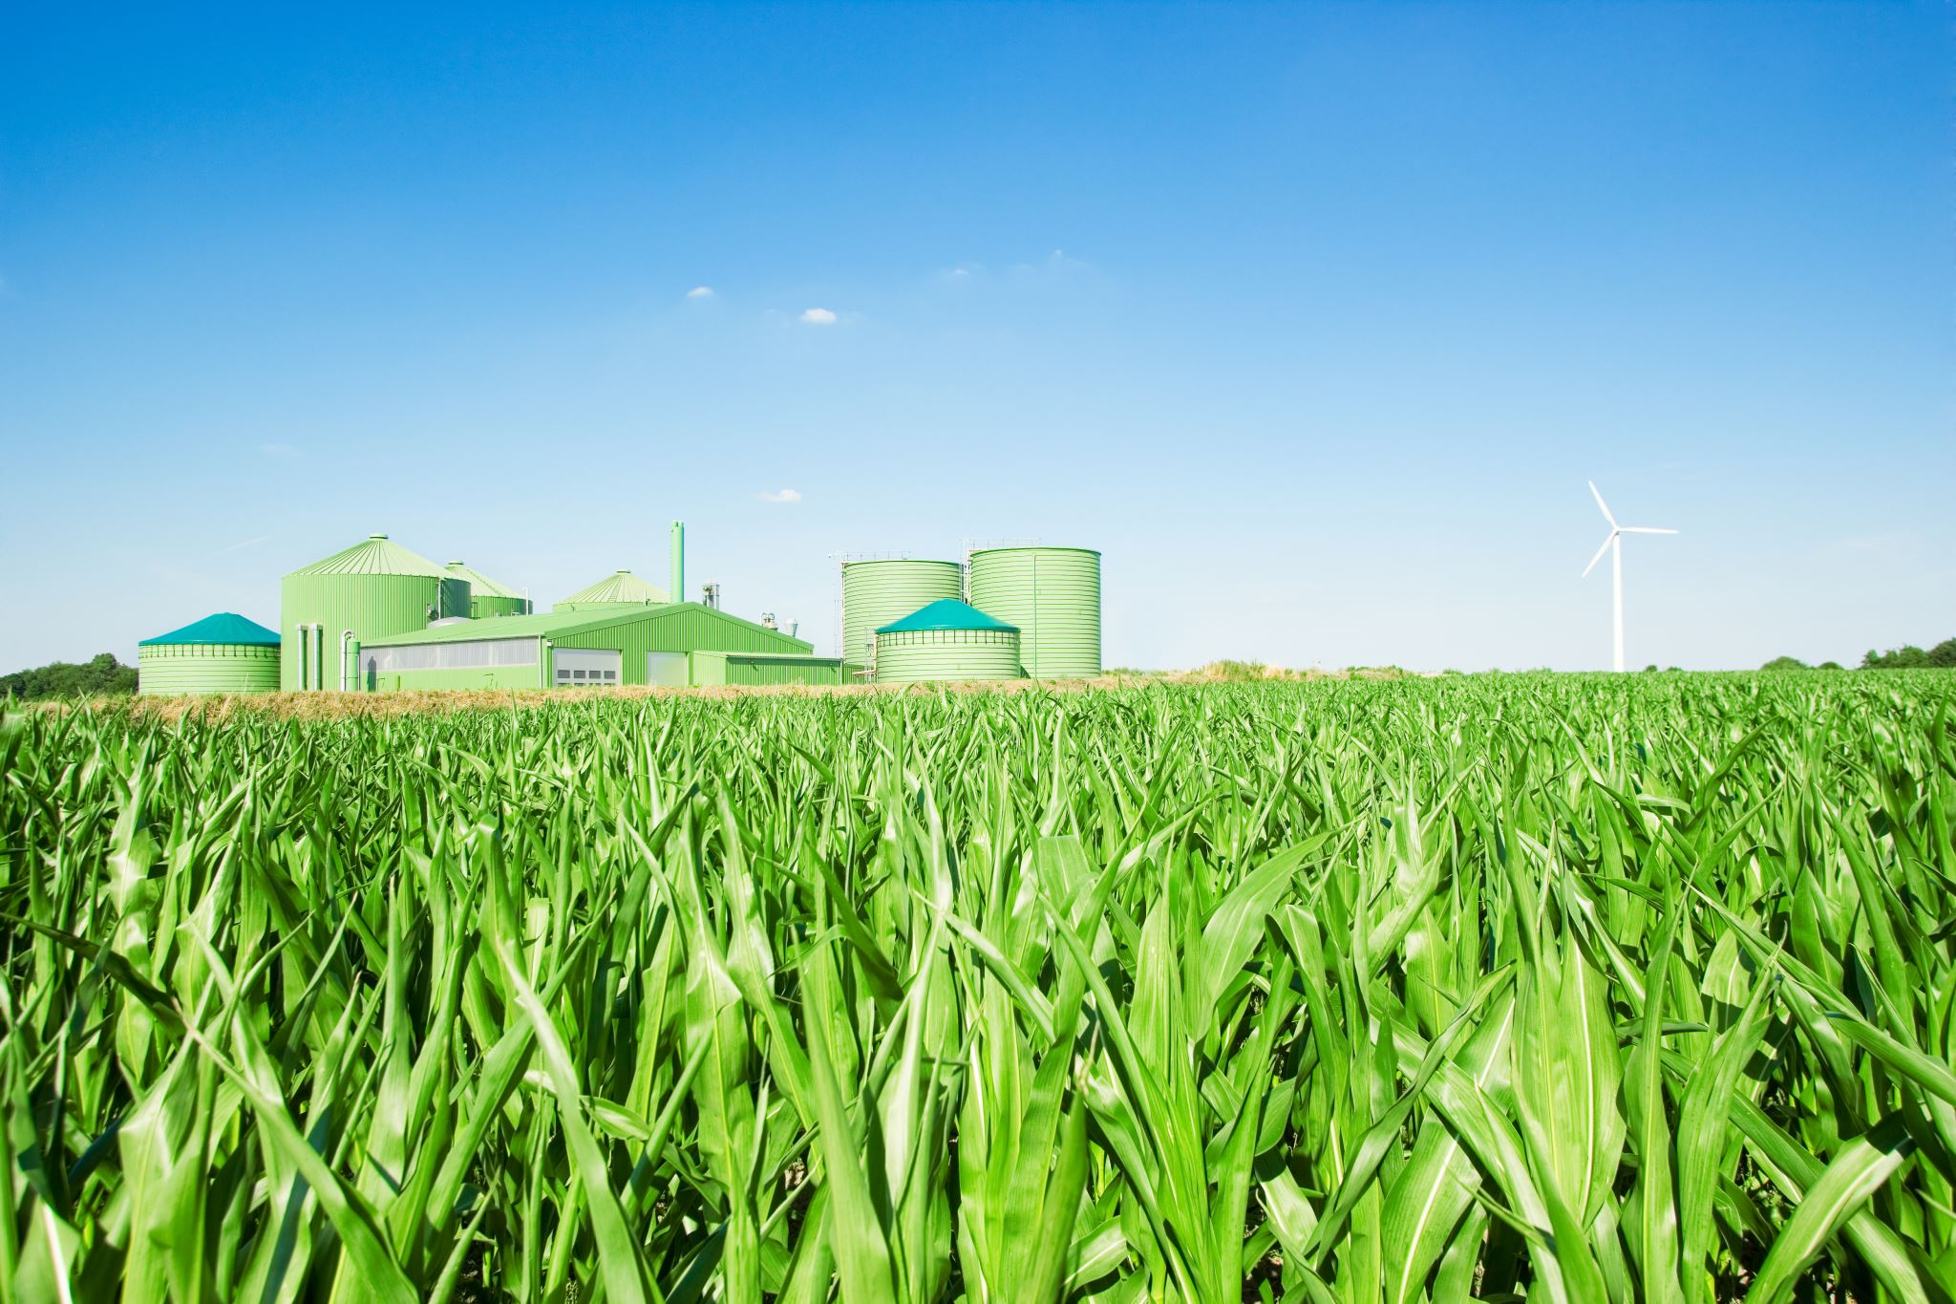
Factors Impacting Crop Yield Prediction
Team F
Neha Nooka
Chaturya Gajula
Harshali Narkhede

Slide 2
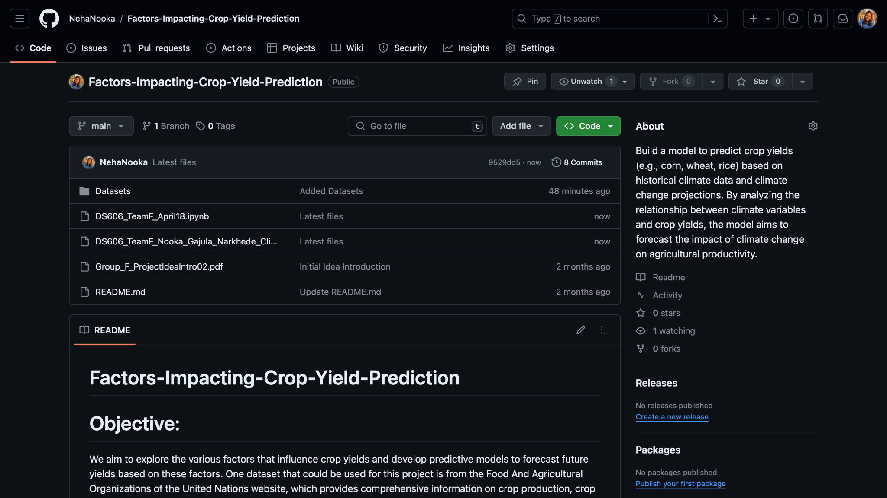
Github Page (Link)

Slide 3
Project Introduction
The primary objective of this project is to identify the most significant factors affecting crop yields and develop accurate predictive models to forecast future yields. We will also focus on Trade Analysis predicting trade volumes based on factors like crop production, trade type, and geographical area. We will evaluate the performance of our models using metrics such as root mean squared error (RMSE), and mean squared value to assess their predictive accuracy and reliability.
To explore the various factors that influence crop yields and develop predictive models to forecast future yields based on these factors. One dataset that we will be using for this project is the FAO website, which provides comprehensive information on crop production, crop emissions, temperature and agricultural practices across different regions and time periods.

Slide 4
Datasets (Link)
For this project, we have selected the top 4 Agricultural Countries in the world which are China, United States, Brazil and Indonesia. India is also a top agricultural country but we’ve decided not to include India as it has missing data for some years.
So, for the above mentioned countries, the major crop produced in all those countries are:
Rice
Wheat
Maize(Corn)
Soya Beans
The time span for all the tables are from 2000-2021.
All the datasets are collected from FAO website.
Tables:
Crop Production
Pesticides Use
Crop Trade
Land Use
Emission from Crops
Value of Agricultural Production

Slide 5
Dataset Descriptions
Crop Production : Data are expressed in terms of area harvested, production quantity and yield.
Pesticides Use : The Pesticides Use database includes data on the use of major pesticide groups (Insecticides, Herbicides, Fungicides, Plant growth regulators and Rodenticides) and of relevant chemical families. Data report the quantities (in tonnes of active ingredients)
Crop Trade : The trade database includes the following variables: export quantity, export value, import quantity, and import value. The trade database includes all food and agricultural products imported/exported annually by all the countries in the world.
Land Use : The FAOSTAT Land Use domain contains data on categories of land use, irrigation and agricultural practices and indicators relevant to monitor agriculture activities at national, regional and global level.
Emission from Crops : The FAOSTAT domain Emissions from Crops provides estimates of emissions associated with crop processes like Crop residues to soils. Estimates are computed at Tier 1 following the 2006 IPCC Guidelines for National greenhouse gas (GHG) Inventories (IPCC, 2006).
Value of Agricultural Production : Values of agricultural production are calculated based on production data of primary commodities from Production domain and producer prices from Prices domain.

Slide 6
Dataset Descriptions
After merging all the 6 tables, we have total of 39,384 rows and 21 columns.
The main features from each tables are:
Crop Production
Area Harvested, Yield and Production Quantity
Pesticides Use
Pesticides, Insecticides, Fungicides and Bactericides
Crop Trade
Import Quantity, Import Value, Export Quantity, Export Value
Land Use
Land Area, Cropland
Emission from Crops
Emissions N20, Emissions CH4
Value of Agricultural Production
Gross Production Value (Current thousand US $)

Slide 7
Previous Projects on the Topic
Crop Yield Prediction and Analysis
US Corn Production: Delve into the world of corn production in the United States, a cornerstone dataset for predicting crop yields.
Soil Health and Quality
Soil Health: Soil Testing Database: Explore a rich database of soil testing results, ideal for soil health analysis and improvement projects.
Precision Agriculture and IoT
Greenhouse Gas Emissions: Contribute to sustainable agriculture by exploring datasets related to greenhouse gas emissions, a crucial aspect of modern farming practices.
Agricultural Economics:
FAO Crop Statistics: Explore datasets related to world food and feed production to understand global agricultural economics better.

Slide 8
Literature Review
Crop Yield Analysis:
Studied 8,000+ global crop yield time series.
50% showed slowed growth due to maximum yields and sustainable policies.
25% saw increased variability from climate change.
Agricultural Emissions:
Annual emissions rose 1.1%, reaching 4.6 gigatons CO2 in 2010.
Agriculture's share dropped from 17.2% to 13.7% from 2000 to 2010.
Call for Updates:
Studies urge updates every 5 years for emissions reporting.
Crucial for policy decisions, especially in developing countries.
Agriculture contributes 10-15% of total emissions.

Slide 9
Data Cleaning
Checked for Null Values and Outliers.
Dropped Irrelevant Columns.
Renamed Columns Appropriately.

Slide 10
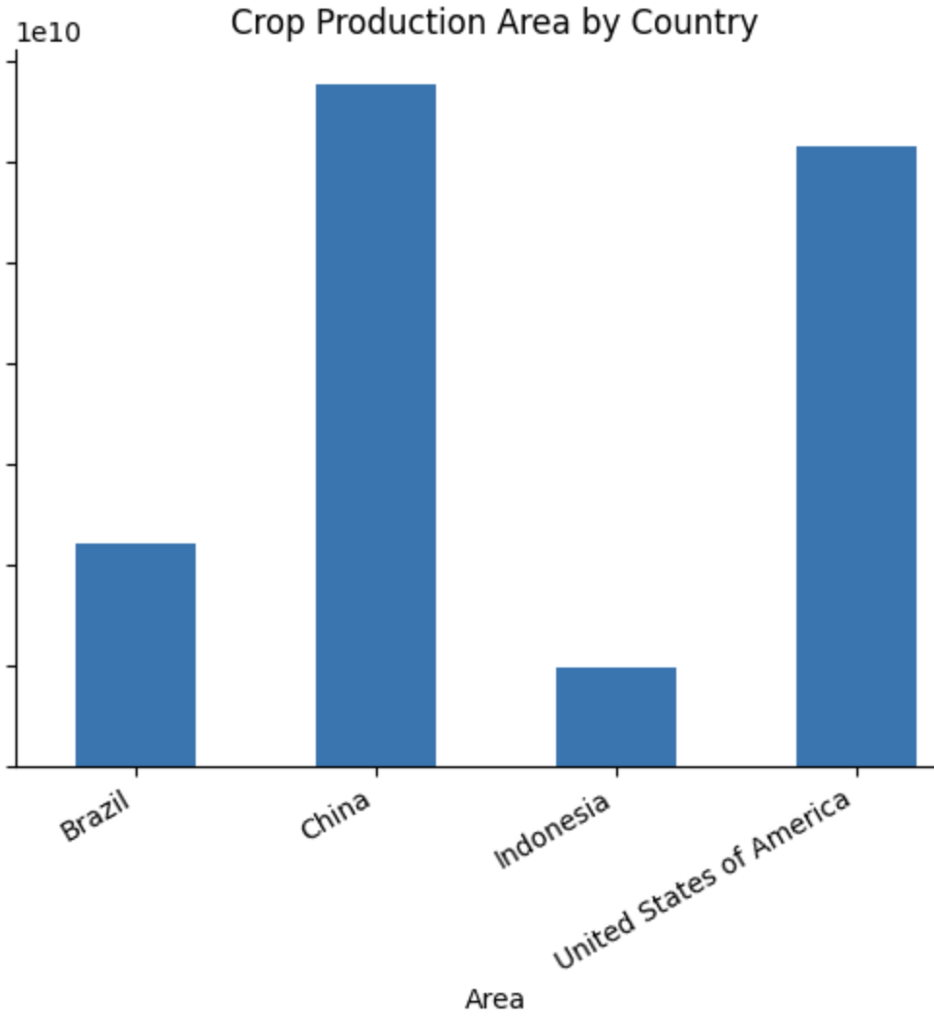
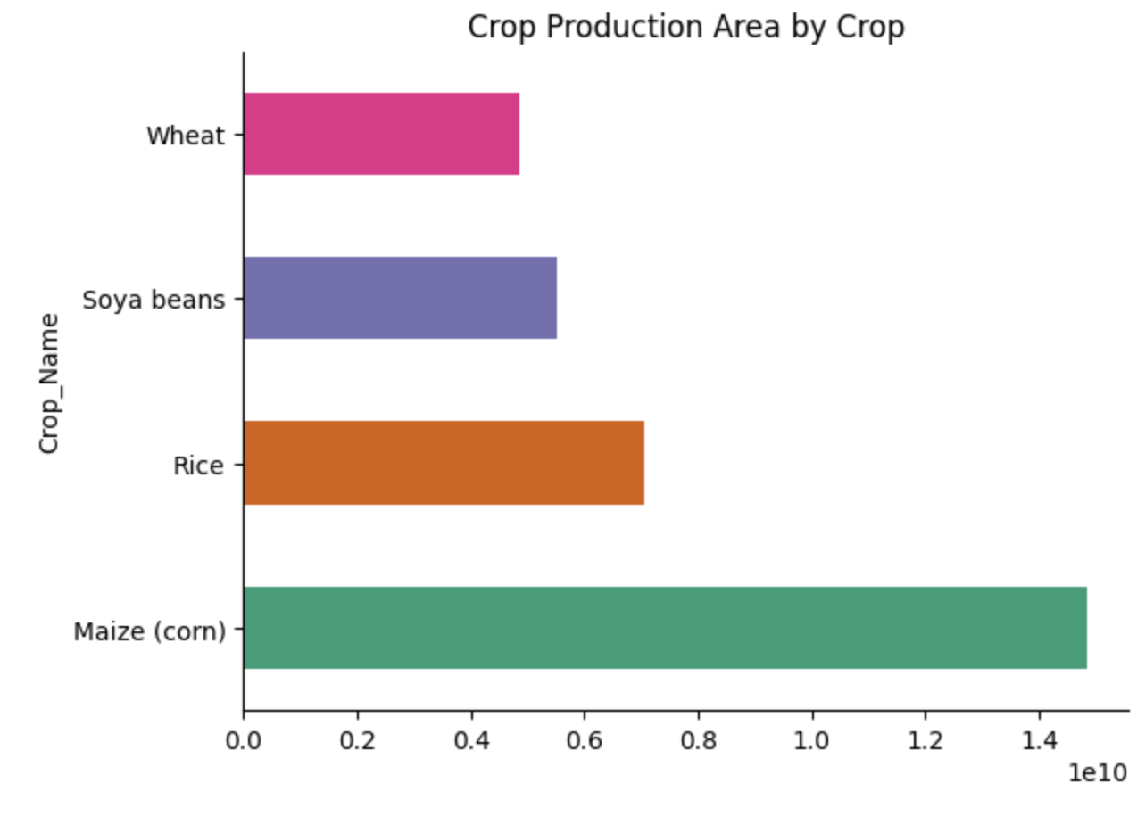
Exploratory Data Analysis(EDA)

Slide 11
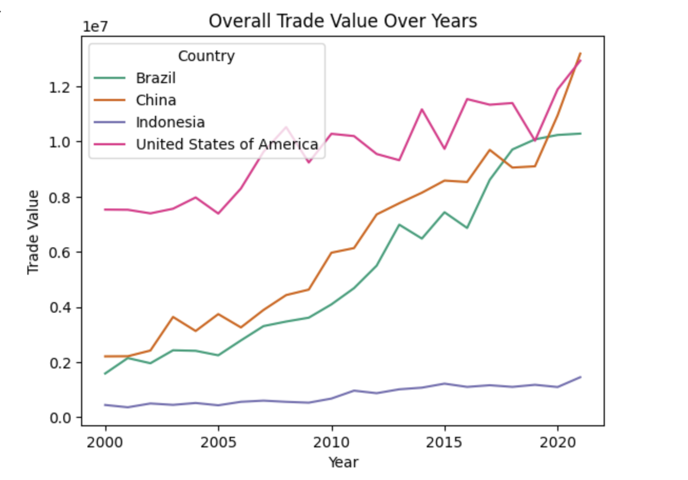
Exploratory Data Analysis(EDA)

Slide 12
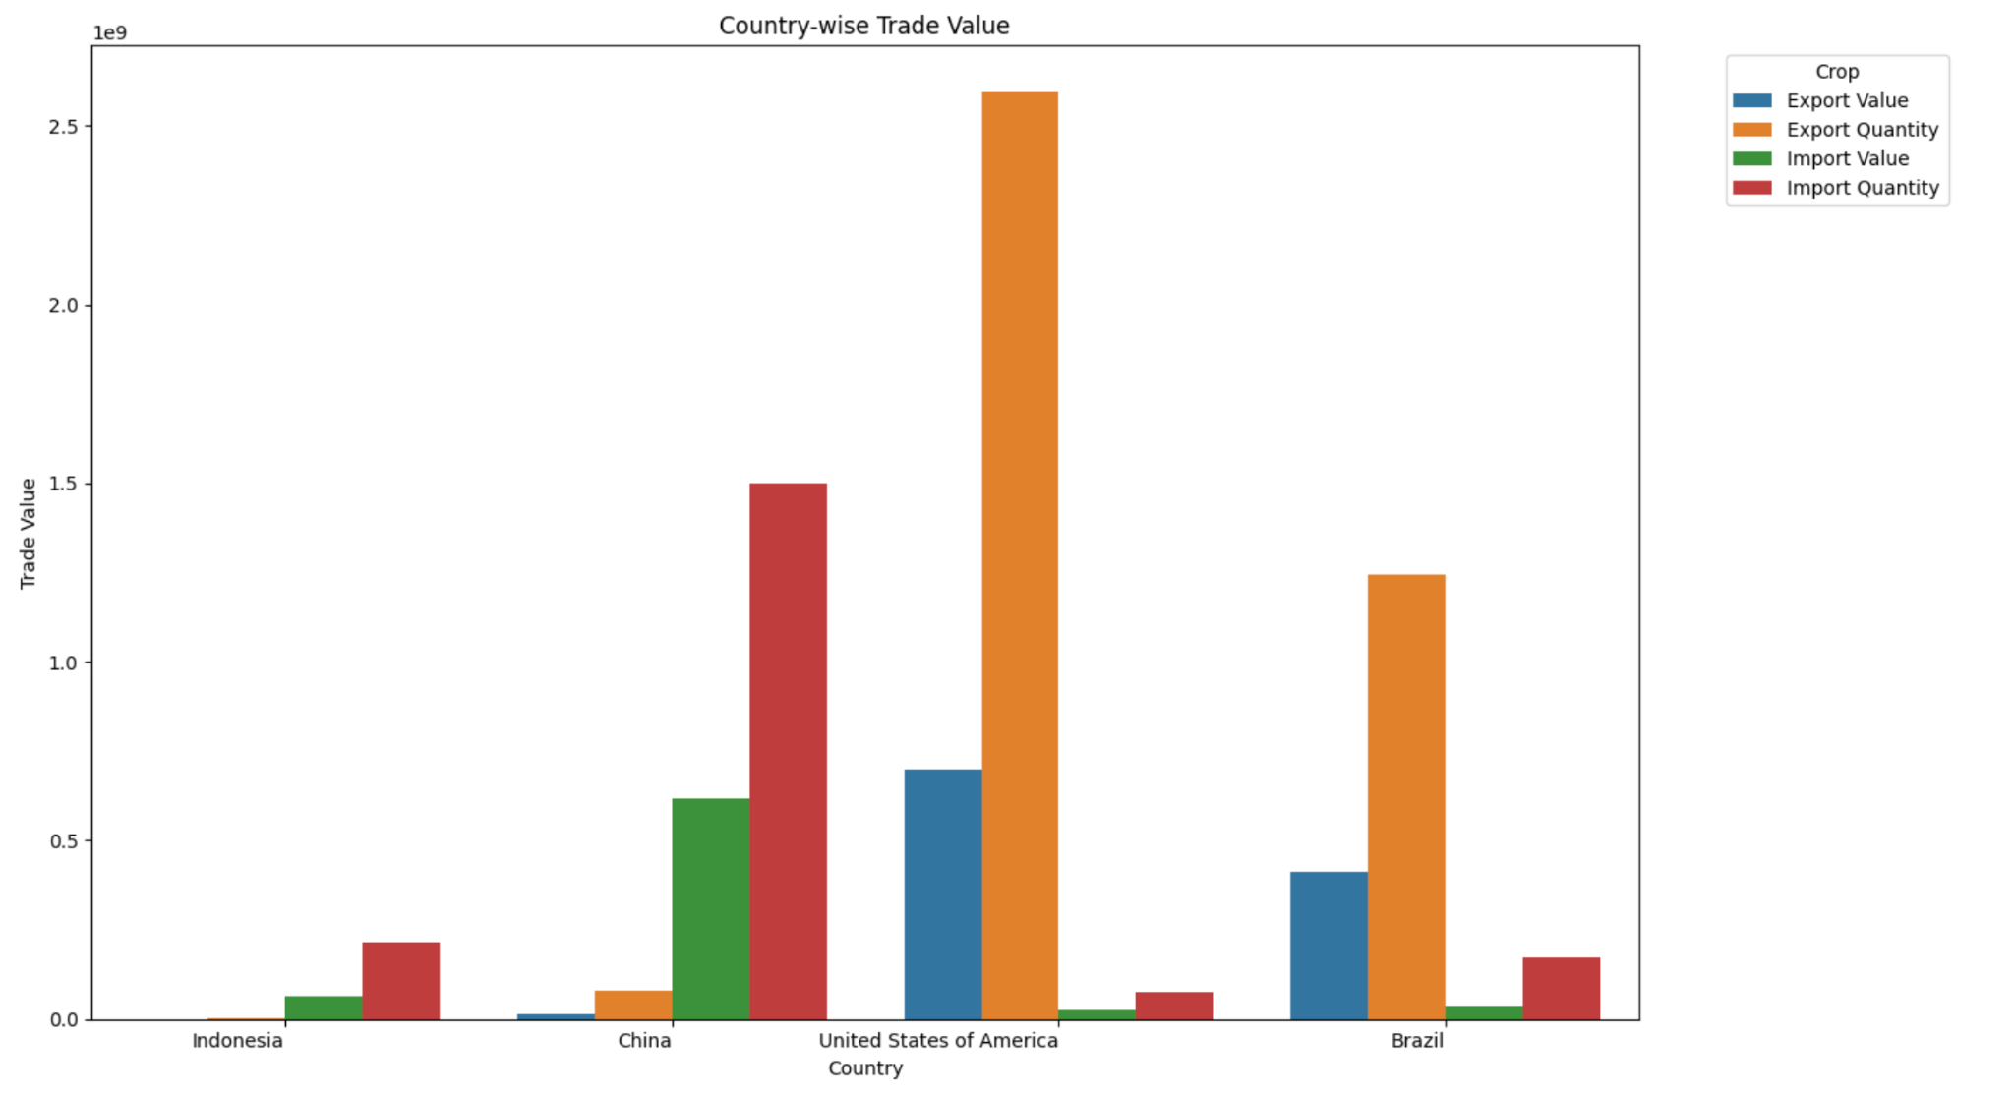
Exploratory Data Analysis(EDA)

Slide 13
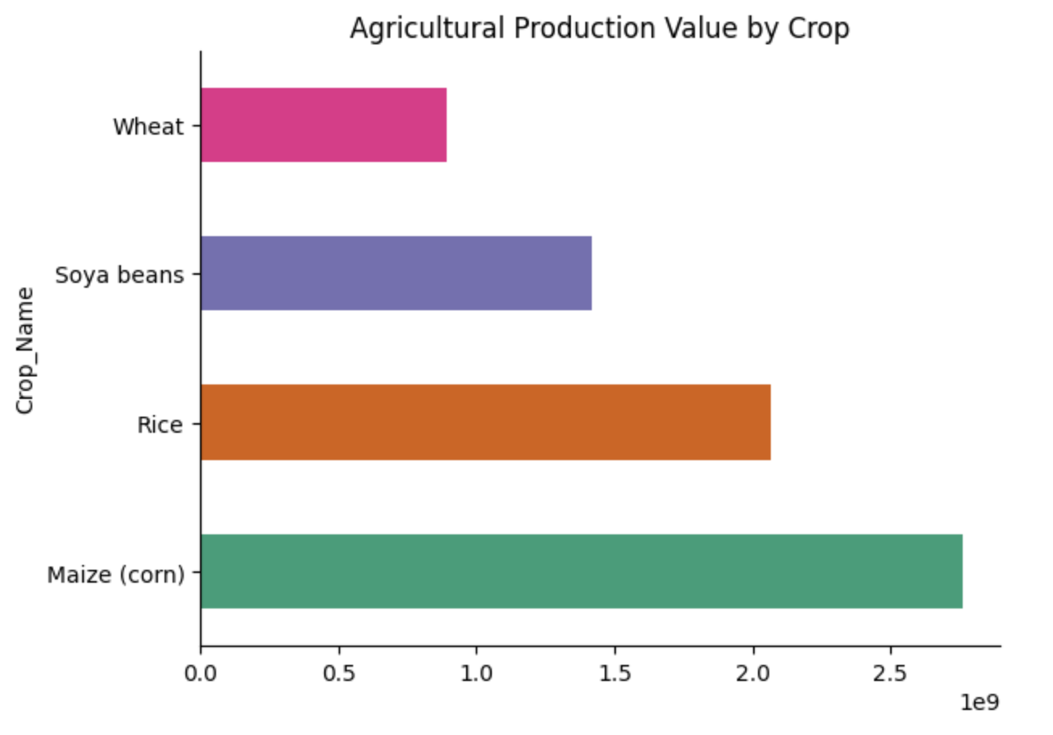
Exploratory Data Analysis(EDA)

Slide 14
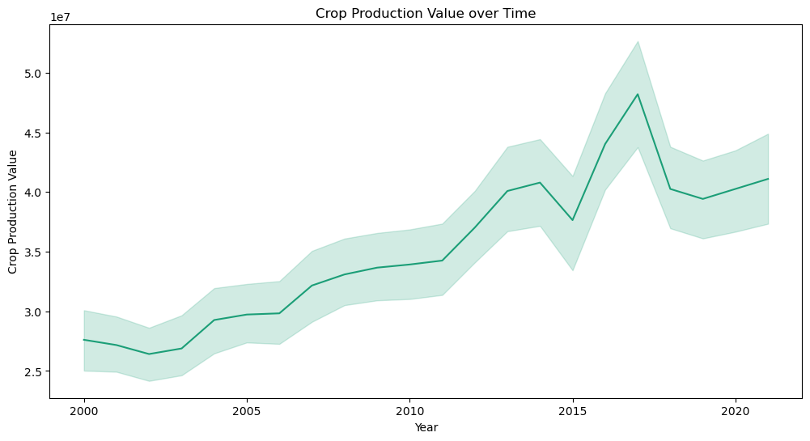
Exploratory Data Analysis(EDA)

Slide 15
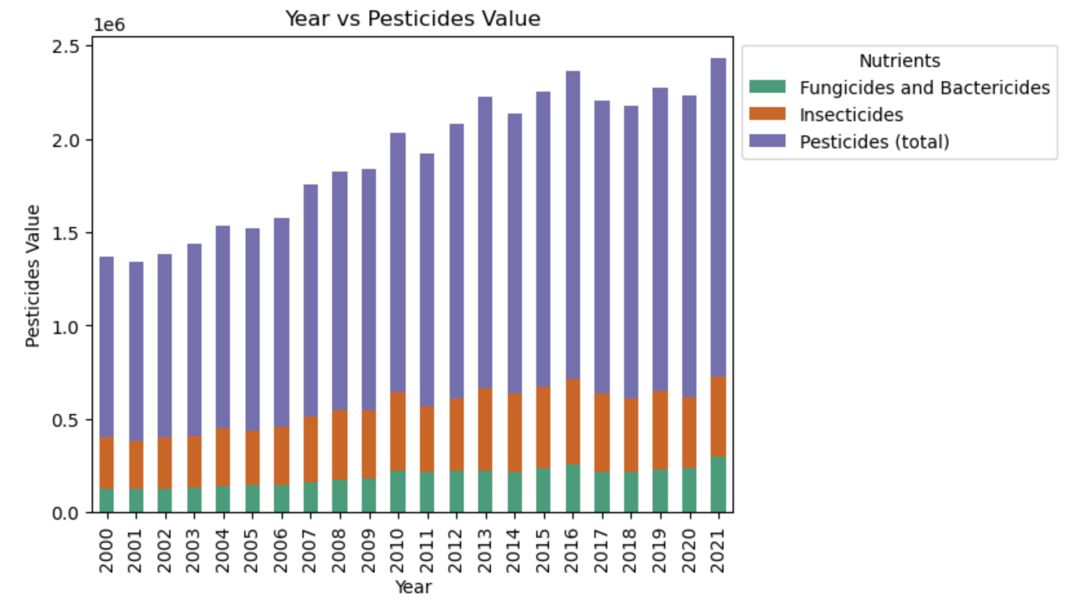
Exploratory Data Analysis(EDA)

Slide 16
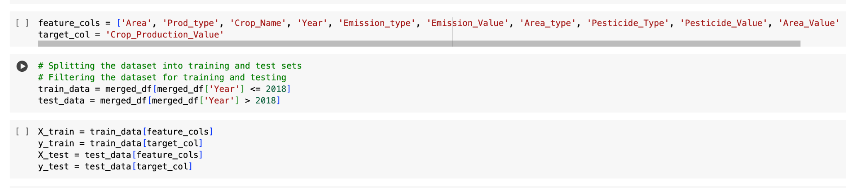
Splitting the Data

Slide 17
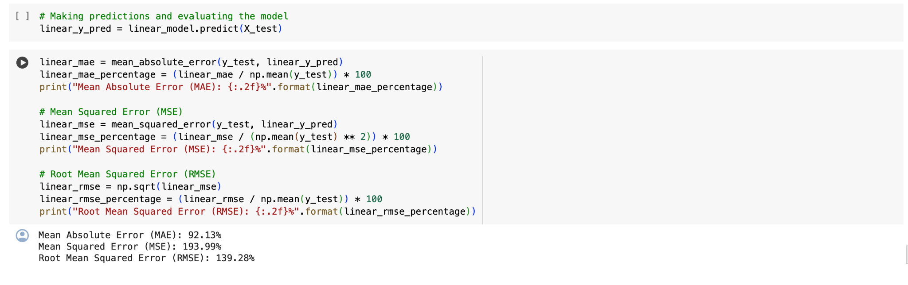
Crop Production - Linear Regression

Slide 18
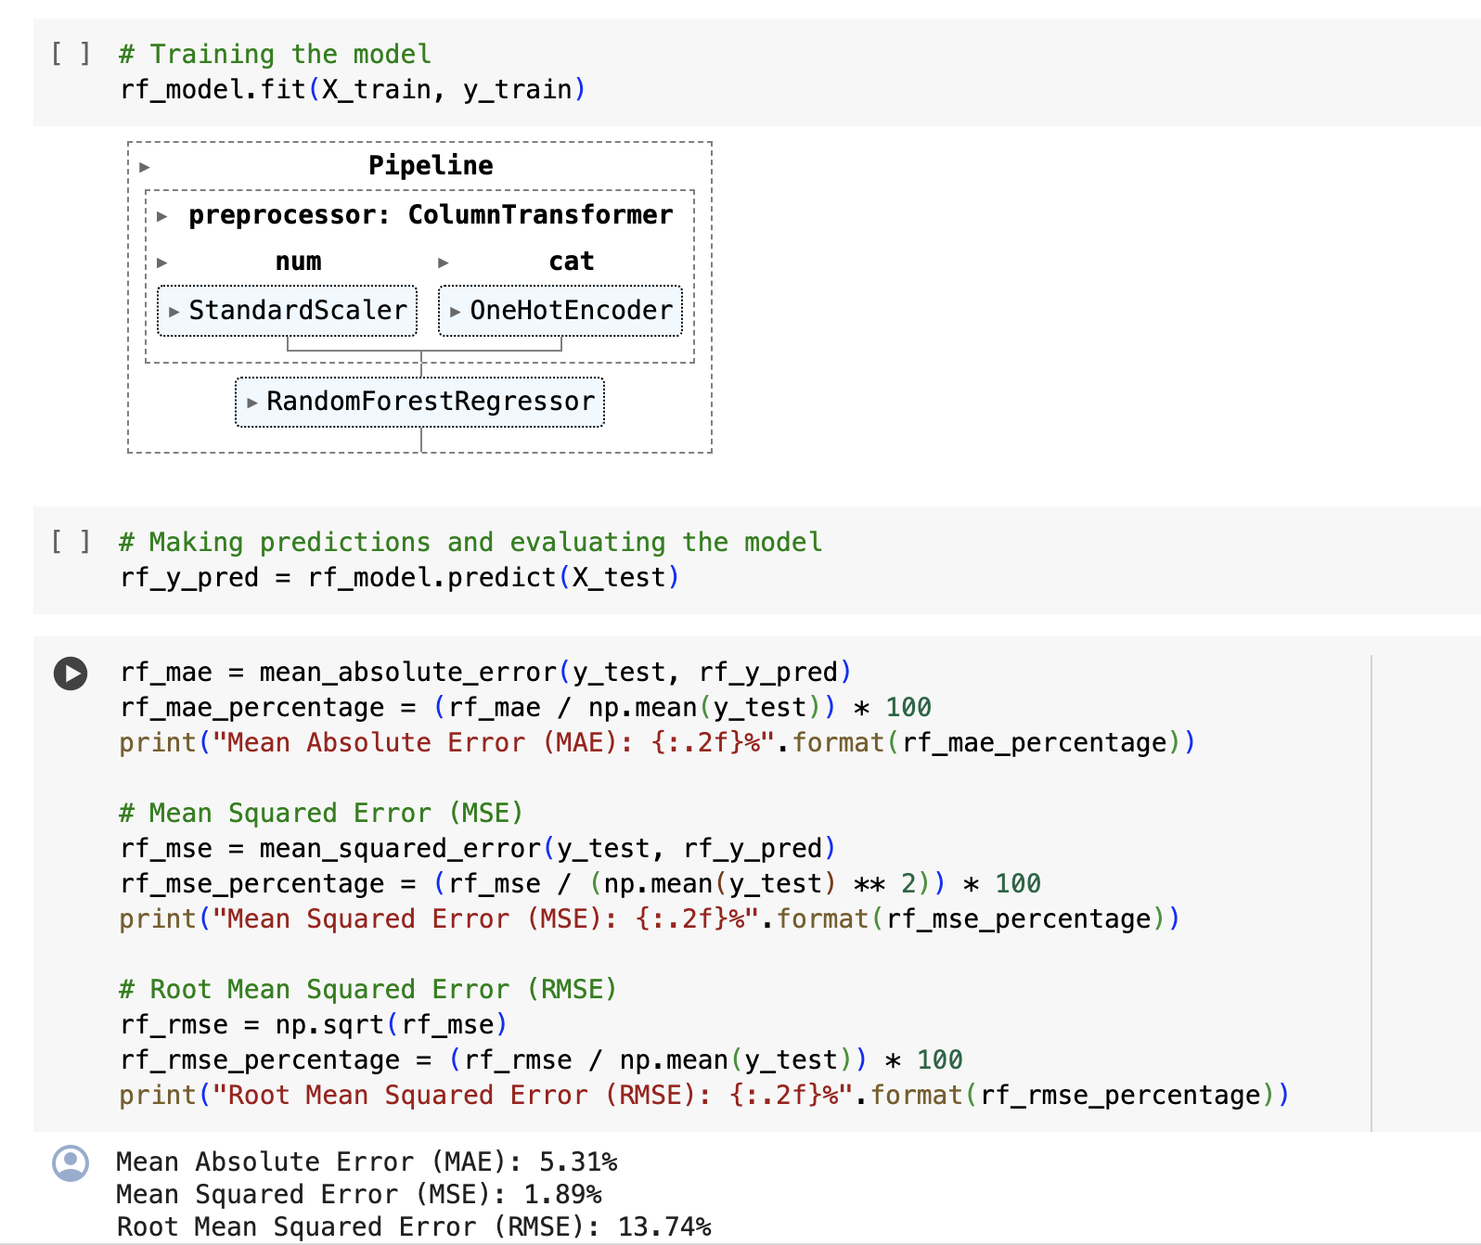
Crop Production - Random Forest

Slide 19
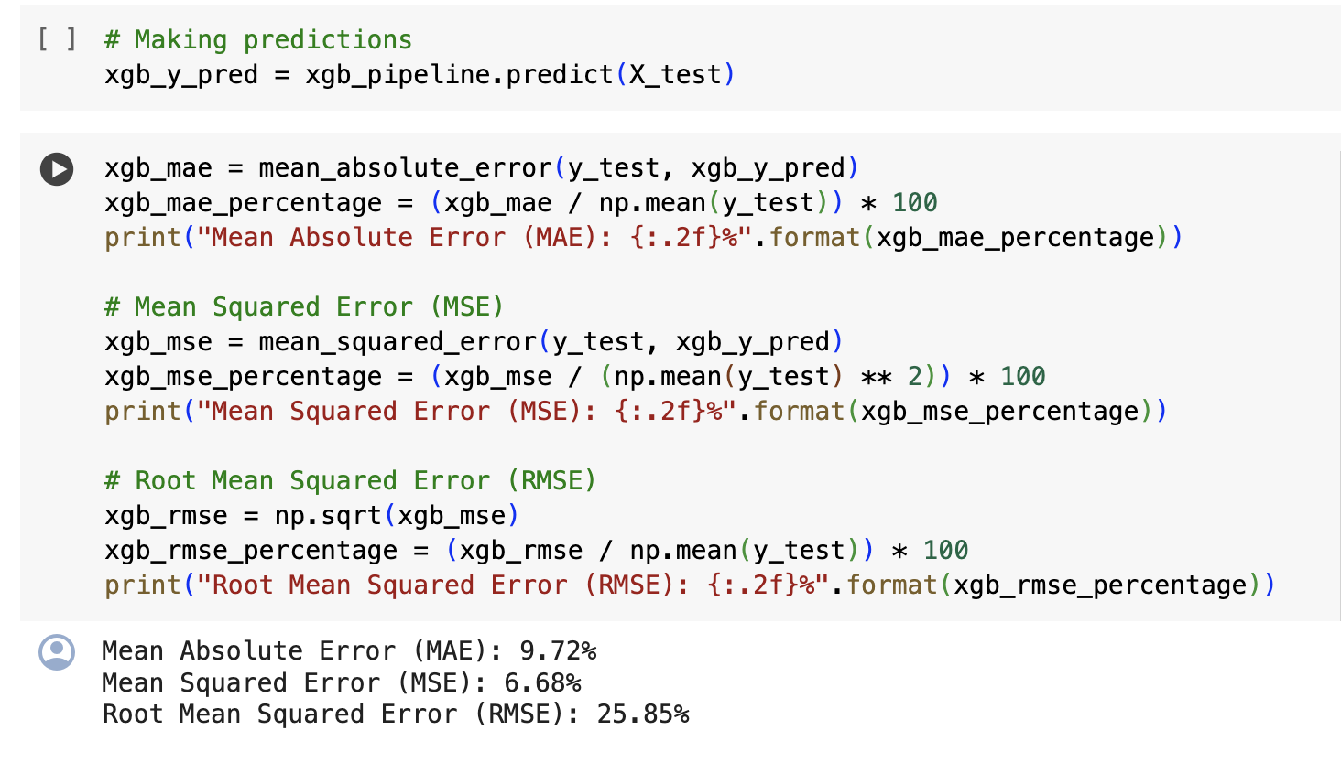
Crop Production - XGBoost

Slide 20
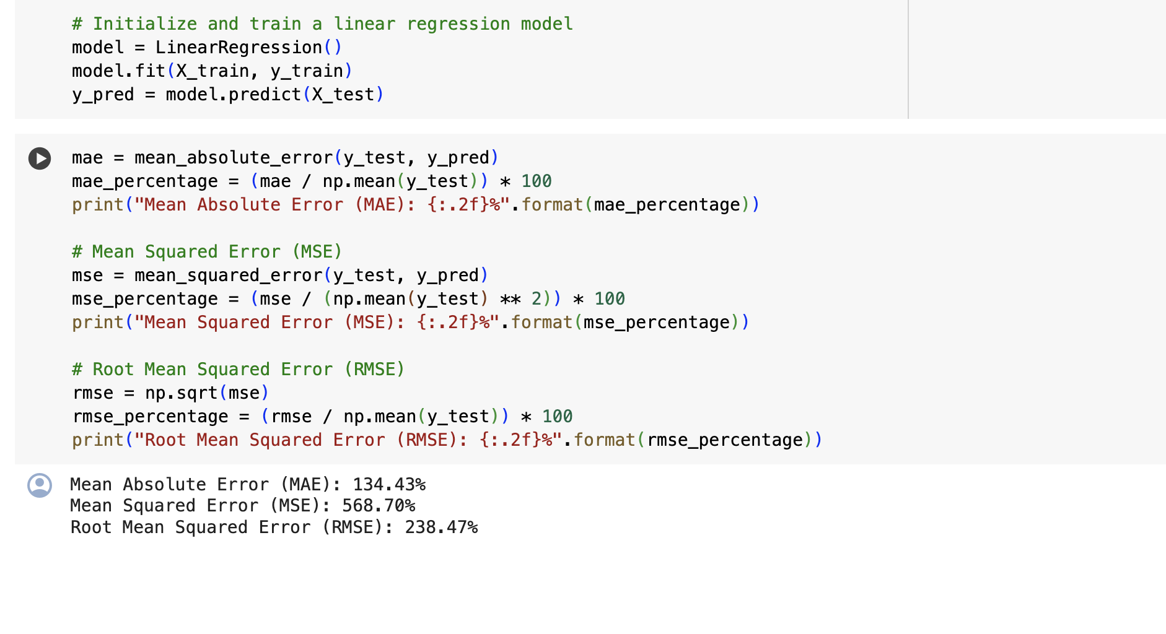
Trade Analysis - Linear Regression

Slide 21
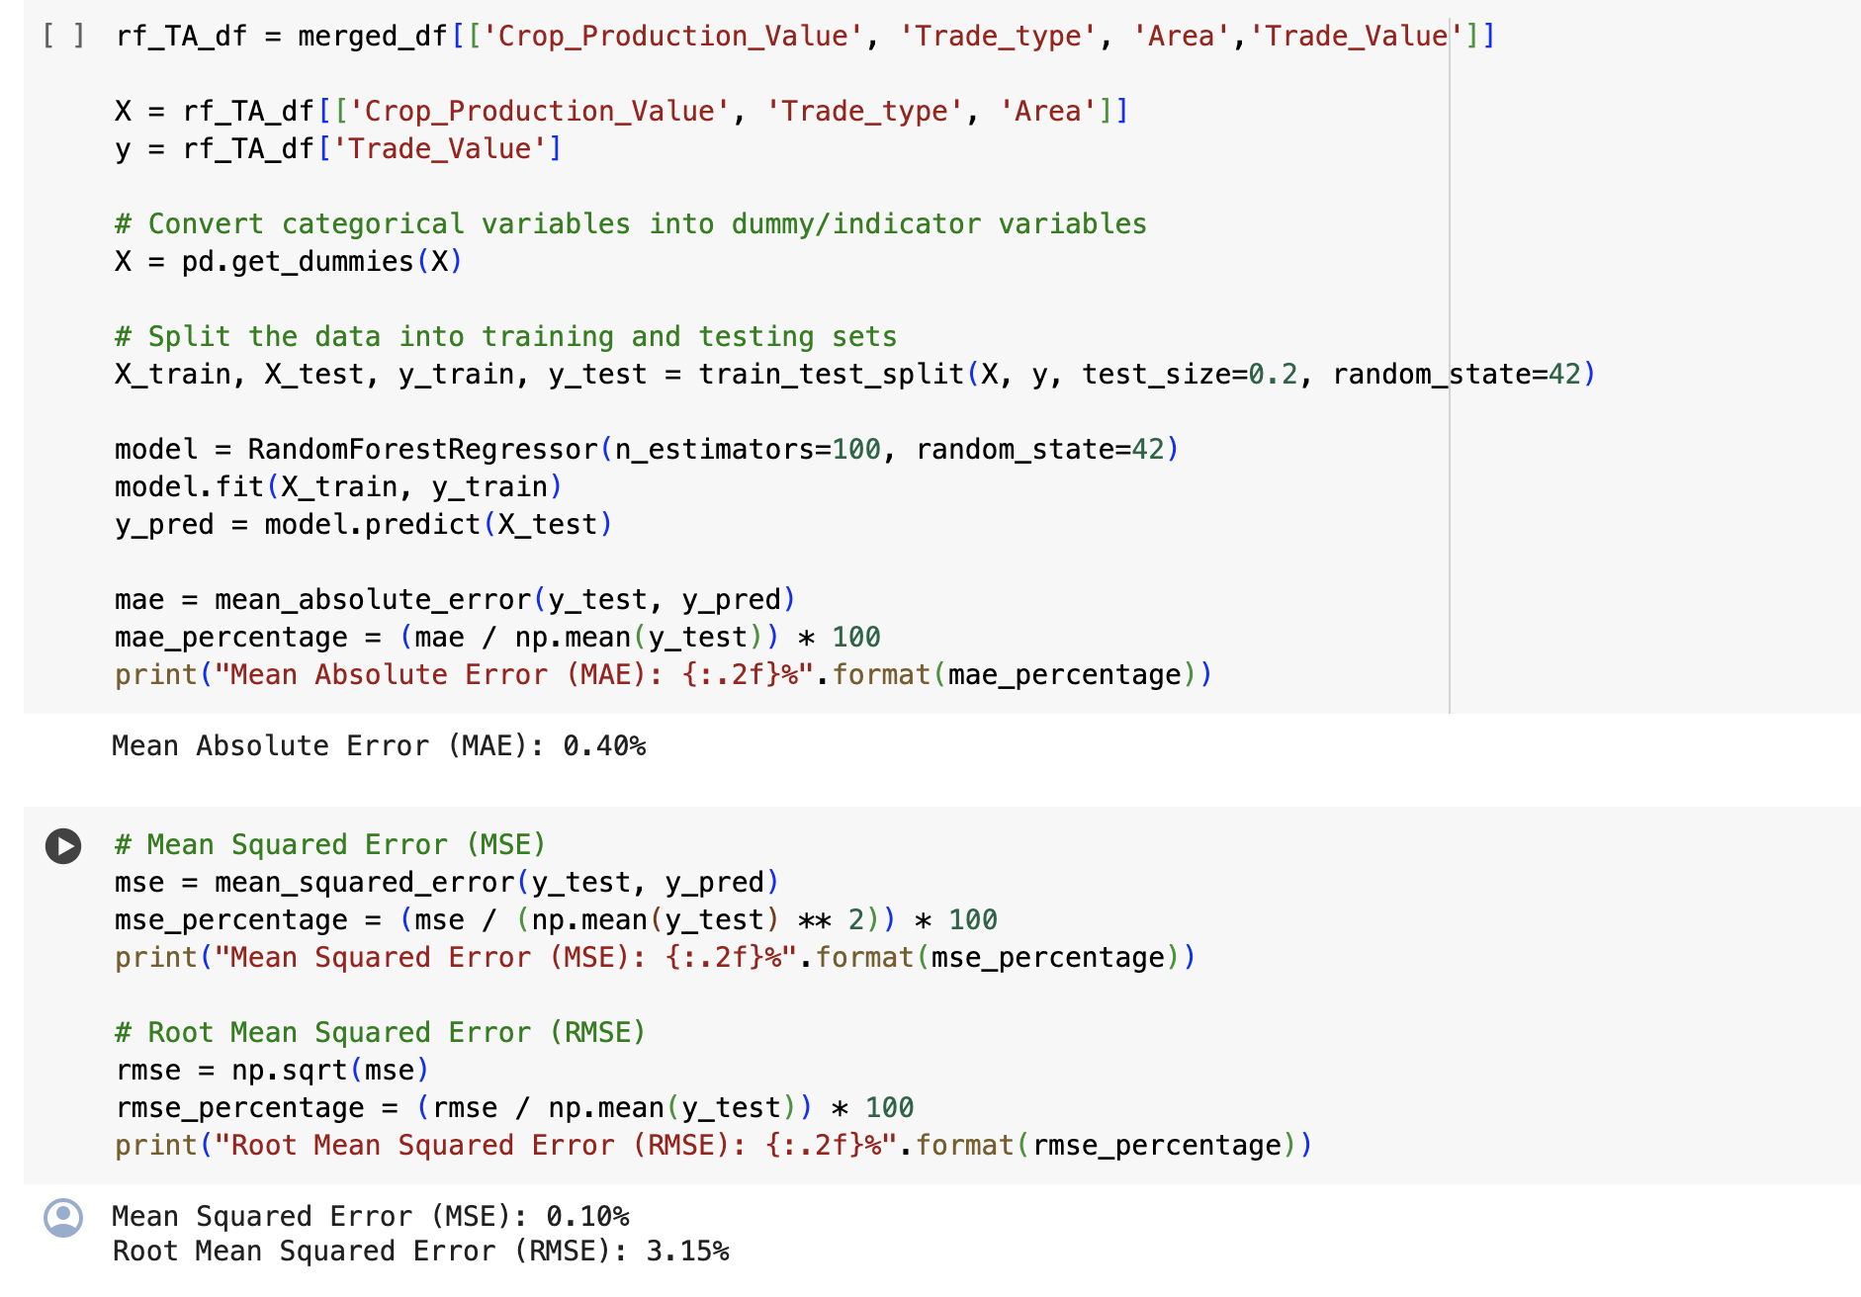
Trade Analysis - Random Forest

Slide 22
References
1. Lobell, D. B., & Field, C. B. (2007). Global scale climate–crop yield relationships and the impacts of recent warming. Environmental Research Letters, 2(1), 014002. [DOI: 10.1088/1748-9326/2/1/014002]
2. Ray, D. K., West, P. C., Clark, M., Gerber, J. S., Prishchepov, A. V., & Chatterjee, S. (2019). Climate change has likely already affected global food production. PLoS One, 14(5), e0217148. [DOI: 10.1371/journal.pone.0217148]
3. Rosenzweig, C., Elliott, J., Deryng, D., Ruane, A. C., Müller, C., Arneth, A., ... & Jones, J. W. (2014). Assessing agricultural risks of climate change in the 21st century in a global gridded crop model intercomparison. Proceedings of the National Academy of Sciences, 111(9), 3268-3273. [DOI: 10.1073/pnas.1222463110]
4. Zhao, C., Liu, B., Piao, S., Wang, X., Lobell, D. B., Huang, Y., ... & Zeng, Z. (2017). Temperature increase reduces global yields of major crops in four independent estimates. Proceedings of the National Academy of Sciences, 114(35), 9326-9331. [DOI: 10.1073/pnas.1701762114]

Slide 23
Thank You
Questions?

