Slide 1
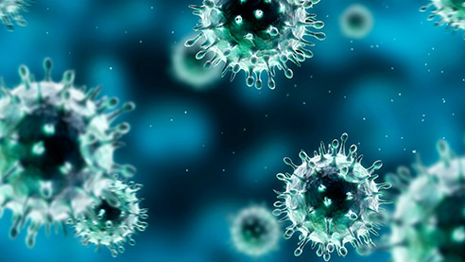
Deep Learning – Chest X-Rays
Differential Diagnosis of COVID-19, Viral Pneumonia, TB
Neha Patel
Student, Flatiron School

Slide 2
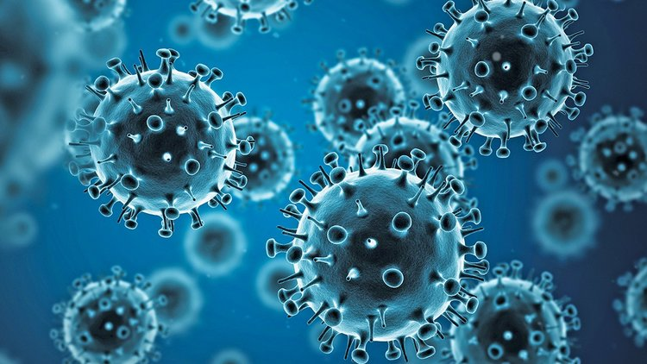
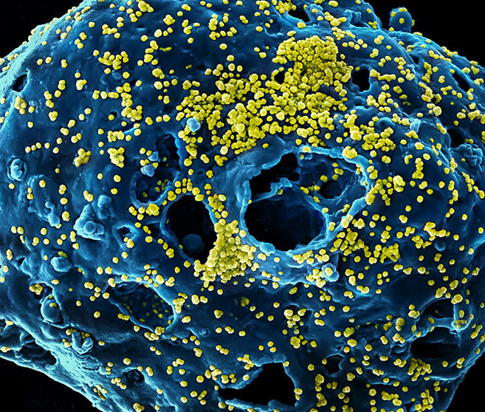
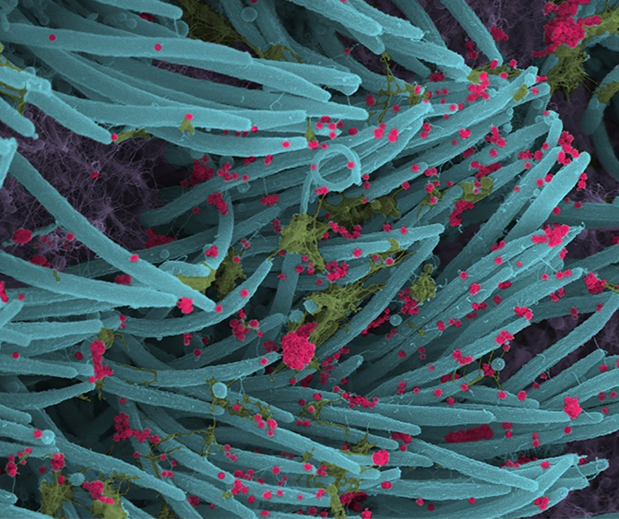
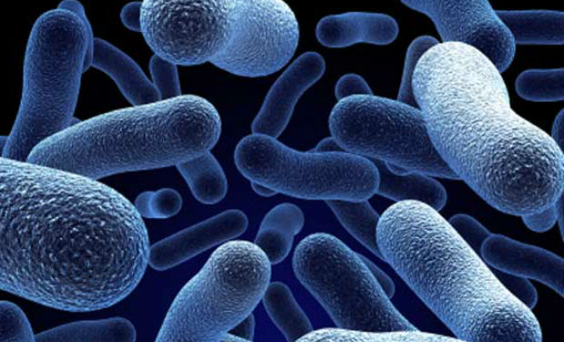
OBJECTIVES
Differential Diagnosis of COVID-19, Viral Pneumonia, TB
Analyze the importance of the differences and similarities of various diseases and viral infections like COVID, Viral Pneumonia, and Tuberculosis.
Present a model that would accurately diagnose whether a person is infected and if so, diagnoses the underlying condition
Discuss the positives and shortcomings of using an AI-based model and recommend the best use of and modifications to this model for appropriate diagnosis

Slide 3
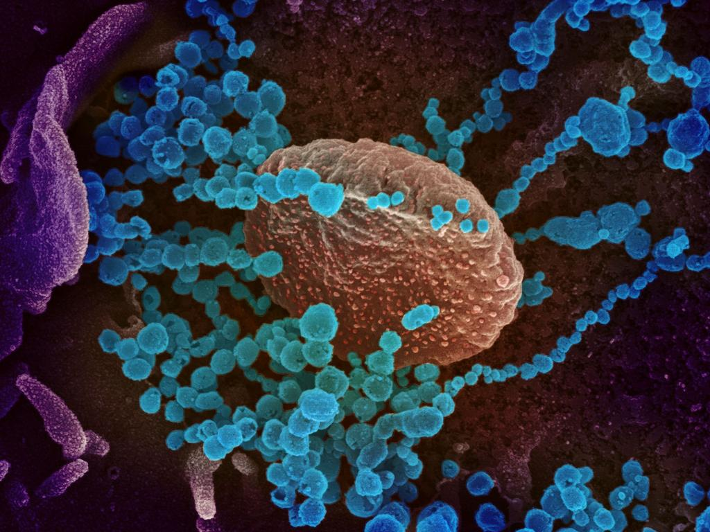
INTRODUCTION
Differential Diagnosis of COVID-19, Viral Pneumonia, TB
Outbreak of COVID-19 has taken over all our lives
Difficult to detect and differentiate from other common diseases and infections
- Share common symptoms
- Example Pneumonia
Deep Learning models in the past – about 90% Accuracy in detecting pneumonia
Pneumonia often misdiagnosed as Tuberculosis
Model trained to accurately diagnose COVID, Pneumonia, TB, and Healthy
Also visualizes explanations
Important measures:
Accuracy
Precision (Important when differentiating between various diagnosis
Recall (Important when detecting if a patient is healthy)

Slide 4
DATA
Differential Diagnosis of COVID-19, Viral Pneumonia, TB
Dataset 1
COVID-19
Viral Pneumonia
Dataset 2
Tuberculosis, China
Normal, China
Normal, Montgomery
Tuberculosis, Montgomery
Dataset 3
Normal
Notes:
The Data for this project has been generated by combining the X-Ray Images from 2 sources. One dataset consisted of the X-ray Images differentiating COVID, Viral Pneumonia and Normal Chest X-rays, while the other data set had chest x-rays for TB and normal. The normal x-rays from each data set were not combined since there could be a possibility that the X-rays not showing pneumonia could have TB and vis-a-versa.

Slide 5
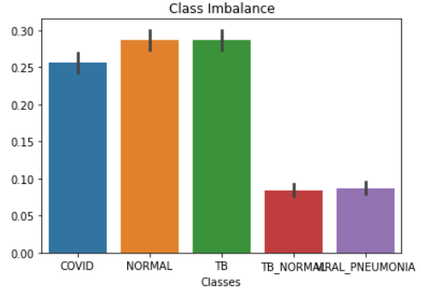
CLASS IMBALANCE | METHODOLOGY
Differential Diagnosis of COVID-19, Viral Pneumonia, TB
Data Pre-processing
Explore and optimize various pre-trained models to use as base model to build on.
Finalize the best model based on performance measures (Accuracy, Precision, Recall) and model explanation
Class weights included in the model to incorporate the class imbalance

Slide 6
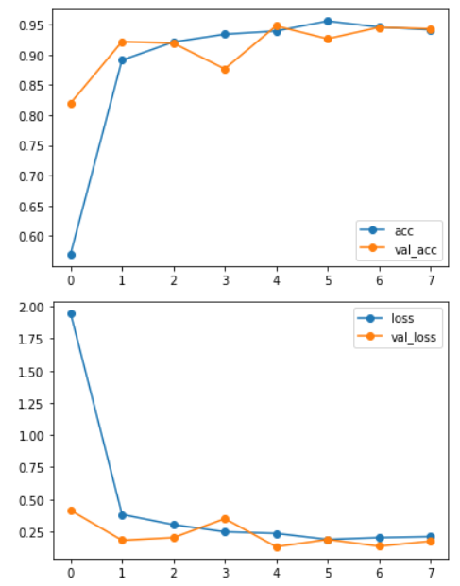
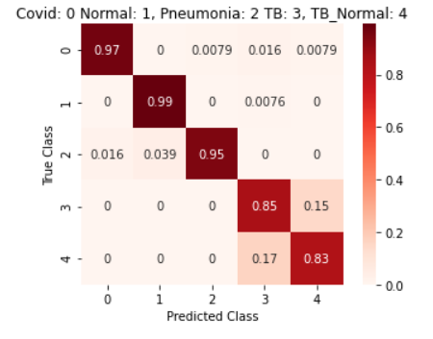
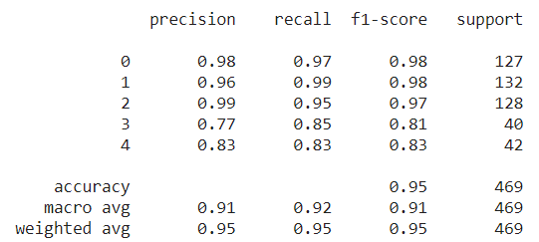
BEST MODEL
Differential Diagnosis of COVID-19, Viral Pneumonia, TB
Accuracy
Loss

Slide 7
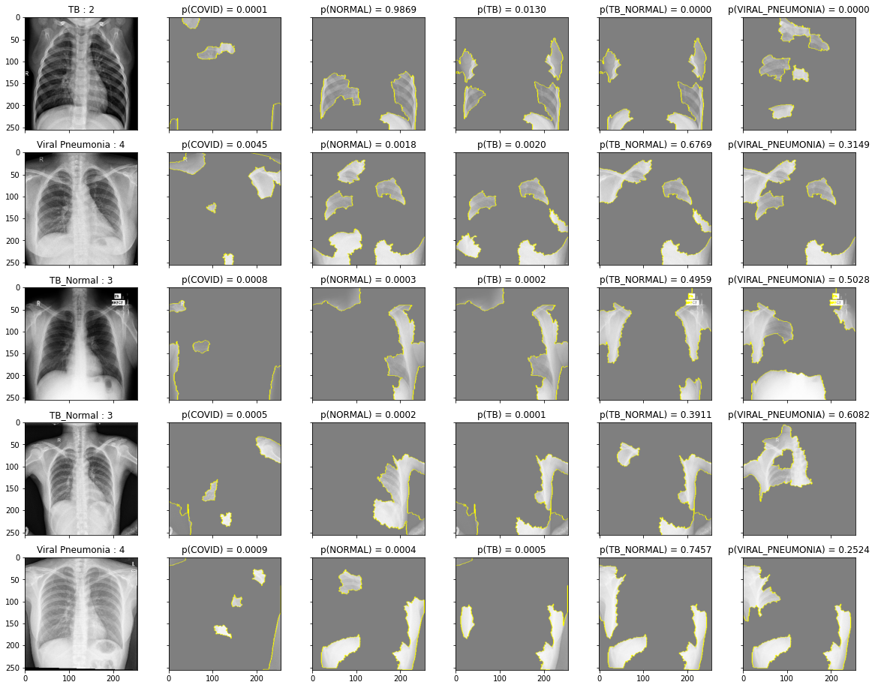
EXPLANATION
Differential Diagnosis of COVID-19, Viral Pneumonia, TB
Total Bad Predictions: 25/422

Slide 8
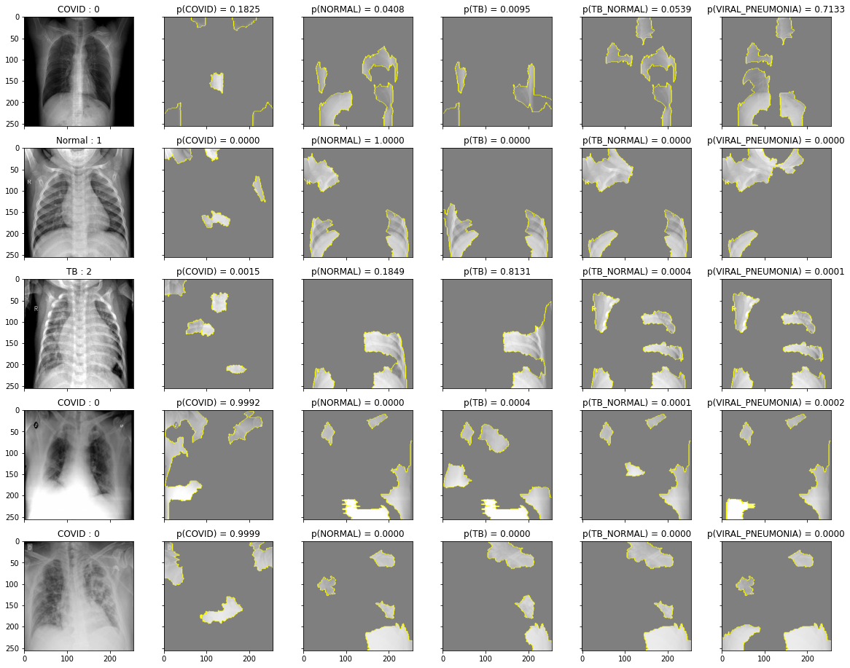
EXPLANATION
Differential Diagnosis of COVID-19, Viral Pneumonia, TB
Explanation for 5 Random Images

Slide 9
DASHBOARD/APP
Differential Diagnosis of COVID-19, Viral Pneumonia, TB

Slide 10
RECOMMENDATIONS
Differential Diagnosis of COVID-19, Viral Pneumonia, TB
Recommended to use AI based model to distinguish COVID-19 from Viral Pneumonia and Normal: 95% ACCURACY, HIGH PRECISION and RECALL
Recommended to invest in research in gathering more data and building on the model to be able to use it to detect TB
Use a COMBINATION OF SYMPTOMS either by knowledge or integrating with the model for better and reliable diagnosis

Slide 11
FUTURE WORK
Differential Diagnosis of COVID-19, Viral Pneumonia, TB
Building a Dashboard/Application that would accept any Xray, preprocess and use the model for diagnosis, and explanation
Explore other models by building by scratch, and including image augmentation, and adding masks to improve the predictability of the model
Include other symptoms in the model to aid in better diagnosis.

Slide 12
THANK YOU!
QUESTIONS?

