Slide 1


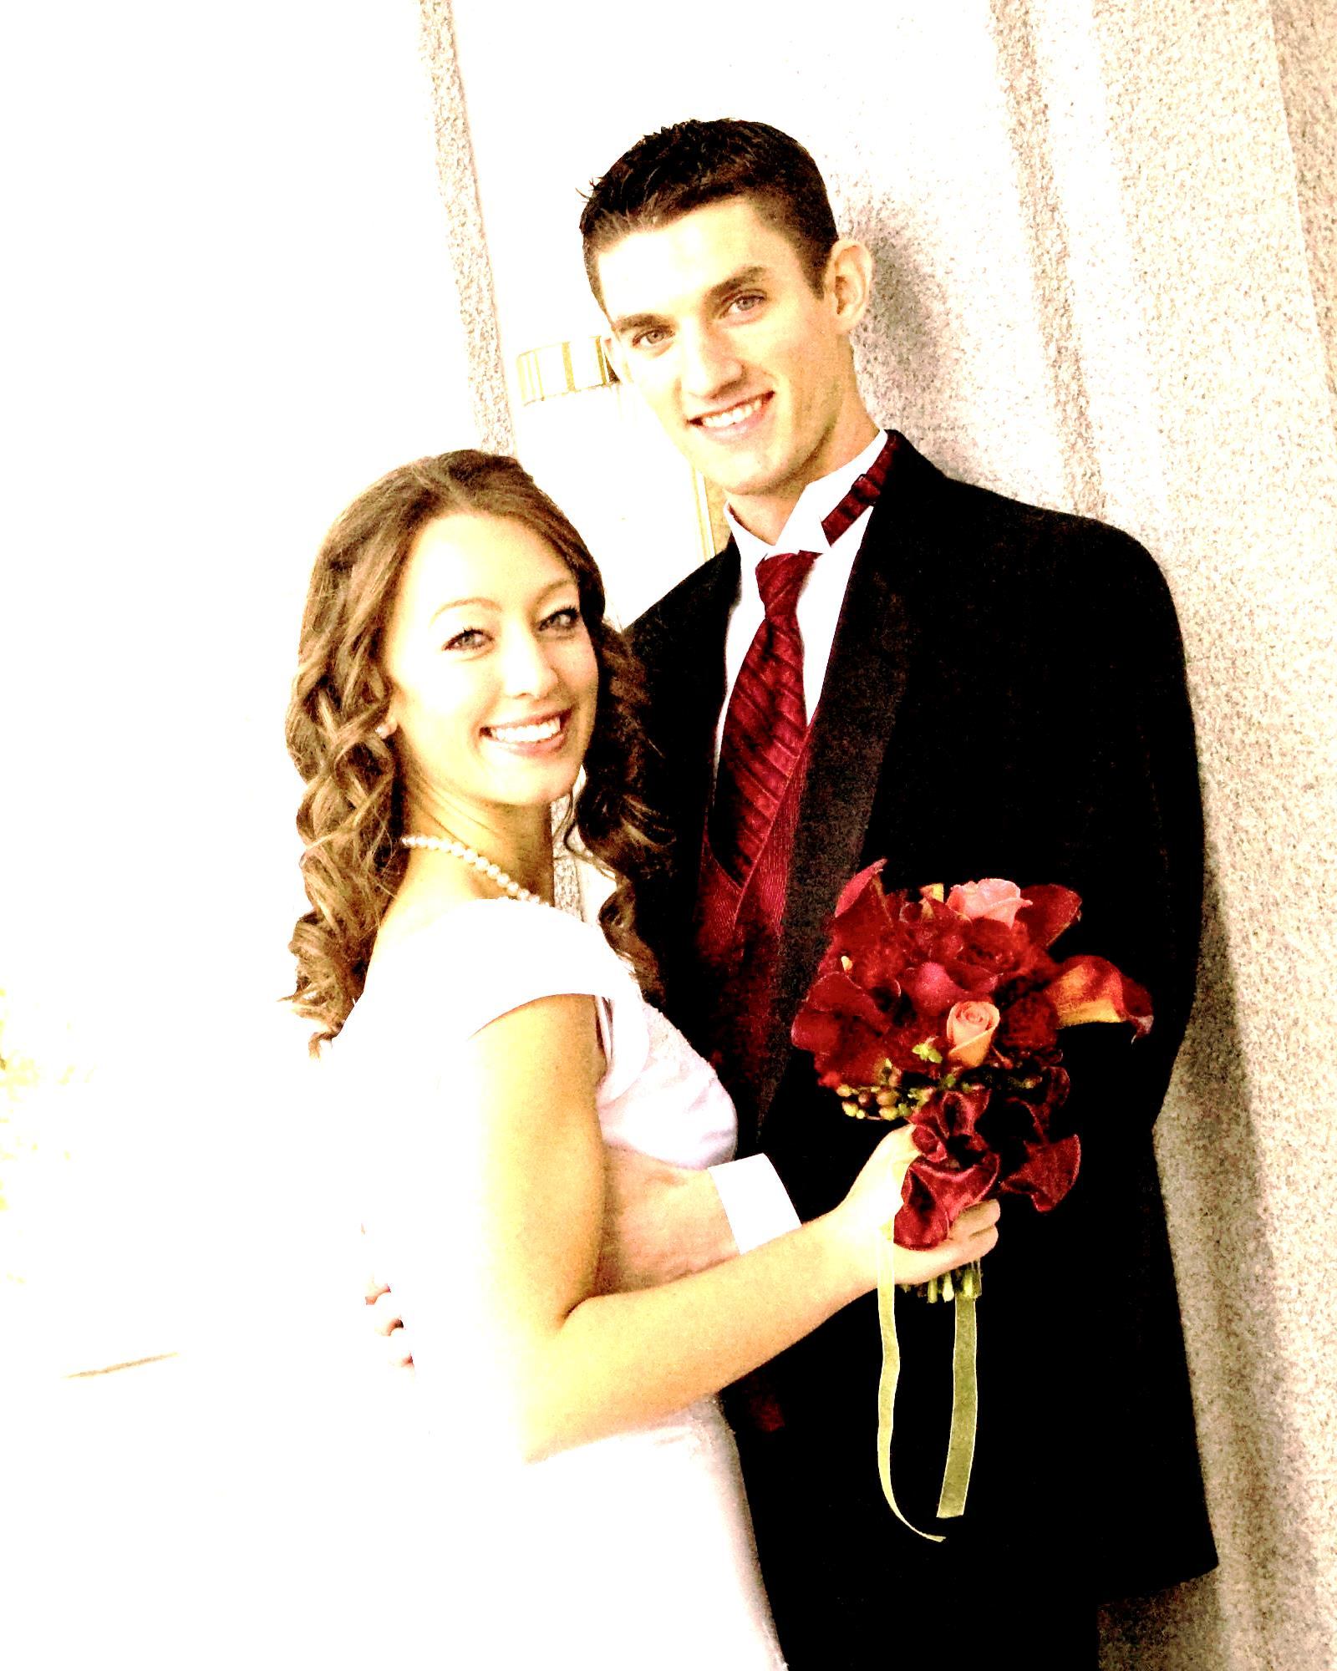
Enter the names here
Enter the names here
Enter the names here
Enter the names here
Lina & Nick
5.16.2008
Enter the names here
Enter the names here
Notes:
Instructions: Right click on each photo. Click “Change photo.” Browse through your files to insert the correct photo. Type the names below the photo.

