Slide 1

Machine Learning & Deep Learning (24EECC309)
TransFAD: Hybrid CNN–LSTM and Ensemble-Based Approach for Transmission Line Fault Detection and Classification
Name | USN | Roll No
Neha R Shettar | 01FE23BEC058 | 240
Sahana M Dasanakoppa | 01FE23BEC027 | 220
Aditi M Gorawar | 01FE23BEC081 | 260
Guide – Ramesh Tabib
Department of Electronics & Communication Engineering

Slide 2
Outline
Introduction
Problem Statement
Objectives
Dataset
Literature Survey
State-of-the-Art Metrics Used
Trends in Fault Detection and Classification
Research Gaps
Block Diagram
Methodology
Results
Discussions
Conclusion
Future Work
References
Department of Electronics & Communication Engineering . 2

Slide 3
Introduction
Reliable fault detection in transmission lines is essential for maintaining power system stability and preventing equipment damage. Conventional protection techniques based on fixed thresholds often fail under noisy conditions, transient disturbances, and varying operating scenarios. With the increasing availability of high-resolution voltage and current measurements, data-driven approaches have gained attention for fault analysis. However, standalone machine learning models struggle to capture temporal fault behavior, while deep learning models may lack robustness and interpretability. To address these limitations, this project proposes TransFAD, a hybrid framework that combines engineered electrical features with a CNN–LSTM-based temporal learning model and integrates their predictions using a weighted ensemble strategy for accurate and reliable transmission line fault detection and classification
Department of Electronics & Communication Engineering . 3

Slide 4
Problem Statement
Conventional transmission line fault detection methods rely on fixed thresholds and handcrafted rules, which are often unreliable under noisy conditions, transient disturbances, and varying operating scenarios. Existing machine learning approaches based on static electrical features fail to capture the temporal evolution of faults, while standalone deep learning models may suffer from poor generalization and limited interpretability. Therefore, there is a need for a robust and accurate fault detection framework that can effectively combine instantaneous electrical characteristics with temporal fault dynamics using voltage and current measurements.
Department of Electronics & Communication Engineering .4

Slide 5
Objectives
To design a reliable transmission line fault detection and classification system using three-phase voltage and current measurements.
To extract and utilise engineered electrical features for effective fault characterisation using classical machine learning models.
To develop a CNN–LSTM–based deep learning model to capture the temporal behaviour of transmission line faults.
To integrate machine learning and deep learning models using a weighted ensemble strategy to improve accuracy and robustness.
To evaluate the performance of the proposed framework using standard classification and error-based metrics.
Department of Electronics & Communication Engineering . 5

Slide 6
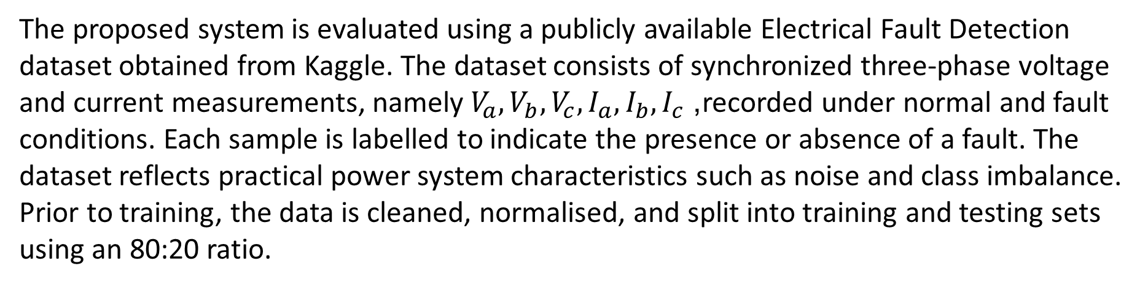
Dataset
The proposed system is evaluated using a publicly available Electrical Fault Detection dataset obtained from Kaggle. The dataset consists of synchronized three-phase voltage and current measurements, namely $V_{a},V_{b},V_{c},I_{a},I_{b},I_{c}$, recorded under normal and fault conditions. Each sample is labelled to indicate the presence or absence of a fault. The dataset reflects practical power system characteristics such as noise and class imbalance. Prior to training, the data is cleaned, normalised, and split into training and testing sets using an 80:20 ratio.
Department of Electronics & Communication Engineering . 5

Slide 7
Literature Survey
Several studies have explored data-driven approaches for transmission line fault detection using voltage and current signals. Traditional machine learning techniques such as k-nearest neighbours, support vector machines, and decision trees have been widely used due to their simplicity and interpretability. To improve performance, signal processing methods like wavelet transforms combined with machine learning classifiers were introduced to capture transient characteristics. More recently, deep learning models such as convolutional neural networks and long short-term memory networks have been applied to model nonlinear and temporal fault behaviour. However, most existing methods rely on a single learning approach and fail to effectively capture both instantaneous electrical features and temporal fault dynamics, motivating the need for a hybrid framework.
Department of Electronics & Communication Engineering . 6

Slide 8
State Of the Art Metric Used:
Accuracy: Measures the overall percentage of correctly classified fault and non-fault samples.
F1-score: Represents the harmonic mean of precision and recall, useful for evaluating performance on imbalanced datasets.
RMSE: Quantifies the square root of the average squared prediction error, emphasizing larger errors.
MAE: Measures the average absolute difference between predicted and actual values.
R² (Coefficient of Determination): Indicates how well the model’s predictions explain the variance in the actual data.
Department of Electronics & Communication Engineering . 7

Slide 9
Trends in Fault Detection and Classification
A shift from conventional threshold-based relays to data-driven machine learning methods using voltage and current measurements.
Increasing use of deep learning models such as CNNs and LSTMs to capture nonlinear and temporal fault behavior.
Growing adoption of hybrid ML–DL frameworks that combine engineered electrical features with temporal learning for improved robustness.
Use of ensemble learning techniques to enhance accuracy under noisy and imbalanced operating conditions.
Emphasis on real-time, reliable, and scalable solutions suitable for smart grid and intelligent protection systems.
Department of Electronics & Communication Engineering . 7

Slide 10
Research Gaps Identified
Most existing methods rely on a single learning paradigm (only ML or only DL), limiting their ability to capture both instantaneous electrical features and temporal fault dynamics.
Classical machine learning approaches depend on static handcrafted features and struggle under noisy and transient operating conditions.
Standalone deep learning models often suffer from poor generalization when training data is limited or class-imbalanced.
Limited use of hybrid and ensemble-based frameworks that integrate interpretability with temporal learning.
Lack of robust evaluation using both classification and error-based metrics to assess real-world reliability.
Department of Electronics & Communication Engineering . 8

Slide 11
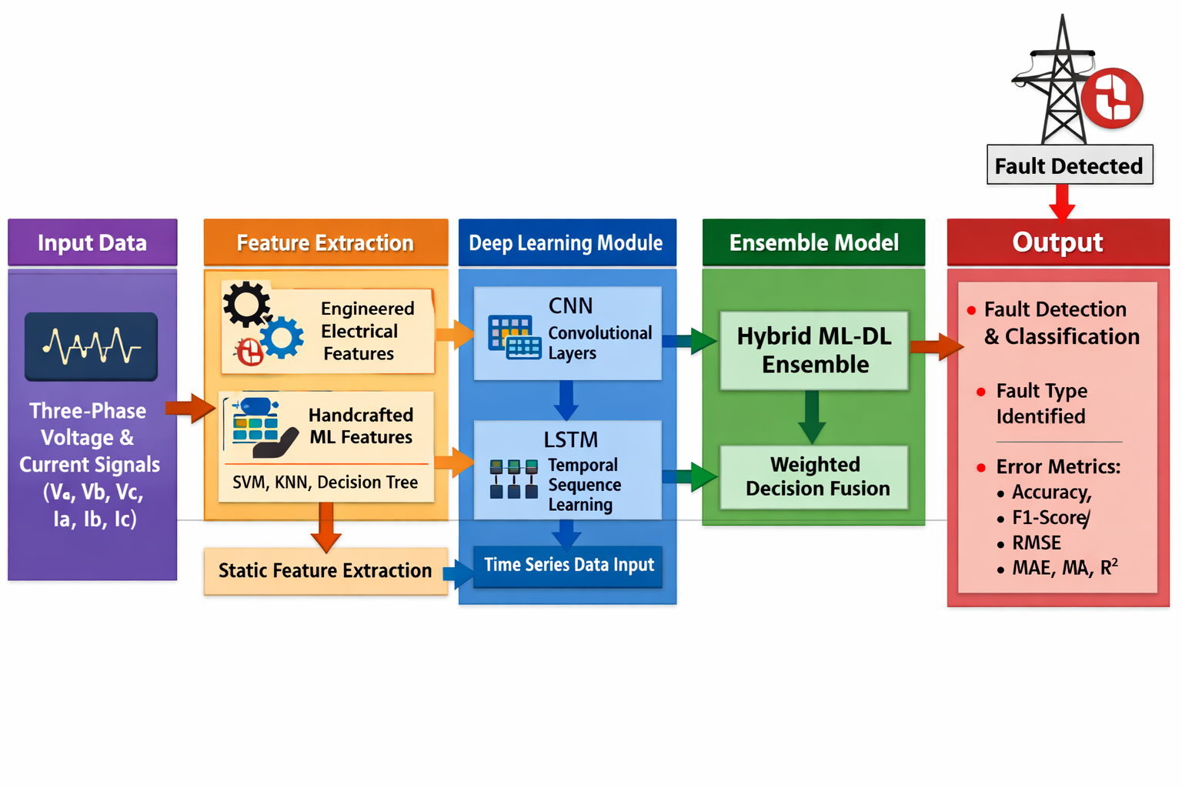
Block Diagram
Department of Electronics & Communication Engineering . 9

Slide 12
Methodology
Input Signal Acquisition
Synchronized three-phase voltage and current signals (Va,Vb,Vc,Ia,Ib,Ic)(V_a, V_b, V_c, I_a, I_b, I_c)(Va​,Vb​,Vc​,Ia​,Ib​,Ic​) are collected at the relay location.
These signals reflect voltage depression, current surge, and phase imbalance during fault conditions.
Parallel Processing Framework
The proposed TransFAD system processes the input signals through two parallel branches:
  Engineered-Feature Machine Learning (EF–ML) branch
  CNN–LSTM Deep Learning branch
Engineered Feature Extraction (EF–ML Branch)
Line-to-line voltage differences are computed to capture phase asymmetry.
Voltage and current magnitudes are calculated to represent fault severity.
Phase imbalance indices are obtained using standard deviation across phases.
All extracted features are concatenated to form a discriminative feature vector.
Department of Electronics & Communication Engineering . 10

Slide 13
Methodology
Feature Standardization and Classical Classification
Extracted features are standardized using mean and standard deviation.
Logistic Regression, Support Vector Machine (RBF kernel), and Decision Tree classifiers are trained.
Each classifier produces posterior fault class probabilities.
Sequence Construction for Deep Learning
Fixed-length sequences of 50 time samples are constructed from raw voltage and current signals.
Synthetic noise is added during training to improve generalization and robustness.
CNN-Based Feature Extraction
One-dimensional convolutional layers extract local temporal patterns from the signal sequences.
Stacked convolution layers learn hierarchical fault representations.
BiLSTM Temporal Modeling
Bidirectional LSTM layers capture forward and backward temporal dependencies in fault evolution.
Mean pooling is applied to obtain a fixed-length feature representation.
Deep Learning Output Generation
A softmax layer generates fault class probability outputs from the CNN–LSTM model.
Department of Electronics & Communication Engineering . 10

Slide 14
Methodology
Weighted Ensemble Decision Fusion
Probability outputs from the EF–ML and CNN–LSTM branches are combined using weighted fusion.
Higher weight is assigned to the deep learning branch to emphasize temporal modeling.
Final Fault Classification
The class with the maximum fused probability is selected as the final fault decision.
The output indicates fault presence and fault classification.
Department of Electronics & Communication Engineering . 10

Slide 15
Contribution
A hybrid transmission line fault detection and classification framework, termed TransFAD, is proposed by integrating classical machine learning and deep learning techniques.
Physically interpretable engineered electrical features are designed and utilized to enhance the discriminative capability of conventional machine learning models.
A CNN–LSTM based deep learning architecture is developed to learn spatial and temporal fault characteristics directly from voltage and current signal sequences.
A weighted ensemble fusion strategy is introduced to combine machine learning and deep learning predictions, improving robustness under noisy and imbalanced conditions.
Extensive experimental evaluation is conducted using a publicly available electrical fault detection dataset, demonstrating that the proposed framework outperforms standalone models across multiple performance metrics.
Department of Electronics & Communication Engineering . 11

Slide 16
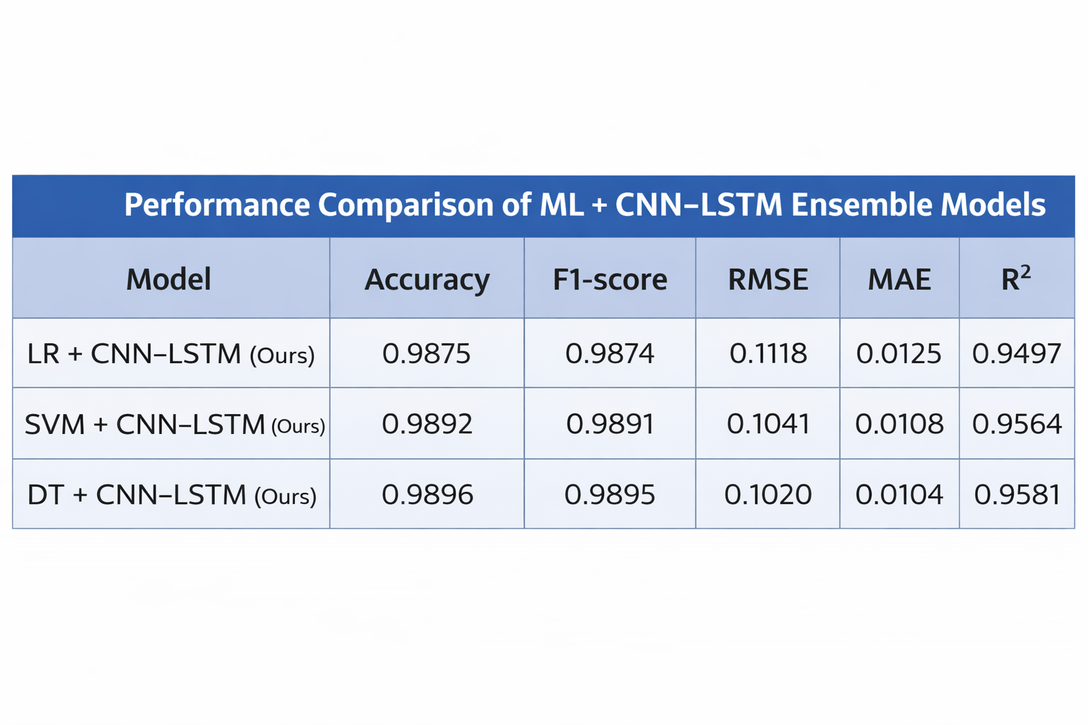
RESULTS:
Department of Electronics & Communication Engineering . 12

Slide 17
Discussion
The results show that the proposed TransFAD framework effectively improves transmission line fault detection by combining engineered electrical features with CNN–LSTM-based temporal learning. The hybrid ensemble captures both instantaneous and time-varying fault characteristics, leading to higher accuracy and robustness under noisy conditions. Among the evaluated models, the Decision Tree + CNN–LSTM ensemble achieves the best performance, with lower error metrics and higher consistency. The weighted ensemble strategy further enhances reliability by leveraging the strengths of both machine learning and deep learning approaches, making the framework suitable for practical power system protection.
.
Department of Electronics & Communication Engineering . 13

Slide 18
Conclusion
This work presented TransFAD, a hybrid machine learning and deep learning framework for transmission line fault detection and classification using three-phase voltage and current measurements. By combining engineered electrical features with CNN–LSTM-based temporal learning and weighted ensemble fusion, the proposed system effectively captures both steady-state and transient fault characteristics. Experimental results demonstrate that the hybrid ensemble outperforms standalone models in terms of accuracy and error-based metrics, indicating its reliability under noisy and imbalanced conditions. The proposed approach is therefore suitable for practical and real-time power system protection applications.
Department of Electronics & Communication Engineering . 14

Slide 19
Future Work
Extend the proposed framework to perform fault location estimation in addition to fault detection and classification.Validate the model using real-time field data from digital relays and PMUs.Optimize the architecture for real-time deployment on embedded or edge devices.Expand the framework to handle multi-terminal and complex transmission networks.Investigate adaptive learning techniques to improve performance under changing grid conditions.
Department of Electronics & Communication Engineering . 14

Slide 20
References
Y. Özupak, “Machine learning-based fault detection in transmission lines: A comparative study with random search optimization,” Bull. Polish Acad. Sci., Tech. Sci., vol. 73, 2025.
A. H. Ali, A. M. Abdulsada, and M. T. Yaseen, “Detection of power transmission line faults using k-nearest neighbors,” IEEE Access, vol. 9, pp. 135217–135228, 2021.
A. A. Salam, M. S. Rahman, and A. K. M. M. Islam, “Robust fault detection and classification using machine learning,” Electric Power Systems Research, vol. 189, 2020.
S. R. Samantaray, P. K. Dash, and G. Panda, “Fast and accurate fault detection using extreme learning machine,” IET Generation, Transmission & Distribution, vol. 3, no. 5, pp. 431–441, 2009.
Y. Özupak, “Transmission line fault detection using artificial intelligence techniques,” Proc. IPST, 2019.
R. K. Patel and A. Panahi, “Transmission line fault detection using machine learning approaches,” IEEE Transactions on Power Delivery, vol. 35, no. 6, pp. 2914–2923, 2020.
J. L. Sarmiento, J. C. Delfino, and E. R. Arboleda, “Machine learning advances in transmission line fault detection: A review,” Preprints, 2024.
S. R. Samantaray, “Decision tree-based fault classification in transmission lines,” IEEE Transactions on Power Delivery, vol. 25, no. 3, pp. 1547–1555, 2010.
Department of Electronics & Communication Engineering . 15

Slide 21
References
A. Yadav and A. Swetapadma, “Single-ended directional fault section identification using machine learning,” IEEE Transactions on Power Delivery, vol. 34, no. 2, pp. 579–588, 2019.
M. Biswal, P. K. Dash, and S. Mishra, “Fault detection using wavelet transform and probabilistic neural network,” IEEE Transactions on Power Delivery, vol. 27, no. 1, pp. 467–475, 2012.
P. Ray, D. P. Mishra, and S. R. Samantaray, “Fault classification using support vector machines,” IEEE Transactions on Power Delivery, vol. 26, no. 4, pp. 2626–2635, 2011.
S. A. Elkalashy et al., “AI-based fault classification and location in transmission lines,” IET Generation, Transmission & Distribution, vol. 5, no. 5, pp. 525–533, 2011.
M. J. B. Reddy and D. K. Mohanta, “Adaptive fault classification using machine learning,” IEEE Transactions on Smart Grid, vol. 7, no. 4, pp. 1982–1991, 2016.
H. Livani and C. Y. Evrenosoglu, “Fault classification and localization for three-terminal circuits,” IEEE Transactions on Power Delivery, vol. 28, no. 4, pp. 2282–2290, 2013.
S. Mishra, C. N. Bhende, and B. K. Panigrahi, “Power system disturbance detection using SVM,” IEEE Transactions on Power Delivery, vol. 25, no. 3, pp. 1719–1727, 2010.
Department of Electronics & Communication Engineering . 15

Slide 22

Department of Electronics & Communication Engineering . 16

Slide 23
Department of Electronics & Communication Engineering . 13

