Slide 1
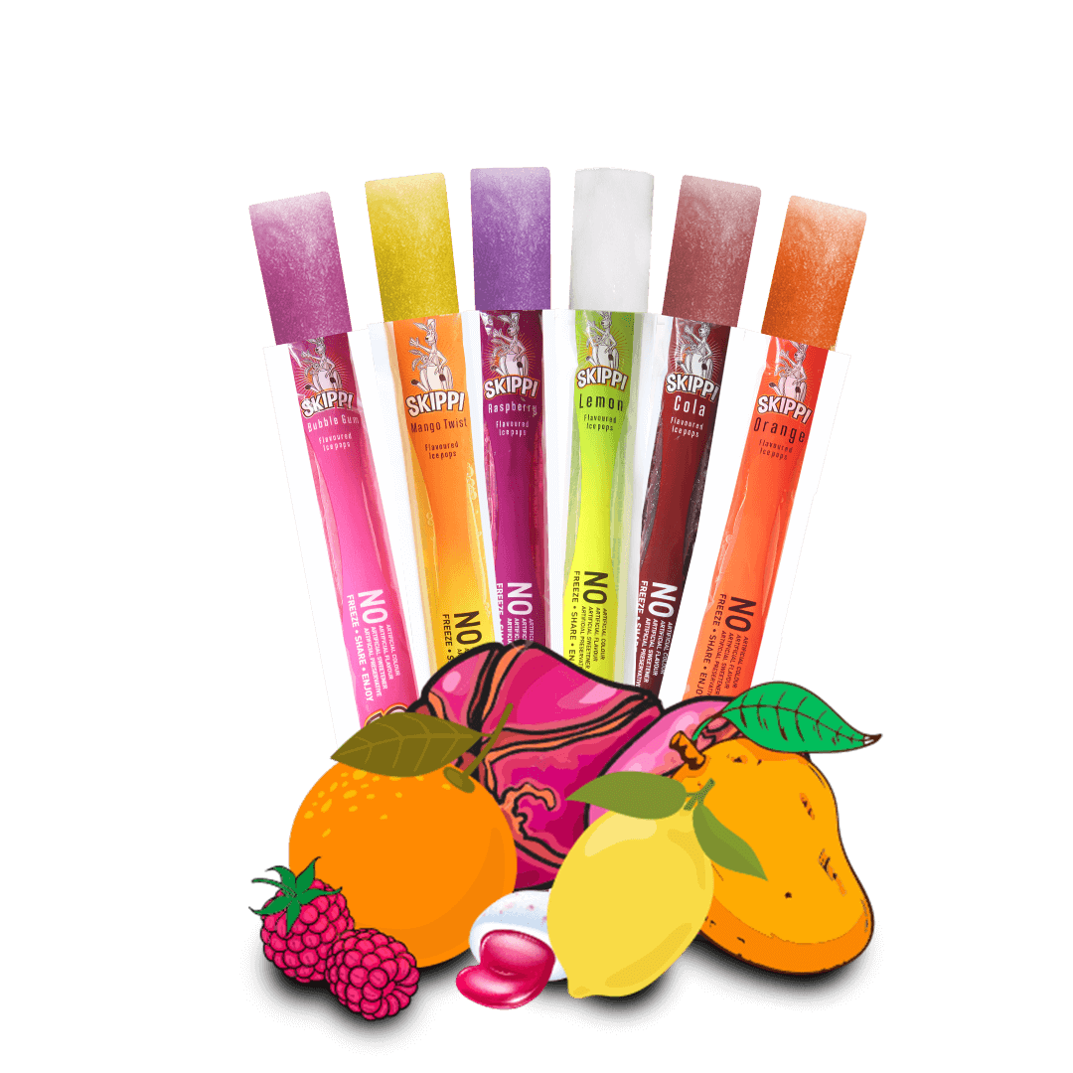
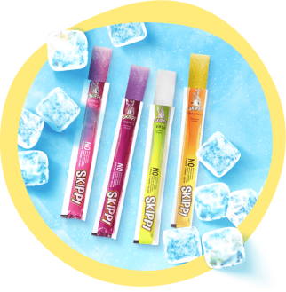
Skippi ice pops
Name | Roll No
Debasree Choudhury | 20
Jaimin Puj | 31
Neha Shahani | 36

Slide 2

Skippi Premium Ice Pops
They provide online delivery of Best Frozen Popsicles In India.
They aim at producing high quality products which are clean, green and healthy.
Every product they develop, is aimed at bringing down the intake of artificial flavours and colours to zero.
Skippi is owned by Kabra Global Products Pvt. Ltd., an offshoot of M/s Prabhat Udyog (India).

Slide 3
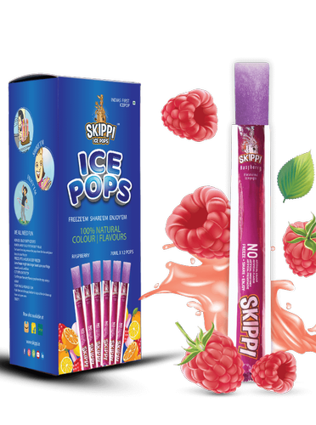
Why you have selected this company
The global online food delivery services market is expected to grow at a compound annual growth rate of 15.4% from 2019 to 2025
Hectic schedule and growing disposable income in India pushes people towards ready-to-eat food at a cheaper rate.
Getting it quickly through one-click has popularized food delivery options, especially in urban areas.
Also, skippi ice pops provides below qualities in their product:
No Added preservatives
No artificial colors
No artificial flavors
No artificial sweeteners
Made with 100% RO Water

Slide 4
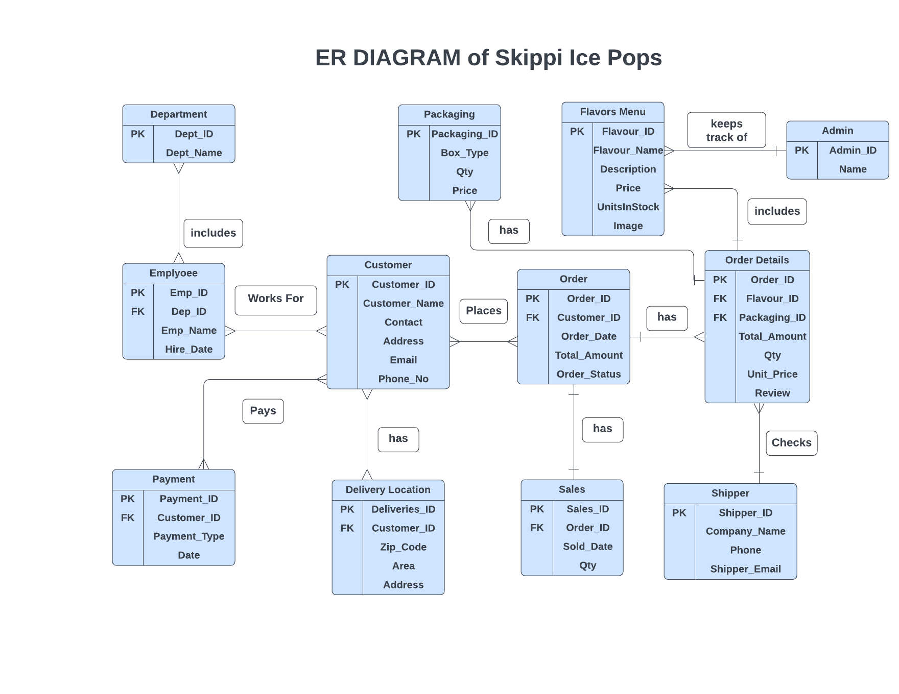

Slide 5
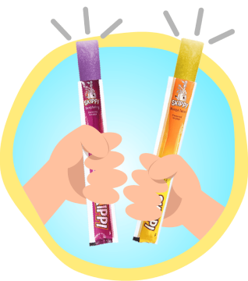
Thank You
- Childhood flavors reinvented

